Slide 1

MODELLING AND PARAMETRIC PERFORMANCE ANALYSIS OF AN AEM ELECTROLYSER USING ASPEN PLUS
Department of Chemical Engineering
Presented By:
Ankit Saha
Under the guidance of:
Dr. Sourav Mondal
22CH30004
Indian Institute of Technology Kharagpur
1

Slide 2
ACKNOWLEDGEMENT
Department of Chemical Engineering
I am grateful to Prof. Sourav Mondal for his continuous guidance and support during my BTP project.
I sincerely thank Mr. Rajeev Ranjan for helping me at every stage and with every problem during the AWE model preparation in Aspen
I appreciate the support from the department and all who assisted me in completing this work.
2

Slide 3
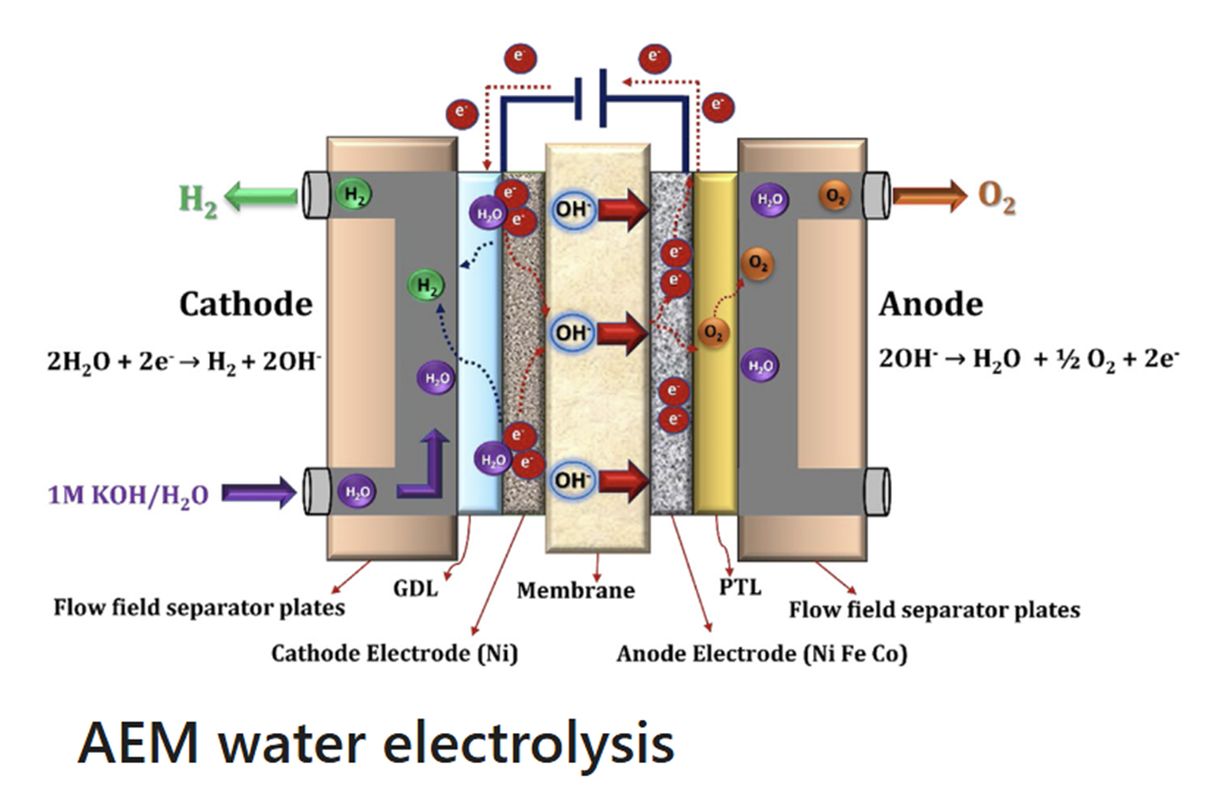
INTRODUCTION
Department of Chemical Engineering
Alkaline Water Electrolyser (AWE)
Mature and low-cost technology
Uses concentrated KOH → corrosion, gas crossover
Limited current densities, diaphragm-based gas separation
Anion Exchange Membrane (AEM) Electrolyser
Operates in alkaline mode but uses a solid polymer membrane
Enables non-precious catalysts, better gas purity, and reduced crossover
Ideal for decentralised, renewable-powered hydrogen systems
Challenges: membrane conductivity, durability, long-term stability
2

Slide 4
INTRODUCTION
Department of Chemical Engineering
Key Differences
Parameter | AWE | AEM
Electrolyte | 20–40 wt% KOH | 0–1 M KOH
Cathode | Ni, Ni–Mo | Ni alloys
Anode | Ni–Co alloys | Ni/Fe/Co oxides
Separator | Diaphragm (~500 µm) | AEM (20–100 µm)
Current Density | 0.2–0.4 A/cm² | 0.2–1.0 A/cm²
Cell Voltage | 1.8–2.4 V | 1.8–2.2 V
Temperature | 60–80 °C | 50–60 °C
H₂ Purity | >99.5% | >99.99%
Technology Status | Mature | Emerging
3

Slide 5
OBJECTIVE:
Department of Chemical Engineering
Develop a zero-gap AEM electrolyser model in Aspen Plus using the adapted AWE framework.
Analyse how temperature, current density, and membrane properties affect cell voltage.
Use the AWE-based voltage model to generate performance trends for AEM optimisation.
4

Slide 6
Model Description
Department of Chemical Engineering
Theory:
Cathode Half Cell Reaction (HER):
  2H₂O(l) + 2e⁻ ↔ H₂(g) + 2OH⁻(aq) E₀ (298 K) = -0.769 V
Anode Half Cell Reaction (OER):
  2OH⁻(aq) ↔ ½O₂(g) + H₂O(l) + 2e⁻ E₀ (298 K) = +0.460 V
Overall Water Splitting Reaction:
  H₂O(l) ↔ H₂(g) + ½O₂(g) E₀_{rev} (298K)=1.229 V
5

Slide 7
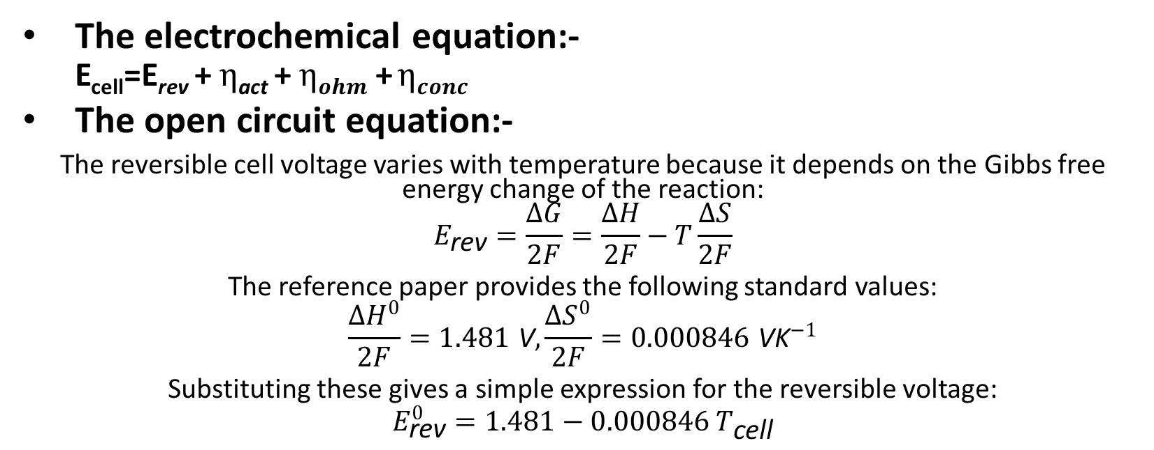
Model Description
Department of Chemical Engineering
Theory:
The electrochemical equation:-
  E_{cell}=E_{rev} + $η$_{act} + $ηohm$ +$ηconc$
The open circuit equation:-
The reversible cell voltage varies with temperature because it depends on the Gibbs free energy change of the reaction:
$$E_{\text{rev}}=\frac{ΔG}{2F}=\frac{ΔH}{2F}−T\frac{ΔS}{2F}$$
The reference paper provides the following standard values:
$$\frac{ΔH^{0}}{2F}=1.481 \text{V}, \frac{ΔS^{0}}{2F}=0.000846 {\text{VK}}^{−1}$$
Substituting these gives a simple expression for the reversible voltage:
$$E_{\text{rev}}^{0}=1.481−0.000846 T_{\text{cell}}$$
6

Slide 8
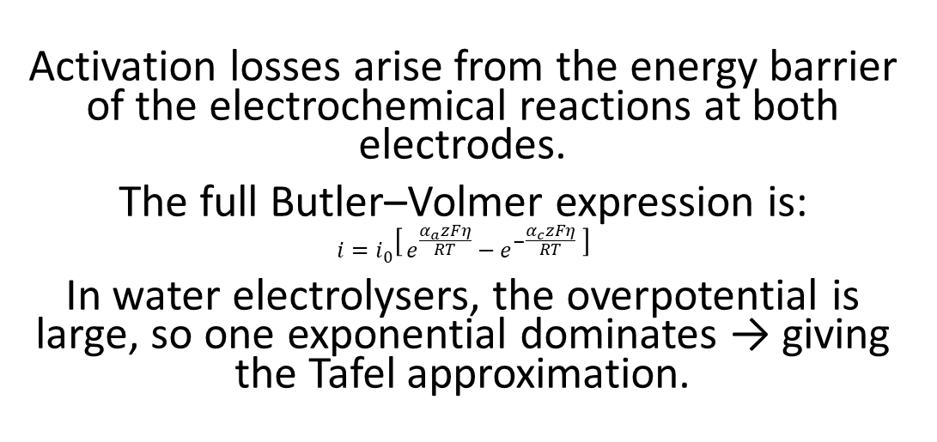
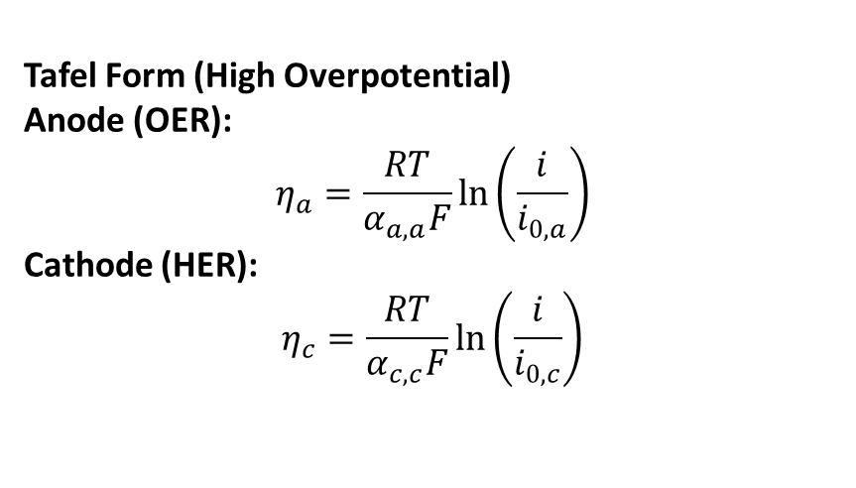
Activation Overpotential
Department of Chemical Engineering
Theory:
Tafel Form (High Overpotential)
Anode (OER):
$$η_{a}=\frac{RT}{α_{a,a}F}\ln\left(\frac{i}{i_{0,a}}\right)$$
Cathode (HER):
$$η_{c}=\frac{RT}{α_{c,c}F}\ln\left(\frac{i}{i_{0,c}}\right)$$
Activation losses arise from the energy barrier of the electrochemical reactions at both electrodes.
The full Butler–Volmer expression is:
$$i=i_{0}\left[ e^{\frac{α_{a}zFη}{RT}}−e^{−\frac{α_{c}zFη}{RT}} \right]$$
In water electrolysers, the overpotential is large, so one exponential dominates → giving the Tafel approximation.
7

Slide 9
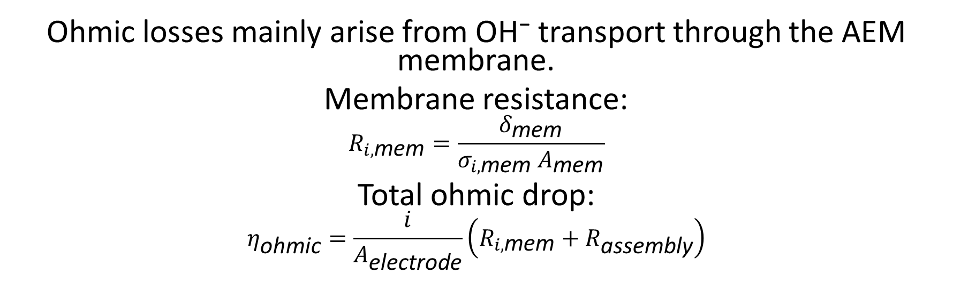
Ohmic Overpotential
Department of Chemical Engineering
Theory:
Ohmic losses mainly arise from OH⁻ transport through the AEM membrane.
Membrane resistance:
$$R_{i,\text{mem}}=\frac{δ_{\text{mem}}}{σ_{i,\text{mem}} A_{\text{mem}}}$$
Total ohmic drop:
$$η_{\text{ohmic}}=\frac{i}{A_{\text{electrode}}}\left(R_{i,\text{mem}}+R_{\text{assembly}}\right)$$
8

Slide 10
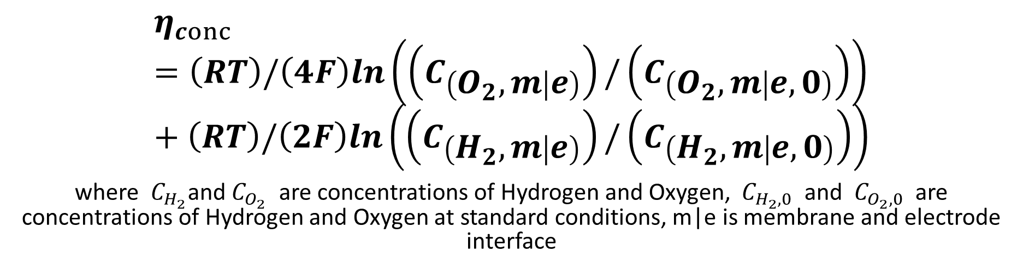
Concentration Overpotential
Department of Chemical Engineering
Theory:
$$η_{conc}=\left(RT\right)/\left(4F\right)ln\left(\left(C_{\left(O_{2},m | e\right)}\right)/\left(C_{\left(O_{2},m | e,0\right)}\right)\right)+\left(RT\right)/\left(2F\right)ln\left(\left(C_{\left(H_{2},m | e\right)}\right)/\left(C_{\left(H_{2},m | e,0\right)}\right)\right)$$
where $C_{H_{2}}$and $C_{O_{2}}$ are concentrations of Hydrogen and Oxygen, $C_{H_{2},0}$ and $C_{O_{2},0}$ are concentrations of Hydrogen and Oxygen at standard conditions, m|e is membrane and electrode interface
9

Slide 11
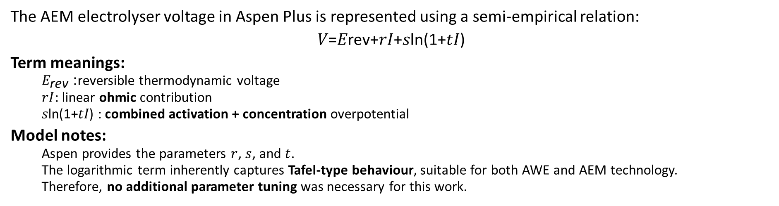
Aspen Semi-Empirical Voltage Model
Department of Chemical Engineering
Methodology:
The AEM electrolyser voltage in Aspen Plus is represented using a semi-empirical relation:
𝑉=𝐸rev+𝑟𝐼+𝑠ln⁡(1+𝑡𝐼)
Term meanings:
  $E_{\text{rev}}$: reversible thermodynamic voltage
  $rI$: linear ohmic contribution
  𝑠ln⁡(1+𝑡𝐼) : combined activation + concentration overpotential
Model notes:
  Aspen provides the parameters $r$, $s$, and $t$.
  The logarithmic term inherently captures Tafel-type behaviour, suitable for both AWE and AEM technology.
  Therefore, no additional parameter tuning was necessary for this work.
10

Slide 12
Aspen Semi-Empirical Voltage Model
Department of Chemical Engineering
Methodology:
Structure Parameter
Operational Parameter
Parameter | Value
Cathode Active Area | 1 cm²
Anode Active Area | 1 cm²
Thickness of cathode electrode | 250 µm
Thickness of anode electrode | 250 µm
Membrane Active Area | 9 cm²
Membrane Thickness | 60 µm
Stacks | 1
Cells per stack | 1
Reference anode exchange current density | 0.001
Reference cathode exchange current density | 1×10⁻⁵
Parameter | Value
Total current | 0.6 A
Temperature of electrolyser | 20 °C
Feed flow rate | 1.56 mL/min
Concentration of KOH | 0.1 M
Feed-to-anode ratio | 0.5
11

Slide 13
Outlet flow and composition:-
Department of Chemical Engineering
Result and Discussion:
Voltage and efficiencies:
Cell voltage: 1.984 V at 0.6 A
Voltage efficiency (Total): 0.747
Overpotential breakdown:
Activation (total): 0.512 V (anode 0.198 V, cathode 0.313 V).
Ohmic: 0.239 V.
Concentration: 1.45×10⁻⁴ V (negligible).
Hydrogen (CAT-OUT):
Vapor molar flow: 1.106×10⁻⁵ kmol h⁻¹
Vapor mole fraction (gas purity basis): 0.9767 ≈ 97.7 % H₂
Oxygen (AN-OUT):
Vapor molar flow: 5.506×10⁻⁶ kmol h⁻¹
Vapor mole fraction (gas purity basis): 0.9688 ≈ 96.9 % O₂
12

Slide 14
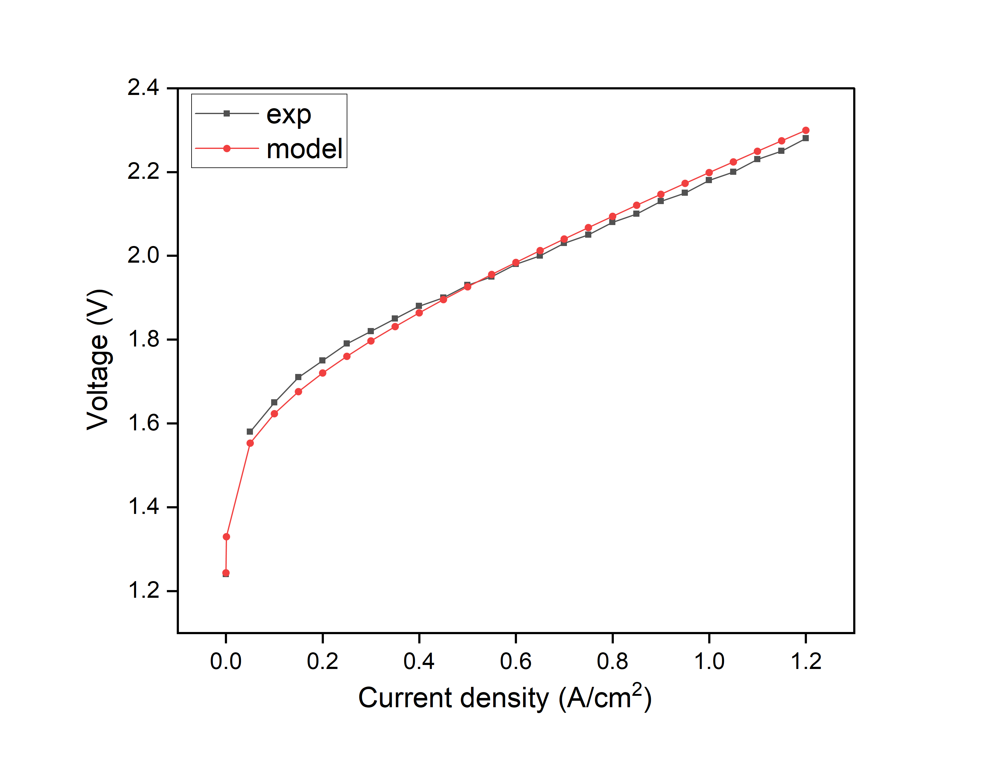
Polarization Curve:
Department of Chemical Engineering
Result and Discussion:
The model matches the experimental polarization curve well, capturing both the activation region at low currents and the linear ohmic region at higher currents, with only minor deviations at very low currents.
13

Slide 15
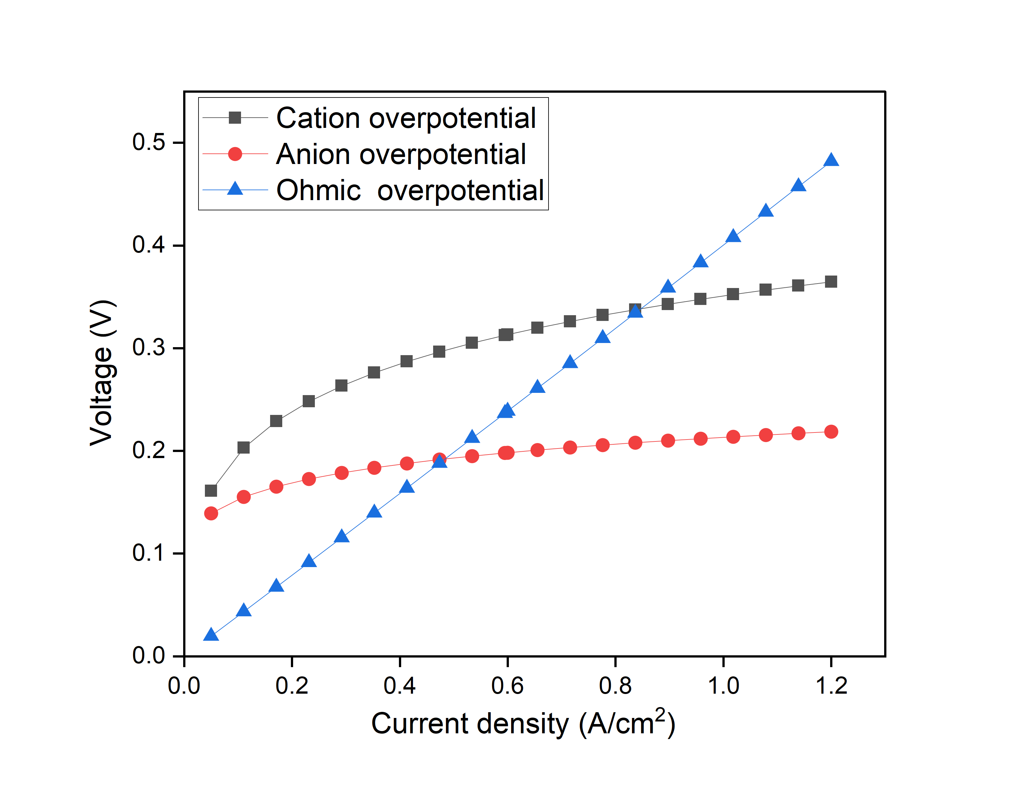
Overpotential Distribution:
Department of Chemical Engineering
Result and Discussion:
Overpotential Distribution
Activation overpotentials at both electrodes rise sharply at low current densities due to slower reaction kinetics, with the cathode showing higher losses because hydrogen evolution is less favorable and requires a larger driving force.
Ohmic overpotential increases almost linearly with current density as membrane and electrolyte resistance dominate.
Overall, the cell is activation-controlled at low currents and becomes ohmic-controlled at higher currents.
14

Slide 16
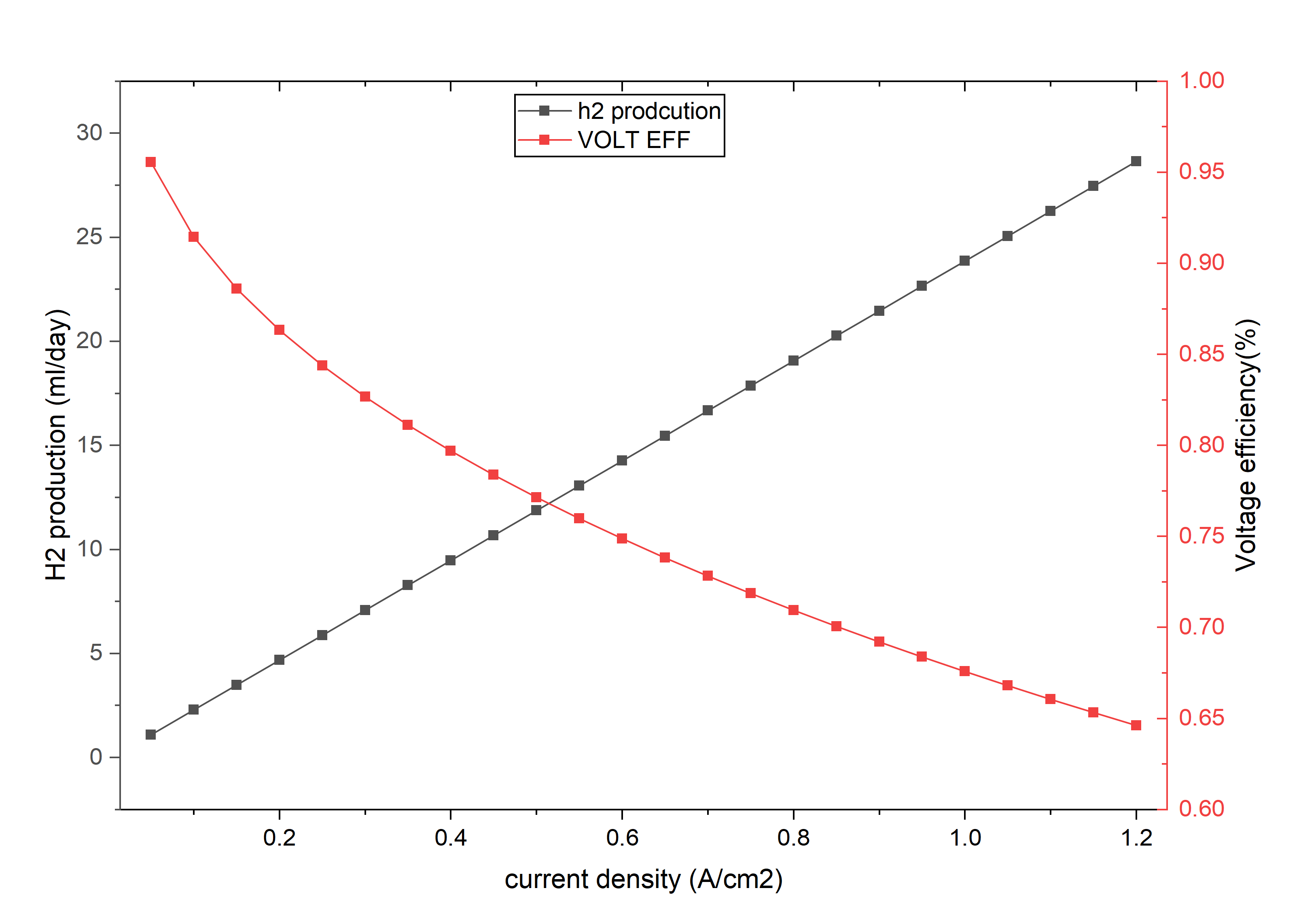
H2 production and voltage efficiency
Department of Chemical Engineering
Result and Discussion:
Efficiency–Production Trade-off
The hydrogen production and voltage efficiency curves intersect at ~0.52 A/cm², where the voltage efficiency is ~77% (cell voltage ≈ 1.87 V).
At this point, the hydrogen production rate is ~12 mL/day, representing a balanced operating “sweet spot.”
Beyond this current density, hydrogen output increases further, but voltage efficiency decreases noticeably.
15

Slide 17
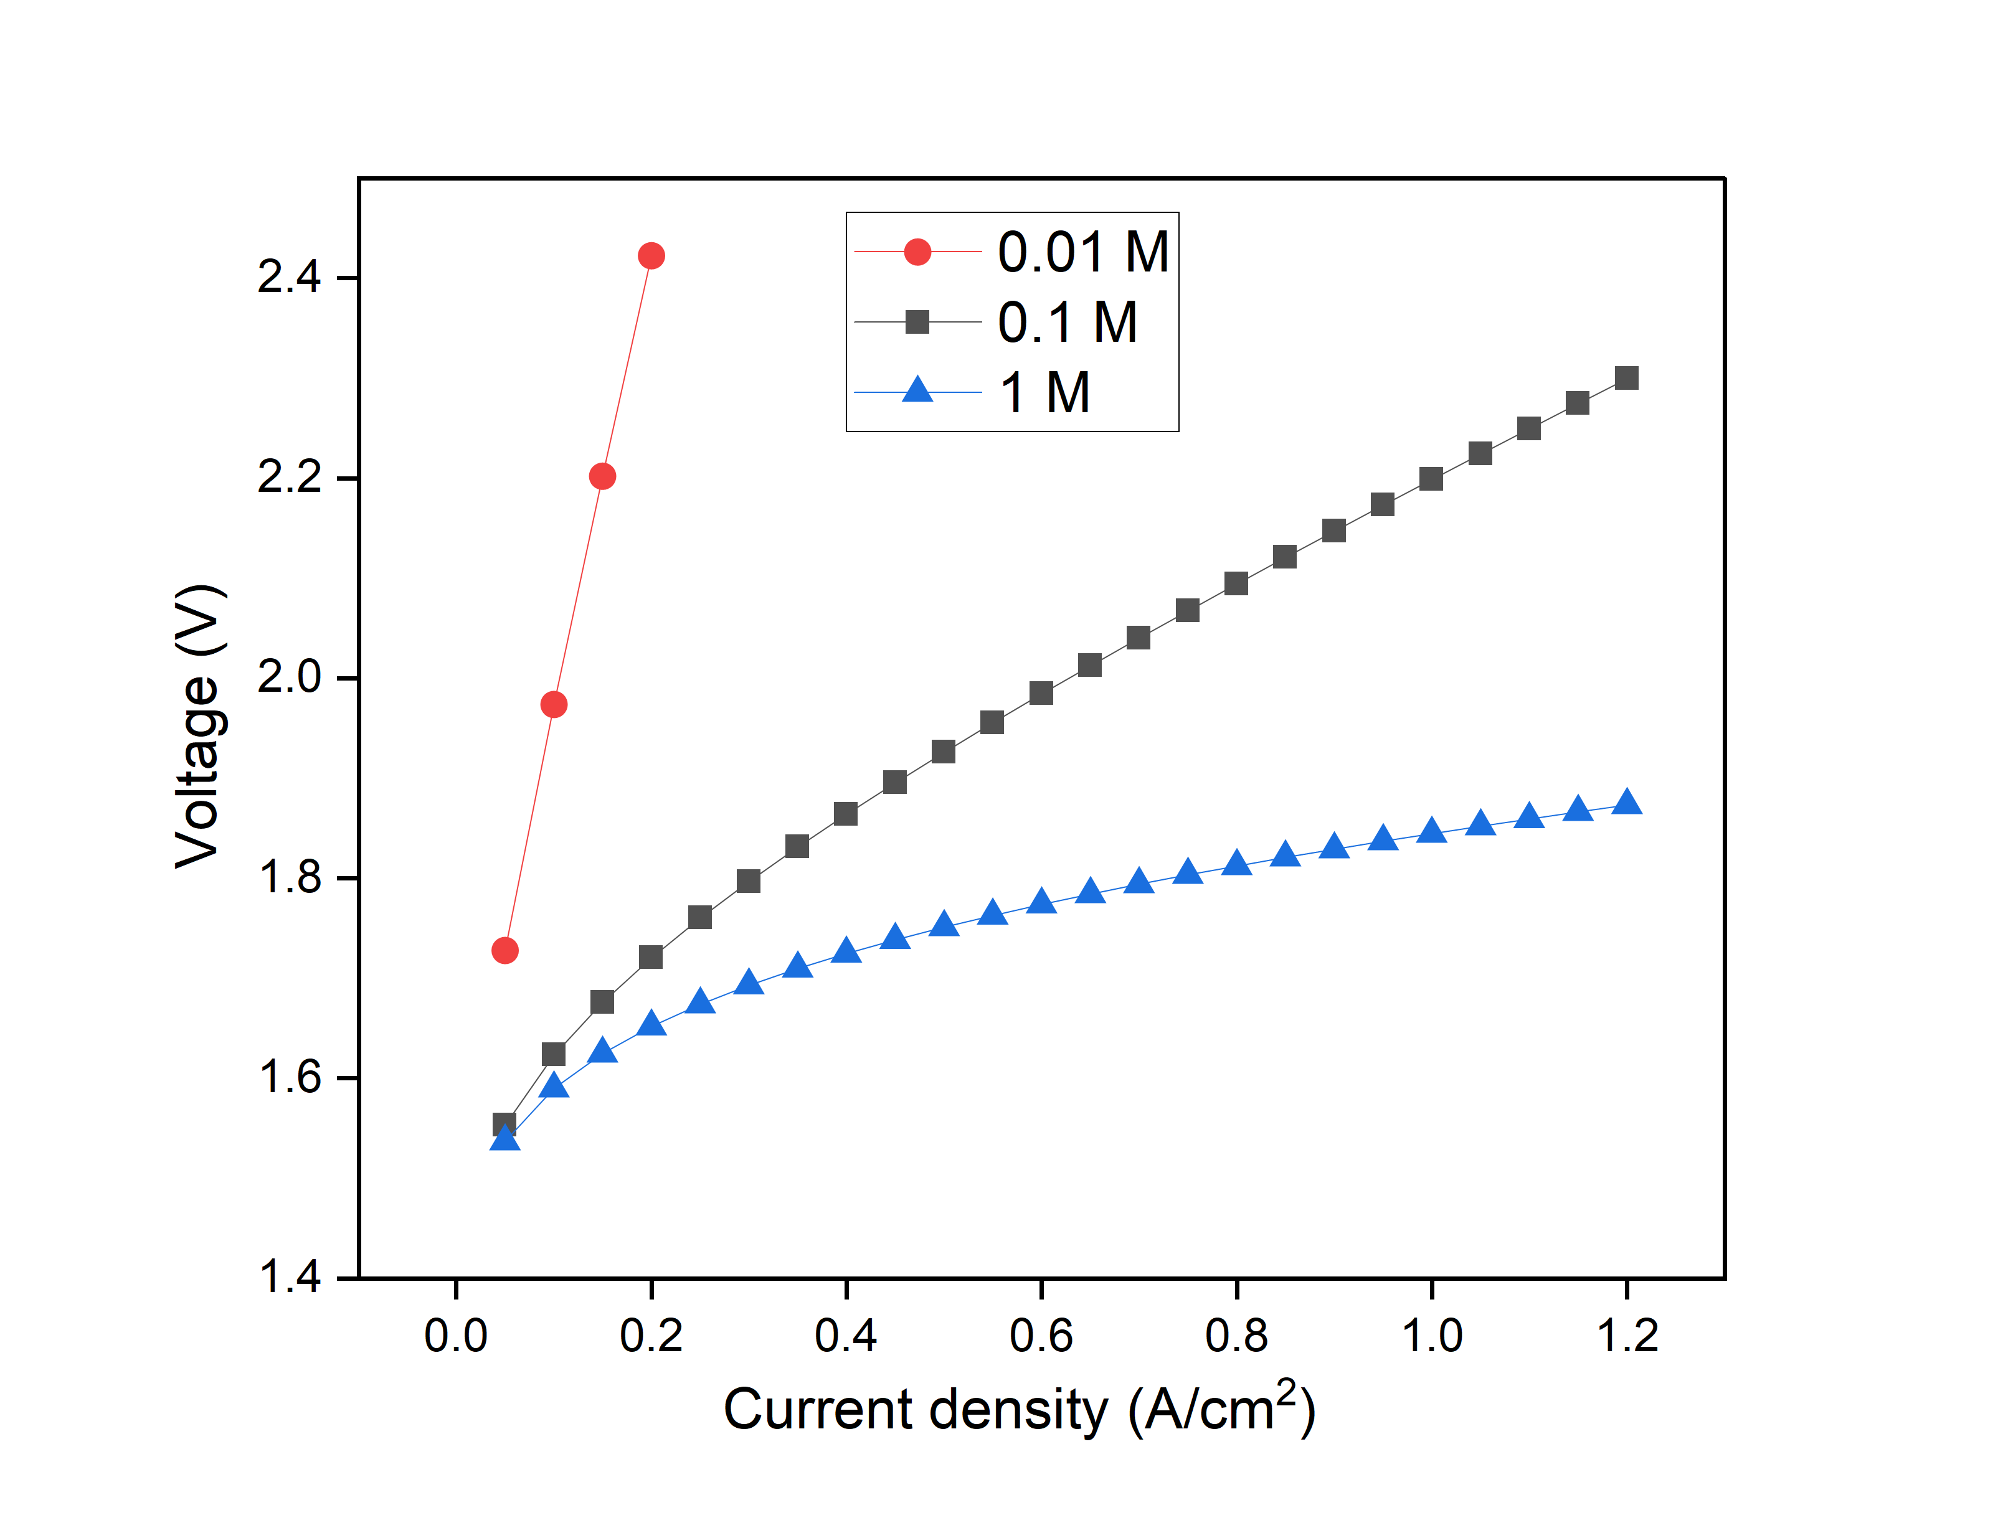
Effect of KOH concentration
Department of Chemical Engineering
Result and Discussion:
Effect of Electrolyte Concentration
Increasing KOH concentration from 0.01 M → 0.1 M → 1 M reduces the cell voltage at a given current density.
Higher concentration provides more OH⁻ ions, improving ionic conductivity and lowering ohmic resistance.
At 0.01 M, limited OH⁻ availability causes poor ionic transport and higher activation losses, leading to a steep voltage rise even at low currents.
1 M KOH gives the lowest voltage due to better ion mobility and stable reaction conditions.
Overall, higher electrolyte concentration improves cell performance by reducing resistive losses.
16

Slide 18
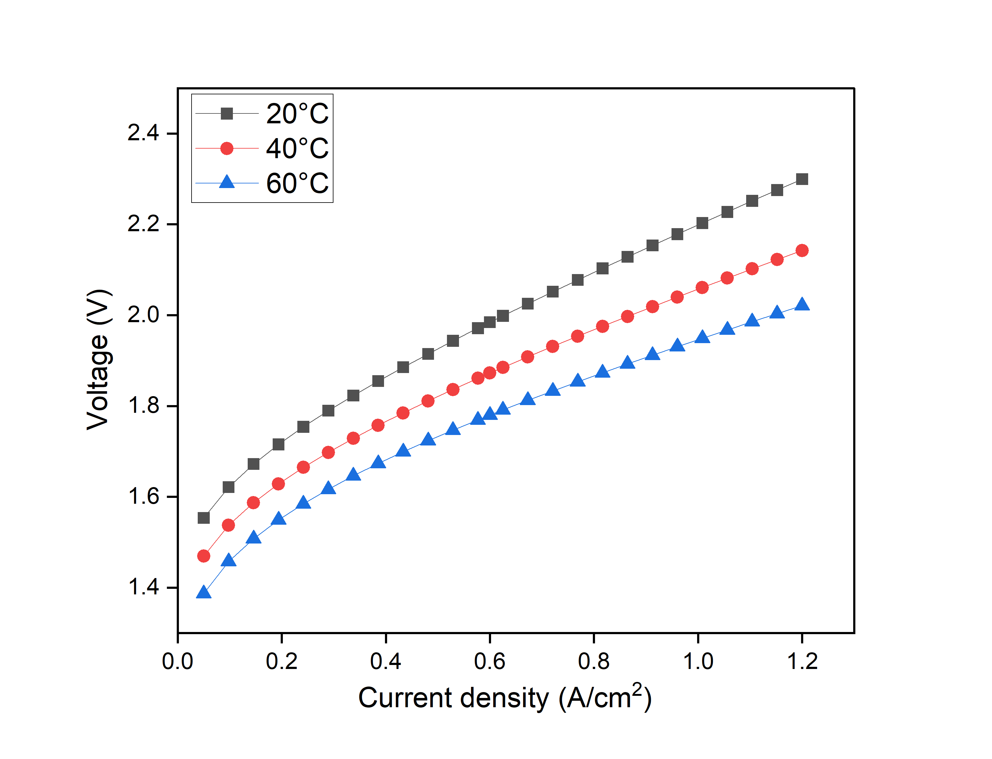
Effect of electrolyser temperature
Department of Chemical Engineering
Result and Discussion:
Cell voltage decreases as temperature increases due to faster reaction kinetics and higher ionic conductivity.
Both activation and ohmic losses are reduced at elevated temperatures, lowering the voltage at the same current density.
The improvement from 20°C → 40°C is significant, while 40°C → 60°C shows a smoother but still clear reduction.
17

Slide 19
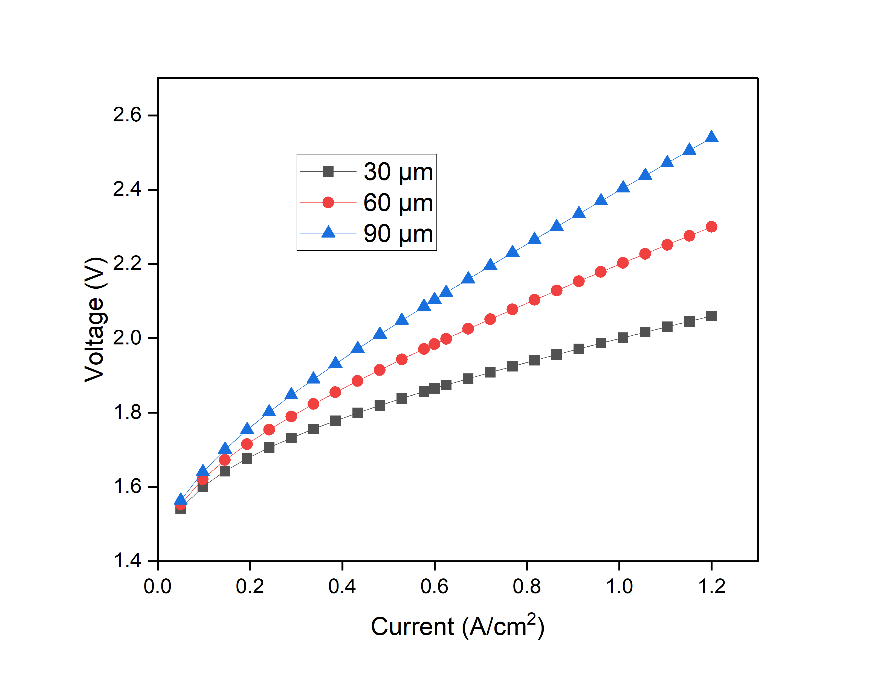
Effect of membrane thickness
Department of Chemical Engineering
Result and Discussion:
Cell voltage increases with membrane thickness because a thicker AEM adds more ionic transport resistance.
OH⁻ ions must travel a longer distance, increasing the ohmic overpotential.
The 90 μm membrane shows the highest voltages, while the 30 μm membrane performs best across all currents.
Differences between curves become larger at high current densities where ohmic losses dominate.
18

Slide 20
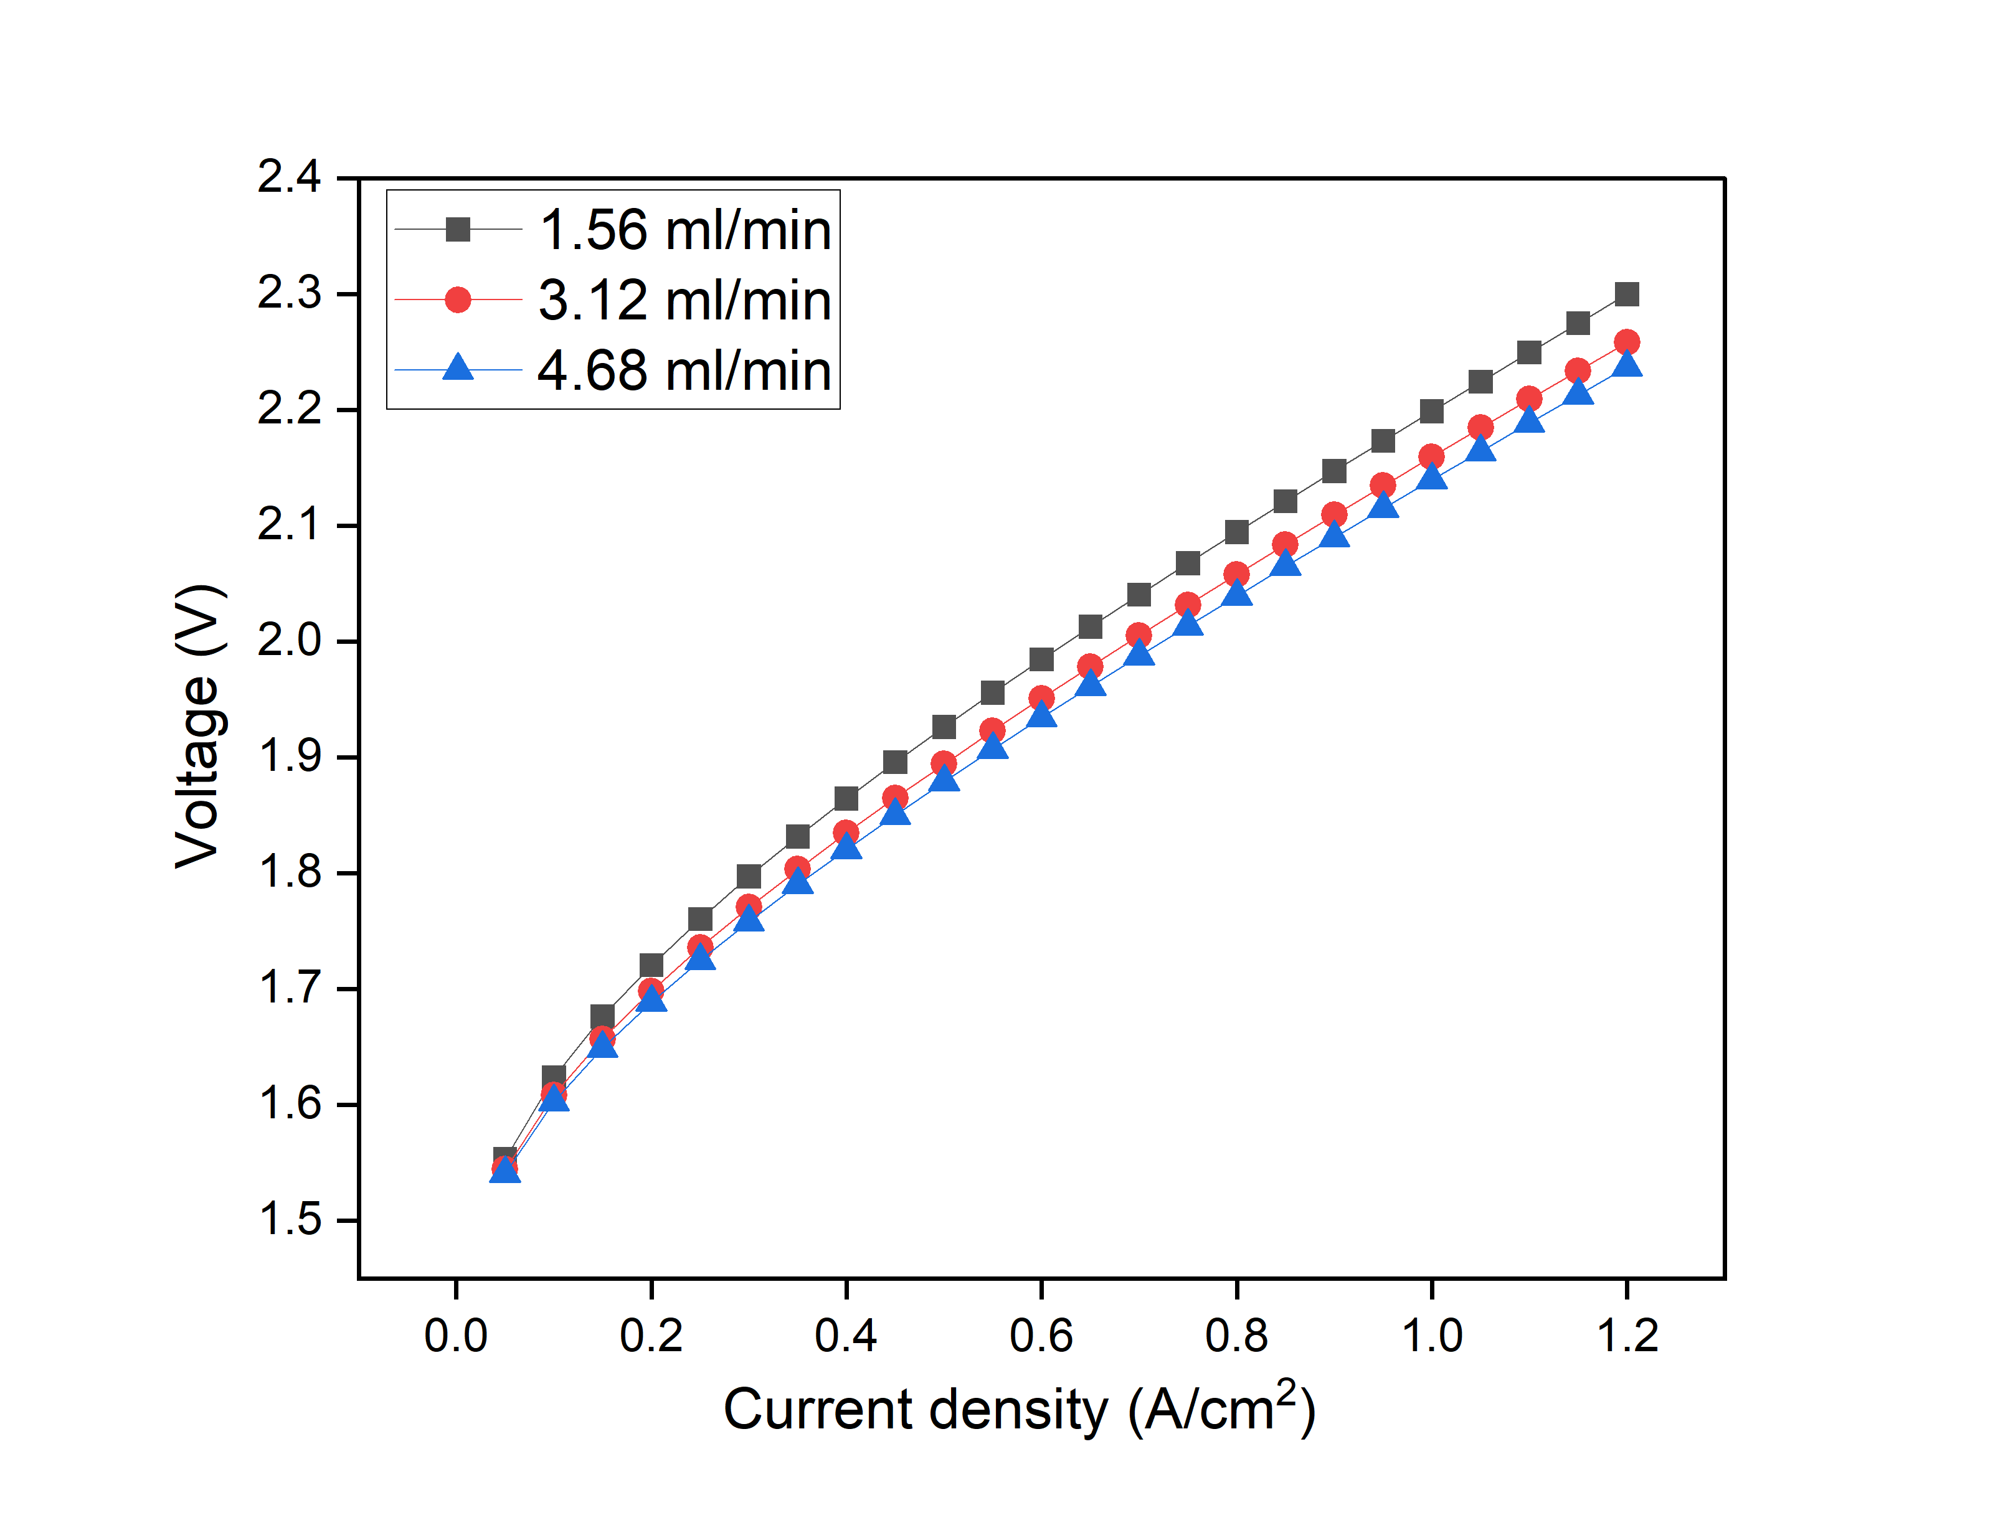
Effect of feed flow rate:
Department of Chemical Engineering
Result and Discussion:
Polarization curves for 1.56, 3.12, and 4.68 mL/min nearly overlap, showing only a minor voltage drop at higher flow rates.
This indicates that flow rate has no significant impact on cell voltage in this range.
In a zero-gap electrolyser, water supply is governed mainly by membrane hydration and reaction consumption, so increasing bulk flow does not noticeably change local reaction conditions.
19

Slide 21
Conclusion:
Department of Chemical Engineering
A zero-gap AEM electrolyser model was developed in Aspen Plus using the adapted AWE electrochemical framework.
The model closely matched the experimental polarization curve, confirming its validity.
Higher temperatures improved performance by reducing activation and ohmic losses.
Increasing electrolyte concentration lowered cell voltage by enhancing OH⁻ conductivity.
Thinner membranes reduced ohmic resistance and improved efficiency.
Exchange current densities affected activation losses, with the anode showing stronger sensitivity.
Feed flow rate had negligible impact on voltage or hydrogen production.
20

Slide 22
Future Work:
Department of Chemical Engineering
Extend the single-cell model to a stack-level simulation to study scalability, voltage balancing, heat distribution, membrane hydration, and gas crossover in larger systems.
Perform a detailed energy and process analysis in Aspen to identify required utilities (heaters, coolers, pumps, separators) and evaluate overall energy demand and heat-integration potential.
Assess KOH recyclability by modelling a closed-loop electrolyte recovery system to reduce chemical consumption and improve sustainability.
21

Slide 23
References:
Department of Chemical Engineering
1. Lawand, K., Nuggehalli Sampathkumar, S., Mury, Z., & Van Herle, J. (2024). Membrane electrode assembly simulation of anion exchange membrane water electrolysis. Journal of Power Sources, 595, 234047.
2. Gunuru, M., & Paravada, M. (2025). Mathematical modelling of an AEMWE: Investigating optimum operating conditions of an alkaline-fed AEM electrolyser. International Journal of Hydrogen Energy, 50, 332550
3. An, L., Zhao, T. S. Chai, Z. H. Tan, P., & Zeng L. (2014). Mathematical modeling of an anion-exchange membrane water electrolyzer for hydrogen production. International Journal of Hydrogen Energy, 39(35), 19869–19876.
4. H. A. Miller , Bouzek K., Hnat, J., Loos, S., Bernäcker, C. I., Weißgärber, T., Röntzsch, L., & Meier-Haack, J. (2020). Green hydrogen from anion exchange membrane water electrolysis: A review of recent developments in critical materials and operating conditions. Sustainable Energy & Fuels, 4, 2114–2133.
5. Du, N., Roy, C., Peach, R., Turnbull, M., Thiele, S., & Bock, C. (2022). Anion-exchange membrane water electrolyzers. Chemical Reviews, 122(14), 11830–11895
.6. Ulleberg, Ø. (2003). Modeling of advanced alkaline electrolyzers: A system simulation approach. International Journal of Hydrogen Energy, 28(1–2), 21–33.
7. Aspen documentation on AWE electrolyzers.
8. Du, N., Roy, C., Peach, R., Turnbull, M., Thiele, S., & Bock, C. (2022). Anion-exchange membrane water electrolyzers. Chemical Reviews, 122(14), 11830–11895.
22

