Slide 1

Micro-Credit Defaulter Model
Ankit pratap singh

Slide 2
• Business Problem Framing
A Microfinance Institution (MFI) is an organization that offers financial services to low income populations. We are working with one such client that is in Telecom Industry. They are a fixed wireless telecommunications network provider. They understand the importance of communication and how it affects a person’s life, thus, focusing on providing their services and products to low income families and poor customers that can help them in the need of hour. They are collaborating with an MFI to provide micro-credit on mobile balances to be paid back in 5 days. The Consumer is believed to be defaulter if he deviates from the path of paying back the loaned amount within the time duration of 5 days

Slide 3
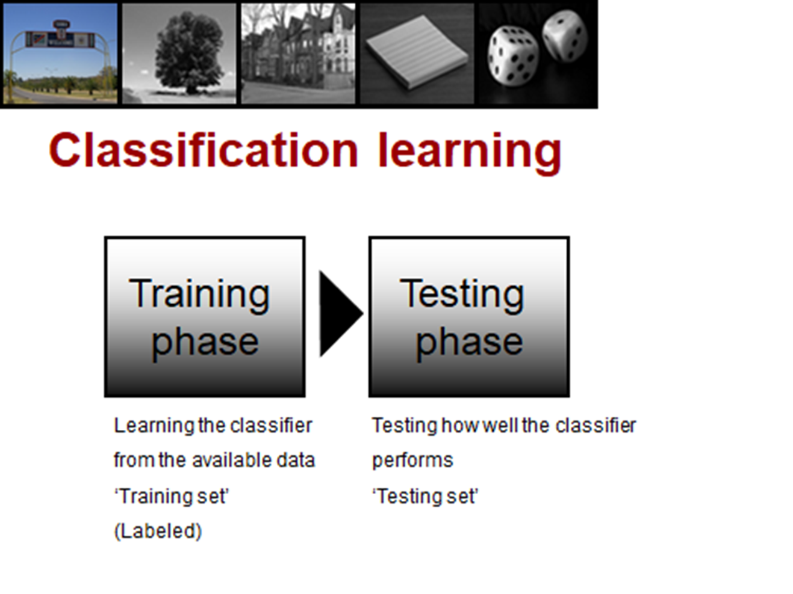

Slide 4
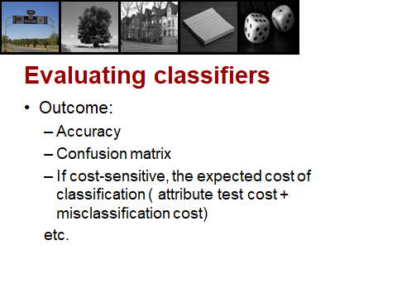

Slide 5
Methods using for modeling:
Decision Tree Based Method
Gradient Boosting Based Method
Random Forest Classifier Base Method

Slide 6

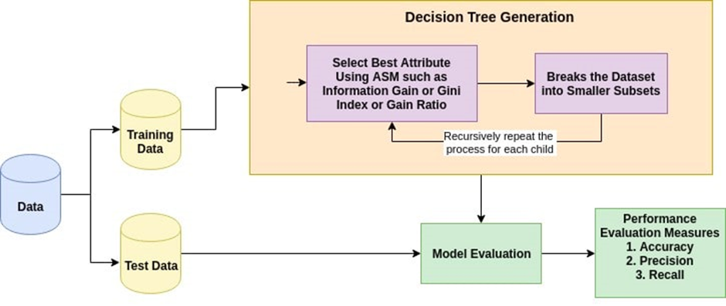
Decision Tree Based Method
The decision tree classifiers organized a series of test questions and conditions in a tree structure. In the decision tree, the root and internal nodes contain attribute test conditions to separate recordes that have different characteristics. All the terminal node is assigned a class lable Yes or No. The decision tree induction algorithm works by recursively selecting the best attribute to split the data and expanding the leaf nodes of the tree until the stopping cirterion is met. The choice of best split test condition is determined by comparing the impurity of child nodes and also depends on which impurity measurement is used.

Slide 7
Gradient Boosting Based Method
The idea of boosting came out of the idea of whether a weak learner can be modified to become better. Gradient boosting involves three elements:
A loss function to be optimized.
A weak learner to make predictions.
An additive model to add weak learners to minimize the loss function.
Gradient boosting is a greedy algorithm and can overfit a training dataset quickly. It can benefit from regularization methods that penalize various parts of the algorithm and generally improve the performance of the algorithm by reducing overfitting.

Slide 8
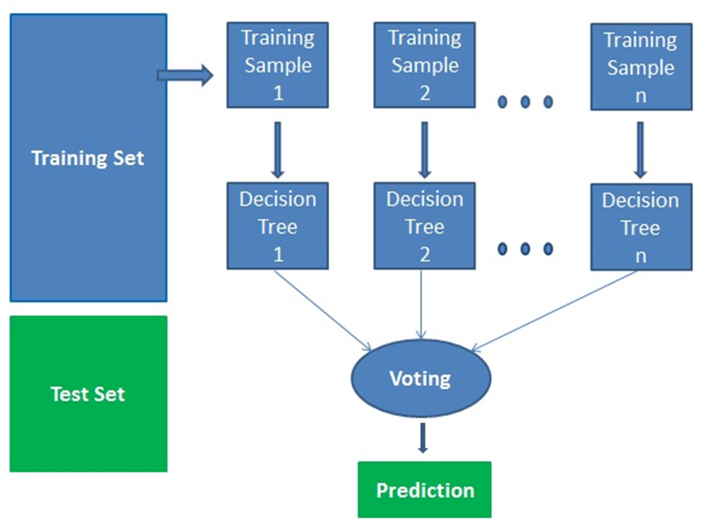
Random Forest Classifier Base Method
Random forests creates decision trees on randomly selected data samples, gets prediction from each tree and selects the best solution by means of voting. It also provides a pretty good indicator of the feature importance. It technically is an ensemble method (based on the divide-and-conquer approach) of decision trees generated on a randomly split dataset.

Slide 9
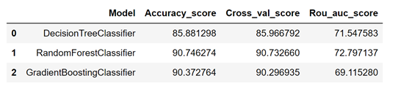
Evaluation best Classifier
As from the accuracy table we can see that Random Forest Classifier is the best classifier for predicting micro-credit defaulter.

Slide 10
Thank You

