Slide 1
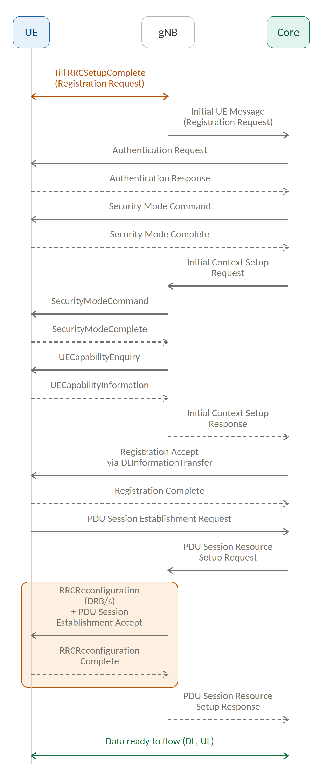
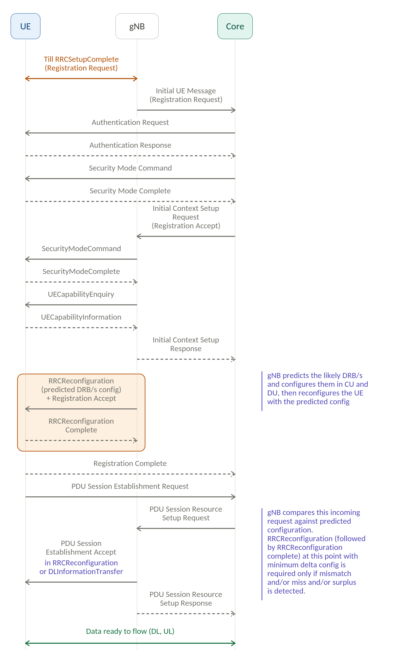
PAIBO: data ready sooner with predicted DRB/s config
UE – gNB – Core. Both procedures reach the same end state; they differ only in when the DRB/s get configured. Amber marks the RRC reconfiguration procedure — watch where it sits in each flow.
Standard 3GPP Attach Procedure
Proposed PAIBO Attach Procedure
DRB/s configured after the PDU session request
DRB/s configured during registration, before the request
Diagrams are not drawn to time scale.
Notes:
The amber block is the RRC reconfiguration procedure. In the standard 3GPP attach it sits after the PDU Session Resource Setup Request, on the critical path, costing an RRCReconfiguration/Complete round trip before data can flow. In PAIBO the gNB predicts the likely DRB/s after UECapabilityInformation, configures them in CU and DU, and reconfigures the UE during registration, carrying the Registration Accept in the same message. When the real PDU Session Resource Setup Request arrives it usually matches the prediction, so only the PDU Session Establishment Accept goes out over DLInformationTransfer and data is ready one air-interface round trip sooner.

