Slide 1
Tensorflow
Learn TF Researchers Engineer’s way
Ankit Agrawal, MTech CSE

Slide 2
About Tensorflow (TF)
Developed by Google brain team
One of the most popular framework for deep learning
Others are PyTorch, Microsoft’s CNTK etc
Made open source by google back in 2015
TF 2.0 was released in 2019
Huge community support
Horizontally scalable with negligible changes to code
Notes:
Community Support: You can just copy-paste in Google to get answers for your error
For the last point
It can be deployed in multi node environment with just less than 10 lines of code changes

Slide 3
Why TF
With TF 2.0 its very easy to create deep learning models
Developer friendly syntax
Runs everywhere
Mobile (TF lite)
Browser (TF.js)
Large Production Environment (TF Extended)
Supported across range of chipsets
CPU 😄
GPU
TPU
FSD Tesla (Full self driving computers)
Notes:
Some of the benefits mentioned till now are not exclusive to TF, they are available in other DL frameworks also. But still what I feel is that google today owns mobile OS with Android, Browsers with Chrome & not very far behind in cloud…
So TF will always get first hand support in all the major platforms, hence its a good choice to learn TF

Slide 4
TF1.0 VS TF2.0
TF 1.0 (Scary 👻, researcher oriented )
TF 2.0 (Keras API’s has first hand support, Developer Friendly)
You need not know 1.0 to learn 2.0
What is Keras ?
It is open source high level API and can support multiple backends such as TF, Microsoft’s CNTK etc
Think of it as some high level programming language (Python) and TF 1.0 as low level language (Assembly)
Notes:
TF 1.0 was initially released by google brain team and it was targeted towards DL researchers, hence it had a very steep learning curve.
But with TF_2.0 google has first hand support for Keras API.

Slide 5
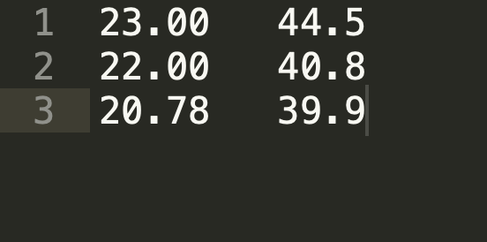
Motivation
Why even bother about these things…
It gives you super powers. You can predict the future (Just kidding…)
But, it does gives you some power
Let’s remember what we gained by learning programming
You can program computers to do many things
With the power of programming language we can reduce a tedious tasks which could have taken hours to seconds.
Let’s see what TF framework has in its arsenal for us

Slide 6
Power of Deep Learning Frameworks
You can classify handwritten digits with just a few (<20) lines of code, without knowing much about mathematics behind
Classify text and extract deep insights from it (Sentiment Analysis)
Deep learning is very iterative process so you can implement your idea within 30-40 minutes and improve upon it
Code less think more
And many more just by using concepts from this class

Slide 7
Projects Which we cover today
Digit Recognition (Using multilayer perceptron)
Image Classification (Using Convolutional Neural Networks)
Lean how you can classify a image in real time taken from your mobile phone (Using ResNet-50)
All these in just 1 class 😃

Slide 8
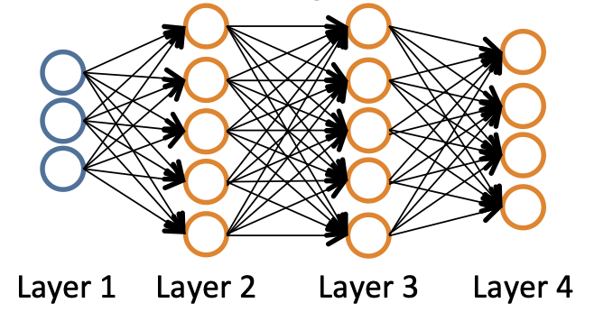
Neural Network
Think of them as function generators (Explain how)
We know how NN looks like (Image)
Input shape depends on dataset
Output shape depends on task (Digit classification eg)
In between we can put any complex structure
Once you have the NN image which you want to draw, lets see how to put that in code…
Notes:
We all have seen something called NN’s and they look like shown in the image
Even if you don’t understand what are these, it will be made clear by my explaination.
Think of them as function generators (Show how by writing)

Slide 9
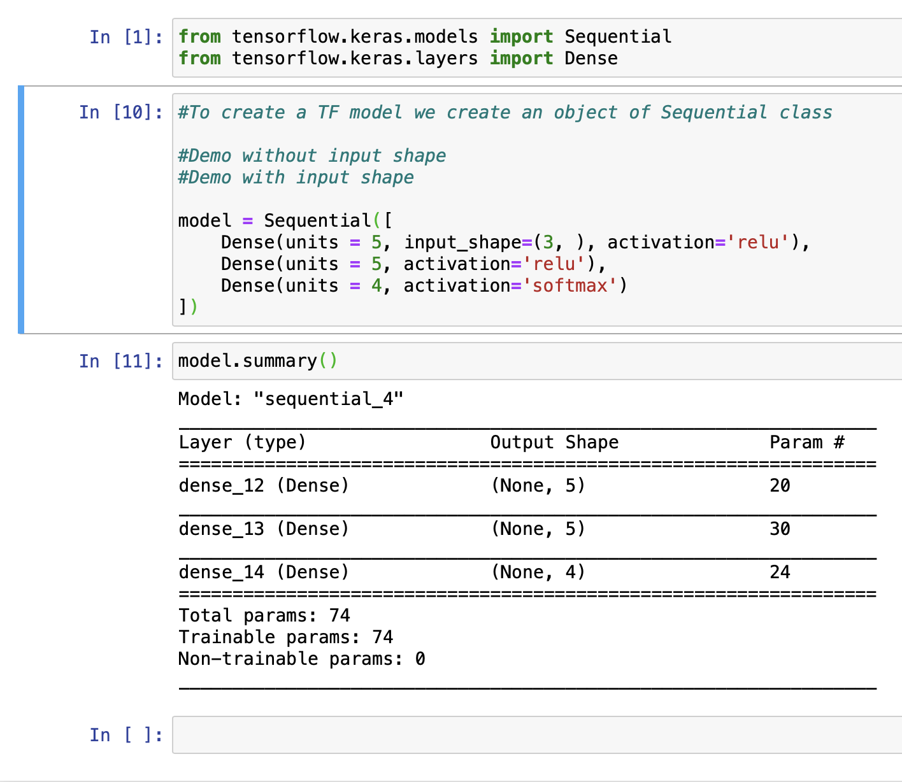
Multilayer Perceptron in TF 2.0
Image to code: Demo_1
Notes:
See how easy it is to transfer image to code in TF…
input_shape is optional
Explain each line of code:
We import 2 type of classes
Sequential and Dense
Dense class tells that the models have fully connected layers
In NN our task is to learn parameters .i.e weights which are 74 in this small NN
Explain how total params = 74 ?
There can be millions of parameters in Deep NN’s as we will see later

Slide 10
Terminologies
Activation: Used to introduce non linearity in NN’s
Final layer “Sigmoid” for classification
Intermediate Layers “Relu” (Typically, but not always)
Loss Function: Quantifies the amount by which predicted value differ from actual value. (sparse_categorical_crossentropy if final layer has Sigmoid)
Optimiser: Gradient descend, Adam etc…
Metrics: AUC, accuracy, False negatives etc etc…
Notes:
There are many types of each of these supported by TF, you can look at the documentation
If you don’t know which activation functions to use start with RELU in intermediate layers and Sigmoid in output layer if you are doing classification
Sparse_categorical_crossentropy as loss if Sigmoid is in last layer
Optimiser Algo: “Adam”

Slide 11
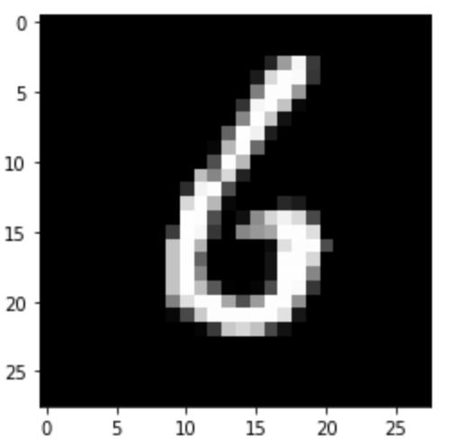
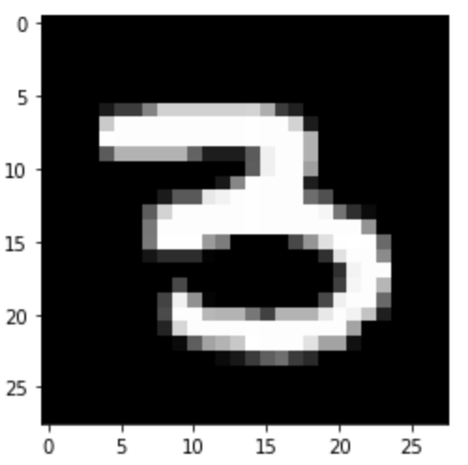
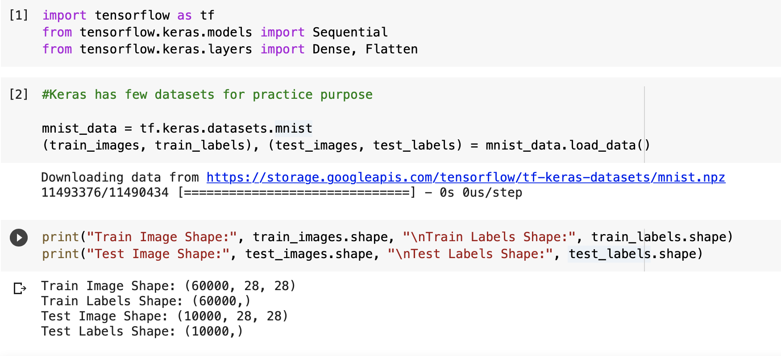
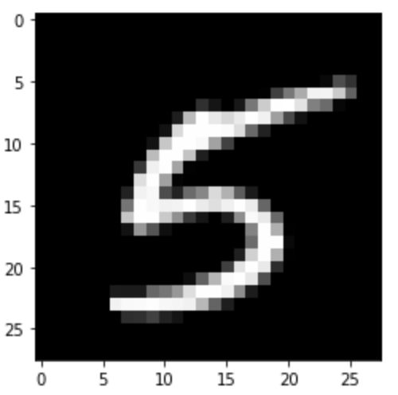
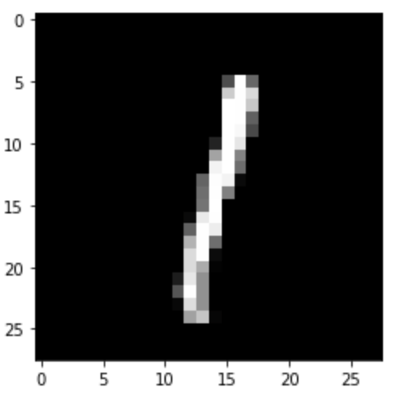
Digit Classification
Lets classify some handwritten digits
Notes:
We will use the NN we build earlier for the task of handwritten digit classification

Slide 12
Digit Recognition
Demo_2
Typical Model Creation
Create Model
model.compile(…)
model.fit(…)
model.predict(…)
What is Flatten() layer ?

Slide 13
Fashion Dataset
Demo_3
Give idea about the dataset
To gain better understanding I encourage you to play around with demo presented in class and
Build your own classifier for MNSIT fashion dataset

Slide 14
Digit Recognition
Using CNN. Demo_4
Let’s increase the accuracy of our model to >95% by using CNN
Show the difference between number of parameters and accuracy of CNN and MLP
CNN is proven to be good for images
CNN
Convolution Layers (Filter, Stride, Paddings)
Pooling Layers (Max and Min)
Notes:
There is something called Convolutional NN. Which are nothing but kind on NN’s which are proven to be good classifiers for images.
Aim is not to understand CNN but to show you how to implement CNN, so that when you study about it in later classes you can implement it right away.

Slide 15
You should be able to build your own NN models
Able to understand code written in TF
Train your models
Test the performance of your models
We have covered 5-10% of what TF offers which you will be using 90% of the times

Slide 16
Train, Test & Validation Split
Demo_5
Train set is to train your model
Test set is to test the performance
Why can’t you test using training data ?
What is validation data ?
How to give validation data to TF ?
Simple just pass an extra argument to model.fit(…)
Uses of validation data
Helps tune the hyper-parameters of the model
One of the ways to detect overfitting
Notes:
If we optimise our model for some training data and report performance on same data than results will be biased
So we need a unbiased dataset to report performance because when I say that accuracy of my model is 97% it is expected that in unseen data it give 97% accuracy

Slide 17
Overfitting & How to Identify it
Demo_6
Overfitting is condition when your model gives GREAT accuracy for training data but fails to generalise for UNSEEN data
How to identify: Demo_ (Plot between train and test loss)
How to rectify ?
Get more data
Modify the model
Use regularisation techniques

Slide 18
Regularisation Techniques in TF
Dropout Layer ( Usage: “Dropout(rate)” )
Interesting, we are destroying few connections
It has the effect that each weight connection between 2 layers is set to 0 with probability ‘rate’
Other Methods
Bath Normalisation Layer
Callbacks (Very Interesting and powerful)
Notes:
I will not go into much details about regularisation but my purpose is to show you that this kind of things are possible in TF with just one line of code
So that when you see it somewhere you are not confused and when you need it, it wont be new for you

Slide 19
Callbacks
Cover what it can do
We have ability to monitor performance of model, callbacks gives us ability to perform some action based on the performance
EarlyStopping(): Stop training if performance of model is not increasing for certain epochs (Demo_6)
There are many more
We can use callbacks already available or define our own callbacks
See documentation…

Slide 20
Saving Models
Demo_7
Large NN’s trainings can take weeks
We want to save models to have a backup in case system stops
Ability to share model
Ability to train model in Server and use on mobile
What can be save:
Save weights only
Save complete model
How to save:
Manually using model.save()
Using callbacks (Save automatically at the end of every epoch)
Save just one model which has given best performance
Native TF format vs Keras format (.h5, saved in hdf5 format)

Slide 21
Keras Applications
In Keras pre-trained models are referred to as Applications
https://keras.io/api/applications/
Explain include top argument

Slide 22
Classification Demo with ResNet-50
Demo_8
How to load pre trained model using Keras API
Load ResNet-50 model
See model info
Show real time image classification

Slide 23
Tensorflow Hub
Visit TF Hub page at: https://www.tensorflow.org/hub
Its a separate library and needs to be installed using commands…
Explore on your own

Slide 24
Conclusion
You can do a lot of ML even without knowing ML
Use the knowledge of TF framework to quickly build and test your model
As ML specially DL is highly iterative process
These kind of frameworks if used correctly simplifies Build and Result phase so that you can spend much time on Ideation

Slide 25
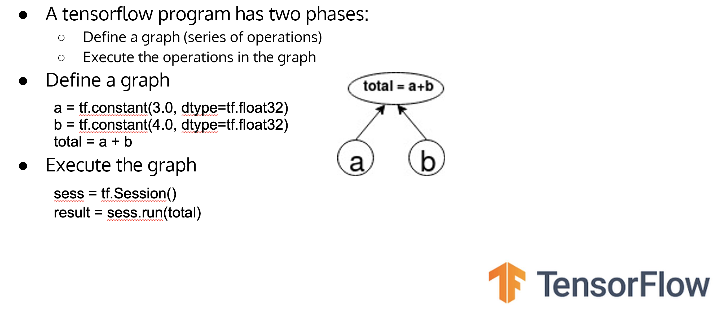
TF 1.0
TF as mathematical library
Notes:
Mostly you will need it to read legacy code

Slide 26
Multilayer Perceptron in TF 1.0
Demo

Slide 27
Thank-you

