Slide 1
Online Crime Reporting System
The Brainy Fools

Slide 2
Sponsor(s) and Stakeholder(s)
Sponsor
Government Department (Police)
Stakeholder(s)
Government Department (Police)
The Brainy Fools
Registered User

Slide 3
Business Needs
To allow visitors to register their self to access system
To allow registered users to submit FIR online
To allow registered users to submit complaint about officer
Authorised officer can share report with other officers

Slide 4
Business Requirements
Registration
User must fill all their personal details such as name, phone number, email, password
Register FIR Online
User need to give all details about crime such as crime type, location, how many people are involve in crime, time and more.
To allow registered users to submit complaint about officer
User need to give information about police officer who had committed crime.
By share function FIR and Complaint are shared to other officers
Information retrieve by user_id like FIR ,Complaint detail.

Slide 5
Business Rules
For register user must have 18+ age.
Alphabets and numbers accepted as password and maximum length for password is 8.
User must have to upload one passport size photo during registration for identity user.
For identity proof document number must be required to validate user details.

Slide 6
New Function
Share FIR to police officer
which allow authorised officer to share FIR and Complaint with other officers.
When FIR or Complaint registered on website it cab ne accessible authorise officers only then they are sharing FIR or Complaint summary with other officers.

Slide 7
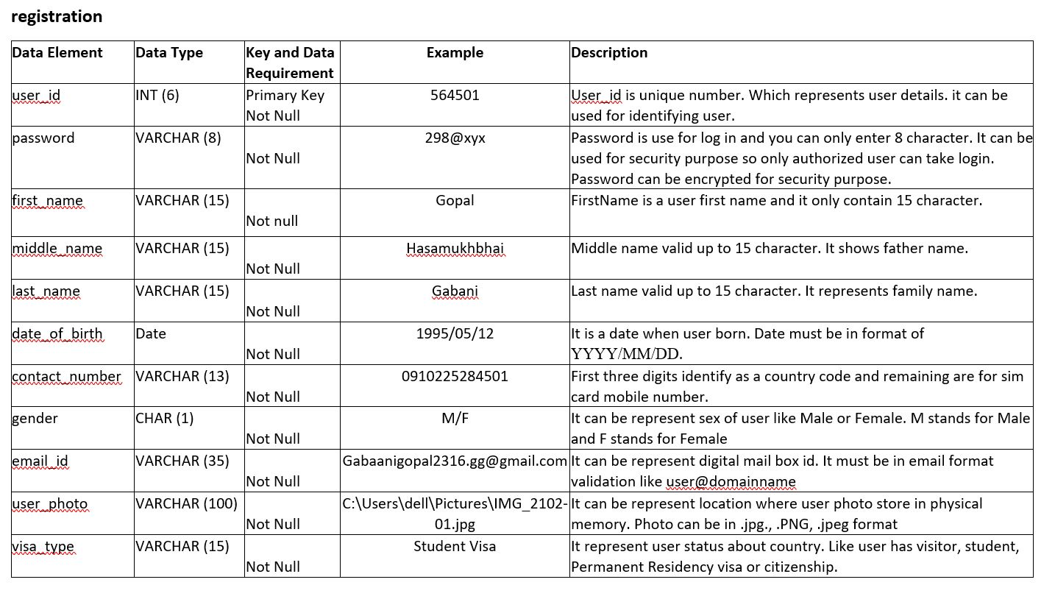
Data Elements for registration

Slide 8
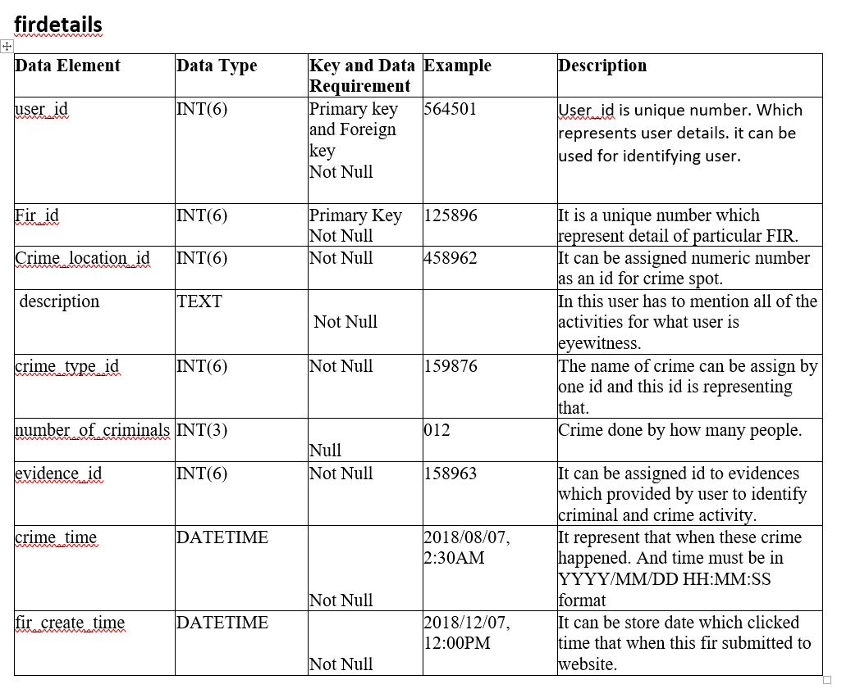
Data Elements For Firdetail

Slide 9
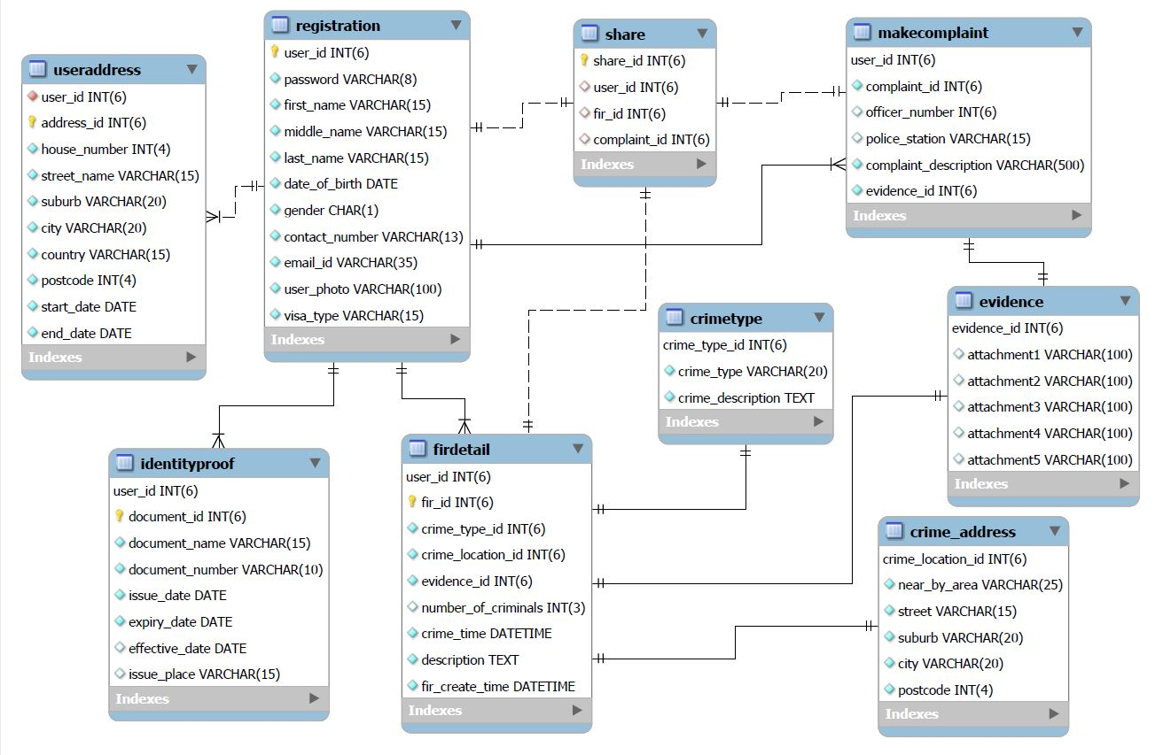
ER-Diagram

Slide 10
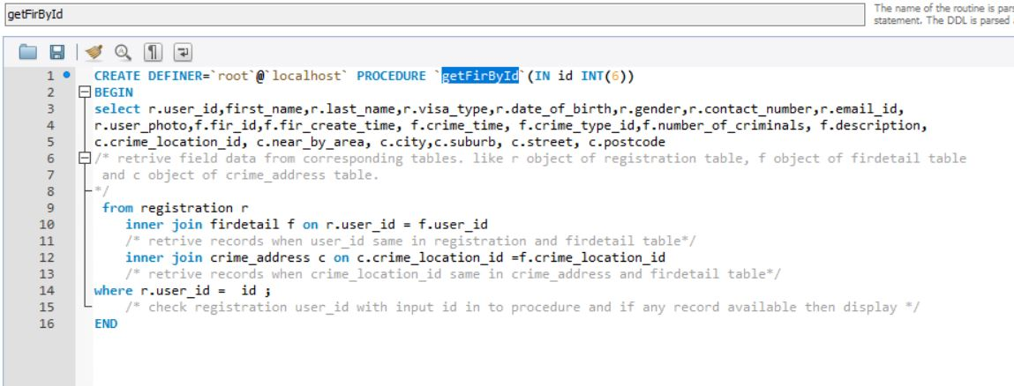
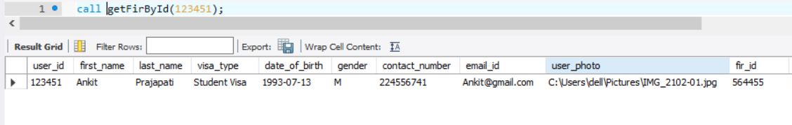
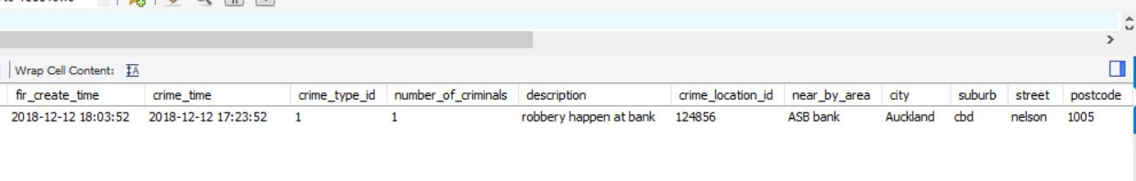
Check Validations

Slide 11
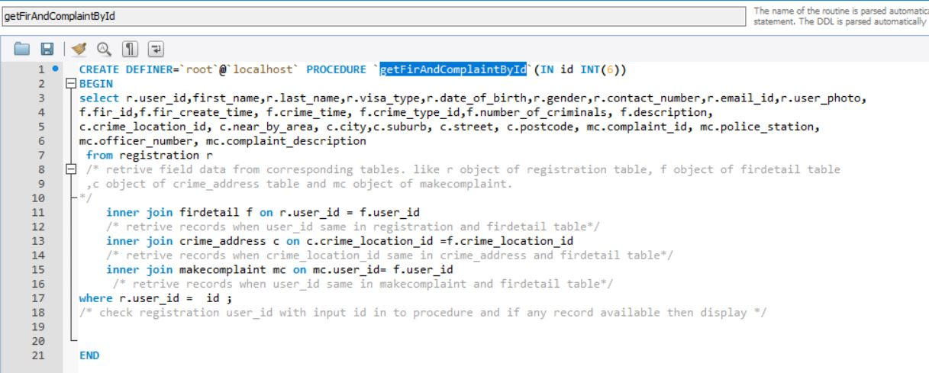
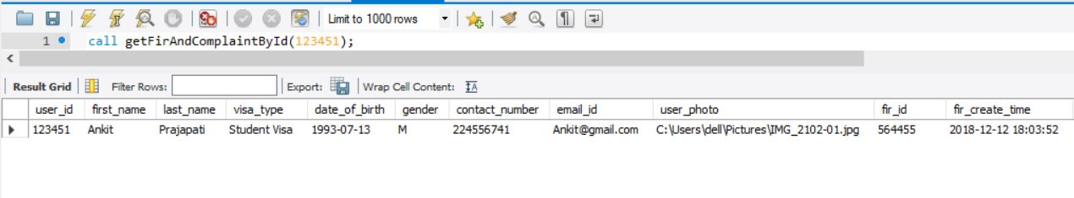
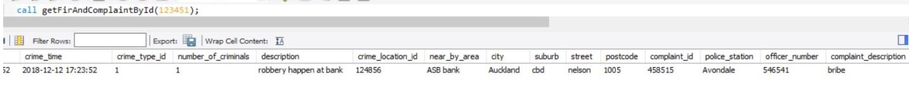

Slide 12
Next Phase Planning
Track FIR
FIR registered user can track their FIR application Status.
Session
Using session function system will automatically logout user when user close browser, shutdown computer or website not get any request from user within 5 minutes.

Slide 13
Questions?

Slide 14
Thank You
The Brainy Fools

