Slide 1
Project by Team: Data Solutions
Members:
Ankit Yadav
Kumar Roushan
Simran Kashayap
Nitish Kumar

Slide 2
Project Name :
Outpatient Payment for a Hospital

Slide 3
What we have Learnt from the Project?
Firstly we have a learned the foremost important thing which is Team Management for the Project .
We have gain the Required basic Knowledge about the Important topic related to the field of Data Science like about Machine Learning and Sql Also.
We have also Learnt the various types of libraries i.e for what they are used for and how we can use in the effective manner.
We have also learnt various basic techniques used during the Data Processing like how to Import the file and how to display those required records .
We have also learnt ,how we can use different types of library for a particular work like we can use various libraries for data visualization.

Slide 4
Conclusion:
The observation of the Project was resulted in the prediction of the result of payment using various regression techniques like Linear Regression and Lasso Regression. In this we also tried to show the Co-relation among the data values in the Data Set. We also tried to represent some of the visual graph which are used to display various relation among the Records.

Slide 5
Some of Glimpse of the Project:
With the different Modules:
Data Manipulation
Data Cleaning
Data Visualization
Regression
Data Validation
Data Spliting etc

Slide 6
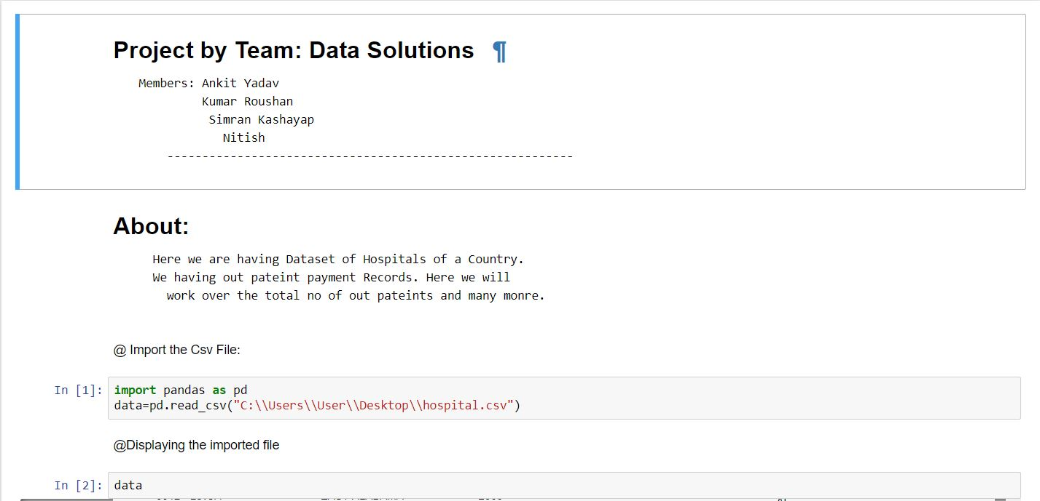
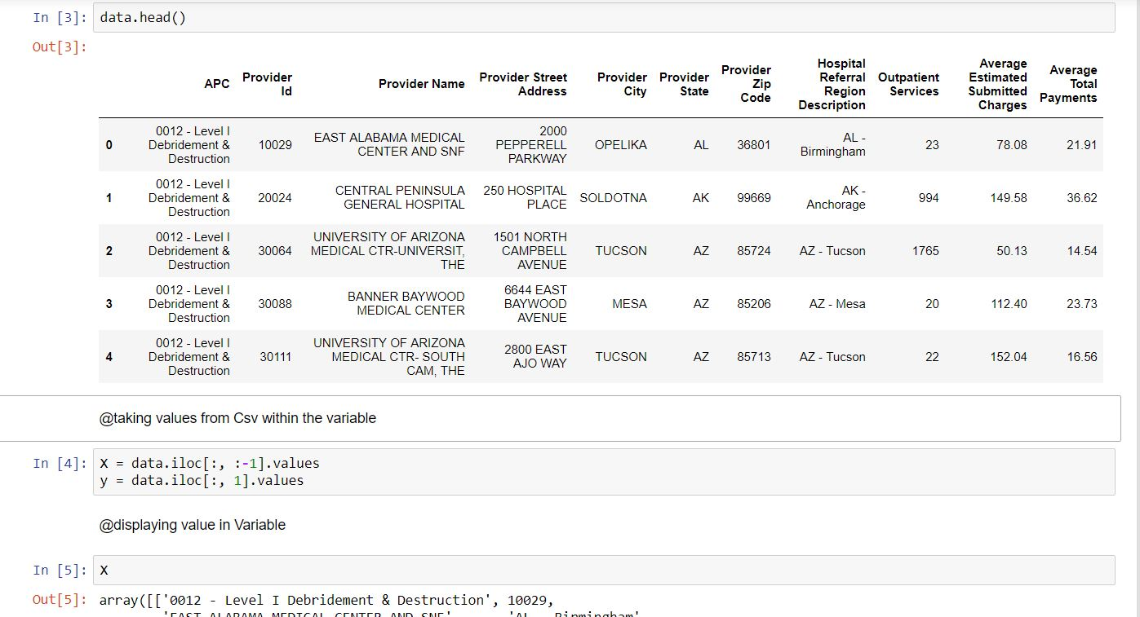

Slide 7
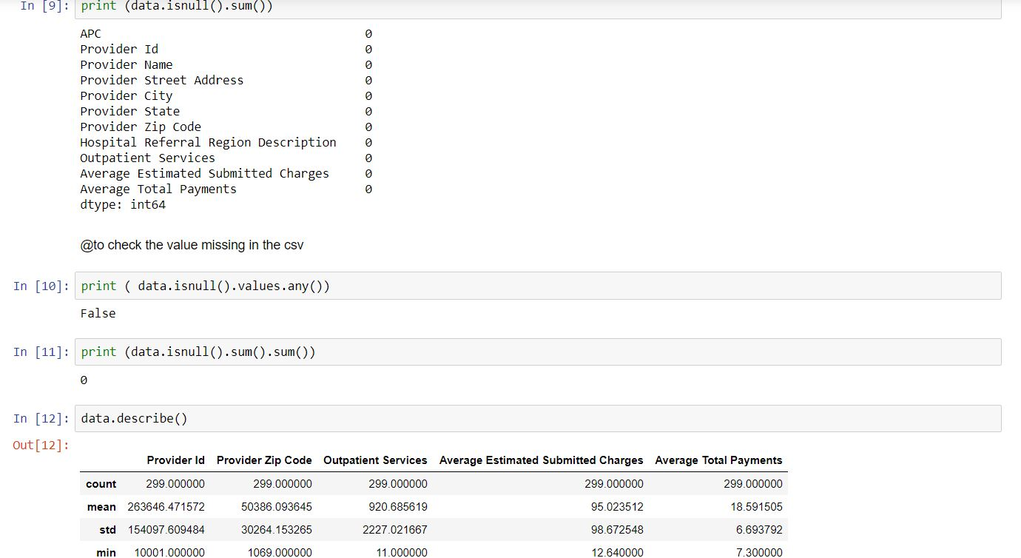
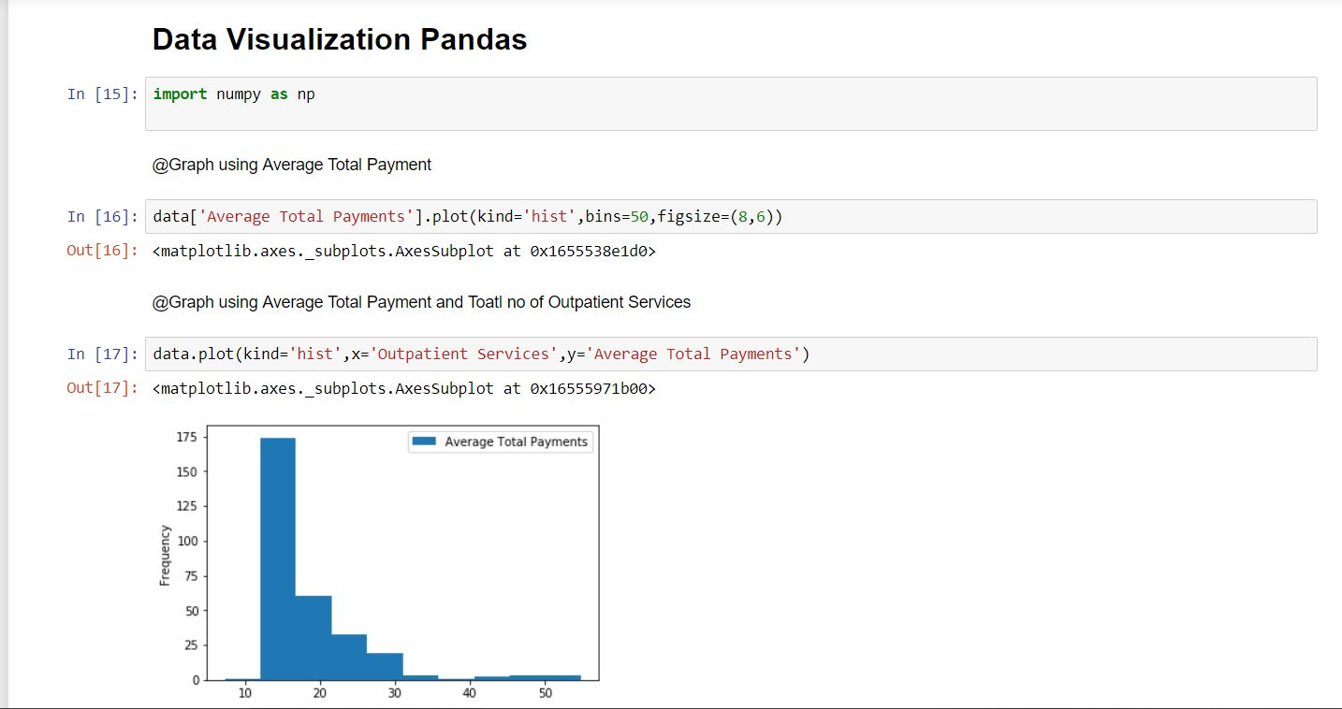

Slide 8
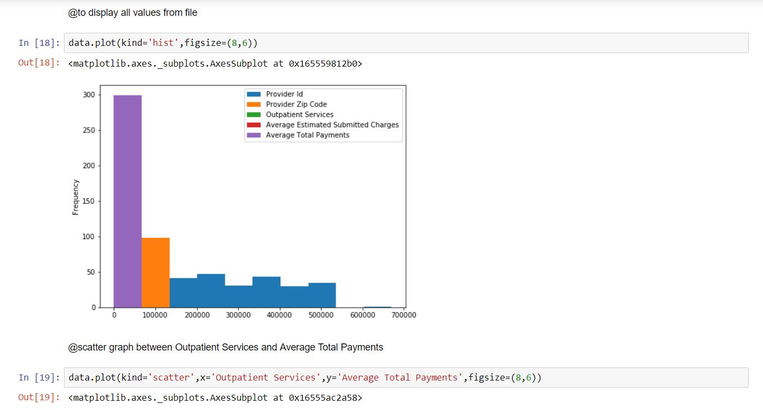
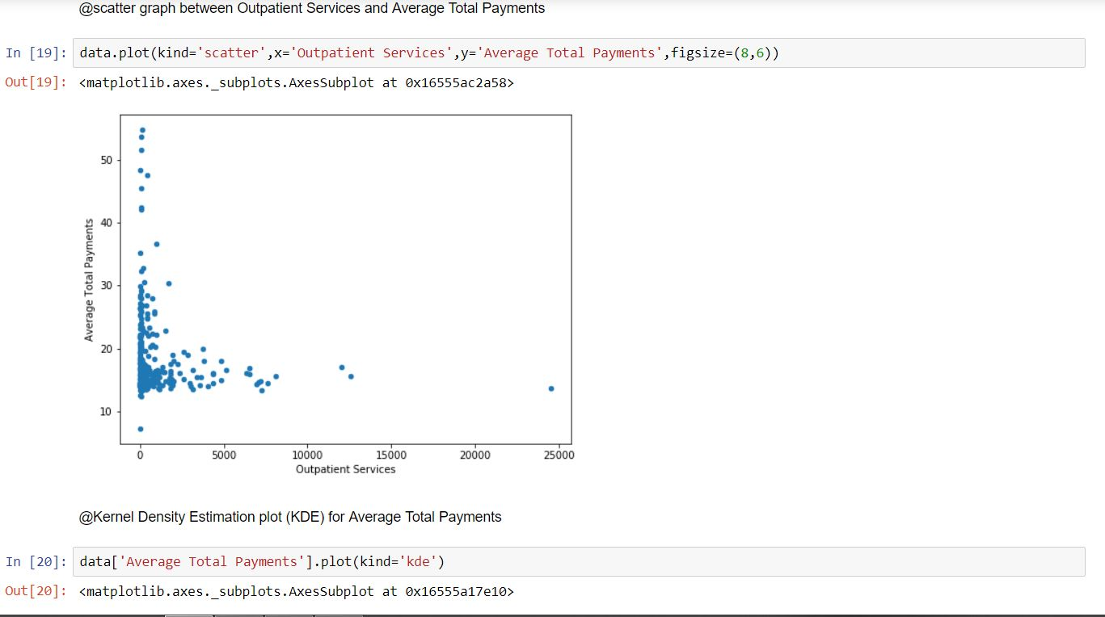

Slide 9
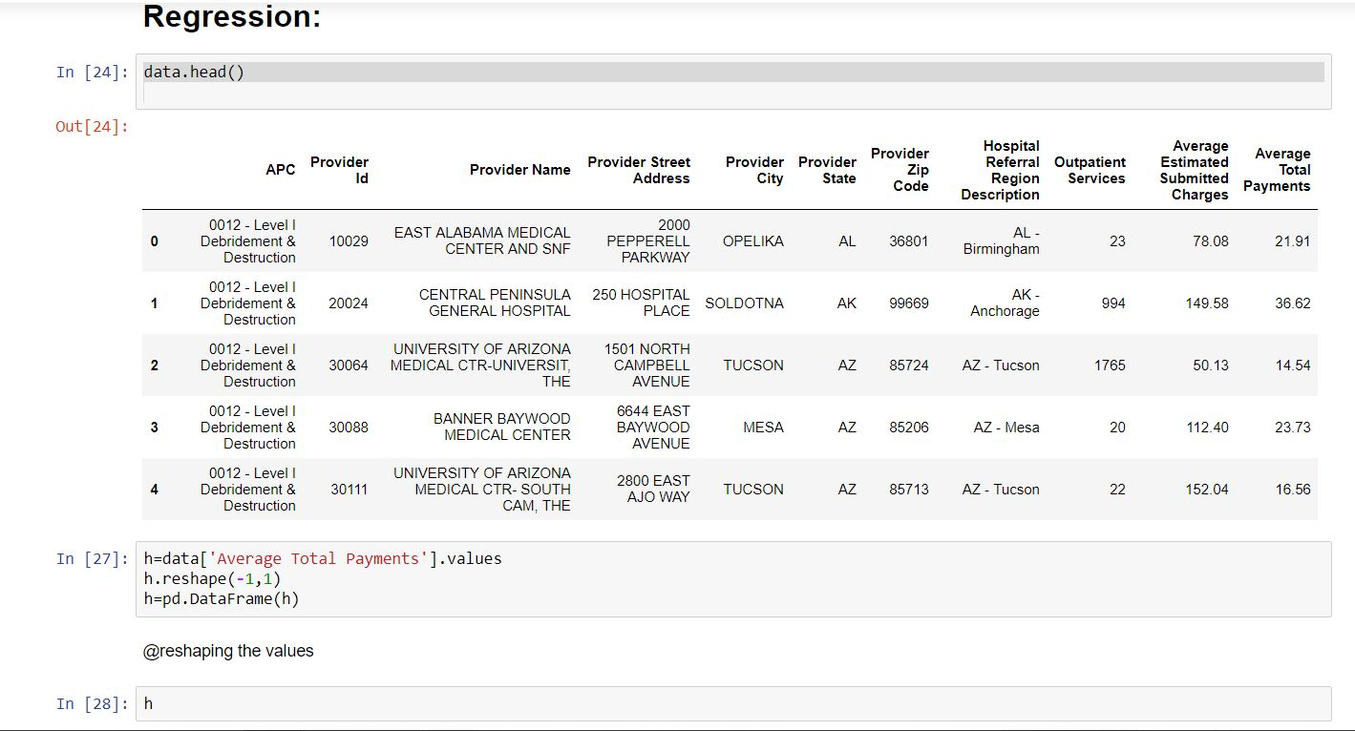
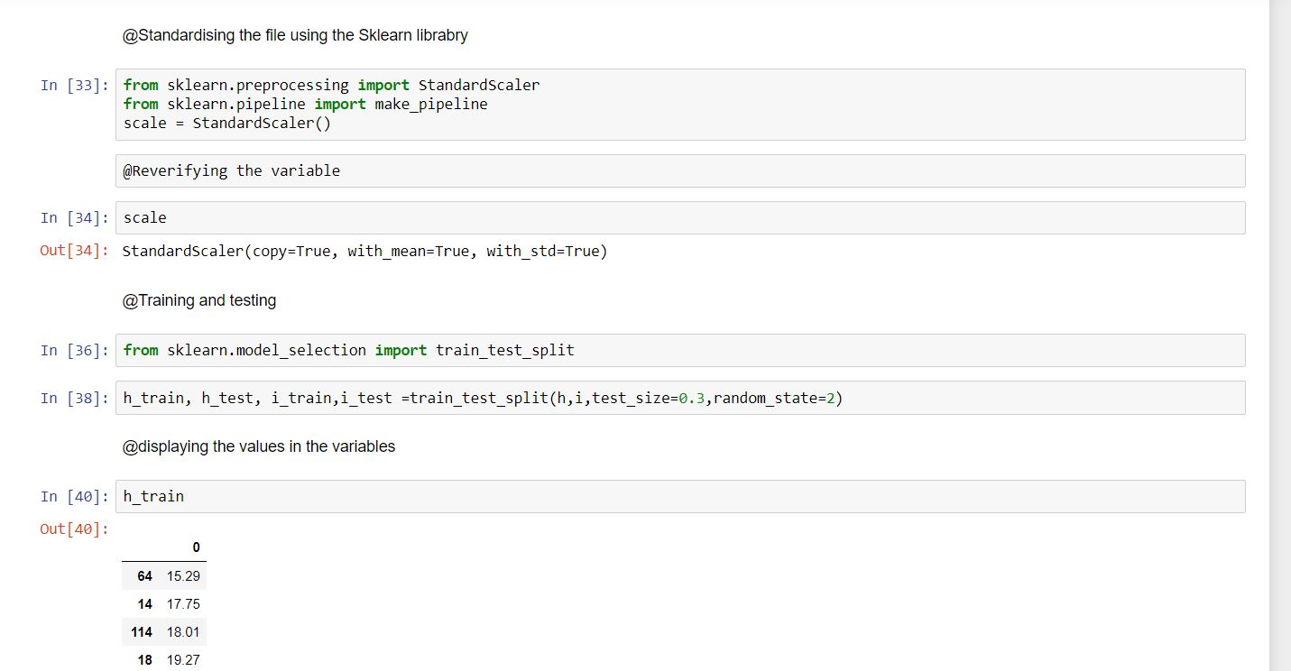

Slide 10
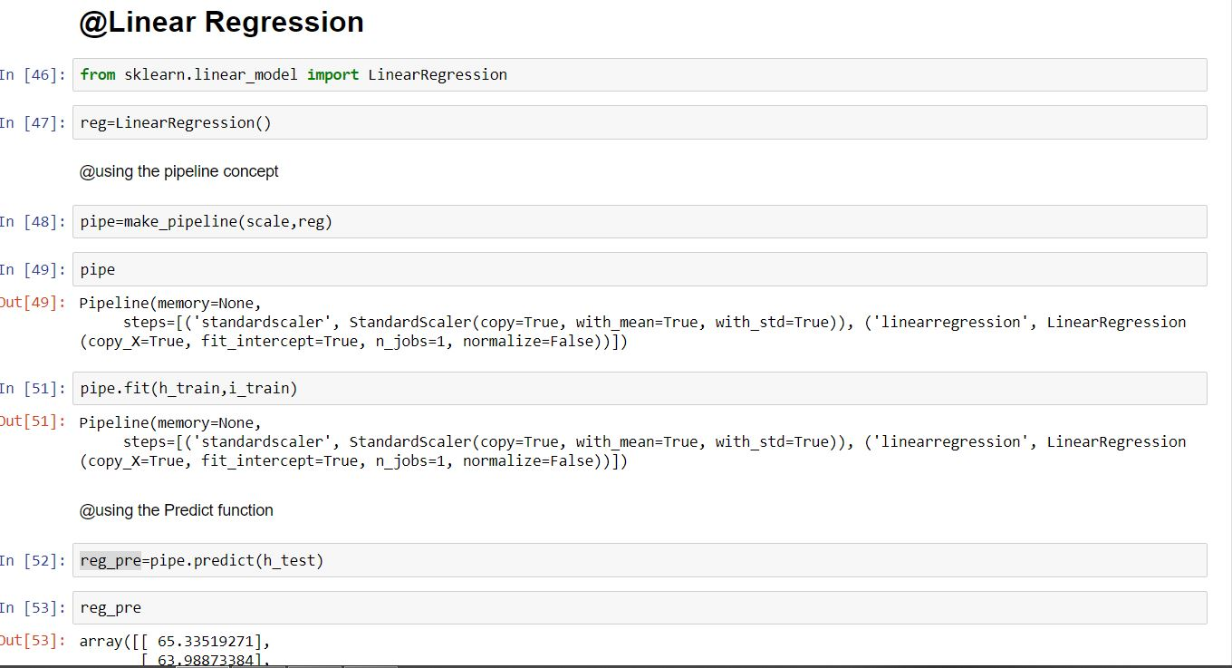
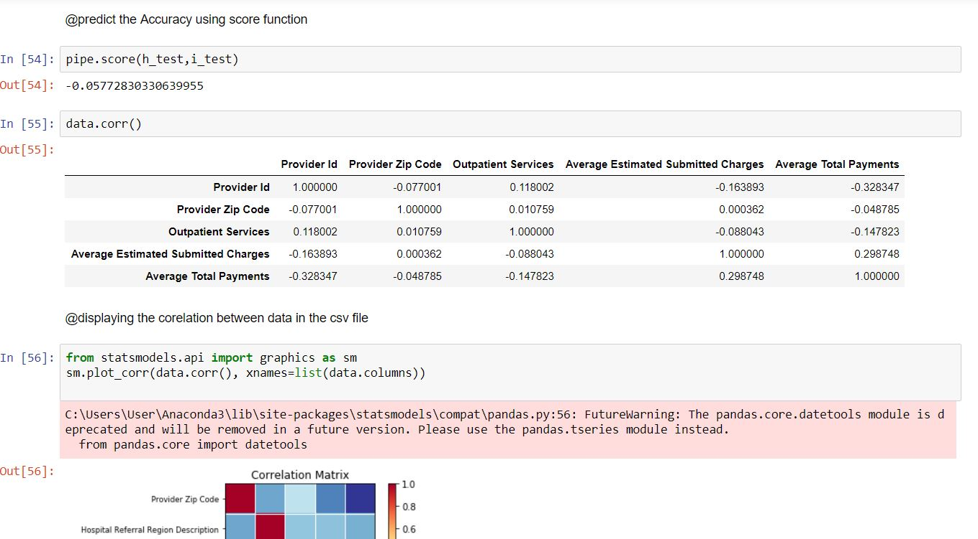

Slide 11
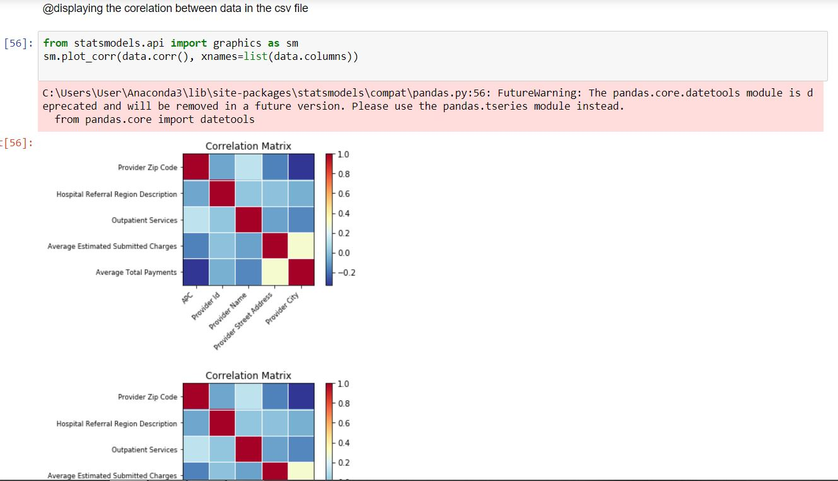
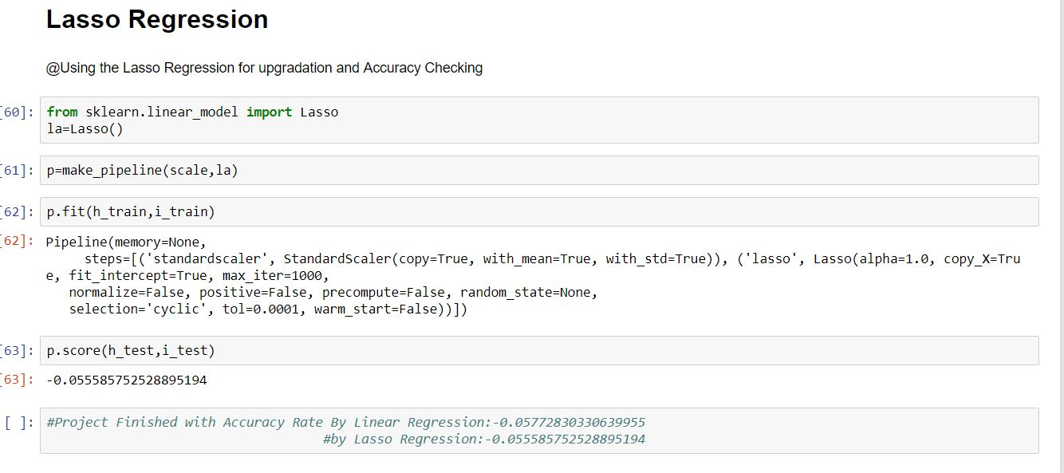

Slide 12
THANK YOU

