Slide 1
Chapter :- 1
Introduction

Slide 2
Topic to be covered ….
What is web page and web site
Static and dynamic web page
Scripting language and its types
About web server
HTTP & HTTPS protocol
FTP

Slide 3
web page
A document which can be displayed in a web browser such as Firefox, Google Chrome, Microsoft Internet Explorer or Edge, or Apple's Safari. These are also often called "web pages" or just "pages”.
website
A collection of web pages which are grouped together and usually connected together in various ways. Often called a "web site" or simply a "site”.
web server
A computer that hosts a website on the Internet.
search engine
A website that helps you find other web pages, such as Google, Bing, or Yahoo.

Slide 4
What is Web page?
A web page is a document commonly written in HyperText Markup Language (HTML) that is accessible through the Internet or other network using an Internet browser.
A web page is accessed by entering a URL address and may contain text, graphics, and hyperlinks to other web pages and files..

Slide 5
How to open a web page
To view a web page requires a browser (e.g. Internet Explorer, Edge, Safari, Firefox, orChrome).
you can open a web page by entering the URL in the address bar. For example, typing "https://www.computerhope.com/esd.htm"
opens the Computer Hope ESD page.
If you don't know the URL of the website you want to visit, you can use a search engineto find the web page or use the search on the website containing the web page.

Slide 6
first web page….
The first web page was created at CERN by Tim Berners-Lee on August 6, 1991.
Types of web pages..
Two types..
Static web pages
Dynamic web pages

Slide 7
Static web page
Static Web pages display the exact same information whenever anyone visits it. Static Web pages do not have to be simple plain text. They can feature detailed multimedia design and even videos. However, every visitor to that page will be greeted by the exact same text, multimedia design or video every time he visits the page until you alter that page's source code.

Slide 8
Dynamic web page
Dynamic Web pages are capable of producing different content for different visitors from the same source code file. The website can display different content based on what operating system or browser the visitor is using, whether she is using a PC or a mobile device, or even the source that referred the visitor. A dynamic Web page is not necessarily better than a static Web page. The two simply serve different purposes.

Slide 9
What is web site?
A website is a collection of related web pages, including multimedia content, typically identified with a common domain name, and published on at least one web server.
A website may be accessible via a public Internet Protocol (IP) network, such as the Internet, or a private local area network (LAN), by referencing a uniform resource locator (URL) that identifies the site

Slide 10
A Web site is a related collection of World Wide Web (WWW) files that includes a beginning file called a home page.
A company or an individual tells you how to get to their Web site by giving you the address of their home page.
From the home page, you can get to all the other pages on their site

Slide 11

In the above URL example,
the website is computerhope.com and the web page is "url.htm" and is always the last part of the URL.

Slide 12
What is URL?
URL is the abbreviation of Uniform Resource Locator and is defined as the global address of documents and other resources on the World Wide Web. To visit this website, for example, you'll go to the URL www.webopedia.com.
We all use URLs to visit webpages and other resources on the web. The URL is an address that sends users to a specific resource online, such as a webpage, video or other document or resource. When you search Google, for example, the search results will display the URL of the resources that match your search query. The title in search results is simply a hyperlink to the URL of the resource.

Slide 13
PARTS OF URL . . .
What Are the Parts of a URL?
The first part of the URL is called a protocol identifier and it indicates what protocol to use, and the second part is called a resource name and it specifies the IP address or the domain name where the resource is located.
The protocol identifier and the resource name are separated by a colon and two forward slashes. EXAMPLE:-

Slide 14
WHAT IS WWW ?
The Web, or World Wide Web (W3), is basically a system of Internet servers that support specially
formatted documents.
The documents are formatted in a markup language called HTML (HyperText Markup Language) that supports links to other documents, as well as graphics, audio, and video files.
This means you can jump from one document to another simply by clicking on hot spots.
Not all Internet servers are part of the World Wide Web.

Slide 15
What is Domain name?
A domain name is your website name. A domain name is the address where Internet users can access your website. A domain name is used for finding and identifying computers on the Internet. Computers use IP addresses, which are a series of number. However, it is difficult for humans to remember strings of numbers. Because of this, domain names were developed and used to identify entities on the Internet rather than using IP addresses. A domain name can be any combination of letters and numbers, and it can be used in combination of the various domain name extensions, such as .com, .net and more. The domain name must be registered before you can use it. Every domain name is unique. No two websites can have the same domain name. If someone types in www.yourdomain.com, it will go to your website and no one else's.

Slide 16
Why you need a Domain Name ?
On the Internet, your domain name is your unique identity.
Any individual, business or organization planning to have an Internet presence should invest in a domain name.
Having your own domain name, website and email addresses will give you and your business a more professional look.
Another reason for a business to register a domain name is to protect copyrights and trademarks, build creditability, increase brand awareness, and search engine positioning.

Slide 17
domain suffix
Every domain name has a suffix that indicates which top level domain (TLD) it belongs to. There are only a limited number of such domains. For example:
gov - Government agencies
edu - Educational institutions
org - Organizations (nonprofit)
mil - Military
com - commercial business
net - Network organizations
ca - Canada
th - Thailand
Because the Internet is based on IP addresses, not domain names, every Web server requires a Domain Name System (DNS) server to translate domain names into IP addresses.

Slide 18
IP address
IP address is short for Internet Protocol (IP) address.
An IP addressis an identifier for a computer or device on a TCP/IP network.
Networks using the TCP/IP protocol route messages based on the IP address of the destination.
Contrast with IP, which specifies the format of packets, also called datagrams, and the addressing scheme.
The Format of an IP Address
The format of an IP address is a 32-bit numeric address written as four numbers separated by periods. Each number can be zero to 255.
For example, 1.160.10.240 could be an IP address.

Slide 19
Types of web site
Two types
Static web site
Dynamic web site

Slide 20
Static website
Static website
Any website which contains no dynamic content is called static website, i.e. the information provided on that particular site is static and hardly needs any update or modification.
In short, the site containing static information is known as static website.
E.g.
Machine tool manufacture’s site.
Sites of this category generally contain product information and company profile.
Explanation: as we all know that any manufacturer has limited range of products that he sells. There are few chances of change in information related to products. Also, the information uploaded in such a site is hardly updateable. So, we can put this site in category of static site.

Slide 21
Static website is the basic type of website that is easy to create. You don't need web programming and database design to create a static website. Its web pages are coded in HTML.
The codes are fixed for each page so the information contained in the page does not change and it looks like a printed page.

Slide 22
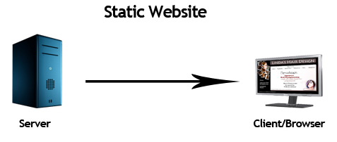
Static web site

Slide 23
Static website
Advantages
disadvantages
Quick to develop
Cheap to develop
Cheap to host
Requires web development expertise to update site
Site not as useful for the user
Content can get stagnant

Slide 24
Dynamic website
Any website which contains dynamic content is called dynamic site, i.e. the information provided on that particular site is needed to be updated frequently.
In short, the site containing dynamic information is known as dynamic website.
E.g.: Website of Newspaper agency.
Sites of this category generally contain daily news updates and archives of past editions.
Explanation:
As we all know that we must update site daily since, we are dealing with daily news. It is quite clear that the information stored in site needs to be charged daily. So, we can put this site in category of Dynamic site.

Slide 25
Dynamic website is a collection of dynamic web pages whose content changes dynamically. It accesses content from a database or Content Management System (CMS). Therefore, when you alter or update the content of the database, the content of the website is also altered or updated.
Dynamic website uses client-side scripting or server-side scripting, or both to generate dynamic content.
Client side scripting generates content at the client computer on the basis of user input. The web browser downloads the web page from the server and processes the code within the page to render information to the user.
In server side scripting, the software runs on the server and processing is completed in the server then plain pages are sent to the user.

Slide 26
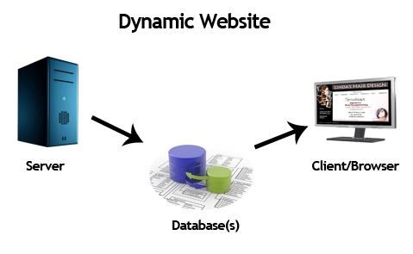
Dynamic web site

Slide 27
Dynamic website
Advantages
disadvantages
Much more functional website
Much easier to update
New content brings people back to the site and helps In the search engines
Can work as a system allow staff or users to collaborate
Slower to develop
More expensive
Hosting costs a little more

Slide 28
What is scripting language??
A script is a set of instructions
A script can contain variable, any control statements, looping structure or procedure function etc
Scripting language generally interpreted language
Conventional programs are converted permanently into executable files before they are run

Slide 29
Types of scripting language
A Scripting language is classified in two types
Client side scripting language
Serve side scripting language

Slide 30
Client side scripting language
A script which is interpreted by web client (web browser) is known as client side scripting.
A client side script is also an instruction set but that is not process by the server but that is processed by the web client
Client side scripts are executed and changed by the user on his side.
Java Script
Vb Script

Slide 31
Advantages of client side scripting:
The main advantage of client side scripting over pure HTML is that it allows the developer to create more functional interactive web pages
The response time is often faster because the script is interpreted on the browser machine so there is no network involve
Executing script on the web browser means that there is less script to be executed the server so reducing the web server traffic

Slide 32
Disadvantages of client side scripting
The client side scripting is browser specified because same client script run on different browser then may be both result is quite different
The biggest disadvantage is client side scripting code is not secure because it is completely visible to the user.

Slide 33
Server side scripting language
A script that is interpreted by web server is known as server side scripting language
A server side scripting is an instruction set that is process by the server and which generate the result in HTML the HTML results send to the web client
User can create dynamic web page
PHP
ASP
ASP.net
CGI
PYTHON
JSP

Slide 34
What is protocol?
Sometimes referred to as an access method, a protocol is a standard used to define a method of exchanging data over a computer network,
such as local area network,Internet, Intranet, etc.
Each protocol has its own method of how data is formatted when sent and what to do with it once received

Slide 35
What is Web server?
a Web site can be confused with a Web server. A server is a computer that holds the files for one or more sites.
Web site is collection of web pages while web server is a software that respond to the request for web resources.
A very large Web site may be spread over a number of servers in different geographic locations.
A web server is a computer hosting one or more websites. "Hosting" means that all the web pages and their supporting files are available on that computer. The web server will send any web page from the website it is hosting to any user's browser, per user request.

Slide 36
Web server is a computer where the web content is stored. Basically web server is used to host the web sites but there exists other web servers also such as gaming, storage, FTP, email etc.
Web Server Working:-
Web server respond to the client request in either of the following two ways:
Sending the file to the client associated with the requested URL.
Generating response by invoking a script and communicating with database

Slide 37
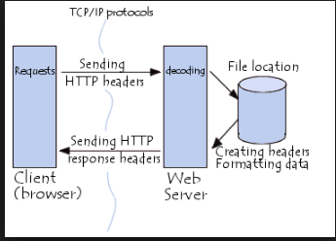

Slide 38
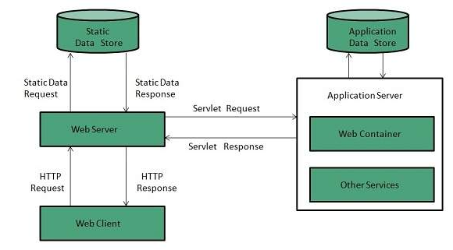
WEB SERVER

Slide 39
WEB SERVER
Program which is used to extends capabilities of server
TCP/IP or UDP
Application layer –work
Network interaction
Another web servers

Slide 40
HOW WEB SERVER WORKS …
When client sends request for a web page, the web server search for the requested page if requested page is found then it will send it to client with an HTTP response.
If the requested web page is not found, web server will the send an HTTP response:Error 404 Not found.
If client has requested for some other resources then the web server will contact to the application server and data store to construct the HTTP response.

Slide 41
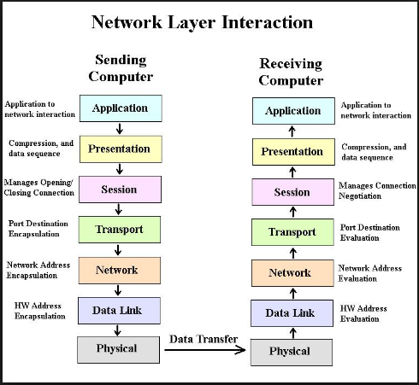

Slide 42
EXAMPLE OF WEB SERVER
APACHE
IIS
OMANI SERVER
NETSCAP ENTERPRICE SERVER
Among of this …
Apache and IIS are two most widely used web server ..

Slide 43


SYMBOL(LOGO) OF SERVER
APACHE SERVER
IIS SERVER

Slide 44
Apache HTTP Server / Apache Server
It is most popular web server in the world
developed by the Apache Software Foundation.
open source software and can be installed on almost all operating systems including Linux, UNIX, Windows, FreeBSD, Mac OS X and more.
About 60% of the web server machines run the Apache Web Server.

Slide 45
Apache server
License: Apache License 2.0
Initial release date: April 1995
Stable release: 2.4.29 (October 23, 2017; 15 days ago)
Developed by: Apache Software Foundation
Operating system: Unix-like, Windows
Written in: C, XML, C++

Slide 46
Features of APACHE server
Easily customized
Open source
Allow to do required modification to user
Put own module
Install on multiple platform
More stable
Newer version can handle more request compare to old version
Cross platform , os , scripting language

Slide 47
Features of APACHE server
An Apache server can be customized easily as it contains a modular structure.
It is an open source which means that you can add your own modules to the server when to require and make modifications that suit your specific needs.
It is more stable than any other web servers and is easier to solve administrative issues.
It can be install on multiple platforms successfully.
Recent Apache releases provide you the feasibility of handling more requests when you compare to its earlier versions.

Slide 48
Internet Information Services (IIS) SERVER
The Internet Information Server (IIS)
It is a high performance Web Server from Microsoft.
This web server runs on Windows NT/2000 and 2003 platforms (and may be on upcoming new Windows version also).
IIS comes bundled with Windows NT/2000 and 2003; Because IIS is tightly integrated with the operating system so it is relatively easy to administer it.
IIS supports HTTP, HTTPS, FTP, FTPS, SMTP and NNTP.

Slide 49
IIS server
Stable release: 10 / 29 July 2015; 2 years ago
Initial release: May 30, 1995; 22 years ago
Operating system: Windows NT
License: Part of Windows NT (same license)
Developed by: Microsoft Corporation
Written in: C++

Slide 50
Features of IIS server
It cannot directly perform server side processing but can delegate the task to ISAPI
Internet Server Application Programming Interface (ISAPI) application on the server
Microsoft developed, maintains it, thus works with all the Windows operating system platforms.
Also, they had good customer support if it had any issues.

Slide 51
Apache - XAMPP
XAMPP stands for Cross-Platform (X), Apache (A), MariaDB (M), PHP (P) and Perl (P).[ It stands for Practical Extraction and Report Language.]
It is a simple, lightweight Apache distribution that makes it extremely easy for developers to create a local web server for testing and deployment purposes.
Everything needed to set up a web server – server application (Apache), database (MariaDB), and scripting language (PHP) – is included in an extractable file.

Slide 52
XAMPP
XAMPP is also cross-platform, which means it works equally well on Linux, Mac and Windows.
Since most actual web server deployments use the same components as XAMPP,
it makes transitioning from a local test server to a live server extremely easy as well.

Slide 53

Tim berners Lee’s Invention(HTTP)
It was in March 1989 that Tim lee first outlined the advantages of a hypertext-based, linked information system.
This method incorporated the use of hypertext, a system that links documents from different sources.
by the end of 1990, Berners-Lee, along with Robert Cailliau,
created the first Web browsers and servers and
designed the first version of HTTP V0.9 (1991).

Slide 54
HTTP & HTTP protocol
HTTP (Hyper Text Transfer Protocol)
HTTP is short for Hyper Text Transfer Protocol.
It is the set of rules or protocol that governs the transfer of hypertext between two or more computer.
The World Wide Web encompasses the universe information that is available via HTTP.

Slide 55
HTTP
The Hypertext Transfer Protocol (HTTP) is application-level protocol for collaborative, distributed, hypermedia information systems.
It is the data communication protocol used to establish communication between client and server.
HTTP is TCP/IP based communication protocol, which is used to deliver the data like image files, query results, HTML files etc on the World Wide Web (WWW) with the default port is TCP 80. It provides the standardized way for computers to communicate with each other.

Slide 56
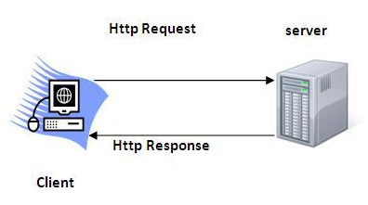
HTTP

Slide 57
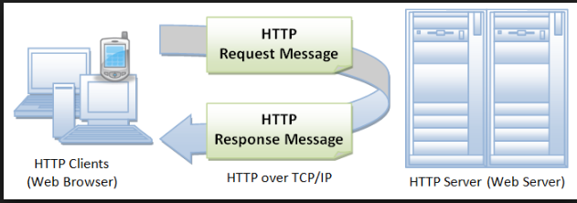

Slide 58
HTTP:-
HTTP allows client to establish a connection to the server and make a request. The server accepts the connection initiated by the client and sends back a response.
HTTP request identifies the resources that the client is interested in and tells the server what “action” to take on the resource.
When a user select a hypertext link, the client program on their computer users HTTP to contact the server, identify a resource, and ask the server to respond with an action. The serve accepts the request, and then uses HTTP to respond to or perform the action.
HTTP also provides access to other internet protocols like FTP(File Transfer Protocol) & SMTP(Simple Mail Transfer Protocol)
If you visit any website you may see the address gets prefixed with HTTP:// this means your browser is now connected to the server using HTTP.

Slide 59
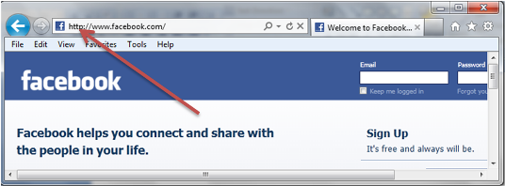

Slide 60
HTTPS
HTTPS – SECURE HTTP
Sometimes, the clients may be exchanging private information with a server, which needs to be secured for preventing some hacking issue.
HTTPS was developed byNetscape Corporation to allow authorization and secured transactions.
Here is the fact of HTTP :
HTTPS URLs begin with “https://”.
HTTPS uses a port 443 by default to transfer the information.
This kind of communication is used for accessing those websites where security is required. Banking websites, payment gateway, emails (Gmail offers HTTPS by default in Chrome browser), and corporate sector websites are some great examples where HTTPS protocols are used.

Slide 61
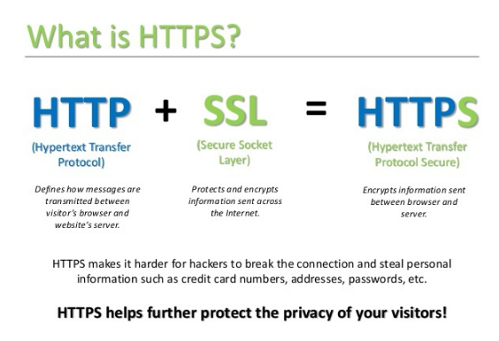

Slide 62
DIFFRENCE BETWEEN HTTP/HTTPS
HTTP | HTTPS
1. URL begins with “http://” | URL begins with “https://”
2.It uses port 80 for communication | It uses port 443 for communication
3. Unsecured | Secured
4. Operates at Application Layer | Operates at Transport Layer
5. No encryption | Encryption is present
6. No certificates required | Certificates required

Slide 63
HTTP vs FTP
HTTP (Hypertext Transfer Protocol) and FTP (File Transfer Protocol) are only two of the multitude of protocols that are being used in the internet, each with its own function.

Slide 64
FTP :-
The File Transfer Protocol (FTP) is the standard network protocol used for the transfer of computer files between a client and server on a computer network.
FTP is built on a client-server model architecture and uses separate control and data connections between the client and the server.
FTP users may authenticate themselves with a clear-text sign-in protocol, normally in the form of a username and password, but can connect anonymously if the server is configured to allow it.
For secure transmission that protects the username and password, and encrypts the content, FTP is often secured with SSL/TLS (FTPS). SSH File Transfer Protocol (SFTP) is sometimes also used instead; it is technologically different.

Slide 65
The first FTP client applications were command-line programs developed before operating systems had graphical user interfaces, and are still shipped with most Windows, Unix, and Linux operating systems.
Many FTP clients and automation utilities have since been developed for desktops, servers, mobile devices, and hardware, and FTP has been incorporated into productivity applications, such as web page editors.

Slide 66
FTP
FTP is a File Transfer Protocol.
It is used to copy a file from one host to another. While copying a file from one host to another
the problems that may occur are, the communicating host may have different file name conventions, may have different directory structures, different way to represent data.
FTP overcomes all these problems.
FTP is used when two hosts with different configurations want to exchange data between them.

Slide 67
For secure transmission that protects the username and password, and encrypts the content, FTP is often secured with SSL/TLS (FTPS).
SSL(Secure socket layer)
TLS(Transport layer security)
SSH File Transfer Protocol (SFTP) is sometimes also used instead;
(Technology Different FTPS----SFTP)
SSH(Secure Shell)

Slide 68
HTTP is used to view websites while FTP is used to access and transfer files
The common HTTP client is the browser while FTP can be accessed via the command line or a graphical client of its own.
Most people use HTTP while only a few use FTP, mostly people who maintain websites.
Downloading files can either be via HTTP or FTP.
FTP is slowly being replaced by other protocols while HTTP will remain for the foreseeable future.

Slide 69
BASIS FOR COMPARISON | HTTP | FTP
Basic | HTTP is used to access websites. | FTP transfers file from one one host to another.
Connection | HTTP establishes data connection only. | FTP establishes two connection one for data and one for the control connection.
TCP ports | HTTP uses TCP's port number 80. | FTP uses TCP's port number 20 and 21.
URL | If you are using HTTP, http will appear in URL. | If you are using FTP, ftp will appear in URL.
Efficient | HTTP is efficient in transferring smaller files like web pages. | FTP is efficient in transferring larger files.
Authentication | HTTP does not require authentication. | FTP requires a password.
Data | The content transferred to a device using HTTP is not saved to the memory of that device. | The file transferred to the host device using FTP is saved in the memory of that host device.

Slide 70
What is web hosting?
Web Hosting
Web hosting is an internet common service.
Web hosting means storing your web site on a public server. In other word web hosting is a service which allocates space for customers to showcase their websites on computer servers that are connected to the Internet
Web hosting normally includes email services and often includes domain name registration
Web Hosting Provider using two options:-
SELF HOSTING
USING ISP

Slide 71
Self hosting
Self Hosting
Hosting your web site on your own server is known as self-hosting.
Self-hosting becoming a realistic option for more sites as the price of connectivity goes down.
It is the ultimate in command, control and its offer security advantages.
Problem solving faster because you don’t have to waste a time on a tech support line.

Slide 72
Using ISP :-
Using an Internet Service Provider (ISP)
Renting a server from an Internet Service Provider (ISP) is a common option.
Here are some advantage:
Connection Speed
Powerful Hardware
Security and Stability

Slide 73
Types of hosting:-
It can split generally in following types:-
Free hosting
Shared hosting
Reseller hosting
Virtual private server hosting
Dedicated hosting
Colocated hosting
Application hosting

Slide 74
free web hosting:-
Some service providers offer free web hosting.
Free web hosting is best suited for small sites with low traffic, like family sites for sites about hobbies.
It is not recommended for high traffic or for business. Technical support is often limited, and technical options are few.
Very often you cannot use your own domain name at a free site. You have to use a name provided by your host like http://www.freesite/users/~yoursite.htm. This is hard to type, hard to remember, and not very professional.

Slide 75
dedicated hosting
With dedicated hosting your web site is hosted on a dedicated server.
Dedicated hosting is the most expensive form of hosting. The solution is best suited for large web sites with high traffic, and web sites that special software.
You should expect dedicated hosting to be very powerful and secure, with almost unlimited software solutions.

Slide 76
Dedicated hosting
Good: | Bad:
Good for large business | Expensive.
Good for high traffic | Requires higher skills.
Multiple domain names
Powerful email solutions.
Powerful database support
Strong(unlimited) software support

Slide 77
Colocated Hosting
Colocated Hosting
Colocated means “co-location”. It is solution that lets you place (locate) your own web server on the premises (locations) of a service provider.
This is pretty much the same as running your own server In your own office, only that it is located at a place better designed for it.
Most likely a provider will have dedicated resources like high-security against fire and vandalism, regulated backup power, dedicated Internet connections and more.

Slide 78
colocated hosting
Good: | Bad:
High bandwidth. | Expensive.
High up time. | Requires higher skills.
High Security | Harder to configure and debug.
Unlimited software options.

Slide 79
Shared hosting
In this hosting, multiple accounts are hosted on the same server and the resources are also shared among them.
It is best for small businesses, whose websites have low to moderate traffic and CPU needs.
It’s like an apartment building, where you need to pay less amount, but you share the space with many other people.
You also get affected if your neighbor decides to party as he and his visitors may create disturbance for you or may use up your parking space.
Similarly, in shared hosting, if one user uses more bandwidth in case his site has more traffic, then your site may go down.

Slide 80
Reseller hosting
Reseller hosting packages are basically a shared hosting account with extra tools to help you resell hosting space.
Reseller packages come with greater technical control (often via the Web Host Manager (WHM) control panel), billing software to help you invoice clients and other extra perks.
Some of those perks include:
free website templates
white label technical support -- that means the hosting company handles your clients' tech support issues
private name servers -- make your company seem even bigger by telling your clients to point their domain nameservers to ns1.yourwebdesignfirm.com
Price range: Reseller packages range from $15 - $50, depending on features and resource limits.

Slide 81
Virtual private servers (VPS) hosting
Virtual private servers share one physical server but acts like multiple, separate servers. A VPS is a stepping stone between shared hosting and getting your own dedicated machine. Even though each VPS instance shares hardware resources, they are allocated a dedicated slice of the computing resources.
A VPS avoids the problem of having your hosting neighbors bring down your website, while avoiding the cost of a dedicated server.
Price Range: Most VPS hosting packages cost between $50 and $200. Pricing is based on the guaranteed CPU and memory (RAM) you get.

Slide 82
Application hosting
The hosting of custom applications for a purpose other then a running a website , e-mail etc.
Commonly used by larger companies to outsource network infrastructure to hosting company
Example:-
A chain of grocery store that logs orders through servers located in a datacenter.

Slide 83
ONE MARK QUESTION
Which protocol is used to access HTML page?
___________is used to view web page?
List out types of webpage/website.
Which network protocol is used to transfer file from one host to another host?
Who is developer of HTTP?
Which server is developed by microsoft?
List out server side/client side scripting language?
Which technique is used to increase the reliability of internet connection of an IP network?
Which is a method that web servers use to host more than one domain name on the same computer and IP address?

Slide 84
Question for [1] mark
List out 5 web server.
List out 5 web browser
List out 5 web site.
List out 5 search engine..

Slide 85
Question for Full form [1] mark .
HTTP
HTTPS
FTP
IIS
XAMPP
VPS
URL
DIFFERENCE [5] mark
Static /dynamic web page
Static/dynamic web site
Client side /server side scripting language
Web page/web site
Apache/ IIS server

Slide 86
Question bank
Write a note on following [5] mark
Web page
Web site
Web server
Apache server
IIS server
Scripting language
HTTP
HTTPS
FTP
Explain web hosting with its types [7] mark

