Slide 1
Chapter-1
Basic of PHP

Slide 2
Topics to be covered
PHP variable…..
Static & global variable(scope of variable)
Data types
Constants
Comments of php
GET , POST methods
REQUEST variable

Slide 3
PHP TAGS
A php file normally contain HTML tag just like HTML file and
some PHP code Escaping from HTML
PHP TAGS
There are different pairs of opening and closing tags which can be used in php.

Slide 4
Four way to escape in to PHP
Canonical method/standard method/default tag
Html script tag method
Short tag method
Asp style method
To execute your code form web server that is language option of php.ini file

Slide 5
Canonical PHP Tag
Canonical PHP Tag
<?php……….
………
?>

Slide 6
HTML script tag method
<script language=“php”>
……………code is
………………….here..
</script>

Slide 7
Short open tag
The short open tag is by default disable in to php.ini file
<?
.......
…….
?>

Slide 8
ASP style method
<%
………………..
……………….
………………….
%>

Slide 9
Some important notes
The php script block placed anywhere in the document
The each line of the code syntax terminated by the semicolon
Php is case sensitive scripting language
Php ignore the white space
Insert special characters
Comments just like c style // or /*,……..,*/ and #

Slide 10
What is a PHP File?
PHP files can contain text, HTML, CSS, JavaScript, and PHP code
PHP code are executed on the server, and the result is returned to the browser as plain HTML.
PHP files have extension ".php"

Slide 11
Basic PHP Syntax
A PHP script can be placed anywhere in the document.
A PHP script starts with <?php and ends with ?>
<?php // PHP code goes here ?>

Slide 12
Comments in PHP
A comment in PHP code is a line that is not read/executed as part of the program. Its only purpose is to be read by someone who is editing the code!
Use:
To let others understand what you are doing - Comments let other programmers understand what you were doing in each step (if you work in a group)

Slide 13
Comments
1) // Single Line Comment
2) # Single Line Comment
3) /*…..*/ Multi Line Comment

Slide 14
PHP supports 3 ways of commenting:
<html> <body> <?php // This is a single line comment # This is also a single line comment /* This is a multiple lines comment block that spans over more than one line */ ?> </body> </html>

Slide 15
echo and print statement
In PHP there are two basic ways to get output:
echo
print.
echo and print are more or less the same.
They are both used to output data to the screen.

Slide 16
The differences of echo/print
echo has no return value while print has a return value of 1 so it can be used in expressions.
echo can take multiple parameters (although such usage is rare) while print can take one argument.
echo is marginally faster than print.

Slide 17
echo is a language construct, and can be used with or without parentheses:
echo or echo().
Syntax:
1) echo (arg1, arg2... );
2) echo “arg1”;

Slide 18
Ex-1
<html> <body> <?php echo "My first PHP script!"; ?> </body> </html>

Slide 19
Ex-1
We can also write like this
<?php echo “<b><u>My first page </b></u>"; ?>

Slide 20
EX:-2
<?php echo "<h2>PHP is fun!</h2>"; echo "Hello world!<br>"; echo "I m about to learn PHP!<br>"; echo "This", " string", " was", " made", " with multiple parameters."; ?>

Slide 21
EX:-3
<?php print "<h2>PHP </h2>"; print "Hello world!<br>"; print "I'm about to learn PHP!";
?>

Slide 22
What is variable
A variable is one type of container that contain special type of value so you can use it for future use
$variable_name=value of variable;

Slide 23
Example
To define a variable in to php you must use the $ singe before the declaring name of it .
Variables are "containers" for storing information:
For variable declaration you do not need to specify the data type
$a=5;
$x=”hello”;

Slide 24
PHP Variable Naming Conventions
PHP variables must start with a letter or underscore "_".
PHP variables may only be comprised of alpha-numeric characters and underscores. a-z, A-Z, 0-9, or _
Variables with more than one word should be separated with underscores. $my_variable
Variable names are case sensitive
A variable name should not contain spaces

Slide 25
A variable's scope determines the locations from which the variable can be accessed.
PHP variables are of three types
Super global,
global,
local.

Slide 26
PHP Variable Scopes
PHP has four different variable scopes:
Local variables
Function parameters
Global variables
Static variables.

Slide 27
Super global
Super global variables are predefined arrays
They are accessible from anywhere on the page.
It can always declared with $_ sign

Slide 28
Following are Super global variables
$_GET - variables passed into a page on the query string.
$_POST - variables passed into a page through a form using the post method.
$_SERVER - server environment variables (e.g, $_SERVER['HTTP_REFERER'] returns the URL of the referring page).
$_COOKIE - cookie variables.

Slide 29
$_FILES - variables containing information about uploaded files.
$_REQUEST - variables passed into a page through forms, the query string and cookies.
$_SESSION - session variables.
The elements within super global variables can be accessed in three different ways, which the authors of PHP and MySQL Web Development refer to as short style, medium style, and long style.

Slide 30
Global
Global variables are visible throughout the script in which they are declared. However, they are not visible within functions in the script unless they are re-declared within the function as global variables.
Variables in the function scope are called local variables. Local variables are local to the function in which they are declared.

Slide 31
GLOBALS
GLOBALS is a php super global variable which can be used instead of 'global' keyword to access variables from global scope,
The $GLOBALS array is an associative array with the name of the global variable being the key and the contents of that variable being the value of the array element. Notice how $GLOBALS exists in any scope, this is because $GLOBALS is a superglobal.

Slide 32
EXAMPLE
<?php
$s = 25; //global variable
$t = 50; //global variable
function subtraction()
{
$GLOBALS['v'] = $GLOBALS['t'] - $GLOBALS['s'];
//re-declare with GLOBALS KEYWORDS
}
subtraction();
echo $v;
?>

Slide 33
Local Scope
variable declared within a PHP function is local and can only be accessed within that function:
<?php $x=5; // global scope function myTest() {
$x=10; echo $x; // local scope } myTest(); ?>

Slide 34
Global Scope
A variable that is defined outside of any function, has a global scope.
Global variables can be accessed from any part of the script, EXCEPT from within a function.
To access a global variable from within a function, use the global keyword:

Slide 35
Example
<?php $x=5; // global scope $y=10; // global scope function myTest() { global $x,$y; $y=$x+$y; } myTest(); echo $y; // outputs 15 ?>

Slide 36
GLOBALS[INDEX]
<?php $x=5; $y=10; function myTest()
{
$GLOBALS['y']=$GLOBALS['x']+$GLOBALS['y]; } myTest(); echo $y; ?>

Slide 37
Static Scope
When a function is completed, all of its variables are normally deleted. However, sometimes you want a local variable to not be deleted.
To do this, use the static keyword when you first declare the variable:

Slide 38
EXAMPLE
<?php function myTest() { static $x=0; echo $x; $x++; } myTest(); myTest(); myTest(); ?>

Slide 39
CONSTANTS
A constant is an identifier for a simple value. The value cannot be modified during the script's execution. A valid constant name starts with a letter or underscore (no dollar ($) sign before the name) and by convention constant identifier are always uppercase.
Constants are defined by using the define() function or by using the const keyword outside a class definition.

Slide 40
The name of the constant and the value must be placed within the parentheses. After defining it can never be changed or undefined.
Only scalar data i.e. boolean, integer, float and string can be contained in constants.
define(name, value, case-insensitive)

Slide 41
SYNTAX
define(name, value, case-insensitive)
PARAMETERS…….
name | Specifies the name of the constant
value | Specifies the value of the constant
case-insensitive | Specifies whether the constant name should be case-insensitive. Default is false

Slide 42
Example
<?php
// first we define a constant PASSWORD
define("PASSWORD","admin");
echo (PASSWORD); // will display value of PASSWORD constant, i.e. admin
echo constant("PASSWORD"); // will also display admin
echo "PASSWORD"; // will display PASSWORD
?>

Slide 43
constant() function
As indicated by the name, this function will return the value of the constant.
This is useful when you want to retrieve value of a constant, but you do not know its name, i.e. It is stored in a variable or returned by a function

Slide 44
Example
<?php define("MINSIZE", 50);
echo MINSIZE; echo constant("MINSIZE");
// same thing as the previous line
?>
Note :-
Only scalar data (boolean, integer, float and string) can be contained in constants.

Slide 45
Constants / variables
Differences between constants and variables are
There is no need to write a dollar sign ($) before a constant, where as in Variable one has to write a dollar sign.
Constants cannot be defined by simple assignment, they may only be defined using the define() function.
Constants may be defined and accessed anywhere without regard to variable scoping rules.
Once the Constants have been set, may not be redefined or undefined.

Slide 46
Data types
PHP supports the following data types:
Scalar data types
String
Integer
Float (floating point numbers - also called double)
Boolean
Compound data types
Array
Object
Special data types
NULL
Resource

Slide 47
Scalar Data types
PHP Integer
An integer data type is a non-decimal number between -2,147,483,648 and 2,147,483,647.
Rules for integers:
An integer must have at least one digit
An integer must not have a decimal point
An integer can be either positive or negative
Integers can be specified in three formats: decimal (10-based), hexadecimal (16-based - prefixed with 0x) or octal (8-based - prefixed with 0)

Slide 48
PHP Float
A float (floating point number) is a number with a decimal point or a number in exponential form.
PHP String
A string is a sequence of characters, like "Hello world!".
A string can be any text inside quotes. You can use single or double quotes:

Slide 49
String data types
There are no limits on string length - within the bounds of available memory, you are able to make long strings.
Strings that are delimited by double quotes (as in "this") are preprocessed in both the following two ways by PHP −
Certain character sequences beginning with backslash (\) are replaced with special characters
Variable names (starting with $) are replaced with string representations of their values.

Slide 50
String
A string literal can be specified in four different ways:
single quoted
double quoted
heredoc syntax
nowdoc syntax (since PHP 5.3.0)

Slide 51
Heredoc
A third way to delimit strings is the heredoc syntax: <<<. After this operator, an identifier is provided, then a newline. The string itself follows, and then the same identifier again to close the quotation.
The closing identifier must begin in the first column of the line. Also, the identifier must follow the same naming rules as any other label in PHP: it must contain only alphanumeric characters and underscores, and must start with a non-digit character or underscore.

Slide 52
Example
<?php $str = <<<EOD Example of string spanning multiple lines using heredoc syntax. EOD;
echo $str;
?>

Slide 53
Only difference between heredoc's and nowdoc's syntax is that nowdoc's starting identifier is surrounded by single quotes.
<?php
$name = “abc";
//Heredoc example
echo <<<EOT
My name is $name
I love PHP.
EOT;
echo "<br>";
//Nowdoc example
echo <<<'EOT'
My name is $name
I love PHP.
EOT;
?>

Slide 54
escape-sequence
The escape-sequence replacements are −
\n is replaced by the newline character
\r is replaced by the carriage-return character
\t is replaced by the tab character
\$ is replaced by the dollar sign itself ($)
\" is replaced by a single double-quote (")
\\ is replaced by a single backslash (\)

Slide 55
PHP Boolean
A Boolean represents two possible states: TRUE or FALSE.
$x = true; $y = false;
Booleans are often used in conditional testing

Slide 56
Compound data types
PHP Array
An array stores multiple values in one single variable.
PHP Object
An object is a data type which stores data and information on how to process that data.
In PHP, an object must be explicitly declared.
First we must declare a class of object. For this, we use the class keyword. A class is a structure that can contain properties and methods:

Slide 57
Special data types
PHP NULL Value
Null is a special data type which can have only one value: NULL.
A variable of data type NULL is a variable that has no value assigned to it.
Tip: If a variable is created without a value, it is automatically assigned a value of NULL.
Variables can also be emptied by setting the value to NULL:

Slide 58
PHP Resource
The special resource type is not an actual data type. It is the storing of a reference to functions and resources external to PHP.
A common example of using the resource data type is a database call.
it is an advanced data type

Slide 59
TESTING AND MANIPULATION FUNCTIONS / VARIABLE FUNCTIONS
PHP provides built-in functions for checking if a variable exists, checking if a variable holds a value, and removing a variable.
To output the results of these functions to a browser, use the var_dump() function (e.g. var_dump(isset($a));).

Slide 60
isset() :
isset() :
Checks to see if a variable exists. Returns true or false.
Example
<?php $x = 0; // Evaluates as true because $x is set if (isset($x))
{ echo '$x is set even though it is empty'; } ?>

Slide 61
unset()
unset() : Removes a variable from memory
Example
<?php
$x=‘bca sem4';
echo 'Before using unset() the value of $x is : '. $x.'<br>';
unset($x);
echo 'After using unset() the value of $x is : '. $x; ?>

Slide 62
var_dump():
var_dump(): returns the type ,size and value of the variable.
Example
<?php
$a = 'test';
var_dump($a);
?>

Slide 63
empty()
empty() : Checks to see if a variable contains a non-empty, non-false value
Example
<?php $a = 0; // Evaluates to true because $var is empty if (empty($a))
{ echo '$a is either 0, empty, or not set at all'; } ?>

Slide 64
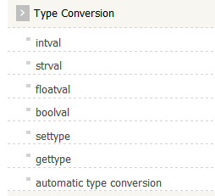
Type conversion function

Slide 65
Gettype()
Gettype():- to know type of variable
Example :-
<?php
echo gettype(102).'<br>';
echo gettype(true).'<br>';
echo gettype(' ').'<br>';
echo gettype(null).'<br>';
echo gettype(array()).'<br>';
?>

Slide 66
Output of gettype( ):
integer boolean string NULL array

Slide 67
settype()
settype() : The settype() function is used to set the type of a variable.
<?php
$a='98';
$b='01';
settype($a, "integer");
settype($b, "integer");
echo ($a.'<br>');
echo ($b.'<br>');
echo ($a+$b.'<br>');
?>

Slide 68
strval()
strval() : PHP strval function is used to get a string value from the given input.
<?php $x = 11.010; echo strval ($x); ?>
Result :
11.010

Slide 69
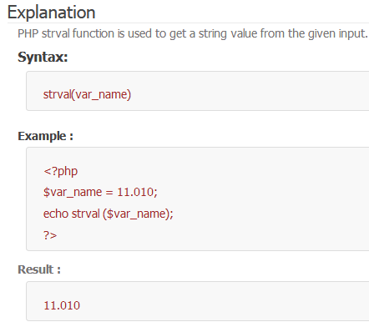

Slide 70
intval ()
intval () : PHP intval function is used to get an integer value from the given input.
<?php $var_name = “1010”; echo intval ($var_name); ?>
Result :
1010

Slide 71
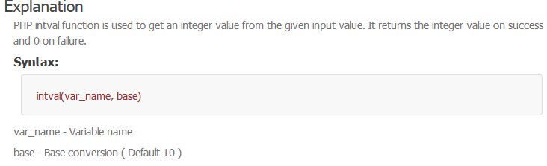

Slide 72
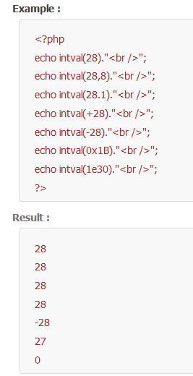

Slide 73

Take note :-

Slide 74
floatval()
floatval() : PHP floatval function is used to get a float value from the given input.
<?php $var_name = “11.11”; echo floatval ($var_name); ?>
Result :
11.11

Slide 75
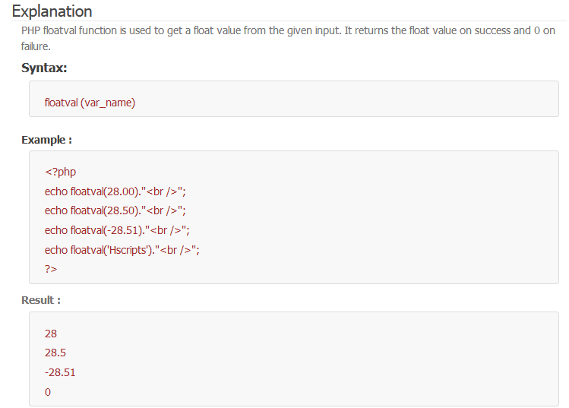

Slide 76
Automatic Type Conversion in PHP
What is automatic type conversion in PHP?
Explanation
In PHP, the variable changes from one type to another automatically, based on the value assigned to it. This is possible, as PHP is a loosely typed language. This automatic conversion happens only when the input is valid.

Slide 77
example
<?php $var1="200"+17; $var2="200"+17.1; $var3=300 ."Hscripts"; echo $var1."<br />"; echo $var2."<br />"; echo $var3."<br />";
?>

Slide 78
output
217 217.1 300Hscripts

Slide 79
Take note:-
In the above example, $var1="200"+17; converts the string "200" into an integer value, as it is given in a mathematical expression. $var2="200"+17.1; converts the string "200" into float since, it is added with a float value. $var3=300 ."Hscripts"; here the integer value 300 is converted to a string value automatically.

Slide 80
print_r()
The print_r() function is used to print value of variable or array with returns keys and elements information.
Syntax:
print_r(var_name, return_output)

Slide 81
Print_r()
The print_r() function is used to print human-readable information about a variable.
Syntax:
print_r(var_name, return_output)

Slide 82
Return value:
If the variable is an integer or a float or a string the function returns value of the variable. If the variable is an array the function returns keys and elements, a similarly notation is used for the object. Setting TRUE to return_output parameter the function returns a string

Slide 83
<?php
$var1=‘hello';
$var2=123.33;
print_r($var1);
echo'<br>';
print_r($var2);
echo'<br>'; $abc = array('Subj1'=>'Physics','Subj2'=>'Chemistry','Subj3'=>'Mathematics','Class'=>array(5,6,7,8));
print_r($abc);
?>

Slide 84
Output:-
hello
123.33
Array ( [Subj1] => Physics [Subj2] => Chemistry [Subj3] => Mathematics [Class] => Array ( [0] => 5 [1] => 6 [2] => 7 [3] => 8 ) )

Slide 85
var_dump() vs print_r()
PHP var_dump() vs print_r()
The var_dump() function displays structured information (type and value) about one or more variables.
The print_r() function displays human-readable information about a variable.

Slide 86
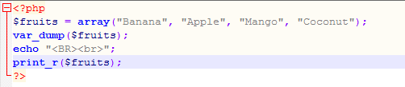
Example

Slide 87

Output

Slide 88
HTTP Request Methods: GET and POST
Two commonly used methods for a request-response between a client and server are:
GET and POST.
GET - Requests data from a specified resource
POST - Submits data to be processed to a specified resource

Slide 89
Before the browser sends the information, it encodes it using a scheme called URL encoding. In this scheme, name/value pairs are joined with equal signs and different pairs are separated by the ampersand.
name1=value1&name2=value2&name3=value3 Spaces are removed and replaced with the + character and any other nonalphanumeric characters are replaced with a hexadecimal values. After the information is encoded it is sent to the server.

Slide 90
Form of html
<form
Action=“url”
Method=“get/post” (default– get)
Name=“name of form>
>

Slide 91
Input tag:-
<input
Type=text/password/button/radio…
Name=“name of control”
Value=“value of control”
…….
>

Slide 92
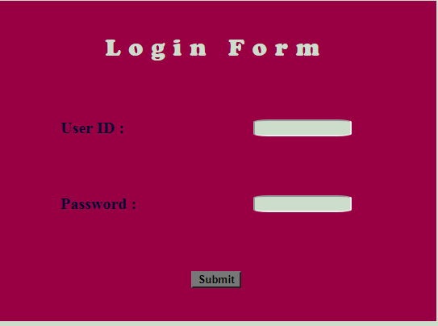

Slide 93
Simple form using get
<html>
<head>
<title>example of get method</title>
</head>
<body>
<form action="" method="post" name="f1">
user id : <input type="text" name="t1" value="atmiya"><br><br>
password : <input type="text" name="p1" value="abc"><br> <br> <br>
<input type="submit" name="sub" value="submit">
<input type="reset" name="rset">
</form>
</body>
</html>

Slide 94
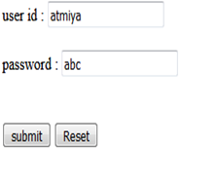
Output of form in html

Slide 95
In GET method the data is sent as URL parameters that are usually strings of name and value pairs separated by ampersands (&).
In general, a URL with GET data will look like this:
http://localhost/demo/form1.php?t1=atmiya&p1=abc&sub=submit
The bold parts in the URL are the GET parameters and the italic parts are the value of those parameters.
More than one parameter=value can be embedded in the URL by concatenating with ampersands (&). One can only send simple text data via GET method.

Slide 96
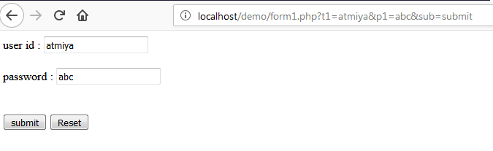
Output :- get

Slide 97
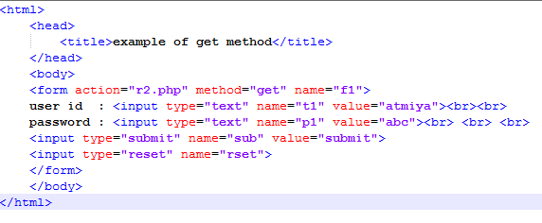
Check url at here

Slide 98

R2.php file

Slide 99
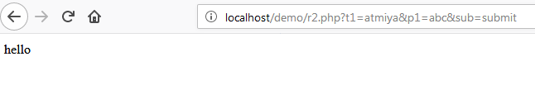
Output

Slide 100
Simple form using post
<html>
<head>
<title>example of get method</title>
</head>
<body>
<form action="" method="post" name="f1">
user id : <input type="text" name="t1" value="atmiya"><br><br>
password : <input type="text" name="p1" value="abc"><br> <br> <br>
<input type="submit" name="sub" value="submit">
<input type="reset" name="rset">
</form>
</body>
</html>

Slide 101
Post method
In POST method the data is sent to the server as a package in a separate communication with the processing script. Data sent through POST method will not visible in the URL.

Slide 102
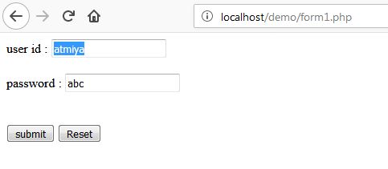
Output :- post

Slide 103
Get methods
Note that the query string (name/value pairs) is sent in the URL of a GET request:
/test/demo_form.php?name1=value1&name2=value2

Slide 104
Get methods
The GET method passes arguments from in page to the next page as a part of the URL (Uniform Resource Locator) Query String.
When used form handling, GET appends the indicated variable name and value to the URL designated in the ACTION attribute with a question mark separator.
Each item submitted via GET method is accessed in the handler via the $_GET array.(super global variable)
The GET method sends the encoded user information appended to the page request. The page and the encoded information are separated by the? Character.
http://localhost/index.php?name1=value1&name2=value2

Slide 105
Some other notes on GET requests:
GET requests can be cached
GET requests remain in the browser history
GET requests can be bookmarked
GET requests should never be used when dealing with sensitive data
GET requests have length restrictions
GET requests should be used only to retrieve data

Slide 106
Disadvantages of GET Method:
It is not suitable for login form because username & password fully visible onscreen.
Every GET submission is recorded in the Web server log, data set included.
The length of URL is limited. So limited data pass using GET method.
The GET method is restricted to send upto 1024 characters.
GET can't be used to send binary data, like images or word documents, to the server.

Slide 107
<?php
if(isset($_GET["submit"]))
{
echo "<font size=6>";
echo "value of name text box -- ".$_GET['name'];
echo "<br>";
echo "value of city text box -- ".$_GET['city'];
echo "</font>";
}
?>
<body>
<hr>
<form method="GET">
Name: <input type="text" name="name" /><br><br>
City: <input type="text" name="city" /><br><br>
<input type="submit" name="submit" value="submit"/>
<input type="reset" name="reset" />
</form> </body>

Slide 108

Using get method
? Mark is there

Slide 109
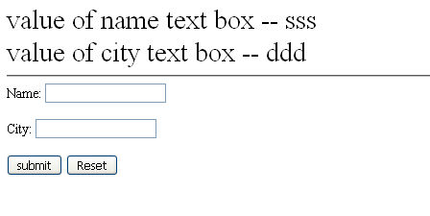
Output

Slide 110
The POST Method
Note that the query string (name/value pairs) is sent in the HTTP message body of a POST request:
POST /test/demo_form.php HTTP/1.1 Host: w3schools.com name1=value1&name2=value2

Slide 111
The POST Method
POST method is the preferred method of form submission.
The POST method does not have any restriction on data size to be sent.
The POST method can be used to send ASCII as well as binary data.
The data sent by POST method goes through HTTP header so security depends on HTTP protocol. By using Secure HTTP you can make sure that your information is secure.
The PHP provides $_POST associative array to access all the sent information using POST method.

Slide 112
Some other notes on POST requests:
POST requests are never cached
POST requests do not remain in the browser history
POST requests cannot be bookmarked
POST requests have no restrictions on data length

Slide 113
Advantages of POST method:
It is more secure then GET because user entered information is never visible in the URL.
There is a much larger limit on the amount of data that can be passed(a couple of kilobytes).

Slide 114
Disadvantages of POST method:
The result at a given moment cannot be book marked.
The result should be expired by the browser, so that an error will result if the user employs the Back button to revisit the page.
This method can be incompatible with certain firewall setups.

Slide 115
Form tag
<form
action=“url”
Method =“get/post”
Name=“name of form”
>

Slide 116
In php
<form
action="<?php echo $_SERVER["PHP_SELF"];?>“
Method =“get/post”
Name=“form1”
>

Slide 117
action="<?php echo $_SERVER["PHP_SELF"];?>“
It means server gives respond in same url means in same page of php which you are accessing
$_SERVER – Super global variable and [“PHP_SELF” is value

Slide 118
<?php
if(isset($_POST["submit"]))
{
echo "<font size=6>";
echo "value of name text box -- ".$_POST['name'];
echo "<br>";
echo "value of city text box -- ".$_POST['city'];
echo "</font>";
}
?>
<body>
<hr>
<form method="POST“action="<?php echo $_SERVER["PHP_SELF"];?>" >
Name: <input type="text" name="name" /><br><br>
City: <input type="text" name="city" /><br><br>
<input type="submit" name="submit" value="submit"/>
<input type="reset" name="reset" />
</form>
</body>

Slide 119

Post method

Slide 120
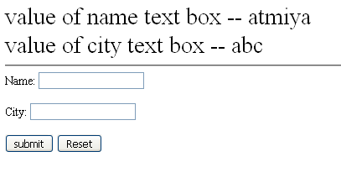
Output

Slide 121
The $_REQUEST variable
The PHP $_REQUEST variable contains the contents of both $_GET, $_POST, and $_COOKIE.
The PHP $_REQUEST variable can be used to get the result from form data sent with both the GET and POST methods.

Slide 122
<!DOCTYPE html>
<html l>
<head>
<title>Example of PHP $_REQUEST variable</title>
</head>
<body>
<?php
if(isset($_REQUEST["name"])){
echo "<p>Hi, " . $_REQUEST["name"] . "</p>";
}
?>
<form method="post" action="<?php echo $_SERVER["PHP_SELF"];?>">
<label for="inputName">Name:</label>
<input type="text" name="name" id="inputName">
<input type="submit" value="Submit">
</form> </body>

Slide 123
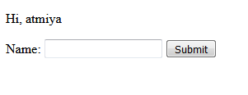
output

Slide 124
Note:-
The superglobal variables $_GET, $_POST and $_REQUEST are built-in variables that are always available in all scopes throughout a script.

Slide 125
How HTML forms work
A web form has two parts: the HTML ‘front end’ and a back end form processor. The HTML front end part handles the presentation while the back end handles the form submissions (like saving the form submissions, sending emails etc).
The back end form processor script is usually written in languages like PHP, ASP or Perl.
The image below illustrates the concept:

Slide 126
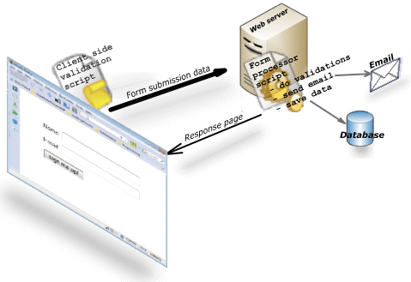

Slide 127
A visitor visits a web page that contains a form.
The web browser displays the HTML form.
The visitor fills in the form and submits
The browser sends the submitted form data to the web server
A form processor script running on the web server processes the form data
A response page is sent back to the browser.

Slide 128
QUESTION BANK
Question for [1] mark
<!-- -- > is valid tags of PHP code block(true/false).
Which delimiter is used in ASP style?
Variable Of PHP is start with ______ sign.
List out comments of PHP .
List out scalar/compound/special data types.

Slide 129
QUESTION BANK
Question for [1] mark
Which function is used to define constant?
Which function is used to return value of constant?
Use of unset()/isset() in PHP.
Which function is used to return type of variable?
Use of intval()/floatval() in PHP.
Take note :- like this Any variable function can be asked..

Slide 130
QUESTION BANK
Question for [5] mark
Explain about variables
Write a naming rules of variables
Write a brief note on constants
What is a comment? Explain different ways to use comments in PHP.
Write different escape sequence replacement with string .

Slide 131
QUESTION BANK
Explain how HTML form can work?
Question for [5] mark
Difference between following
Get / post
Echo / print
constants / variables

Slide 132
QUESTION BANK
Question for [7] mark
Explain in detail all data types of PHP.
Explain testing and manipulation variable function
Explain get and post methods with request variable.
Write a detail note on scope of variable.

