Slide 1
Operators in PHP
Chapter:-1

Slide 2
Topics to be covered
Operators and its types
Types of operators in PHP
1) Arithmetic Operators
2) Comparison Operators
3) Logical (or Relational) Operators
4) Assignment Operators
5) Conditional (or ternary) Operators
6) String Operators
7) Increment / Decrement Operators

Slide 3
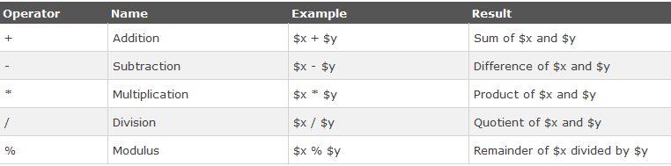
1) Arithmetic Operators

Slide 4
Ex: Arithmetic Operators
<?php
$x=10;
$y=6;
echo ($x + $y); // outputs 16
echo ($x - $y); // outputs 4
echo ($x * $y); // outputs 60
echo ($x / $y); // outputs 1.6666666666667
echo ($x % $y); // outputs 4
?>

Slide 5
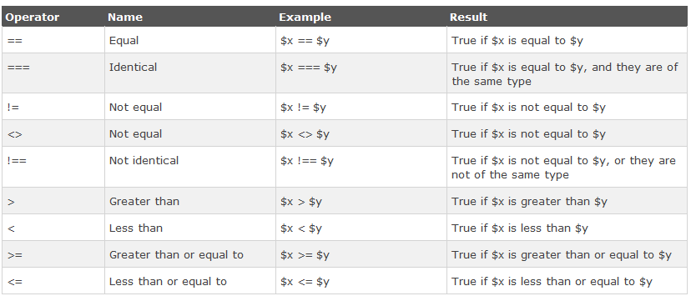
2) Comparison Operators

Slide 6
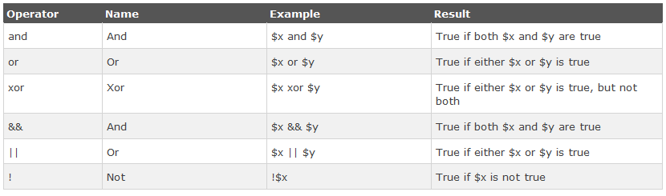
3) Logical (or Relational) Operators

Slide 7
Assignment operators
Assignment operators allow writing a value to a variable.
The first operand must be a variable and the basic assignment operator is "=". The value of an assignment expression is the final value assigned to the variable.
In addition to the regular assignment operator "=", several other assignment operators are composites of an operator followed by an equal sign.

Slide 8
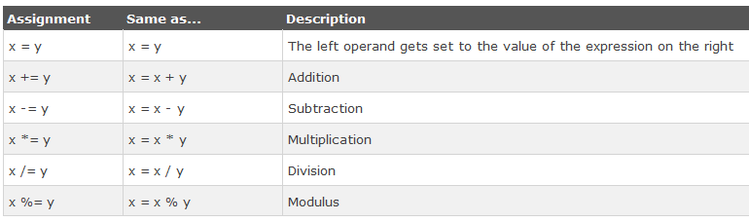
4) Assignment Operators

Slide 9
Ex: Assignment Operators
<?php
$x=10;
echo $x; // outputs 10
$y=20;
$y += 100;
echo $y; // outputs 120
$z=50;
$z -= 25;
echo $z; // outputs 25

Slide 10
$i=5;
$i *= 6;
echo $i; // outputs 30
$j=10;
$j /= 5;
echo $j; // outputs 2
$k=15;
$k %= 4;
echo $k; // outputs 3
?>

Slide 11
CONDITIONAL (OR TERNARY) OPERATORS
The ternary or conditional operator is a quick way to construct if/else comparison operations, and it can often reduce four or more lines of code into one short statement.
The ternary operator is really an alternate (or even shorthand) way of writing if/else comparison operations
SYNTAX:
The ternary operator in PHP consists of three expressions: a condition, and two operands that describe what action should be taken if the condition is true or false
$variable = (condition ) ? true : false;

Slide 12

5) Conditional (or ternary) Operators

Slide 13
Ex: Ternary Operators
<?php
$a = 10;
$b = 20;
/* If condition is true then assign a to result otheriwse b */
$result = ($a > $b ) ? $a :$b;
echo “ Value of result is Big ➔ $result";
?>

Slide 14
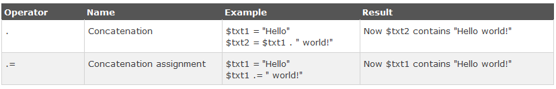
6) String Operators

Slide 15
Ex: String Operators
<?php
$a = "Hello";
$b = $a . " world!";
echo $b; // outputs Hello world!
$x="Hello";
$x .= " world!";
echo $x; // outputs Hello world!
?>

Slide 16
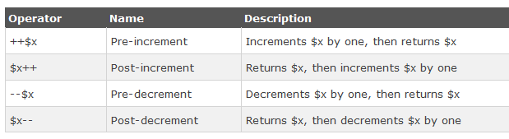
7) Increment / Decrement Operators

Slide 17
Ex:
<?php
$x=10;
echo ++$x; // outputs 11
$y=10;
echo $y++; // outputs 10
$z=5;
echo --$z; // outputs 4
$i=5;
echo $i--; // outputs 5
?>

Slide 18
QUESTION BANK
Write a note on ALL operators of PHP [7] MARK
or
List out all and explain any two operator in detail . [5] MARK
List out all aerithmetic/…(like any operator) operator with symbol , name and description. [1] MARK

Slide 19
Take note :-
Any symbol of operator use of operator and output of that can be asked in one marks

