Slide 1
Deep Q learning

Slide 2
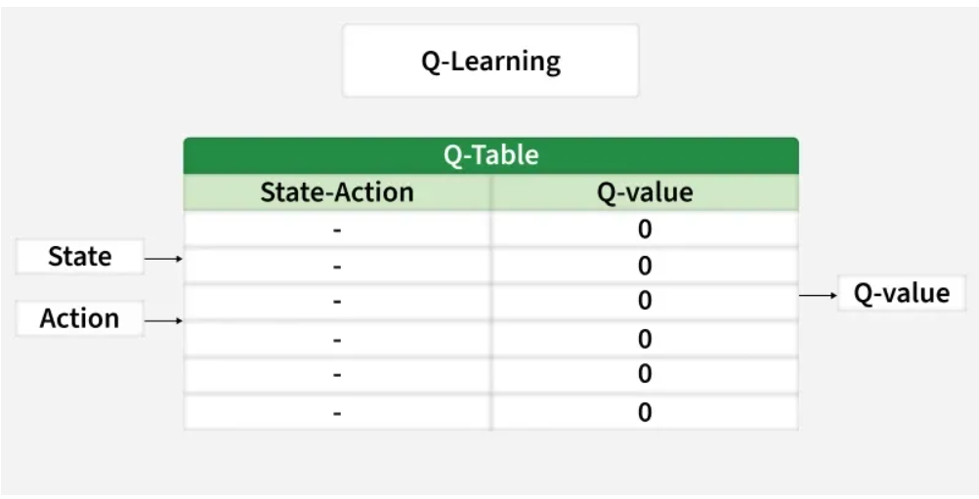
Deep Q-Learning is a method that uses deep learning to help machines make decisions in complicated situations. It’s especially useful in environments where the number of possible situations called states is very large like in video games or robotics.
Before understanding Deep Q-Learning it’s important to understand the main concept of Q-Learning. It is a model-free method that learns an optimal policy by estimating the Q-value function which tells how good it is to take a certain action in a certain situation. The goal is to find a plan that gives the highest total reward over time.

Slide 3
Q-Learning works well for small problems but struggles with complex ones like images or many possible situations. Deep Q-Learning solves this by using a neural network to estimate values instead of a big table.
Key Challenges Addressed by Deep Q-Learning
High-Dimensional State Spaces: Traditional Q-Learning uses a table to store values but this becomes impossible when there are too many situations. Neural networks can understand and work with many different situations at once so they are better for complex problems.
Continuous Input Data: Real-world problems often have continuous data like video images. Neural networks are good at handling this kind of information.
Scalability: Deep learning helps Q-Learning grow and handle bigger, harder tasks that regular Q-Learning couldn’t solve before.

Slide 4
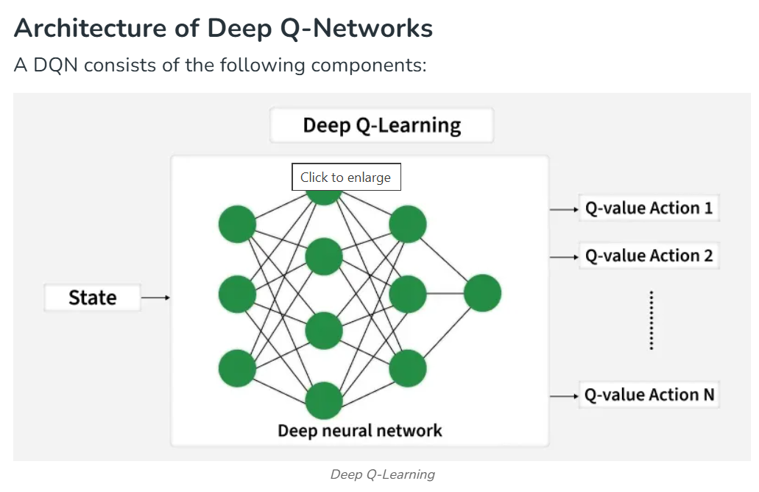

Slide 5
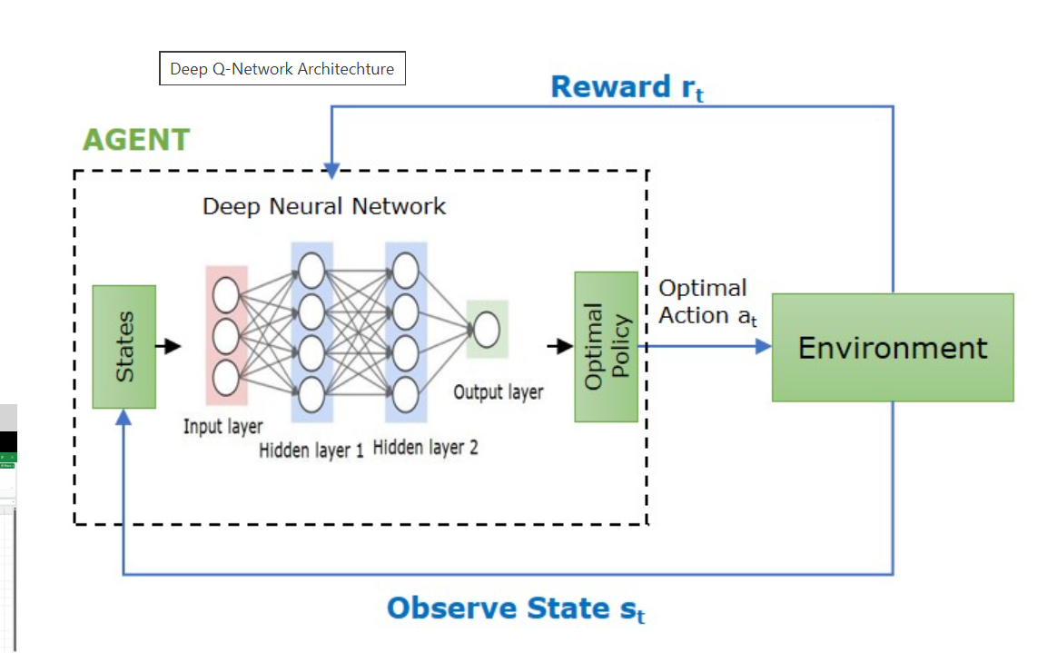

Slide 6
How Deep Q-Networks Work?
The working of DQN involves the following steps −
Neural Network Architecture −
The DQN uses a sequence of frames (such as images from a game) for input and generates a set of Q-values for every potential action at that particular state. the typical configuration includes convolutional layers for spatial relationships and fully connected layers for Q-values output.
In traditional Q-learning, we use a Q-table to store Q-values (state-action values).
For environments with large or continuous state spaces, a Q-table is impossible to maintain.
DQN replaces the Q-table with a neural network that takes the current state as input and outputs Q-values for all possible actions.

Slide 7
Experience Replay
While training, the agent stores its interactions (state, action, reward, next state) in a replay buffer. Sampling random batches from this buffer trains the network, reducing correlation between consecutive experiences and improve training stability.

Slide 8
Target Network
In order to stabilize the training process, Deep Q-Networks employ a distinct target network for producing Q-value targets. the target network receives regular updates of weighs from the main network to minimize divergence risk while training.
Epsilon-Greedy Policy
The agent uses an epsilon-greedy strategy, where it selects a random action with probability ${\epsilon}$ and the action with highest Q-value with probability ${1- \epsilon}$. This balance between exploration and exploitation helps the agent learn effectively.
Training Process
The neural network is trained using gradient descent to minimize the loss between the predicted Q-values and the target Q-values. The target Q-values are calculated using the Bellman equation, which incorporates the reward received and the maximum Q-value of the nect state.

Slide 9
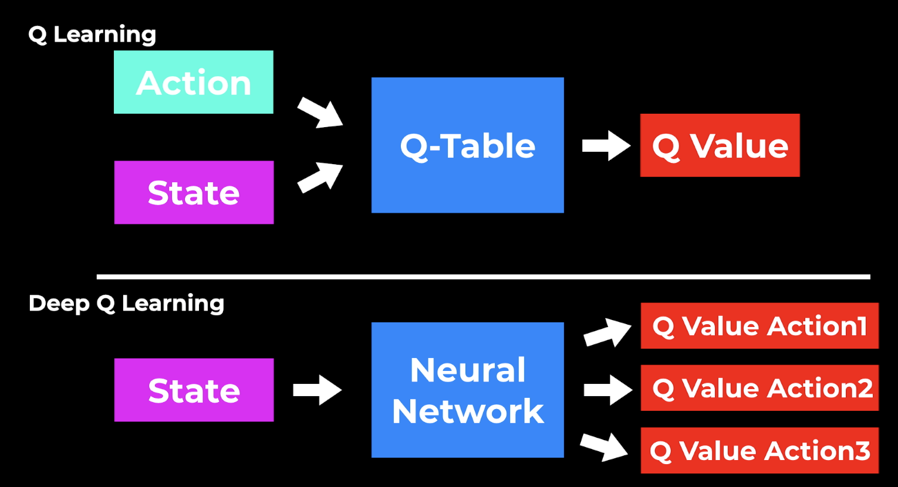
Deep Q Learning
Deep Q Learning uses the Q-learning idea and takes it one step further. Instead of using a Q-table, we use a Neural Network that takes a state and approximates the Q-values for each action based on that state.

Slide 10
The deep Q-learning model breaks the chain in order to find the optimal Q-value function. It determines this by combining Q-learning and a neural network. The uses of the deep Q-learning algorithm can be stated as finding the input and the optimal Q-value for all possible actions as the output.
We do this because using a classic Q-table is not very scalable. It might work for simple games, but in a more complex game with dozens of possible actions and game states the Q-table will soon get complex and cannot be solved efficiently anymore.
use a Deep Neural Network that gets the state as input, and produces different Q values for each action
Then again we choose the action with the highest Q-value. The learning process is still the same with the iterative update approach, but instead of updating the Q-Table, here we update the weights in the neural network so that the outputs are improved.

Slide 11
What are the steps involved in reinforcement learning using deep Q-learning networks (DQNs)?
All the past experience is stored by the user in memory.
The next action is determined by the maximum output of the Q-network.
The loss function here is mean squared error of the predicted Q-value and the target Q-value – Q*. This is basically a regression problem.
However, we do not know the target or actual value here as we are dealing with a reinforcement learning problem. Going back to the Q-value update equation derived fromthe Bellman equation. we have:

Slide 12
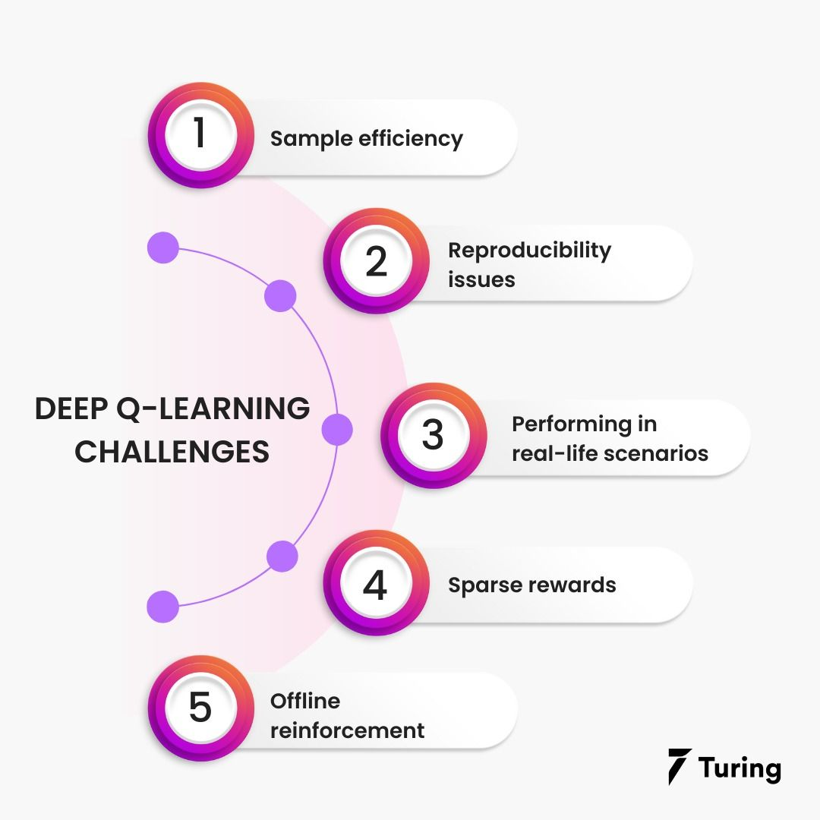
Challenges in deep Q-learning

Slide 13
Sample efficiency
Finding an optimal and efficient way of learning from a limited number of samples is one of the critical challenges of reinforcement learning.
The sample efficiency refers to an algorithm that optimizes the given sample to its maximum extent. It also refers to the amount of experience that an algorithm must develop during training to perform efficiently. A lot of time is required for the RL system to be efficient.
For example, AlphaGo Zero beat the world champion after playing five million Go games.

Slide 14
Real-Life Example (Easy to Understand)
Example 1: Learning to Ride a Bicycle
Imagine two children learning to ride a bicycle.
Child A:
Learns balance after 5–6 attempts
Quickly understands how to pedal and steer
This child is sample efficient (learns from few experiences).
Child B:
Falls 200 times
Takes weeks to learn balance
This child is not sample efficient (needs many experiences).
Reinforcement learning works like Child B in many cases — it needs thousands or millions of tries to learn.

Slide 15
Reproducibility issues
When trying to replicate DeepMind's AlphaZero, Facebook researchers said: “When combined with the unavailability of code and models, the result is that the approach is very difficult, if not impossible, to reproduce, study, improve upon, and extend.”
Neuronal networks are so difficult to understand that even their creators don't fully comprehend them. They are also becoming increasingly complex, supported by large datasets, powerful computers, and many hours of training.
Recent years have seen an increase in AI efforts to resolve the so-called reproducibility crisis. As a result of this crisis, AI researchers report algorithm runs selectively or produce idealized results using GPU power.

Slide 16
Real-Life Example
Imagine this situation:
Baking Competition Example
A famous chef wins a baking competition with a “perfect chocolate cake.”
He publishes the recipe but:
Does not mention exact oven temperature calibration
Does not mention humidity conditions
Uses a special imported ingredient not easily available
Uses a professional oven worth $50,000
Now you try to bake the same cake at home.
Even if you follow the recipe exactly:
Your cake tastes different
Texture is slightly off
It doesn’t look the same
You wonder: “Is the recipe incomplete?” “Did the chef leave out details?” “Is my oven the problem?”
That is exactly what happens with AI reproducibility.

Slide 17
Real AI Example
Suppose a research lab publishes a paper saying:
“Our new AI model achieves 99% accuracy.”
But:
They trained it on 8 high-end GPUs
They ran 20 experiments but only reported the best result
They tuned hyperparameters for weeks
They did not release the training code
Another university tries:
They only have 1 GPU
They follow the paper exactly
They get 91% accuracy
Now they cannot reproduce the claimed result.
This creates:
Lack of trust
Difficulty improving the method
Wasted research effort
AI reproducibility crisis = "Only the original lab can reliably get the published results."

Slide 18
Performing in real-life scenarios
In Reinforcement Learning (RL), agents are usually trained in artificial or simulated environments because:
They can fail safely.
They can try millions of times.
There is no real-world damage.
But in real life:
Mistakes can be dangerous.
The environment is complex.
The agent may face situations it has never seen before.
This difference between simulation and real world is called the reality gap.

Slide 19
Real-Life Example 1: Self-Driving Car
Imagine training a self-driving car in a computer simulation.
In Simulation:
The car crashes → No problem.
It restarts and tries again.
It practices millions of times.
In Real Life:
One wrong decision → Real accident.
People can get injured.
Property can be damaged.
The simulation might not perfectly copy:
Weather conditions
Road damage
Unexpected pedestrian behavior
So when the car moves from simulation to real roads, it may struggle. This difference is the reality gap.

Slide 20
Real-Life Example 2: Training a Robot to Pick Objects
Suppose a robot is trained in a lab to pick up a cup.
In Simulation:
Cups are always in perfect position.
Lighting is ideal.
No noise or distractions.
In Real World:
Cup may be tilted.
Lighting may change.
The table may be messy.
The robot may fail because real life is more unpredictable

Slide 21
Sparse rewards
The agent receives rewards very rarely, only after completing a major task — not during the process.
Because rewards are infrequent, the agent may struggle to understand:
Which actions were correct
What led to success
How to improve step by step
There are some limitations to the reward technique discussed earlier. Due to the sparse distribution of rewards in the environment, an agent may not pay enough attention to the situation to notice rewards and maximize specific actions.
This can also occur when the environment fails to provide rewards on time. For instance, in many cases, green flags are only shown when an agent is close enough to a target.

Slide 22
Real-Life Example 1: Learning to Drive
Suppose a driving instructor says:
“You will only know if you did well after the entire 1-hour drive.”
No feedback during:
Lane changing
Braking
Turning
Parking
At the end, instructor says: “You failed.”
Now the learner doesn’t know:
Which mistake caused failure?
What to improve?
This is sparse reward.

Slide 23
Offline reinforcement
Training an AI agent using a fixed dataset collected from past experiences — without interacting with the environment during learning.
This is different from online RL, where the agent learns by continuously exploring and trying actions in the environment.
In real-time reinforcement learning, as the agent learns from new experiences, offline reinforcement learning relies on logging information without interacting with the environment. As a result, AI agents no longer need to get trained repeatedly to scale.
The challenge remains that if the model trained from an existing dataset or behaves differently than the data collection agent, the reward is not determined.

Slide 24
Real-Life Example: Learning to Drive Using Recorded Videos
Online RL (Real-Time Learning):
A learner practices driving in a car.
Makes decisions and learns from every turn, brake, and accident.
Learns by direct interaction with the road.
Offline RL:
The learner studies thousands of hours of driving videos recorded by expert drivers.
No actual driving happens during training.
Learner tries to understand good and bad driving patterns from past data.
Later applies learned knowledge in real driving.

Slide 25
The future of deep Q-learning
Deep learning has proved to be capable of simulating real-world environments. As a result, it has the potential to solve a wide range of problems that machines have had difficulty tackling up until now. Combining deep learning with RL will help us solve these problems much faster.
There are many future applications of reinforcement learning, including:
Automated trading of stocks and options
Self-driving cars
Smart traffic signals
Automated robots
Automated factory.

Slide 26
Applications
Deep Q-Learning is used in many areas such as:
Atari Games: It can learn to play old video games very well even better than humans by looking at the screen pixels.
Robotics: It helps robots to learn how to pick objects, move around and do tasks with their hands.
Self-Driving Cars: It helps cars to make decisions like changing lanes and avoiding obstacles safely.
Finance: It is used to find the best ways to trade stocks, manage money and reduce risks.
Healthcare: It helps with planning treatments, discovering new medicines and personalizing care for patients.

