Slide 1
Introduction to Reinforcement Learning

Slide 2
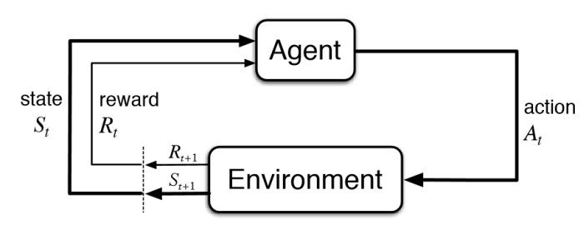
Reinforcement Learning is a part of machine learning. Here, agents are self-trained on reward and punishment mechanisms. It’s about taking the best possible action or path to gain maximum rewards and minimum punishment through observations in a specific situation. It acts as a signal to positive and negative behaviors. Essentially an agent (or several) is built that can perceive and interpret the environment in which is placed, furthermore, it can take actions and interact with it.

Slide 3
It is a type of machine learning technique where a computer agent learns to perform a task through repeated trial and error interactions with a dynamic environment. This learning approach enables the agent to make a series of decisions that maximize a reward metric for the task without human intervention and without being explicitly programmed to achieve the task.
Simplified Definition of Reinforcement Learning:
Through a series of Trial and Error methods, an agent keeps learning continuously in an interactive environment from its own actions and experiences. The only goal of it is to find a suitable action model which would increase the total cumulative reward of the agent. It learns via interaction and feedback.

Slide 4
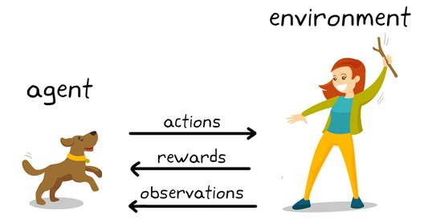
Explanation to Reinforcement Learning
You can see a dog and a master. Let’s imagine you are training your dog to get the stick. Each time the dog gets a stick successfully, you offered him a feast (a bone let’s say). Eventually, the dog understands the pattern, that whenever the master throws a stick, it should get it as early as it can to gain a reward (a bone) from a master in a lesser time.

Slide 5
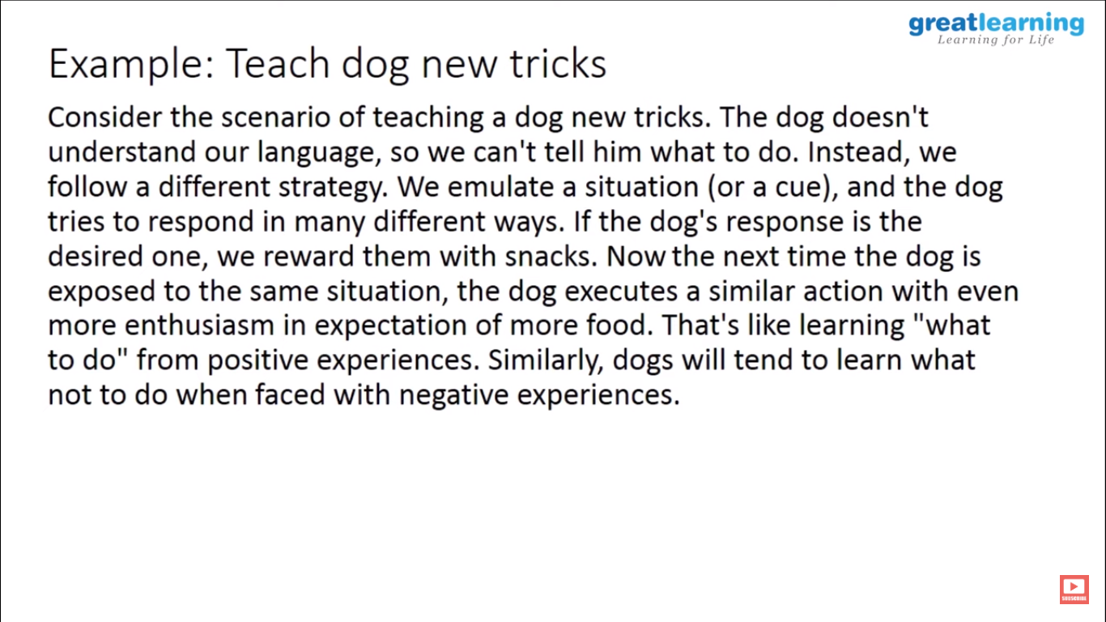

Slide 6
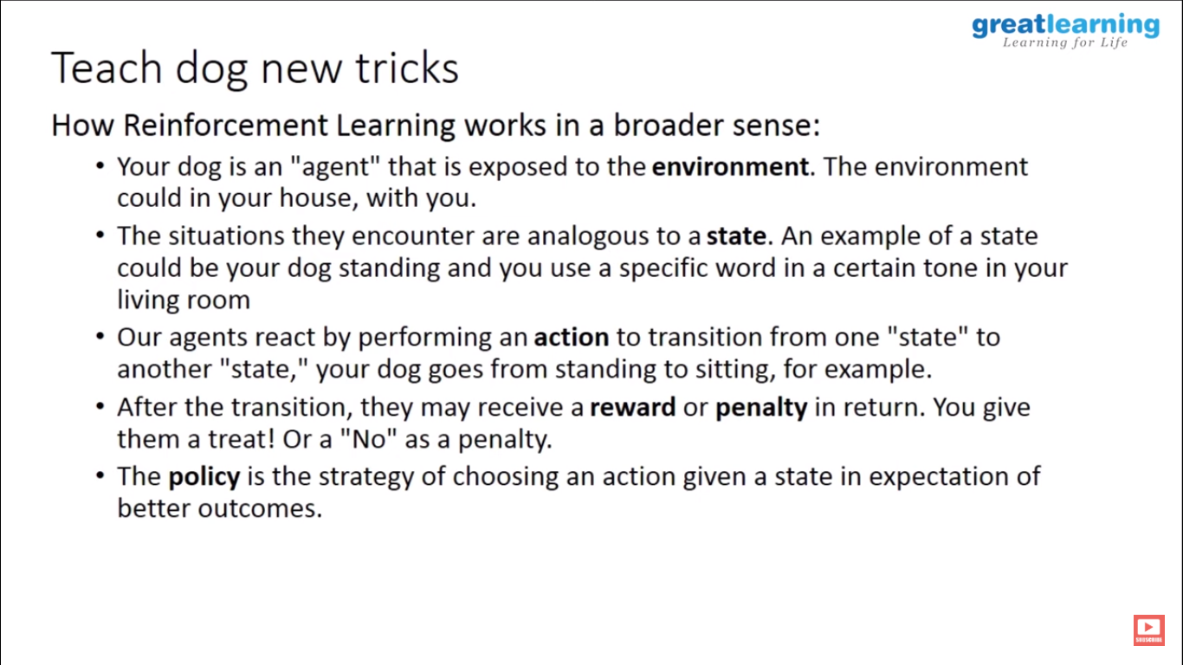

Slide 7
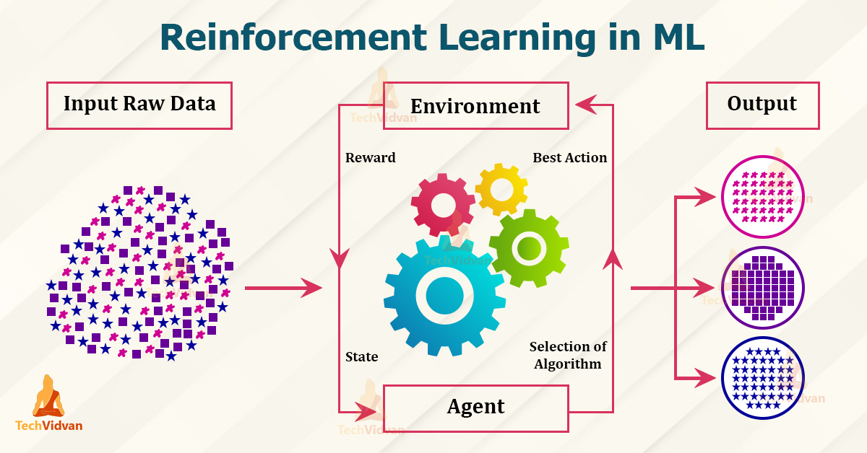
Terminologies used in Reinforcement Learning

Slide 8
Agent – is the sole decision-maker and learner
Environment – a physical world where an agent learns and decides the actions to be performed
Action – a list of action which an agent can perform
State – the current situation of the agent in the environment
Reward – For each selected action by agent, the environment gives a reward. It’s usually a scalar value and nothing but feedback from the environment
Policy – the agent prepares strategy(decision-making) to map situations to actions.
Value Function – The value of state shows up the reward achieved starting from the state until the policy is executed
Model – Every RL agent doesn’t use a model of its environment. The agent’s view maps state-action pairs probability distributions over the states

Slide 9

Reinforcement Learning Workflow
-Create the Environment
– Define the reward
– Create the agent – Train and validate the agent
– Deploy the policy

Slide 10
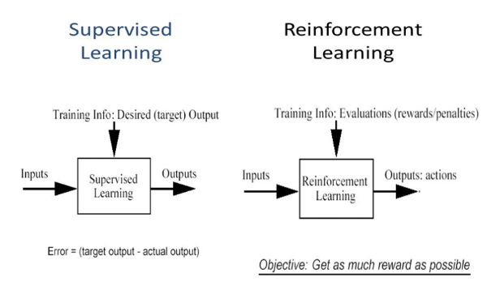
How is reinforcement learning different from supervised learning?
In supervised learning, the model is trained with a training dataset that has a correct answer key. The decision is done on the initial input given as it has all the data that’s required to train the machine. The decisions are independent of each other so each decision is represented through a label. Example: Object Recognition

Slide 11
Basis | Supervised Learning | Reinforcement Learning
Definition | Learns from a labeled dataset (input–output pairs). | Learns by interacting with an environment using rewards and penalties.
Training Data | Given in advance with correct answers (labels). | No labeled data; feedback comes as reward or punishment.
Goal | Minimize error between predicted and actual output. | Maximize cumulative (long-term) reward.
Learning Method | Learns a direct mapping: input → output. | Learns a policy: state → action.
Feedback Timing | Immediate and exact. | Often delayed and indirect.
Human Role | Human provides correct outputs. | Environment provides rewards.
Examples (Algorithms) | Linear Regression, Decision Trees, SVM, Neural Networks. | Q-Learning, SARSA, DQN, Policy Gradient.
Real-life Example | Email spam detection using labeled emails. | Robot learning to walk, game-playing AI.

Slide 12
Basis | Unsupervised Learning | Reinforcement Learning
Definition | Learns patterns from unlabeled data without any predefined output. | Learns by interacting with an environment using rewards and penalties.
Data Type | Only input data, no correct answers. | No dataset in advance; learning happens through experience.
Goal | Discover hidden structure/patterns in data. | Maximize cumulative (long-term) reward.
Feedback | No feedback (no reward/penalty). | Reward signal guides learning.
Output | Clusters, associations, reduced features. | Policy (best actions), value function.
Environment | Static dataset. | Dynamic environment.
Examples (Algorithms) | K-means, Hierarchical clustering, DBSCAN, Apriori, PCA. | Q-Learning, SARSA, DQN, PPO.
Real-life Example | Customer segmentation in marketing. | Robot learning to walk, game-playing AI.

Slide 13
In reinforcement learning, there isn’t any answer and the reinforcement agent decides what to be done to perform the required task. As the training dataset isn’t available, the agent had to learn from its experience. It’s all about compiling the decisions in a sequential manner. To be said in simpler words, the output relies on the current input state and the next input relies on the output of the previous input. We give labels to the sequence of dependent decisions. Decisions are dependent. Example: Chess Game

Slide 14
Characteristics of Reinforcement Learning
– No supervision, only a real value or reward signal
– Decision making is sequential
– Time plays a major role in reinforcement problems
– Feedback isn’t prompt but delayed
– The following data it receives is determined by the agent’s actions

Slide 15
Challenges of Reinforcement Learning
Although Reinforcement Learning (RL) is a powerful approach, applying it to real-world problems involves several significant challenges.
1. Exploration vs. Exploitation Trade-off
An agent must choose between exploring new actions to discover better rewards and exploiting known actions that already give good results. Balancing these two is difficult; too much exploration slows learning, while too much exploitation may lead to sub-optimal solutions.
2. Sparse and Delayed Rewards
In many environments, rewards are infrequent or received only after a long sequence of actions. This makes it hard for the agent to identify which actions were responsible for success or failure. Like in chess.
3. Large State and Action Space
Real-world problems often involve a huge number of possible states and actions (for example, robotics or autonomous driving). This increases computational complexity and makes learning slow and resource-intensive.

Slide 16
4. Sample Inefficiency
Reinforcement learning usually requires a very large number of interactions with the environment. In real systems, collecting such data can be expensive, time-consuming, or unsafe.
5. Training Instability and Convergence Issues
Many RL algorithms, especially those using deep neural networks, can be unstable. They may oscillate, diverge, or fail to converge to an optimal solution.
6. Reward Design Problem
Designing an appropriate reward function is difficult. A poorly designed reward can lead the agent to learn unintended or harmful behaviors.
simple example (robot):
If a cleaning robot is rewarded only for “collecting trash,” it may knock objects onto the floor just to collect more trash and increase reward.
7. Safety and Ethical Issues
During learning, agents may take dangerous actions that can damage equipment, systems, or even endanger humans. Ensuring safe learning is a major challenge.
(robot girna, system crash, human risk).

Slide 17
Applications of Reinforcement Learning
Reinforcement Learning (RL) is widely used in problems where an agent must make a sequence of decisions and learn from interaction with the environment. Some important applications are:
1. Robotics and Automation
RL is used to train robots to perform tasks such as walking, picking objects, assembling parts, and navigating environments. The robot learns optimal actions through trial and error.
Examples: robotic arms in factories, warehouse robots
2. Game Playing and Simulations
RL has achieved great success in games by learning strategies that maximize winning chances.
Examples: AlphaGo (Go game), chess engines, Atari game agents.

Slide 18
3. Autonomous Vehicles
Self-driving cars use RL to learn lane changing, speed control, obstacle avoidance, and decision-making in traffic.
Examples: route planning, parking systems.
4. Recommendation Systems
RL is used to recommend products, movies, or videos by learning user preferences over time.
Examples: Netflix recommendations, YouTube video suggestions, online ads.
5. Healthcare
RL helps in optimizing treatment strategies and personalized medicine.
Examples: drug dosage control, treatment planning, hospital resource management.

Slide 19
6. Finance and Trading
RL is applied to portfolio management, automated trading, and risk optimization.
Examples: stock trading bots, fraud detection strategies.
7. Resource Management and Scheduling
RL is used to optimize the use of limited resources.
Examples: traffic signal control, network routing.
8. Natural Language and Dialogue Systems
RL improves conversational agents by optimizing responses based on user feedback.
Examples: chatbots, virtual assistants, customer support systems.

Slide 20
Healthcare Applications of Reinforcement Learning (In Detail)
Reinforcement Learning (RL) is increasingly being used in healthcare to support clinical decision-making, optimize treatments, and improve hospital operations. Unlike traditional machine learning, RL focuses on sequential decision problems, which are very common in medical practice.
1. Personalized Treatment and Drug Dosage Optimization
Every patient responds differently to treatment. RL can learn an optimal treatment policy by continuously observing a patient’s condition and adjusting medication accordingly.
States: patient health indicators (blood pressure, glucose level, heart rate, lab reports)
Actions: choice of drug, dosage level, treatment timing
Reward: patient improvement, recovery rate, fewer side effects
📌 Example:
In diabetes care, an RL system can suggest insulin dosage based on real-time glucose levels to keep them within a healthy range.
Benefit: personalized medicine, fewer complications, faster recovery.

Slide 21
2. Disease Diagnosis and Clinical Decision Support
RL can assist doctors in choosing the best diagnostic or treatment steps over time.
It learns which sequence of tests and treatments leads to better patient outcomes.
It can reduce unnecessary tests and improve early detection.
📌 Example:
In cancer treatment, RL can help decide the optimal sequence of chemotherapy, radiation, and rest periods to maximize effectiveness and minimize side effects.
Benefit: improved survival rates, optimized treatment paths.
🔹 3. Robotic Surgery and Medical Robotics
RL is used to train surgical robots and rehabilitation robots.
Robots learn precise movements through trial and feedback.
RL improves accuracy, stability, and safety.
📌 Example:
Robotic arms learning how to assist in minimally invasive surgery or help patients relearn walking after paralysis.
Benefit: higher precision, reduced surgical errors, faster patient recovery.

Slide 22
4. Patient Monitoring and ICU Decision Support
In Intensive Care Units (ICUs), patients’ conditions change rapidly. RL models can help in making real-time decisions.
States: vital signs, oxygen level, organ function
Actions: ventilator settings, fluid administration, medication changes
Reward: patient stabilization, reduced mortality risk
📌 Example:
RL systems can recommend how to adjust ventilator pressure or sepsis treatment strategies.
Benefit: early intervention, reduced human error, better survival outcomes.
🔹 5. Hospital Resource and Workflow Optimization
RL is also used at the hospital management level.
Optimizes bed allocation, staff scheduling, and emergency room operations.
Reduces waiting time and improves patient flow.
📌 Example:
An RL model can learn to dynamically assign ICU beds or schedule doctors based on patient inflow patterns.
Benefit: lower costs, better efficiency, improved patient care quality.

Slide 23
6. Mental Health and Digital Therapeutics
RL-based apps adapt therapy techniques based on patient behavior and progress.
📌 Example:
Mental health chatbots that personalize cognitive behavioral therapy (CBT) sessions depending on user responses.
Benefit: personalized care, continuous support, improved engagement.

