Slide 1
Markov Decision Process
Dr. Sonali Goyal

Slide 2
In a typical Reinforcement Learning (RL) problem, there is a learner and a decision maker called agent and the surrounding with which it interacts is called environment.
The environment, in return, provides rewards and a new state based on the actions of the agent. So, in reinforcement learning, we do not teach an agent how it should do something but presents it with rewards whether positive or negative based on its actions.
So our root question is how we formulate any problem in RL mathematically. This is where the Markov Decision Process(MDP) comes in.
The Agent-Environment relationship
Markov Property
Markov Process and Markov chains
Markov Reward Process (MRP)
Bellman Equation
Markov Reward Process

Slide 3
The Agent-Environment Relationship
Agent : Software programs that make intelligent decisions and they are the learners in RL. These agents interact with the environment by actions and receive rewards based on there actions.
Environment :It is the demonstration of the problem to be solved. Now, we can have a real-world environment or a simulated environment with which our agent will interact.

Slide 4
State : This is the position of the agents at a specific time-step in the environment. So, whenever an agent performs an action the environment gives the agent reward and a new state where the agent reached by performing the action.
Anything that the agent cannot change arbitrarily is considered to be part of the environment. In simple terms, actions can be any decision we want the agent to learn and state can be anything which can be useful in choosing actions. We do not assume that everything in the environment is unknown to the agent,
for example, reward calculation is considered to be the part of the environment even though the agent knows a bit on how it’s reward is calculated as a function of its actions and states in which they are taken.
This is because rewards cannot be arbitrarily changed by the agent. Sometimes, the agent might be fully aware of its environment but still finds it difficult to maximize the reward as like we might know how to play Rubik’s cube but still cannot solve it. So, we can safely say that the agent-environment relationship represents the limit of the agent control and not it’s knowledge.

Slide 5
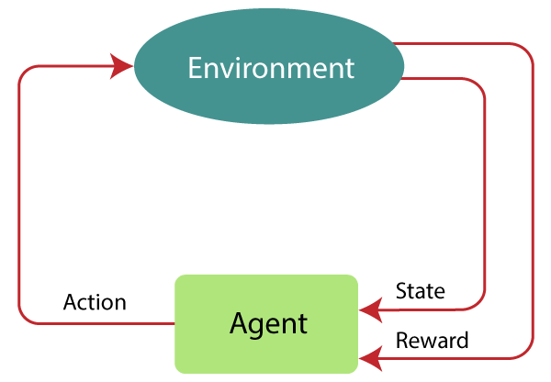
Markov Decision Process
Markov Decision Process or MDP, is used to formalize the reinforcement learning problems. If the environment is completely observable, then its dynamic can be modeled as a Markov Process. In MDP, the agent constantly interacts with the environment and performs actions; at each action, the environment responds and generates a new state.

Slide 6
Reinforcement Learning is a type of Machine Learning. It allows machines and software agents to automatically determine the ideal behavior within a specific context, in order to maximize its performance. Simple reward feedback is required for the agent to learn its behavior; this is known as the reinforcement signal.
There are many different algorithms that tackle this issue. As a matter of fact, Reinforcement Learning is defined by a specific type of problem, and all its solutions are classed as Reinforcement Learning algorithms. In the problem, an agent is supposed to decide the best action to select based on his current state. When this step is repeated, the problem is known as a Markov Decision Process.

Slide 7
MDP contains a tuple of four elements (S, A, P_{a}, R_{a}):
A set of finite States S
A set of finite Actions A
Rewards received after transitioning from state S to state S', due to action a.
Probability P_{a}.
MDP uses Markov property
Markov Property:
It says that "If the agent is present in the current state S1, performs an action a1 and move to the state s2, then the state transition from s1 to s2 only depends on the current state and future action and states do not depend on past actions, rewards, or states.“
Or, in other words, as per Markov Property, the current state transition does not depend on any past action or state. Hence, MDP is an RL problem that satisfies the Markov property. Such as in a Chess game, the players only focus on the current state and do not need to remember past actions or states.
.

Slide 8
Finite MDP:
A finite MDP is when there are finite states, finite rewards, and finite actions. In RL, we consider only the finite MDP.
Markov Process:
Markov Process is a memory less process with a sequence of random states S₁, S₂, ....., S_{t} that uses the Markov Property. Markov process is also known as Markov chain, which is a tuple (S, P) on state S and transition function P. These two components (S and P) can define the dynamics of the system.

Slide 9

The Markov Chain
As mentioned above, states are presented to the agent by the environment. These states change based on transition probabilities underlying the environment. The state space, consisting of all possible states, is completely visible to the agent and must be finite for the finite MDP. Be a state space S given with S= [s1,s2,s3]. Thus a sequence of states observed by the agent describes the Markov process or Markov chain. For example the chain of states: s1, s3, s3, s2.

Slide 10
Let’s make it clear with an example.
Let’s say, you want to model how the weather in a particular place changes over time. That means, you want to make a program for it. In a very simplified model (yes, it is always about the models in ML), we assume that the weather is constant throughout the day, and there can be only three possible states: Sunny, Cloudy and Raining.
For any process to be considered for modeling with Markov Chain, it has to assume the Markov Property.
Markov Property?
Markov property states that, a state at time t+1 is dependent only on the current state ‘t’ and is independent of all previous states from t-1, t-2, . . .. In short, to know a future state, we just need to know the current state.

Slide 11
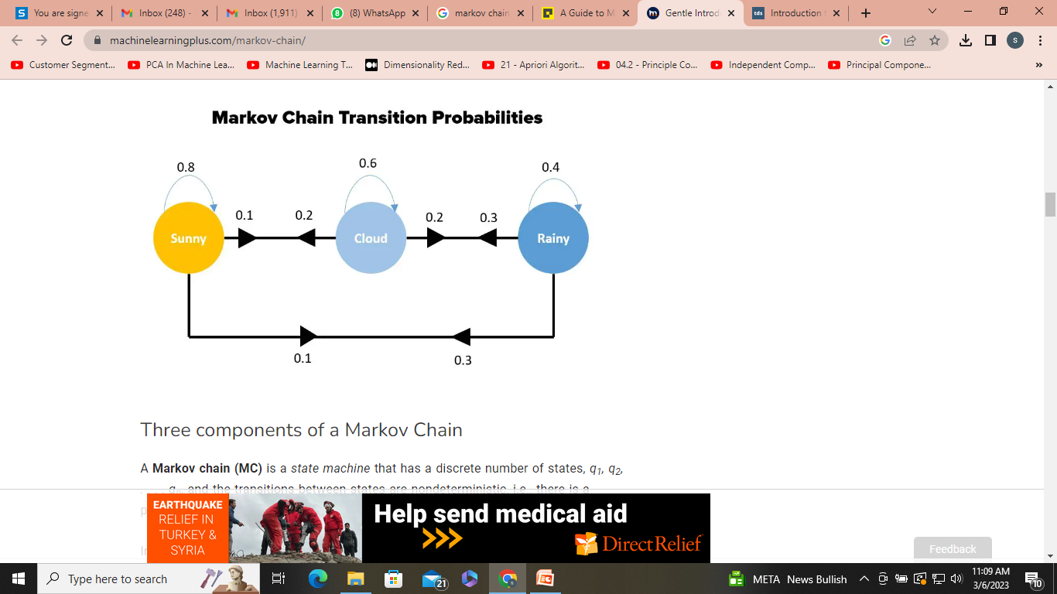
Three components of a Markov Chain
A Markov chain (MC) is a state machine that has a discrete number of states, q₁, q₂, . . . , q_{n}, and the transitions between states are nondeterministic, i.e., there is a probability of transiting from a state q_{i} to another state q_{j} : P(S_{t} = q_{j} | S_{t}−1 = q_{i} ).
In our example, the three states are weather conditions: Sunny(q1), Cloudy(q2) and Rainy(q3)
Time is also discrete, such that the chain can be at a certain state q_{i} for each time step t. It satisfies the Markov property, that is, the probability of the next state depends only on the current state.

Slide 12
Properties of a Markov Chain
A Markov chain satisfies the following properties:
Probability axioms i.e., sum of all probabilities should be one:
Markov property: P(S_{t} = q _{j} | S_{t−1} = q_{i} , S_{t−2} = q_{k}, . . .) = P(S_{t} = q _{j} | S_{t−1} = q_{i} )
For example, consider the previous simple weather model with three states: q₁ = sunny, q₂ = cloudy, *q₃ = raining. In this case to specify an MC we will require a vector with three prior probabilities.

Slide 13
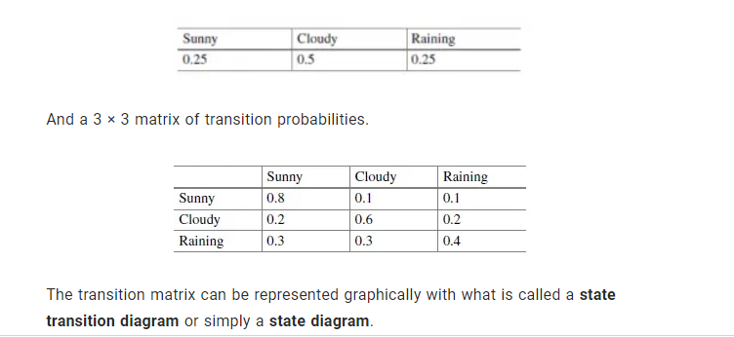

Slide 14
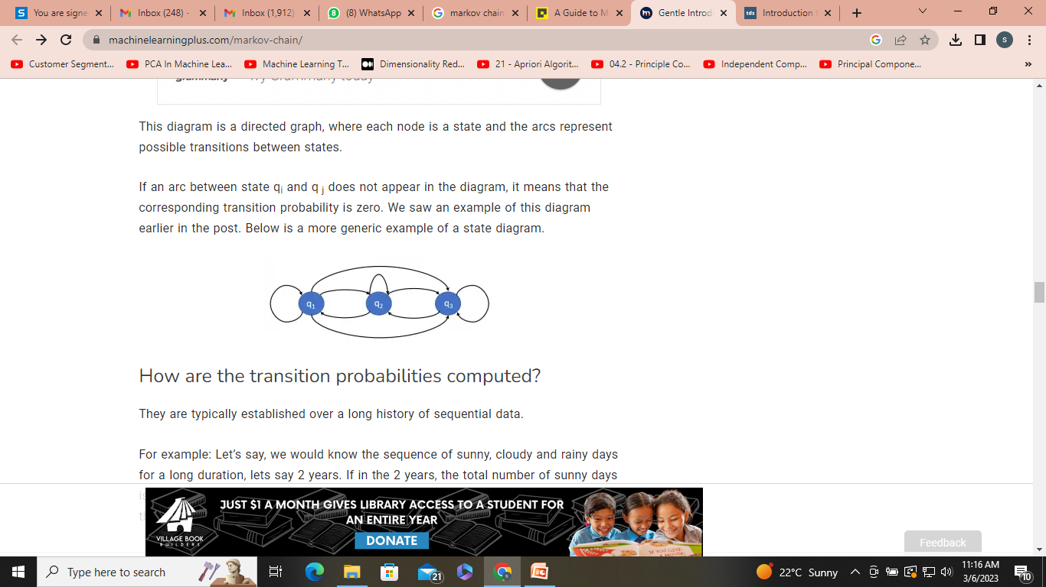
This diagram is a directed graph, where each node is a state and the arcs represent possible transitions between states.
If an arc between state q_{i} and q _{j} does not appear in the diagram, it means that the corresponding transition probability is zero.

Slide 15
How are the transition probabilities computed?
They are typically established over a long history of sequential data.
For example: Let’s say, we would know the sequence of sunny, cloudy and rainy days for a long duration, lets say 2 years. If in the 2 years, the total number of sunny days is 100, and out of that if the next day was a cloudy day 20 percent of the times, then the transition probability of Sunny -> Cloudy would be 20/100 = 0.2.
Likewise, all possible combinations are computed and the transition probability matrix is formed.

Slide 16
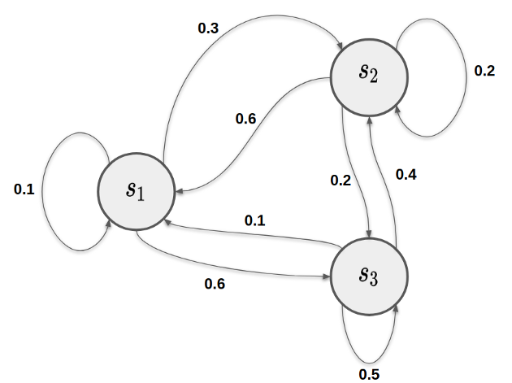
The Markov Property
The second important criterion for the MDP is the Markov property. The Markov property indicates that the future system dynamics of each state must only depend on the current state. This means that each state is self-contained to describe the future of the system. Only one state is required to model the future dynamics of the system, not the entire history of past states or n-steps from the past of the Markov Chain. Furthermore, the Markov property implies stationarity, which means that the underlying transition probabilities for each state do not change over time.

Slide 17
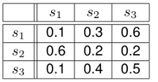
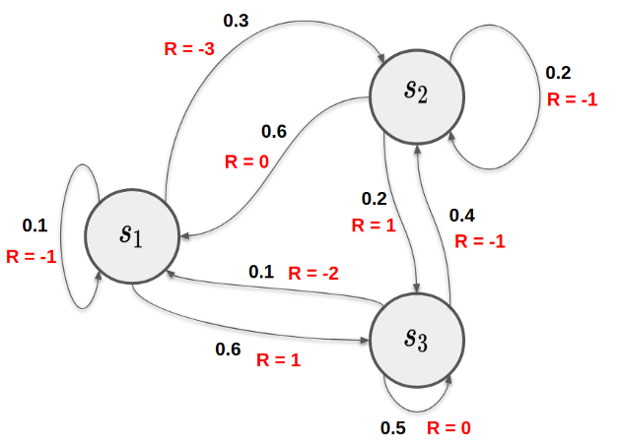
An example of the transition probabilities underlying an environment can be seen in the figure above. If the agent is in state s1, it will change with a probability of p(s3|s1) = 0.6 in state s3. If the agent is in state s1, it stays in state s1 with a probability of p(s1|s1) = 0.1 and changes to state s2 with a probability of p(s2|s1) = 0.3. These transition probabilities can also be represented in a so-called transition matrix. In general, a Markov process is therefore defined by the tuple (S, P). Where S is the state space and P is the transition function, represented by the transition probabilities.
The Markov Reward Process

Slide 18

The Markov Property
Transition : Moving from one state to another is called Transition.
Transition Probability: The probability that the agent will move from one state to another is called transition probability.
The Markov Property state that :
“Future is Independent of the past given the present”
Mathematically we can express this statement as :
S[t] denotes the current state of the agent and s[t+1] denotes the next state. What this equation means is that the transition from state S[t] to S[t+1] is entirely independent of the past. So, the RHS of the Equation means the same as LHS if the system has a Markov Property. Intuitively meaning that our current state already captures the information of the past states.

Slide 19

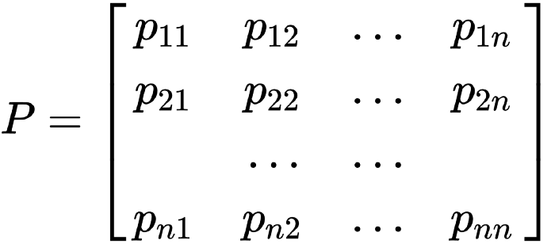
State Transition Probability :
As we now know about transition probability we can define state Transition Probability as follows :
For Markov State from S[t] to S[t+1] i.e. any other successor state , the state transition probability is given by
We can formulate the State Transition probability into a State Transition probability matrix by :
Each row in the matrix represents the probability from moving from our original or starting state to any successor state.Sum of each row is equal to 1.

Slide 20
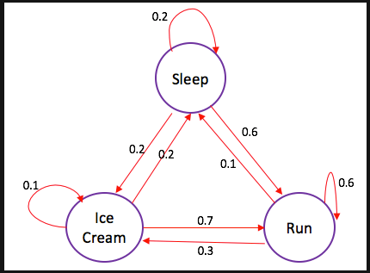
Markov Process or Markov Chains
Markov Process is the memory less random process i.e. a sequence of a random state S[1],S[2],….S[n] with a Markov Property. So, it’s basically a sequence of states with the Markov Property.It can be defined using a set of states(S) and transition probability matrix (P).The dynamics of the environment can be fully defined using the States(S) and Transition Probability matrix(P).
But what random process means ?
To answer this question let’s look at a example:

Slide 21
The edges of the tree denote transition probability. From this chain let’s take some sample. Now, suppose that we were sleeping and the according to the probability distribution there is a 0.6 chance that we will Run and 0.2 chance we sleep more and again 0.2 that we will eat ice-cream. Similarly, we can think of other sequences that we can sample from this chain.
Some samples from the chain :
Sleep — Run — Ice-cream — Sleep
Sleep — Ice-cream — Ice-cream — Run
In the above two sequences what we see is we get random set of States(S) (i.e. Sleep,Ice-cream,Sleep ) every time we run the chain. Hope, it’s now clear why Markov process is called random set of sequence

Slide 22
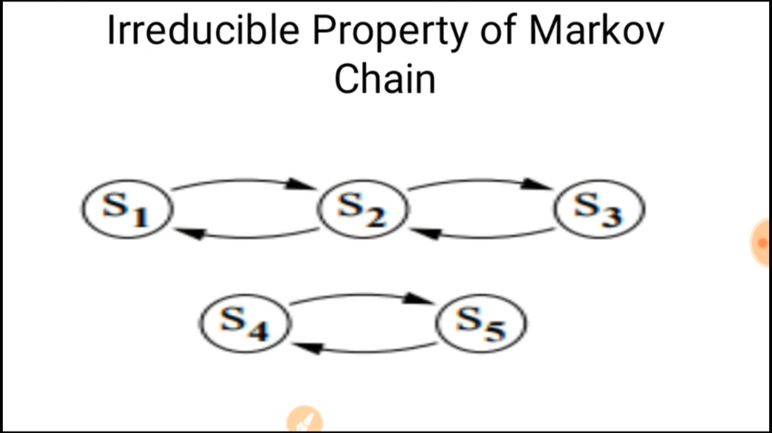
If all the states can communicate with each other

Slide 23
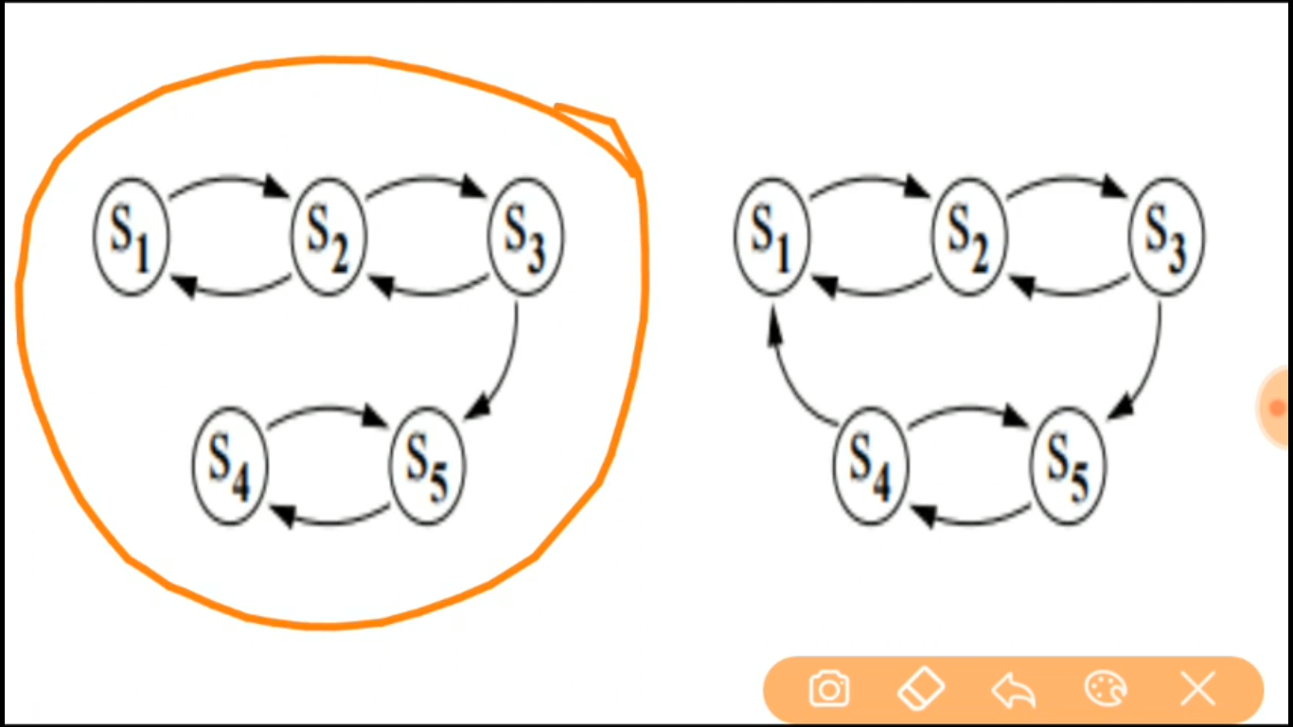
Reducible
Irreducable

Slide 24
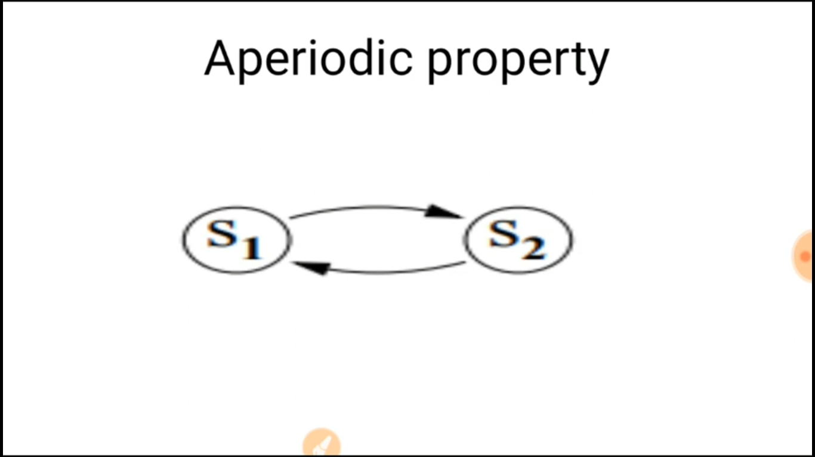
After a fixed time interval, you can come again to same state

Slide 25
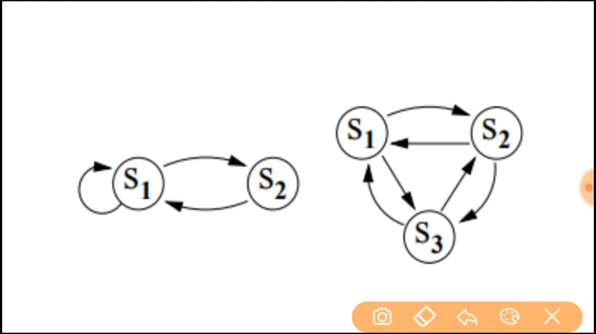
We cant determine period for S1 so it is Aperiodic

Slide 26
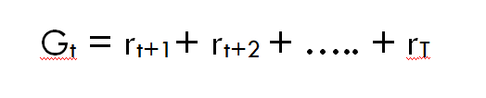
Reward and Returns
Rewards are the numerical values that the agent receives on performing some action at some state(s) in the environment. The numerical value can be positive or negative based on the actions of the agent.
In Reinforcement learning, we care about maximizing the cumulative reward (all the rewards agent receives from the environment) instead of, the reward agent receives from the current state(also called immediate reward). This total sum of reward the agent receives from the environment is called returns.
We can define Returns
r[t+1] is the reward received by the agent at time step t[0] while performing an action(a) to move from one state to another. Similarly, r[t+2] is the reward received by the agent at time step t[1] by performing an action to move to another state. And, r[T] is the reward received by the agent by at the final time step by performing an action to move to another state.

Slide 27
Episodic and Continuous Tasks
Episodic Tasks: These are the tasks that have a terminal state (end state).We can say they have finite states. For example, in racing games, we start the game (start the race) and play it until the game is over (race ends!). This is called an episode. Once we restart the game it will start from an initial state and hence, every episode is independent.
Continuous Tasks : These are the tasks that have no ends i.e. they don’t have any terminal state.These types of tasks will never end.
For example, Learning how to code!
Now, it’s easy to calculate the returns from the episodic tasks as they will eventually end but what about continuous tasks, as it will go on and on forever. The returns from sum up to infinity! So, how we define returns for continuous tasks?
This is where we need Discount factor(ɤ).
Discount Factor (ɤ): It determines how much importance is to be given to the immediate reward and future rewards. This basically helps us to avoid infinity as a reward in continuous tasks. It has a value between 0 and 1. A value of 0 means that more importance is given to the immediate reward and a value of 1 means that more importance is given to future rewards. In practice, a discount factor of 0 will never learn as it only considers immediate reward and a discount factor of 1 will go on for future rewards which may lead to infinity. Therefore, the optimal value for the discount factor lies between 0.2 to 0.8.

Slide 28

Markov Reward Process
Till now we have seen how Markov chain defined the dynamics of a environment using set of states(S) and Transition Probability Matrix(P).But, we know that Reinforcement Learning is all about goal to maximize the reward.So, let’s add reward to our Markov Chain.
This gives us Markov Reward Process.
Markov Reward Process : As the name suggests, MDPs are the Markov chains with values judgement.Basically, we get a value from every state our agent is in.
Mathematically, we define Markov Reward Process as :
What this equation means is how much reward (Rs) we get from a particular state S[t]. This tells us the immediate reward from that particular state our agent is in. As we will see in the next story how we maximize these rewards from each state our agent is in. In simple terms, maximizing the cumulative reward we get from each state.

Slide 29
Markov Decision Process
Now, let’s develop our intuition for Bellman Equation and Markov Decision Process.
Policy Function and Value Function
Value Function determines how good it is for the agent to be in a particular state. Of course, to determine how good it will be to be in a particular state it must depend on some actions that it will take. This is where policy comes in. A policy defines what actions to perform in a particular state s.

