Slide 1
Write a program to implement Cliff Walking problem using Q-learning

Slide 2
The Cliff Walking problem is a classic reinforcement learning (RL) task used to demonstrate how an agent learns an optimal policy while avoiding dangerous states.
Environment Description
🔹 Grid World
The environment is a 4 × 12 grid.
Each cell represents a state.
The agent moves one cell at a time.
S C C C C C C C C C C G
Symbol | Meaning
S | Start state
G | Goal state
C | Cliff (dangerous states)
Start and Goal
Start State: Bottom-left cell → (3, 0)
Goal State: Bottom-right cell → (3, 11)

Slide 3
Cliff Region
All cells between Start and Goal in the bottom row
If the agent enters a cliff cell:
Gets a large negative reward
Is sent back to the start state
Actions Available
At every state, the agent can choose one of four actions:
Action | Meaning
U | Move Up
D | Move Down
L | Move Left
R | Move Right
The agent cannot move outside the grid.

Slide 4
Reward Structure
The reward function guides the agent’s behavior.
Situation | Reward
Normal step | −1
Falling into cliff | −100
Reaching goal | 0
Why −100? To strongly discourage the agent from going near the cliff.
Objective of the Agent
Learn a policy that reaches the goal with minimum total penalty, while avoiding the cliff.
This means:
Shortest path is not always safest
Agent must balance risk vs reward

Slide 5
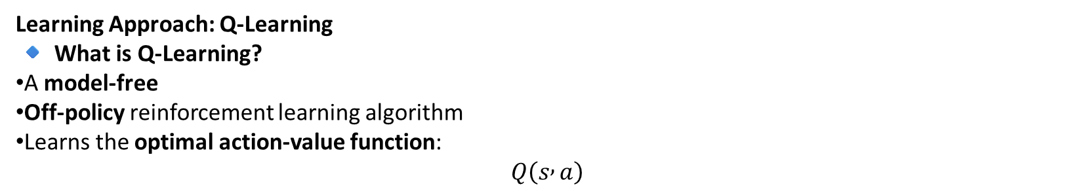
Why Cliff Walking is Important?
The cliff walking problem highlights:
Trial-and-error learning
Delayed rewards
Exploration vs exploitation
Difference between on-policy and off-policy learning
Learning Approach: Q-Learning
🔹 What is Q-Learning?
A model-free
Off-policy reinforcement learning algorithm
Learns the optimal action-value function:
$$Q\left(s , a\right)$$

Slide 6
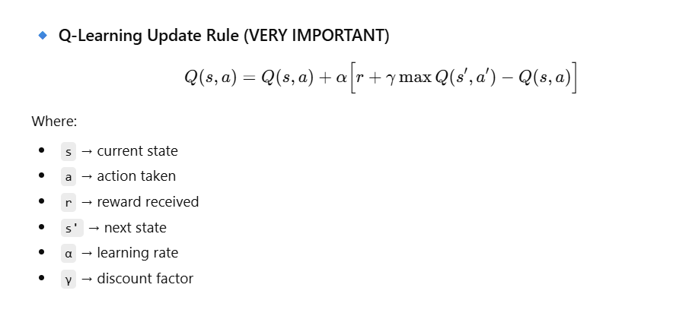

Slide 7
Exploration Strategy (Epsilon-Greedy)
To learn effectively, the agent uses ε-greedy policy:
With probability ε → take a random action (explore)
With probability 1 − ε → take best known action (exploit)
This helps the agent:
Discover new paths
Avoid getting stuck in bad policies
Learned Policy
With Q-Learning:
Agent often learns a path close to the cliff
Because Q-Learning assumes optimal future behavior
With SARSA:
Learns a safer path farther from the cliff
Because SARSA learns using actual taken actions
Behavior of Agent During Learning
🔹 Early Episodes
Agent explores randomly
Falls into cliff many times
Receives large penalties
🔹 Later Episodes
Learns cliff is dangerous
Avoids bottom row
Chooses safer path

Slide 8
Feature | Cliff Walking
Type | Reinforcement Learning
Environment | Grid World
Algorithm used | Q-Learning / SARSA
Learning style | Trial and Error
Reward | Negative for danger
Goal | Safe optimal path

Slide 9
import numpy as np
import random
# Grid size
rows, cols = 4, 12
# Actions: 0=Up, 1=Down, 2=Left, 3=Right
actions = 4
# Q-table
Q = np.zeros((rows, cols, actions))
# Learning parameters
alpha = 0.1 # learning rate
gamma = 0.9 # discount factor
epsilon = 0.1 # exploration rate
# Start and Goal positions
start = (3, 0)
goal = (3, 11)
numpy → for Q-table
random → for exploration
Stores Q(s, a) values
Initially all values = 0
Parameter | Meaning
α | Learning speed
γ | Future reward importance
ε | Exploration chance
Bottom row is dangerous except start & goal

Slide 10
# Cliff cells
cliff = [(3, j) for j in range(1, 11)]
# Take action
def step(state, action):
i, j = state
if action == 0: # Up
i = max(i-1, 0)
elif action == 1: # Down
i = min(i+1, rows-1)
elif action == 2: # Left
j = max(j-1, 0)
elif action == 3: # Right
j = min(j+1, cols-1)
next_state = (i, j)
if next_state in cliff:
return start, -100
if next_state == goal:
return next_state, 0
Decides next position and reward
Prevents going outside grid
Huge penalty
Agent returns to start

Slide 11
return next_state, -1
# Q-Learning
for episode in range(500):
state = start
while state != goal:
i, j = state
# Epsilon-greedy action
if random.random() < epsilon:
action = random.randint(0, 3)
else:
action = np.argmax(Q[i, j])
next_state, reward = step(state, action)
ni, nj = next_state
# Q update
Q[i, j, action] += alpha * (reward + gamma * np.max(Q[ni, nj]) - Q[i, j, action])
state = next_state
Small negative reward per step
Explore randomly
Otherwise exploit best action
Prints best action number for each state
C = cliff, G = goal

Slide 12
# Print policy
print("Learned Policy:")
for i in range(rows):
for j in range(cols):
if (i, j) == goal:
print(" G ", end="")
elif (i, j) in cliff:
print(" C ", end="")
else:
print(np.argmax(Q[i, j]), end=" ")
print()

Slide 13
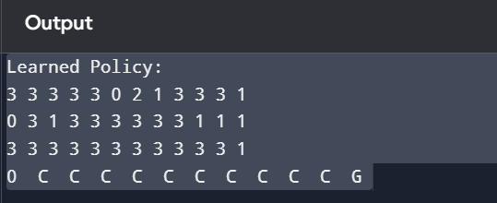
0 = Up
1 = Down
2 = Left
3 = Right
Row 0
3 3 3 3 3 0 2 1 3 3 3 1
R R R R R U L D R R R D
Row 1
0 3 1 3 3 3 3 3 3 1 1 1
U R D R R R R R R D D D
Row 2
3 3 3 3 3 3 3 3 3 3 3 1
R R R R R R R R R R R D
↑ → → → → → → → → → ↓
Row 3
0 C C C C C C C C C C G
U C C C C C C C C C C G

