Slide 1


Welcome to Recipe Finder!
Discover the joy of cooking with Recipe Finder, the ultimate destination for finding delicious recipes for every occasion. Whether you're a seasoned chef or a beginner in the kitchen, we've got you covered!
By Ankit Mishra
2110991966

Slide 2

How It Works
1
Browse or Search
Explore our collection of recipes by browsing different categories or search for specific dishes, ingredients, or dietary preferences.

Slide 3
Benefits of Using Recipe Finder
1
Save Time
Say goodbye to endless recipe browsing. Our smart search and filtered results help you find the perfect recipe in no time.
2
Discover New Favorites
Expand your culinary repertoire by exploring thousands of recipes from around the world. Try new flavors and surprise your taste buds!
3
Cook With Confidence
Our detailed step-by-step instructions and helpful tips ensure that even novice cooks can create impressive dishes with ease.

Slide 4
Features of Recipe Finder
Recipe Ratings
Nutritional Information
Trust the wisdom of the crowd. See ratings and reviews from fellow users to determine the top-rated recipes.
Stay mindful of your dietary needs. Get access to detailed nutritional information for each recipe.
Adapt Serving Sizes
Dietary Filters
Whether you're cooking for a crowd or just yourself, easily adjust the serving size for each recipe to suit your needs.
Customize your search by applying dietary filters such as vegetarian, gluten-free, vegan, and more to find recipes that fit your lifestyle.

Slide 5

Tips and Tricks
1
Try Recipe Collections
Explore our curated collections of recipes for themed occasions, popular trends, and seasonal ingredients to find inspiration.
2
Save Your Substitutions
Forgot to buy an ingredient or need to accommodate dietary restrictions? Save your ingredient substitutions for future reference.
3
Share Your Creations
Show off your culinary masterpieces! Share photos of your cooked dishes and connect with fellow cooking enthusiasts in our community.

Slide 6
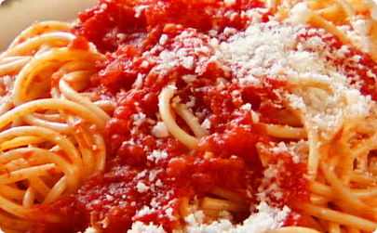
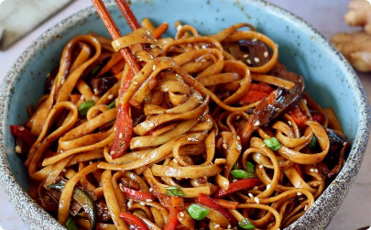

Discover a World of Delicious Recipes
Italian Cuisine
Asian Delights
Decadent Desserts
Indulge in comforting pasta dishes, flavorful pizzas, and delectable desserts that capture the essence of Italy.
Experience the bold and vibrant flavors of Asian cuisine with sizzling stir-fries, aromatic curries, and mouthwatering street food.
Satisfy your sweet tooth with heavenly cakes, rich chocolate treats, delightful pastries, and more irresistible dessert recipes.

Slide 7

Conclusion
Start your culinary adventure today with Recipe Finder! Whether you're looking to impress your dinner guests or simply enjoy a cozy meal at home, our website is your recipe partner for every occasion. Sign up now and unleash your inner chef!

