Slide 1
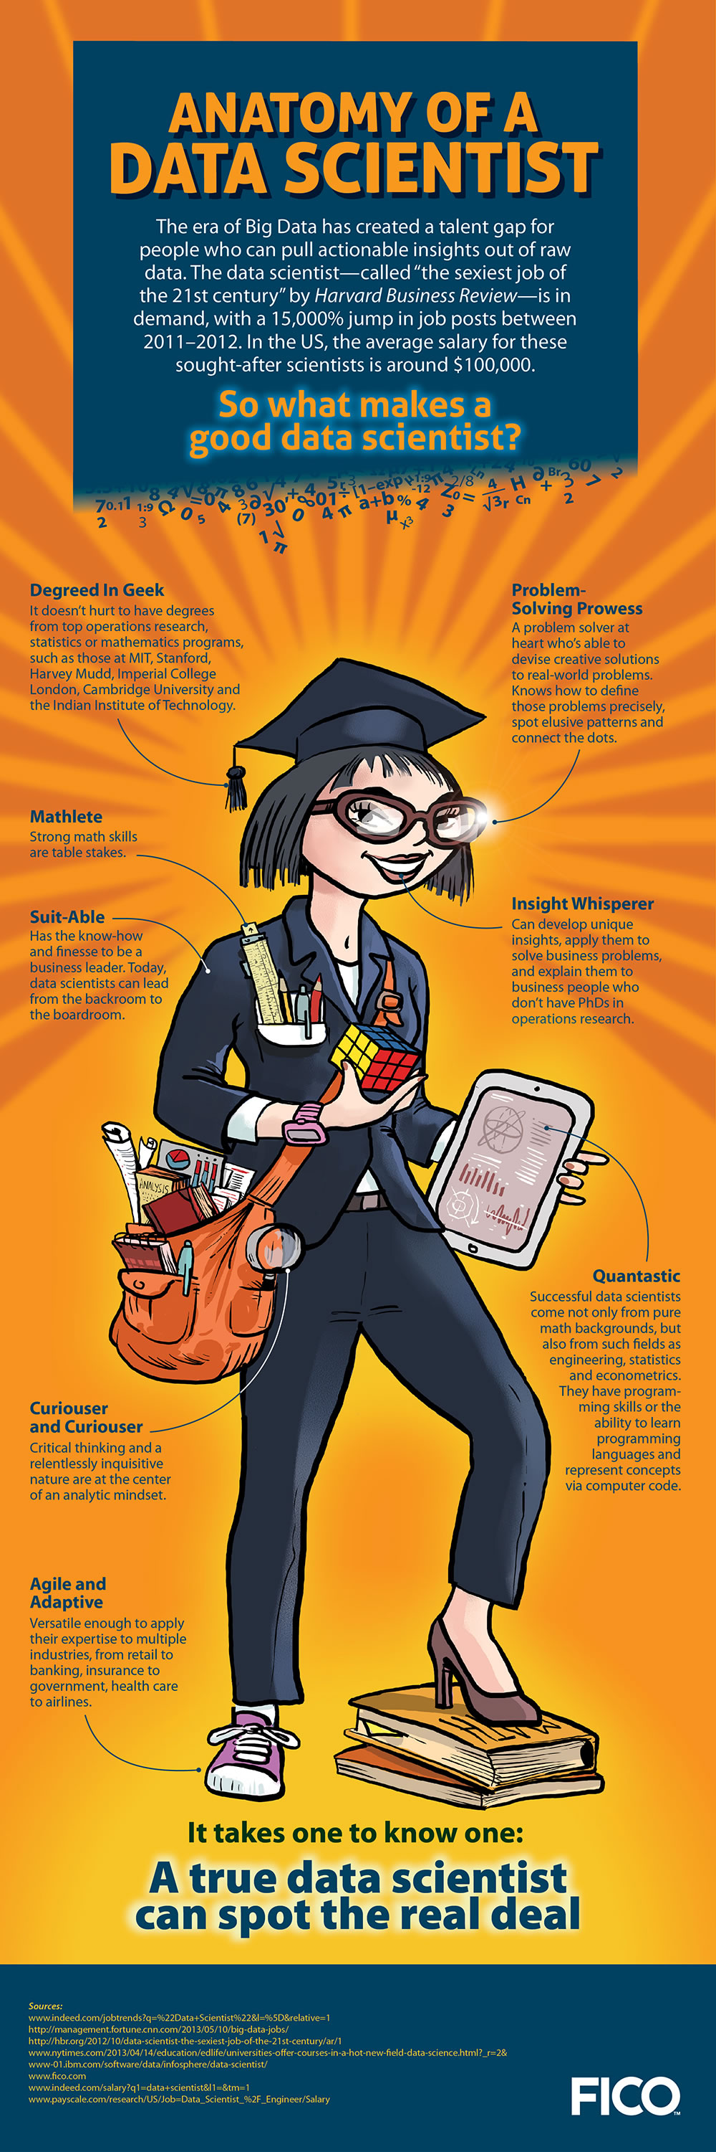

Want to build your Data Scientist resume?
Come to B.I.G. (Business Intelligence group).
What: The Business Intelligence Group
Where:
EB II, room 3300
Tuesdays, 12:30 – 1:30 Dr. Tim Menzies, CS, tjmenzie@ncsu.edu
http://tinyurl.com/bigstate
Undergrads: Learn tips&tricks for real world data mining
Grads: Kick start your research work.
Weekly meetings:
Learn data mining in hands-on workshops.
Invited speakers.
Meet potential employers from industry.
Debate ethics for responsible data science.
When:
Contact:
Web page:

