Slide 1
Similar Neighborhoods
Applied Data Science Capstone
-D.Dheeraj

Slide 2
PROBLEM IN HAND
Suppose a person living in a city has to move to another city due to some reason, but since he has been living in this city for many years he finds it difficult to move out to a new city.
But he would like to find an area which is similar to his current residential area, so that he can still feel at home in a new city.
In order to find another similar neighborhood, we need to cluster similar neighborhoods using K-Means Algorithm
In order to input the data for K-Means Algorithm, the data needs to be pre-processed.

Slide 3
WORKFLOW
Importing Data
Cleaning Data
Processing Data
Importing extra features using Foursquare API (Feature Selection)
Feed processed data to K-Means Algorithm
Append Cluster label to the final data frame with all other required features
Visualize the neighborhood before and after clustered

Slide 4
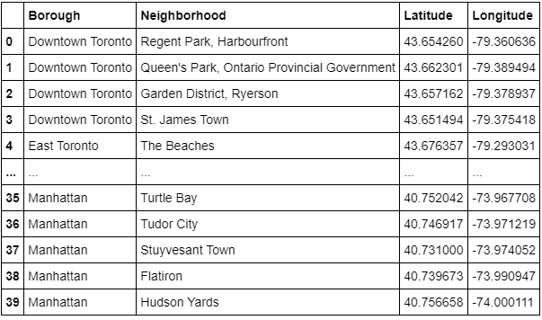
Importing and Cleaning Data
The given data is imported from json file and also extracted from Wikipedia using Web Scrapping tool, and later the data is further cleaned and unnecessary rows and characters were excluded.

Slide 5
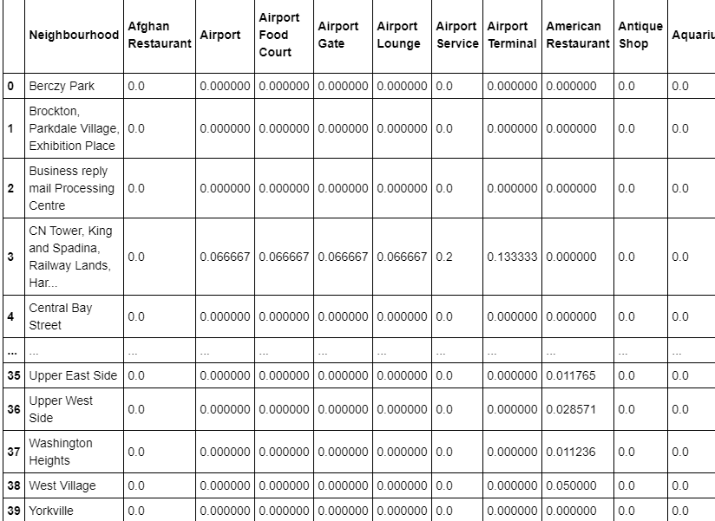
Processing and Feature Selection
The given data is analyzed and further processed, and also feature selection step is implemented by calling Foursquare API to get nearby venues for clustering purpose and then mean is calculated for each neighborhood’s nearby venue.

Slide 6
K-Means Algorithm
The final processed data is later used as an input for K-Means algorithm with 8 clusters and the required clusters are returned as an array. But before using the data frame for the algorithm, we drop the Neighborhood column as we do not require the column for clustering and also we cannot have non-numerical data while finding the cluster.

Slide 7
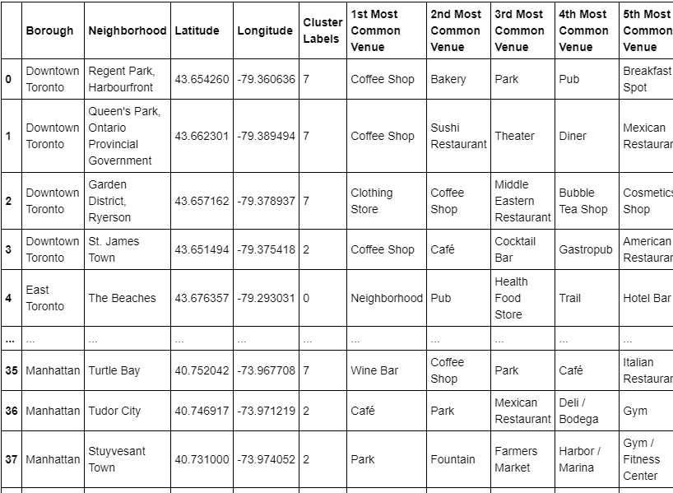
Final Data Frame
The obtained cluster labels are later added to the previously obtained data frame with commonly visited places.

Slide 8
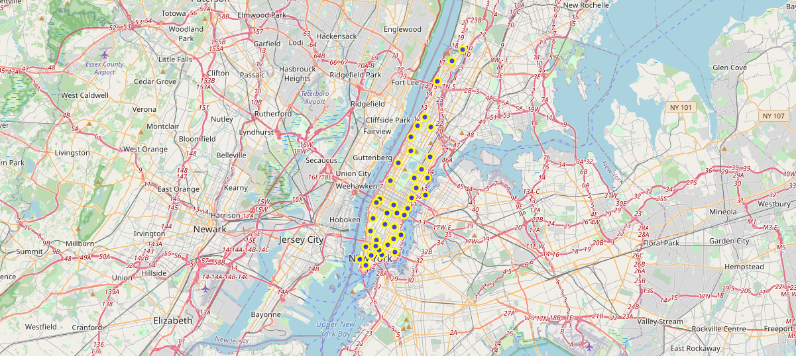
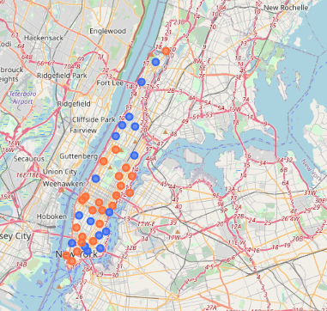
Visualizing the Data
Manhattan Before Clustering
Manhattan After Clustering

Slide 9
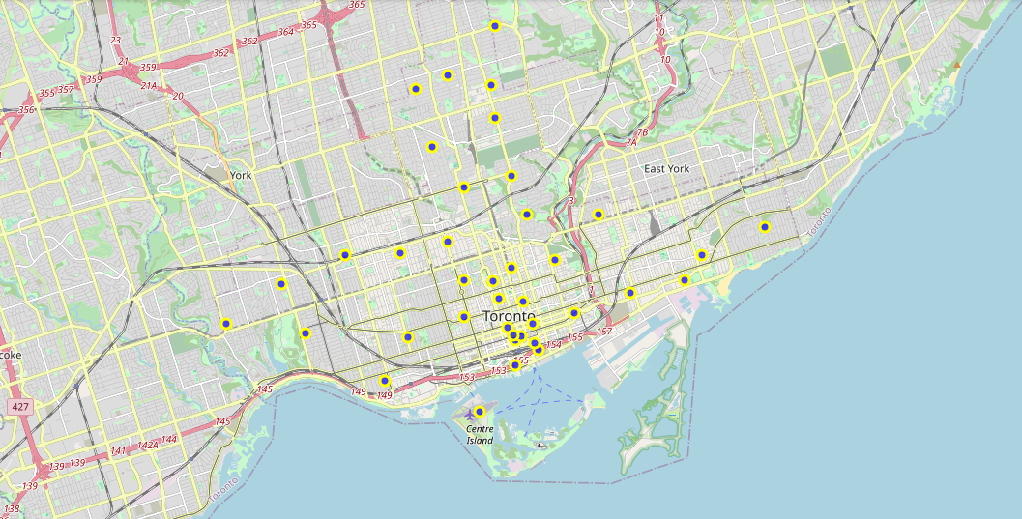
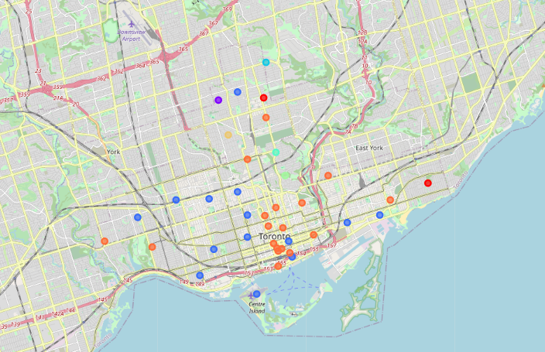
Visualizing the Data
Toronto Before Clustering
Toronto After Clustering

Slide 10
Thank You

