Slide 1

What is Entrepreneurship?
Real Stories, Real Opportunities
Video Storyboard for Grades 6–9 ·

Slide 2
SLIDE 1 · OPENING HOOK
"The Problem Nobody Solved"
Screen Type: Narrative Hook / Real-World Scenario · Estimated Duration: 30 seconds
On-Screen Text
Voice-Over Script
"Every day, students like you struggle to stay organized."
"Jordan noticed this problem too."
"But instead of just complaining… Jordan did something about it."
Text overlay: "Meet Jordan. Problem solver."
Imagine this: You're drowning in homework, projects, and deadlines. Your planner is a mess. Your backpack is chaos. You're not alone—millions of students face this exact problem every single day. But what if someone decided to solve it? What if that someone was a teenager just like you? That's exactly what happened when Jordan, a high school student, noticed her friends struggling to stay organized. Instead of accepting the problem, she decided to become an entrepreneur.
Visual Description
Visual Sync Notes
Split-screen: left side — student overwhelmed with scattered books and disorganized homework. Right side — same student calm, using a color-coded digital planner. Fade to Jordan at her laptop with a determined expression.
Upbeat, modern background music (0–30 sec). Transition at 15 sec: split-screen wipe to single focus on Jordan. Pacing: slow and deliberate to build curiosity.
Animation Notes
Developer Notes
Fade in split-screen (0–5 sec) · Slide transition between panels (10–15 sec) · Zoom in on Jordan's face (20–25 sec) · Text appears with subtle slide-in animation.
Use relatable imagery — real students preferred over stock photos. Color scheme: bright blues and greens for organization theme. Font: sans-serif, easy to read for middle school audience.

Slide 3



SLIDE 2 · DEFINITION
Defining Entrepreneurship
Screen Type: Concept Explanation · Estimated Duration: 45 seconds
Problem Solver
Risk Taker
Innovator
Identifies a real problem that needs fixing — then creates a business solution to address it.
Invests their own money, time, and energy — knowing the outcome isn't guaranteed.
Imagines solutions that didn't exist before and has the courage to make them happen.
ENTREPRENEUR = Problem Solver + Risk Taker + Innovator
"They don't work for someone else — they work for themselves, and they're responsible for every decision their business makes."
Voice-Over Script
Animation & Developer Notes
So, what exactly is an entrepreneur? An entrepreneur is someone who identifies a problem that needs solving and creates a business solution to fix it. But it's more than just having a good idea. Entrepreneurs are risk-takers. They invest their own money, time, and energy into their business, hoping to make a profit. They don't work for someone else — they work for themselves. Think of it this way: an entrepreneur sees a problem, imagines a solution, and then has the courage to make it happen.
Word "ENTREPRENEUR" animates with letter-by-letter reveal (0–5 sec)
Icons appear in sequence with staggered timing (5–20 sec)
Clips fade in/out with 1-second transitions (20–45 sec)
Keep language accessible: define "risk" and "profit" simply
Avoid jargon; use icons and animations to break up text-heavy content

Slide 4
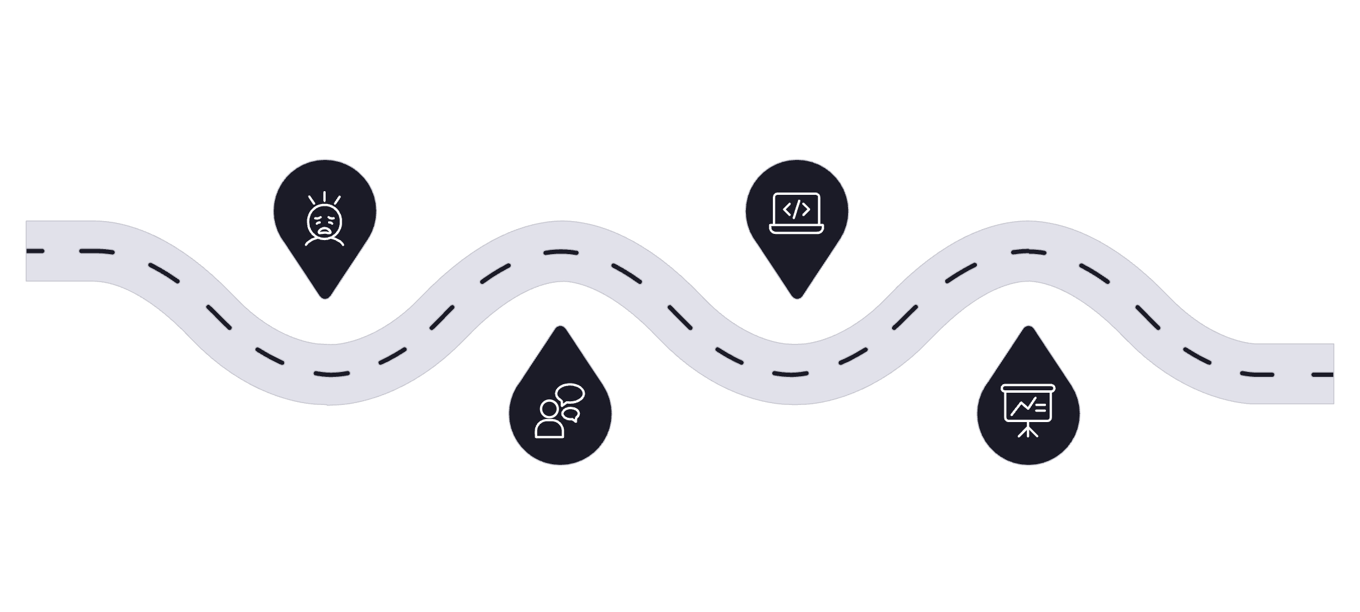

SLIDE 3 · CASE STUDY
Real-World Scenario: Jordan's Journey
Screen Type: Case Study / Real-World Application · Estimated Duration: 60 seconds
Overwhelmed
Creation
Jordan buried in school papers
Coding and sketching wireframes
Frustration
Presentation
Talking with upset friends
Showing StudySync prototype
Jordan's story moves from gray, muted tones of stress and chaos to bright, energetic colors as her solution takes shape — a visual metaphor for the entrepreneurial transformation.
1
2
The Problem
The Risk
Students can't stay organized — Jordan herself was drowning in deadlines, assignments, and scattered
study schedules.
Jordan invested of her own savings from part-time jobs — money she could lose entirely if the app didn't work.
3
4
The Solution
The Reward
StudySync — a free student planner app she taught herself to code after three months of research
with classmates, teachers, and parents.
The app quickly gained popularity among students. in 6 months. Today Jordan runs her own business,
helping thousands of students stay organized. That's entrepreneurship in action.
Voice-Over Script
Animation & Developer Notes
Jordan spent time understanding what students really needed. She spoke with classmates, teachers, and parents before building StudySync. She invested her own savings and launched the app. As more students found it useful, the app gained popularity and helped learners stay organized.
Scene transitions: fade to black between scenes (3-second transitions)
Tone shift from minor key (problem) to major key (solution)
Zoom effect on app interface (30–45 sec)
Celebration animation when download number appears (45–50 sec)
Show actual app interface if possible; emphasize the risk-taking aspect

Slide 5





SLIDE 4 · CHARACTERISTICS
Characteristics of Entrepreneurs
Screen Type: Informational / Characteristics List · Estimated Duration: 50 seconds · These aren't traits you're born with — they're skills anyone can develop.
Problem Solvers
Risk Takers
Creative Thinkers
Persistent
They see challenges as opportunities. When something goes wrong, entrepreneurs ask: "How can I fix this?" rather than accepting the status quo.
They're willing to invest their own money and time, fully aware they might lose it. Risk is a feature, not a bug, of entrepreneurship.
They imagine solutions that didn't exist before — combining ideas from different fields to build something entirely new.
Starting a business is hard. There will be failures and moments of doubt. But entrepreneurs keep going — they learn from mistakes and try again.
Profile cards appear one at a time (0–12 sec, 12–24 sec, 24–36 sec, 36–48 sec). Icons animate with subtle bounce effect. Show diverse entrepreneurs — different ages, genders, and ethnicities — to reflect real-world diversity. Keep language positive, empowering, and stereotype-free.

Slide 6



SLIDE 5 · TRADE-OFFS
Risks vs. Rewards
Screen Type: Comparison / Decision-Making · Estimated Duration: 55 seconds · The key question every entrepreneur asks: Are the potential rewards worth the risks I'm taking?
⚠️ RISKS
Financial Loss
Long Hours
✅ REWARDS
You might lose the money you invest. There is no guaranteed salary or safety net.
Entrepreneurs often spend long hours developing and improving their ideas, especially during the early stages of building a business.
Full Control
Unlimited Earning Potential
You make the decisions. You set the direction. No one tells you what to build.
You keep the profits. Your income is tied directly to your effort and results.
Uncertain Income
Stress & Pressure
Personal Satisfaction
Real Impact
Unlike a regular job, revenue is unpredictable. Some months are great; others are tough.
Every decision falls on you. The weight of responsibility is real and ongoing.
There is a unique pride in building something from nothing — seeing your idea become real.
Your solution can help real people. Jordan's app helped 50,000 students. That's impact.
Voice-Over Note: "For Jordan, the answer was yes. For many entrepreneurs, it is. But it's not the right choice for everyone, and that's okay." Tone should be honest and realistic — avoid making entrepreneurship seem either too easy or too difficult. Use visual scales balancing risk and reward (0–10 sec).

Slide 7
SLIDE 6 · HISTORY
Entrepreneurship Through the Years
Screen Type: Historical Context / Timeline · Estimated Duration: 50 seconds
Past
1
Local Businesses. Entrepreneurs needed physical locations and significant startup capital. Restaurants, shops, and service companies were the norm. Success required deep community roots.
2
Present
Digital Revolution. A teenager with a laptop can start a global business from their bedroom. Many successful businesses began as small ideas before growing into global companies. E-commerce and social media changed everything.
Future
3
The Future. Entrepreneurs are tackling climate change, building AI-powered tools, and creating businesses that prioritize social good alongside profit. The opportunities are endless.
"The internet has democratized entrepreneurship. You don't need a huge investment. You don't need a physical store. You just need an idea, determination, and the willingness to learn."
What Changed?
Animation & Developer Notes
Barriers to entry have never been lower.
Global reach is accessible from day one.
AI, sustainability, and social impact are the new frontiers.
Students today can launch businesses that previous generations couldn't imagine.
Timeline appears left to right (0–15 sec)
Era cards appear with staggered timing (15–35 sec)
Use illustrations or examples of well-known businesses that began as small ideas.
Tone: optimistic and forward-thinking. Music: upbeat, forward-looking (0–50 sec)

Slide 8
SLIDE 7 · DATA
The Importance of Small Businesses
Screen Type: Informational / Data Visualization · Estimated Duration: 45 seconds . Many successful businesses begin as small ideas before growing over time.
Workforce Contribution
Job Creation
Small businesses create employment opportunities and strengthen local communities.
Growing businesses generate new jobs and contribute to economic development.
Business Growth
Small Businesses
Thousands of entrepreneurs start new businesses every year by identifying opportunities
and solving problems.
Many successful companies begin as small businesses before expanding over time.
Voice-Over Script
Developer & Animation Notes
Small businesses play an important role in every economy. They create employment opportunities, encourage innovation, and strengthen local communities. Many successful companies begin as small businesses and gradually grow through dedication, creativity, and customer trust. Whether they remain small or expand into larger organizations, these businesses contribute to economic growth by solving problems and creating value for society.
Animate the bar chart from left to right.
Highlight each category as it is explained in the narration.
Use simple icons with each bar to improve readability.
Keep labels large and easy to read for Grades 6–9 learners.
Reveal one bar at a time with a subtle fade animation.

Slide 9
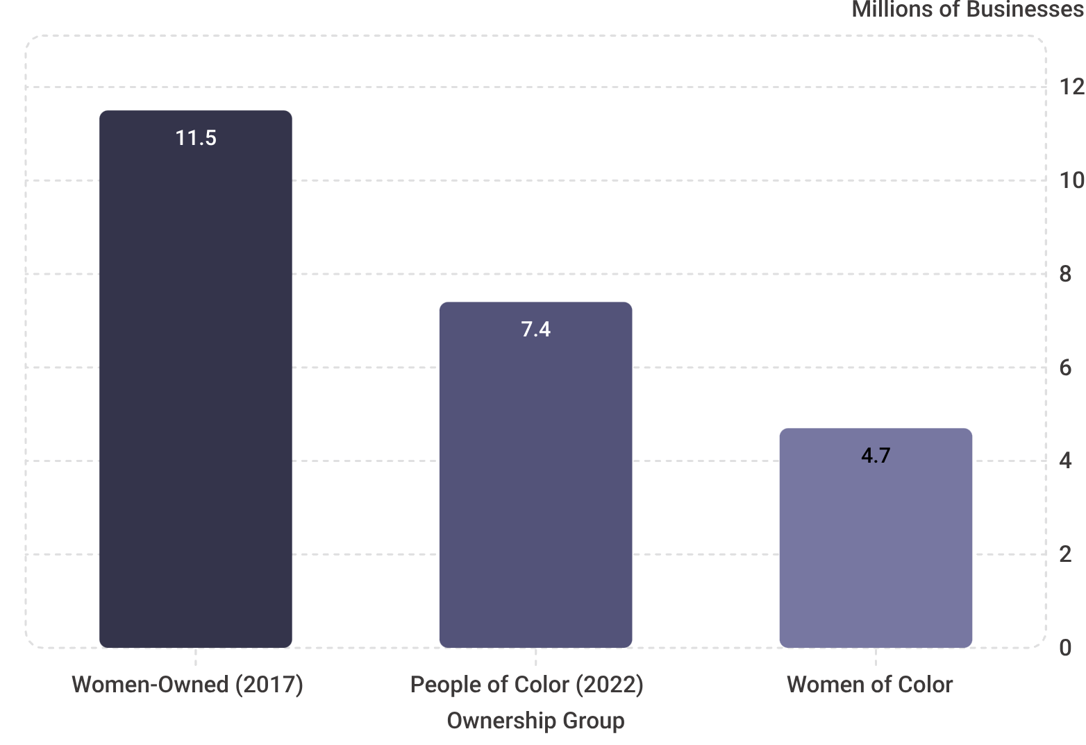
SLIDE 8 · DIVERSITY
Diversity in Entrepreneurship
Screen Type: Diversity & Inclusion / Data Visualization · Estimated Duration: 50 seconds · Entrepreneurship is not limited to any one group.
The Numbers Tell the Story
People from diverse backgrounds become entrepreneurs.
Women continue to build successful businesses across industries.
Education can help, but determination and problem-solving matter even more.
Anyone with a good idea and commitment can begin their entrepreneurial journey.
"Your background isn't a barrier — it's an asset. Your unique perspective and experiences give you insights that others might not have."
Voice-Over Note: Emphasize growth trajectory — these numbers represent massive positive change. Tone: celebratory and inclusive. Pie chart animates with segments appearing (0–15 sec); numbers count up from 0 (15–30 sec); profile cards appear staggered (30–45 sec). Use authentic images of diverse entrepreneurs; avoid tokenism. Show that what you need is an idea, determination, and willingness to learn — not a fancy degree.

Slide 10
SLIDE 9 · ADVANCED CONCEPT
Serial Entrepreneurship
Screen Type: Advanced Concept / Real-World Example · Estimated Duration: 45 seconds · Some entrepreneurs don't stop at one business — and that's not ambition, it's a mindset.
Start Business #1
Apply the Lessons
Identify a problem, build a solution, take the risk, and launch your first venture.
Learn everything you can.
Use failures, wins, and insights from your first venture to inform every decision in your next one. The curve shortens dramatically.
Launch Business #2
Repeat & Innovate
Start again — this time with more experience, a stronger network, and deeper
knowledge of what works.
Serial entrepreneurs keep going because they're driven by innovation, not just money.
Why Do Serial Entrepreneurs Keep Going ?
Voice-Over & Production Notes
Some entrepreneurs build one successful business and then use their experience to create new ventures.
They learn from each experience, improve their skills, and continue identifying new opportunities.
Serial entrepreneurs are driven by curiosity, innovation, and continuous learning.
Why do serial entrepreneurs keep going? Many say they're driven by the desire to innovate and challenge themselves — they love identifying problems and building teams. The internet has made serial entrepreneurship easier than ever: resources are available, global reach is instant, and technology companies can grow incredibly fast. Entrepreneurship isn't a one-time thing. It's a mindset. Once you develop entrepreneurial thinking, you can apply it to multiple ventures throughout your life.
Animation: Timeline left to right (0–15 sec) · Business icons in sequence (15–30 sec) · Arrows animate showing progression (20–35 sec) · Success metrics appear with emphasis (35–45 sec).

Slide 11
SLIDE 10 · REFLECTION & CTA
Reflection & Call to Action
Screen Type: Reflection / Closing / Call to Action · Estimated Duration: 45 seconds
Start with a Problem
Think Creatively
Take the First Step
Every entrepreneurial journey begins by identifying a real problem and thinking of a practical solution.
Great ideas can come from anyone. Your unique perspective can help create innovative solutions.
Every successful entrepreneur starts by taking action, learning from experience, and improving along the way.
Every successful business starts with one idea. What problem would you like to solve?
Voice-Over Script (closing): Whether you choose to start a small business, create a digital solution, or solve a problem in your community, every entrepreneurial journey begins with observing a need and having the courage to act. Your entrepreneurial journey can begin today with one idea and the willingness to take the first step.
Animation & Developer Notes
What You'll Explore Next
Use inclusive visuals featuring students from diverse backgrounds to help learners relate to the content.
Introduce each key message with a subtle fade-in animation while keeping transitions smooth and distraction-free.
Pause briefly after the reflection question to encourage self-reflection before the closing message appears.
Conclude with an inspiring end screen that reinforces the lesson's key takeaway: "Every Great Business Begins with One Idea."
Ensure all visuals, animations, and on-screen text are simple, engaging, and appropriate for learners in Grades 6–9.
Identify real problems and entrepreneurial opportunities
Validate your ideas before investing time or money
Create business plans that are realistic and compelling
Launch your own ventures with confidence

