Slide 1


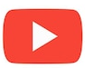
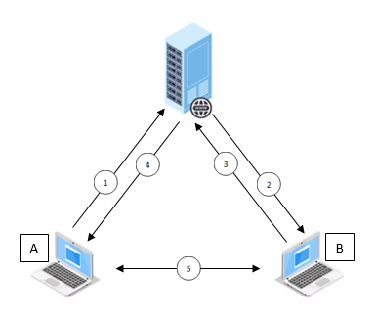

WebRTC Tutorial
Rare Course
Step-by-step | 2023
Section. #1 – Getting Started with WebRTC
What is WebRTC?
How It Works
Supported Features
Field of Usages
Compatible Browsers
PeerJS Library
Video Conference or Chat?
Why Private Video Conference?
All Levels

Slide 2
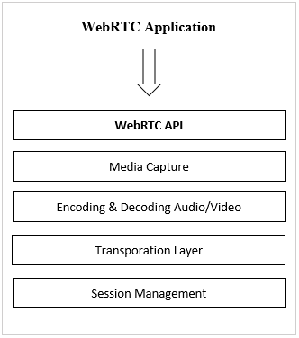
What is WebRTC?
Rare Course
WebRTC stands for Web Real-Time Comunications
A framework that allows user to establish peer-to-peer connections over the internet rapidly with ease.
WebRTC can transfer not only data stream (text, binary), but also in the forms of audio and video stream.
WebRTC programming rules (API) are built based on JavaScript programming.
Can be integrated to any application and device that support Javascript.
WebRTC API works on several layers which include media capture, data encoding/decoding, transportation and session management.
WebRTC Tutorial | 2023
All Levels

Slide 3
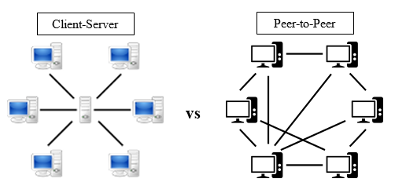
How It Works
Rare Course
WebRTC framework enables peer-to-peer (P2P) data communication.
Data can be sent directly from the originating device to the recipient without any other intermediary.
There’s no need for a programmer to configure how the network operates, because WebRTC is the one that will handle it.
WebRTC Tutorial | 2023
All Levels

Slide 4
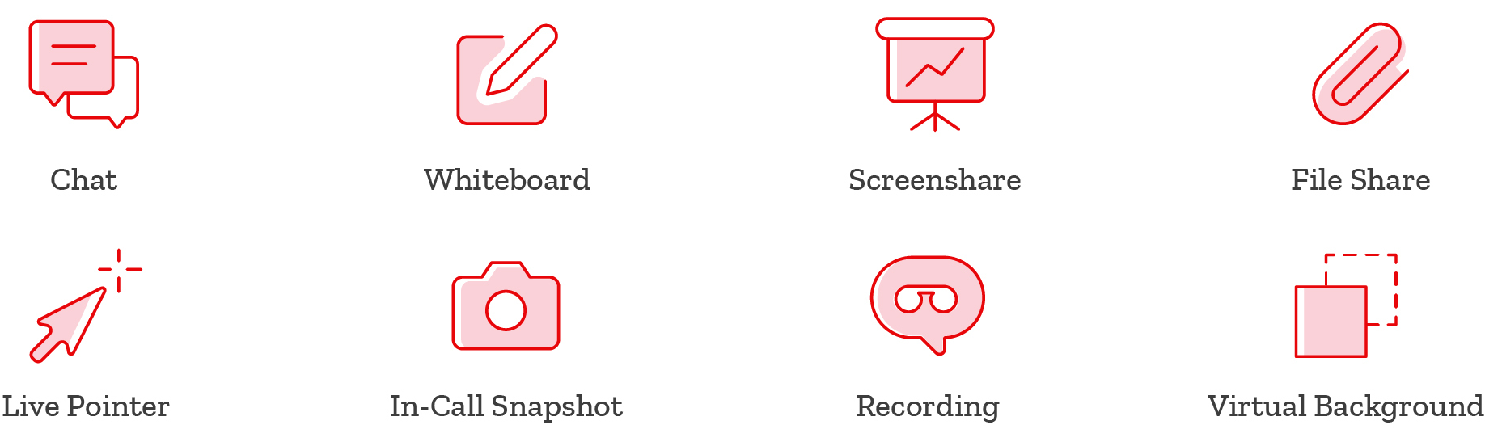
Supported Features
Rare Course
There are a lot of features offered by WebRTC, some are:
Screen Sharing, which is the ability to show speaker's screen to other members so that the topics presented can be understood more easily.
Screen Recording, the option to capture and save all screen activities so that missed parts of the meeting can be replayed when needed.
File Sharing, it is common in a meeting that some files are needed to be distributed to other participants. For this reason, the feature is very useful for people to get the file instantly.
Text Chat, a service to chat with other meeting members via some kind of text messaging. That way, no sound noise is made which might disturb the meeting.
Microphone and camera controls, etc.
WebRTC Tutorial | 2023
All Levels

Slide 5
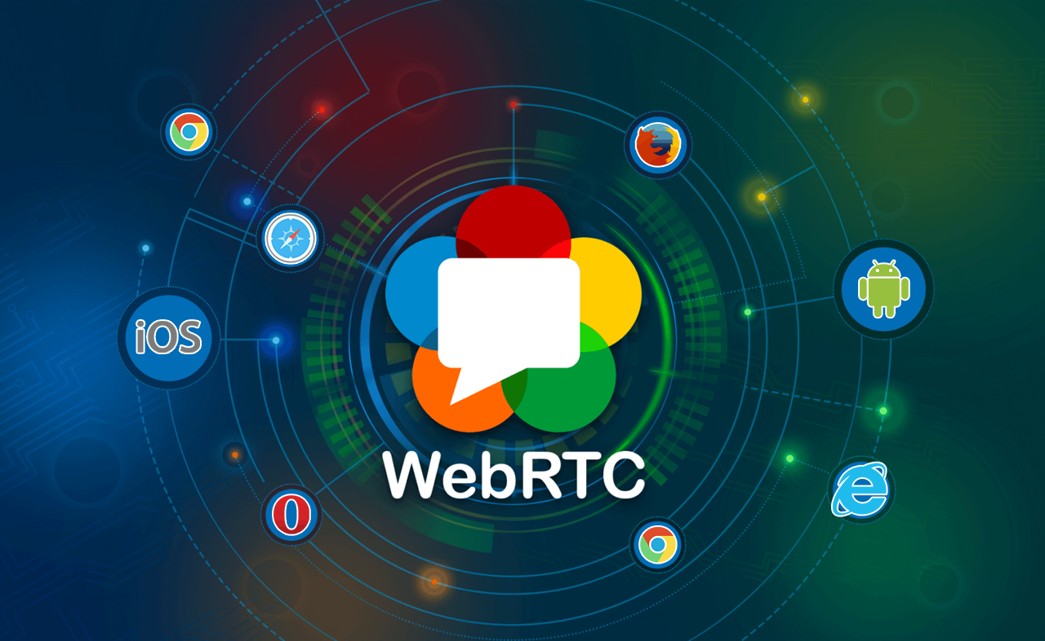
Field of Usages
Rare Course
WebRTC can be implemented for many cases, including:
Product marketing, whereas a salesperson can offer their products utilizing non-direct (virtual) negotiations.
Business management, which includes managing strategic plans through online meetings to develop the company and raise the profit.
Medical consultation, getting help from medical experts regarding illnesses or health emergencies so that the patient can be treated quickly without the need to go to hospital and clinic.
Financial service, that is to get direct financial advice from experts through online meetings.
Security surveillance, as such a remote monitoring to implement crime prevention and control.
Learning in distance, which is the ability to conduct online learning without having to come directly to a certain place that might be far away.
Social media, expanding relations that’s unlimited by countries of the world via online meetings.
Play online games, and so on.
WebRTC Tutorial | 2023
All Levels

Slide 6
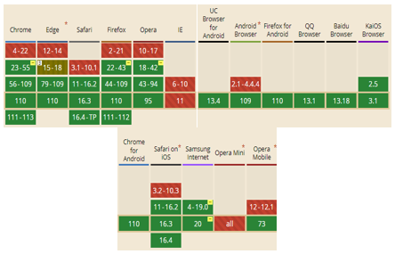
Compatible Browsers
Rare Course
WebRTC operates in a browser environment.
It is necessary to choose the right one for the app to run.
Browsers: Google Chrome, Mozilla Firefox and more
WebRTC Tutorial | 2023
All Levels

Slide 7
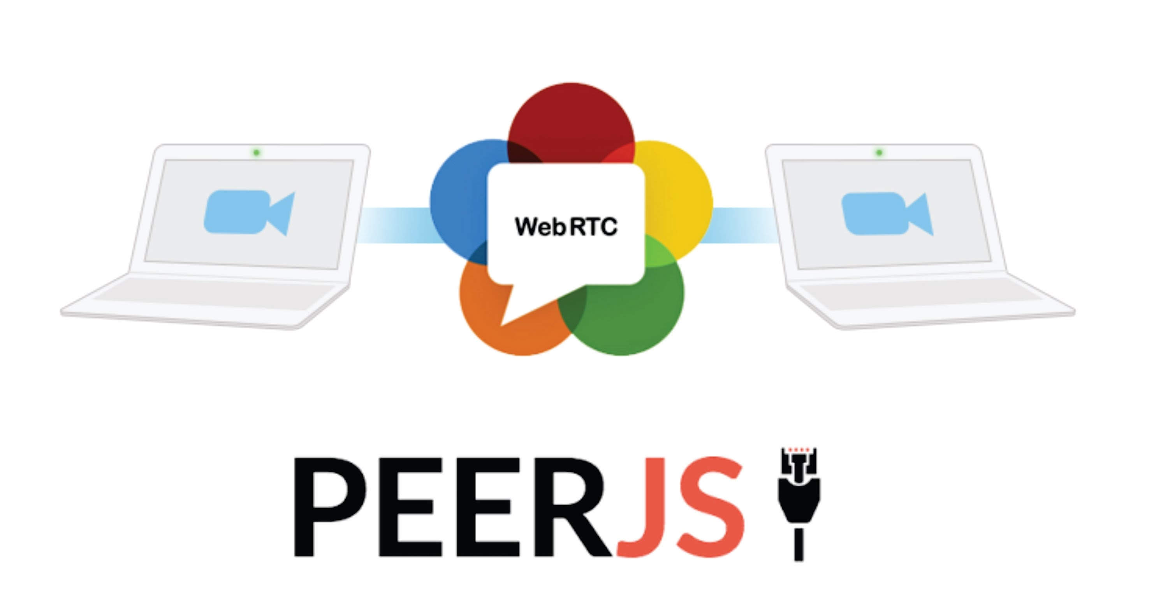
PeerJS Warps All WebRTC Capabilities
Rare Course
WebRTC requires specific steps in ordered to be used in the real implementation.
The steps often result unexpected complexities.
For example, establishing a audio call, many beginners might struggle to perform such function using only WebRTC API.
Therefore, to simplify things peer.js is used.
Peer.js is a ready to use framework as that warps all WebRTC capabilities, including for making audio call, data transfter, et.s
WebRTC Tutorial | 2023
All Levels

Slide 8
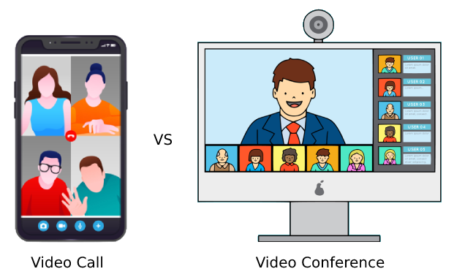
Video Conference or Chat?
Rare Course
It’s quite difficult to differentiate both apps as they share some similarities, however here are the most significant ones:
Number of Connected Users
Utilization Fields
Supporting Features
Devices
Implementation Cost
WebRTC Tutorial | 2023
All Levels

Slide 9

Why Build Private Video Conference App
Rare Course
Among many objectives, here are the most common targets for building private video conference app:
Easy to Customize
Minimizing Operational Costs
Freedom of Use
Make Profit
Beneficial for People
WebRTC Tutorial | 2023
All Levels

