Slide 1
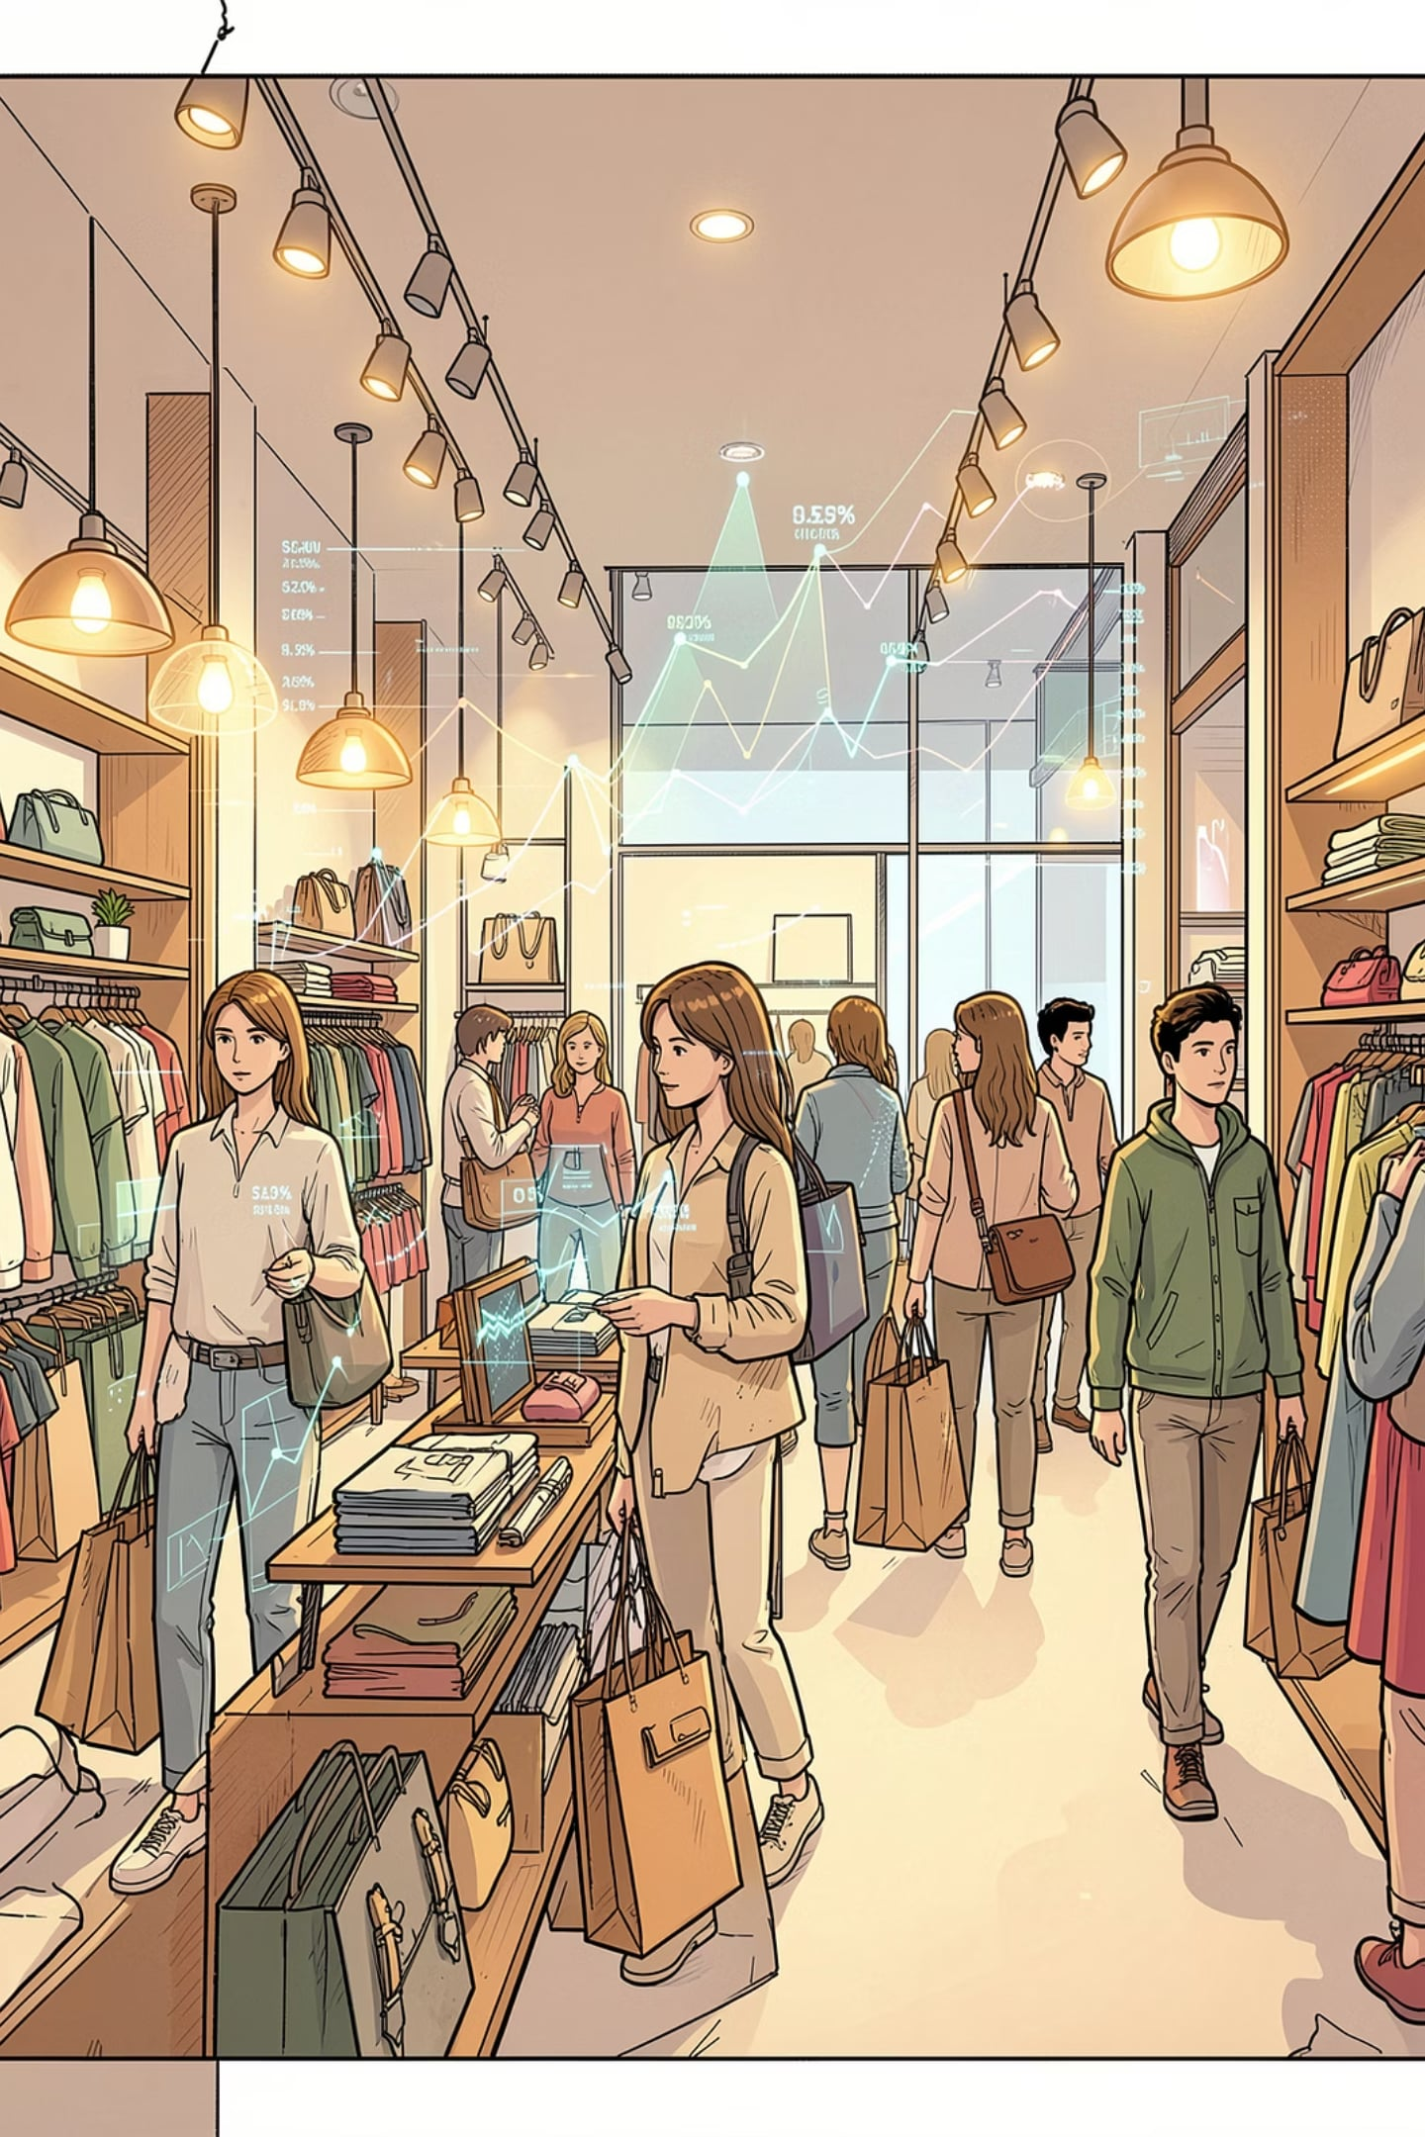
Customer Shopping Behavior Analysis
Uncovering spending patterns, customer segments, and product preferences from 3,900 transactions to guide strategic decisions.

Slide 2

Dataset at a Glance
3,900
18
Transactions
Columns
37
Missing Values
Review Rating only
Features span demographics, purchase details, and shopping behavior — including subscription status, discounts, and review ratings.

Slide 3


Exploratory Data Analysis
Clean & Standardize
Snake_case columns; median imputation for Review Rating
Feature Engineering
Created age_group and purchase_frequency_days
Database Integration
Loaded cleaned data into PostgreSQL for SQL analysis

Slide 4

Revenue by Gender
$157K
Male Revenue
~68% of total
$75K
Female Revenue
~32% of total
Male customers generated more than double the revenue of female customers across 3,900 transactions.

Slide 5
Top Products & Discount Insights
Top 5 by Rating
Most Discounted Products
Product
Rating
Product
Discount Rate
Gloves
3.86
Hat
50%
Sandals
3.84
Sneakers
49.66%
Boots
3.82
Coat
49.07%
Hat
3.80
Sweater
48.17%
Skirt
3.78
Pants
47.37%

Slide 6


Shipping & Subscription Behavior
Express vs. Standard
Express avg: $60.48 · Standard avg: $58.46
Subscribers (27%)
1,053 customers · Avg spend $59.49 · Revenue $62.6K
Non-Subscribers (73%)
2,847 customers · Avg spend $59.87 · Revenue $170.4K

Slide 7
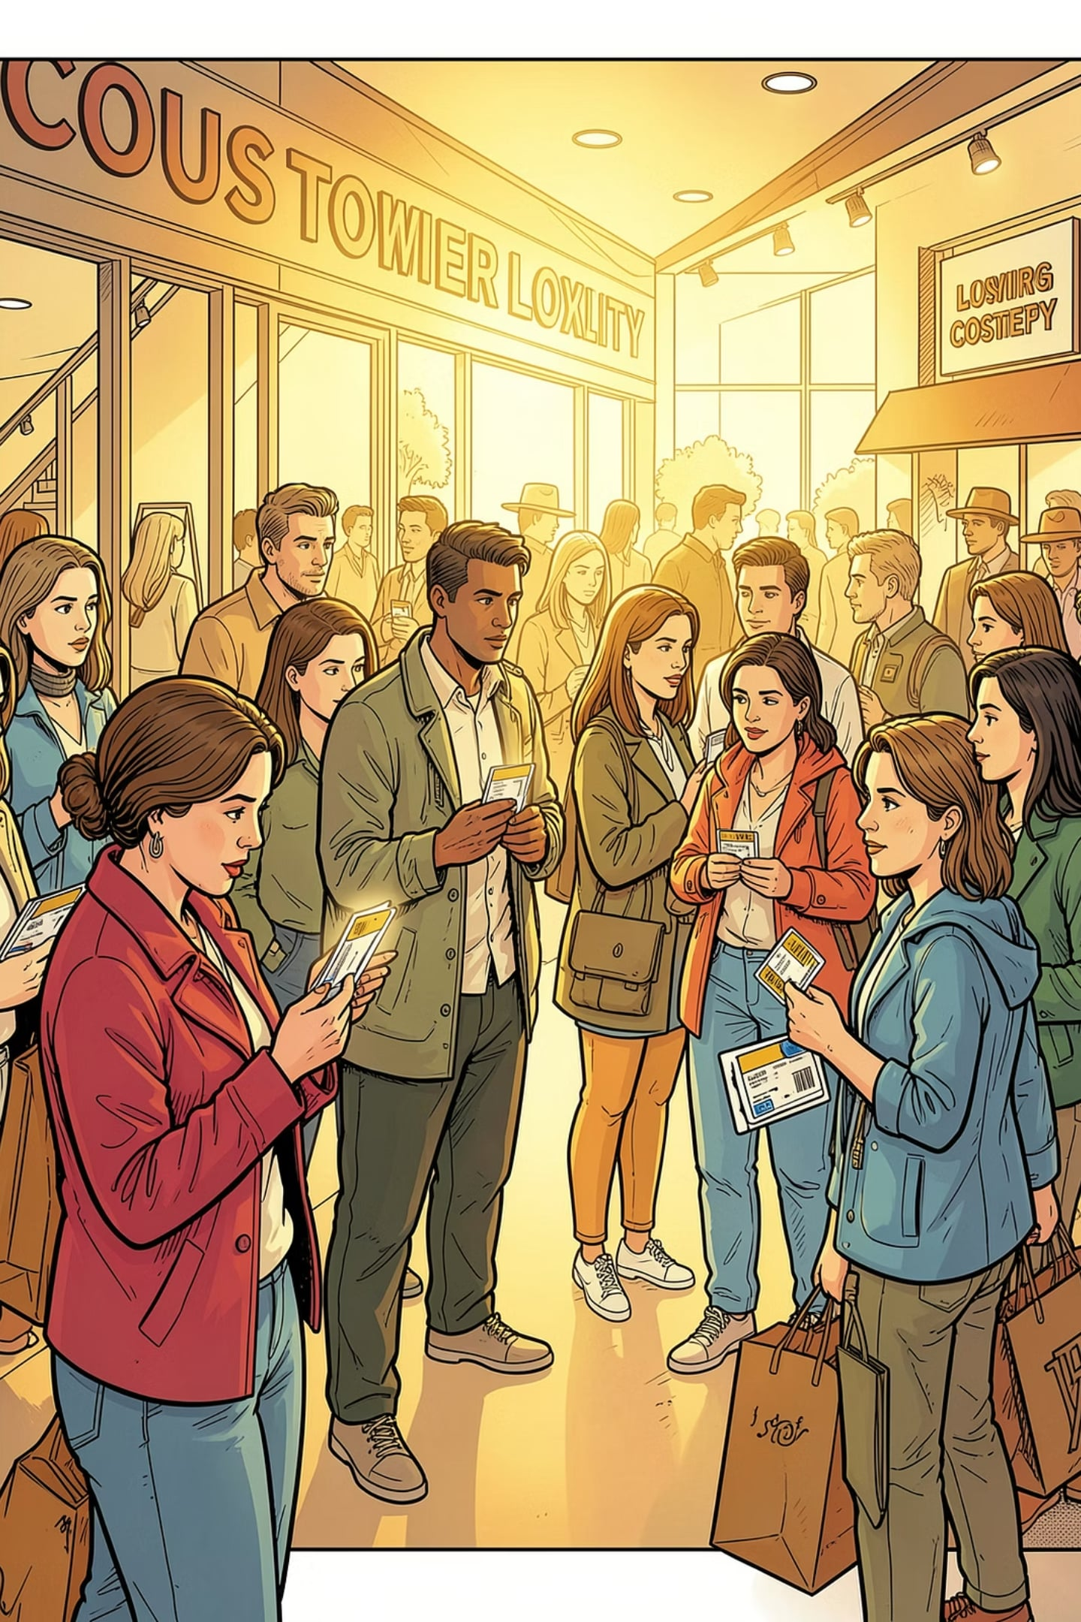
Customer Segmentation
🏆 Loyal
🔄 Returning
3,116 customers
701 customers
🆕 New
83 customers
Of customers with 5+ purchases, 958 are subscribers vs. 2,518 non-subscribers.

Slide 8
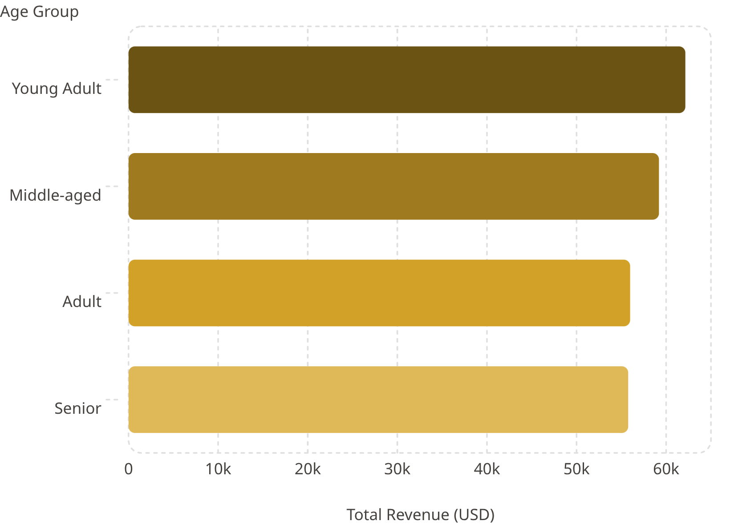
Revenue by Age Group
Key Insight
Young Adults lead revenue at $62,143, though all four age groups contribute fairly evenly — suggesting broad market appeal across demographics.

Slide 9

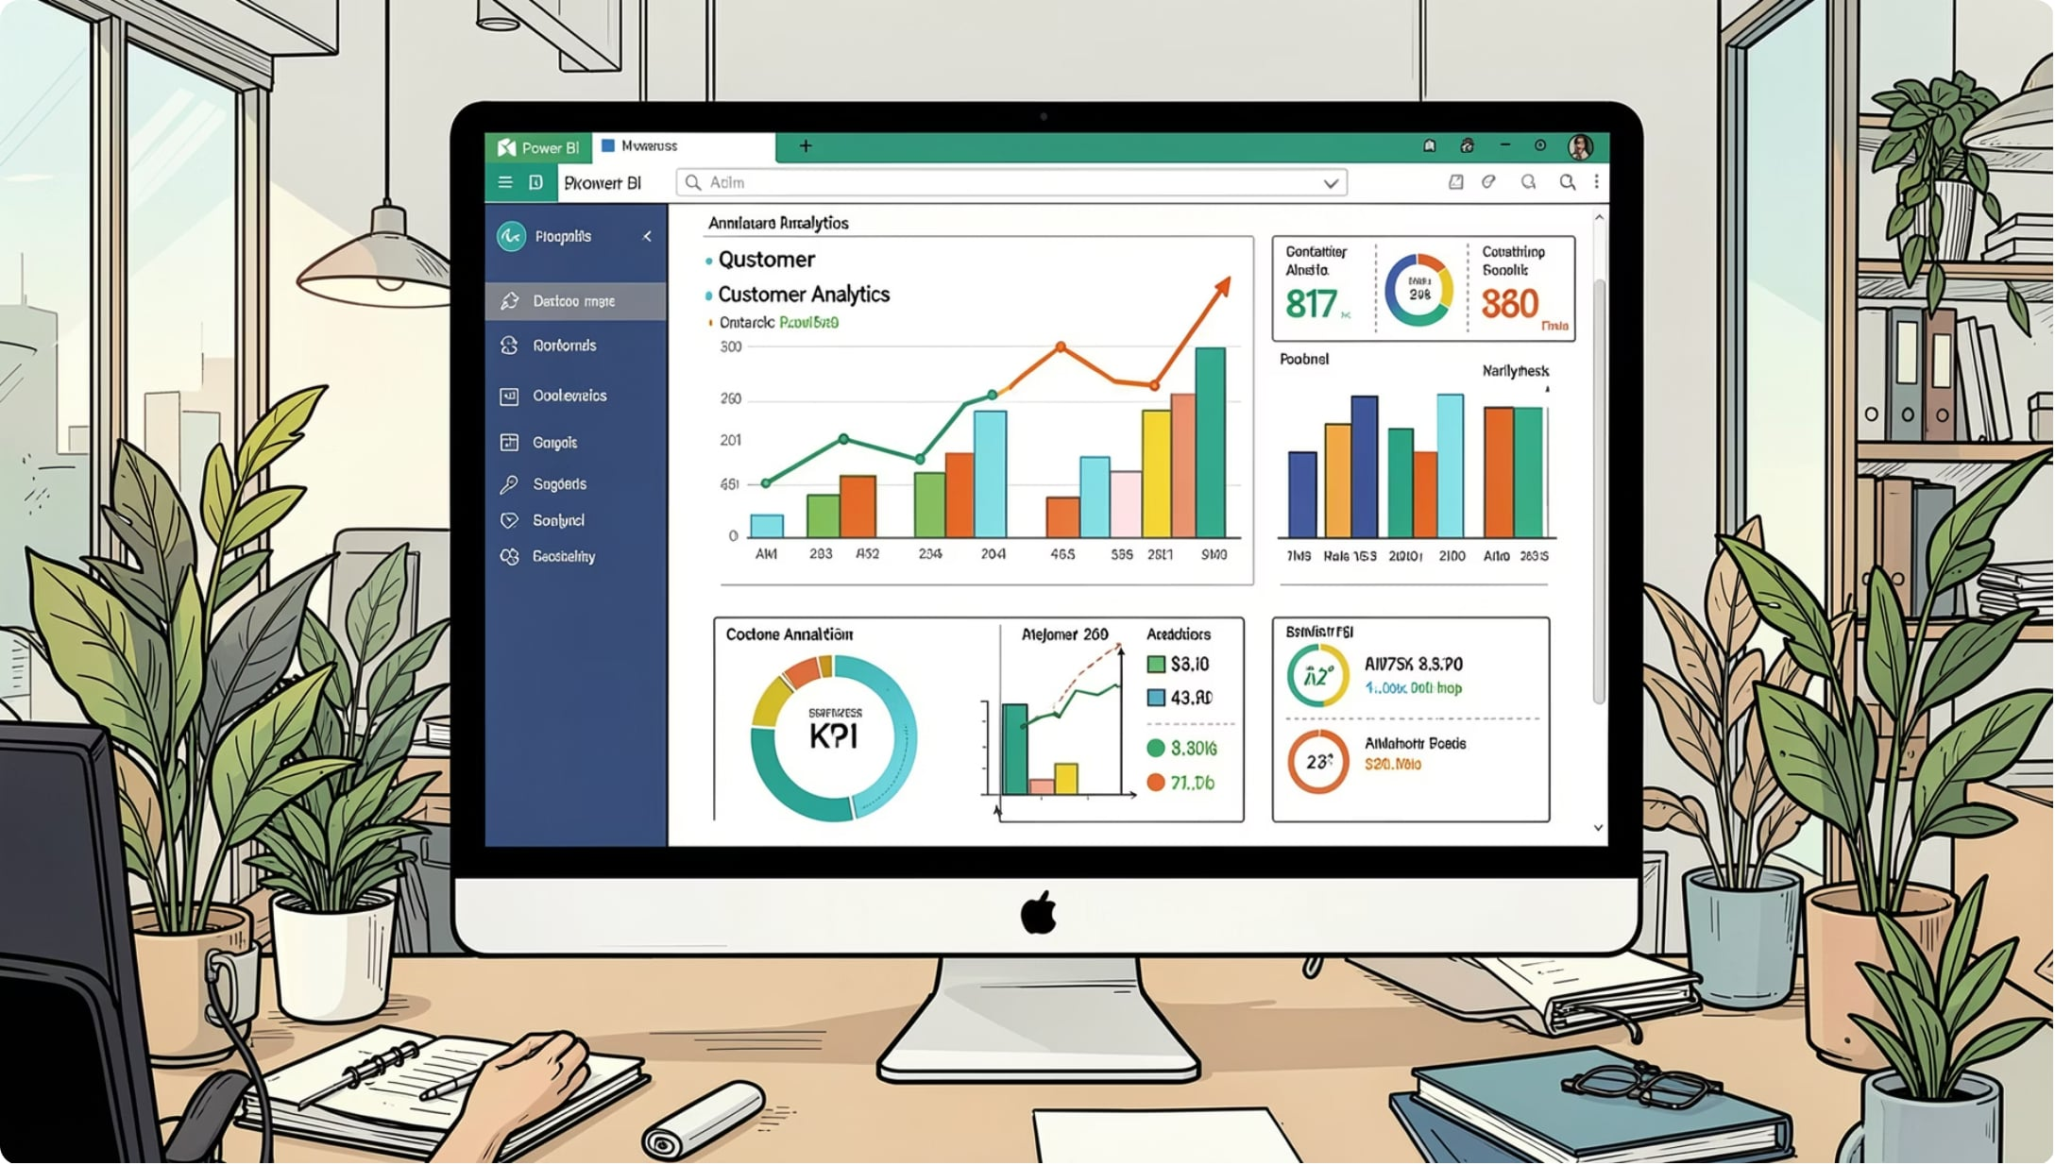


Power BI Dashboard
Interactive Filters
Subscription, Gender, Category, Shipping Type
Visual Charts
Revenue & Sales by Category and Age Group
Key Metrics
3.9K customers · $59.76 avg purchase · 3.75 avg rating

Slide 10
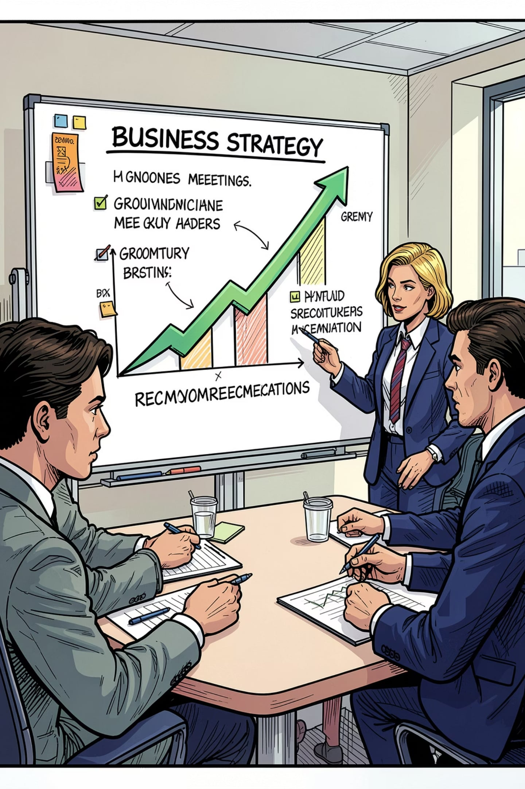




Business Recommendations
Boost Subscriptions
Promote exclusive subscriber benefits
Loyalty Programs
Reward repeat buyers toward "Loyal" segment
Review Discounts
Balance sales lift with margin control
Targeted Marketing
Focus on high-revenue age groups & express shippers

