Slide 1
OLA
RIDE BOOKINGS ANALYSIS
Turning 103,000+ ride bookings into
business decisions
SQL • Power BI • DAX • Excel
Data Analyst Portfolio Project
OLA RIDE BOOKINGS ANALYSIS
1 / 13

Slide 2
THE PROBLEM
Ola processes thousands of ride requests every day. But not every booking turns into a completed ride — some are cancelled by the customer, some by the driver, and some never find a driver at all.
This project analyzes 103,000+ real bookings to answer one question:
Where exactly is Ola losing rides, and why?
103,024
₹3.5 Cr
62%
bookings analyzed
total booking value
success rate
OLA RIDE BOOKINGS ANALYSIS
2 / 13

Slide 3
APPROACH
Three-step workflow, start to finish
01
Structure the data
Loaded 103,000+ raw bookings into MySQL and built a clean, queryable schema.
02
Query with SQL
Wrote 10 SQL views answering real business questions — revenue, cancellations, top customers, ratings.
03
Visualize in Power BI
Built a 5-page interactive dashboard so anyone can explore the findings without touching SQL.
OLA RIDE BOOKINGS ANALYSIS
3 / 13

Slide 4
SQL LAYER
Turning raw rows into answers MySQL can serve on demand
# Which customers ride the most? CREATE VIEW top_5_customers AS SELECT Customer_id, COUNT(Booking_ID) AS total_rides FROM bookings GROUP BY Customer_id ORDER BY total_rides DESC LIMIT 5;
10 SQL views covering:
Successful bookings
Revenue by status
Top 5 customers
Cancellations by driver
Cancellations by customer
Ratings by vehicle type
Payment method breakdown
Incomplete ride reasons
OLA RIDE BOOKINGS ANALYSIS
4 / 13

Slide 5
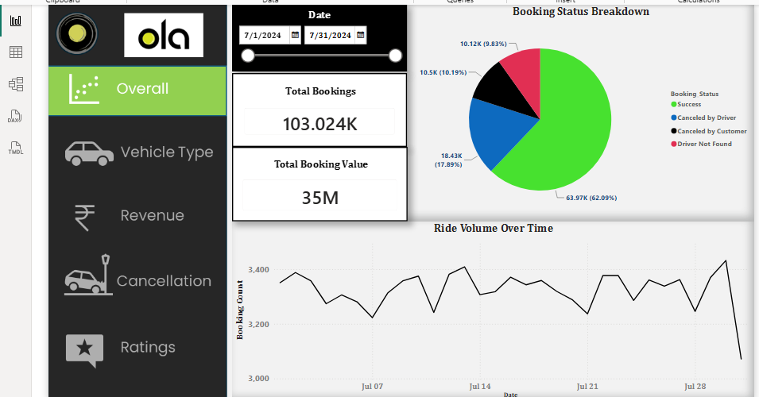
DASHBOARD · PAGE 1 OF 5
Overall Performance
103K bookings and ₹3.5 Cr in value, with a 62% success rate tracked day by day across the month.
OLA RIDE BOOKINGS ANALYSIS
5 / 13

Slide 6
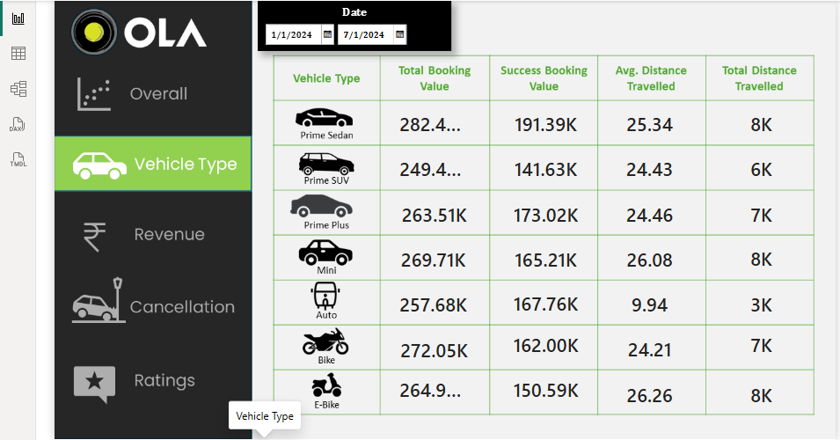
DASHBOARD · PAGE 2 OF 5
Vehicle Type Breakdown
Success booking value stays close across all 7 vehicle types — no single segment carries the business.
OLA RIDE BOOKINGS ANALYSIS
6 / 13

Slide 7
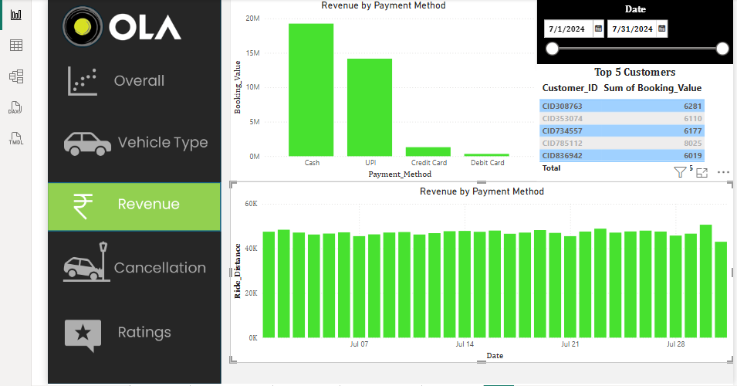
DASHBOARD · PAGE 3 OF 5
Revenue & Top Customers
Cash and UPI bring in the most revenue by far. A small set of repeat customers also stands out clearly.
OLA RIDE BOOKINGS ANALYSIS
7 / 13

Slide 8
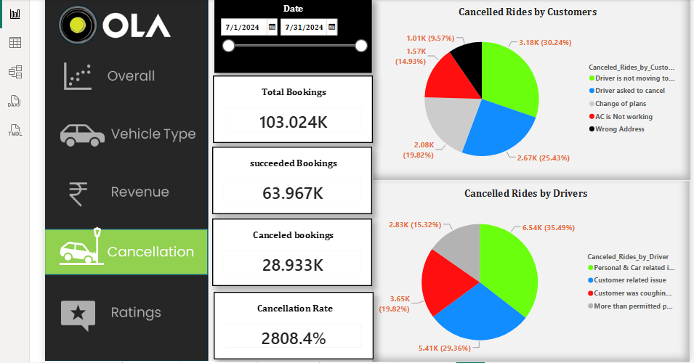
DASHBOARD · PAGE 4 OF 5
Cancellation Analysis
Customers mostly cancel when the driver isn't moving toward them. Drivers mostly cancel over personal or vehicle issues.
OLA RIDE BOOKINGS ANALYSIS
8 / 13

Slide 9
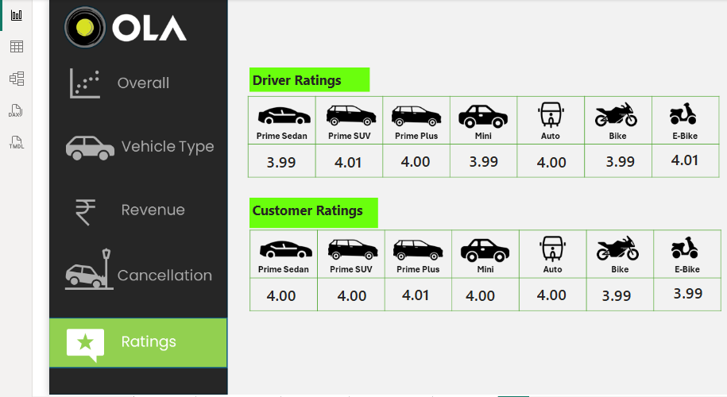
DASHBOARD · PAGE 5 OF 5
Ratings
Both driver and customer ratings sit steady around 4.0/5 across every vehicle type — consistent service quality.
OLA RIDE BOOKINGS ANALYSIS
9 / 13

Slide 10
KEY INSIGHTS
What I'd tell a stakeholder in one minute
01
62% of bookings succeed
The rest are lost almost equally to driver cancellations, customer cancellations, and unmatched drivers.
02
No vehicle type carries the business
Revenue and success value are balanced across Sedan, SUV, Auto, Bike, and E-Bike.
03
Cancellations have two owners
Customers cancel over driver location issues; drivers cancel over personal or vehicle issues — two different fixes needed.
04
Service quality is consistent
Driver and customer ratings hold steady near 4.0/5 across every vehicle type — this is an operations issue, not a service one.
OLA RIDE BOOKINGS ANALYSIS
10 / 13

Slide 11
TECH STACK
Tools used end to end
Excel
MySQL
Power BI
DAX
Raw data — 103,000+ bookings, 20 fields
Schema design + 10 SQL views for business logic
5-page interactive dashboard
Calculated measures for KPIs and ratios
OLA RIDE BOOKINGS ANALYSIS
11 / 13

Slide 12
IN THIS REPOSITORY
ola_sql_queries.sql
All 10 SQL views — schema + business queries
pbi_ola_pro.pbix
Power BI dashboard file (5 pages)
Bookings-100000-Rows.xlsx
Raw dataset, 103,000+ ride bookings
README.md
Project overview, findings, and setup notes
OLA RIDE BOOKINGS ANALYSIS
12 / 13

Slide 13
THANK YOU
Open to Data Analyst roles — feedback and referrals welcome.
Connect with me on LinkedIn or reach out via GitHub.
OLA RIDE BOOKINGS ANALYSIS
13 / 13

