Slide 1





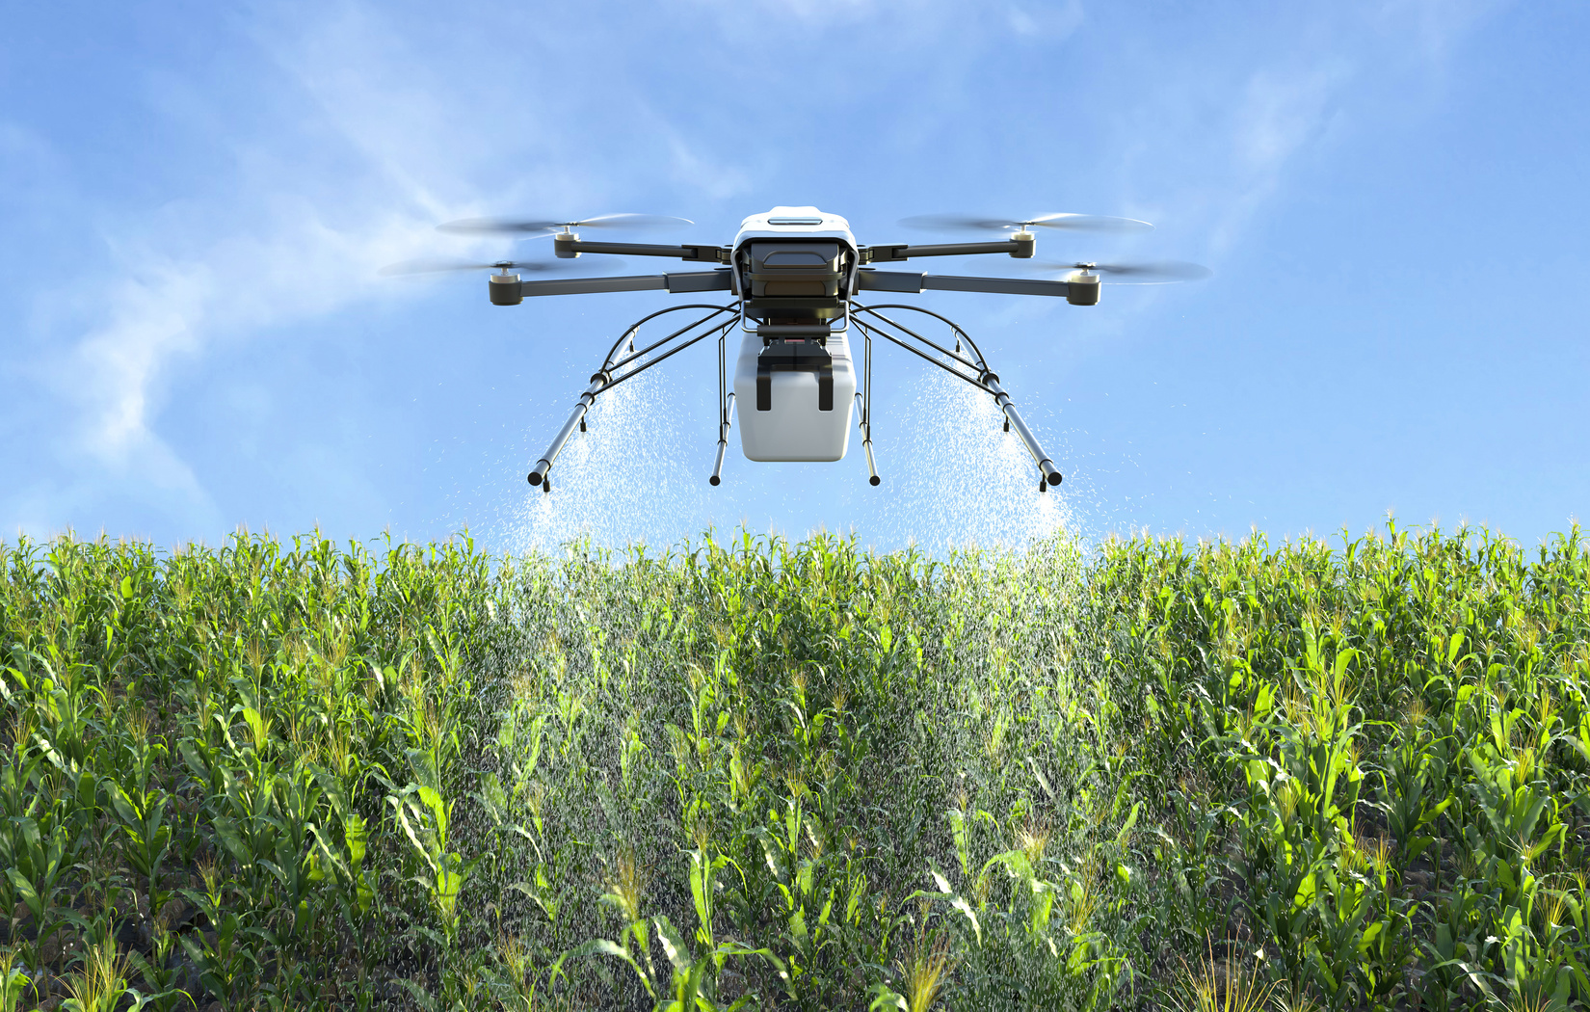



ARVORA
“A world where live, learning and green habits grow together”
•Problem Statement ID – 01
•Problem Statement Title -Gamified Environmental Education Platform for Schools and Colleges
•Theme - Smart Education & E-learning
•PS Category - Software/Hardware
•Team ID - T-011
•Team Name - DATA DIVERS

Slide 2
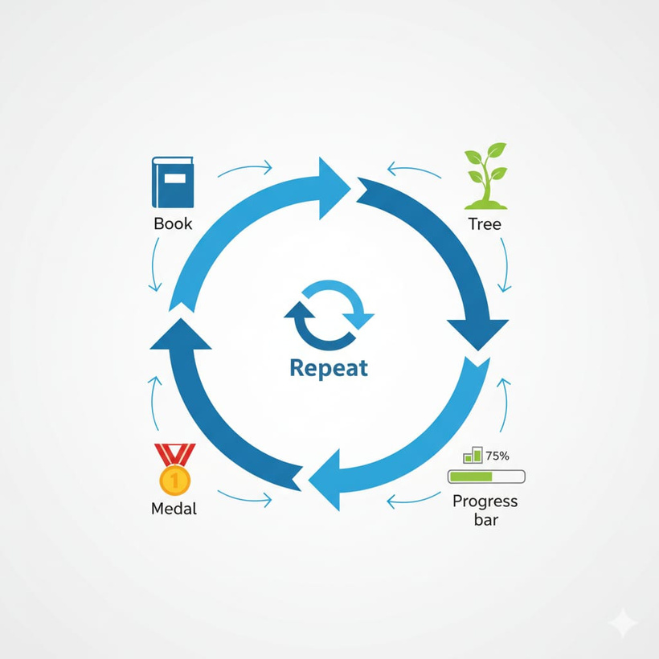

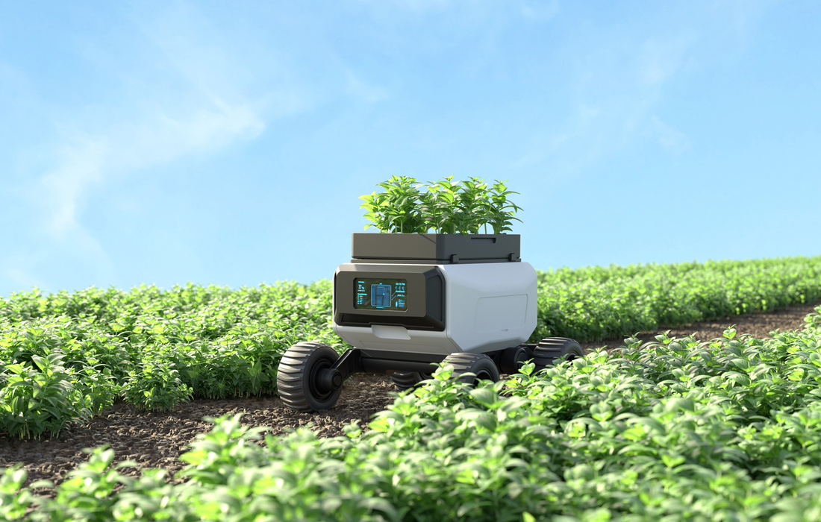
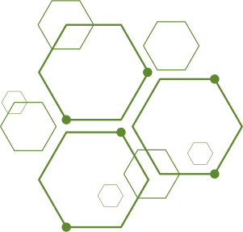
ARVORA: GAMIFIED ENVIRONMENTAL EDUCATION PLATFORM
A web/mobile platform where students learn environmental issues via-interactive lessons, quizzes, and mini-games.
Students take real-world eco-challenges (tree planting, waste segregation, saving electricity) and upload proof.
Eco-points, streaks, and badges track progress and motivate consistency.
A teacher/school portal verifies participation and enables class-level competitions.
..
How it Addresses the Problem
Innovation & Uniqueness
HOW IT ADDRESSES THE PROBLEM
Premium Analytics & Data Licensing
Combines Gamification + Real-world Action + Atomic Habits principles (tiny habits, streaks, rewards).
Not just an e-learning tool → a habit-building platform.
AI Companion : personalized nudges & eco-habit suggestions.
Scalable at individual, class, and school levels.
Turns boring textbook theory into fun, gamified learning
Direct link between knowledge → real action → habit formation
Creates healthy competition (leaderboards, badges) to motivate participation.
Encourages school-wide eco-initiatives and community impact

Slide 3

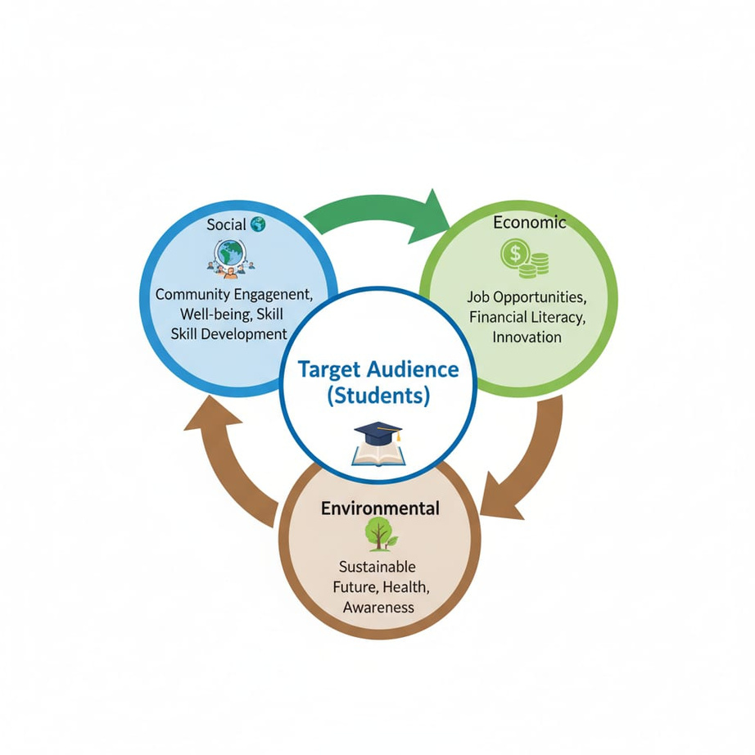
IMPACT & BENEFITS
Potential Impact on Target Audience
Engages students in fun, interactive learning
Builds long-term eco-friendly habits
Increases awareness & responsibility towards environment
BENEFITS OF THE SOLUTION
Social: Promotes teamwork, community participation
Economic: Cost-effective education, prepares future green workforce
Environmental: Reduces waste, encourages conservation, sustainable practices

Slide 4
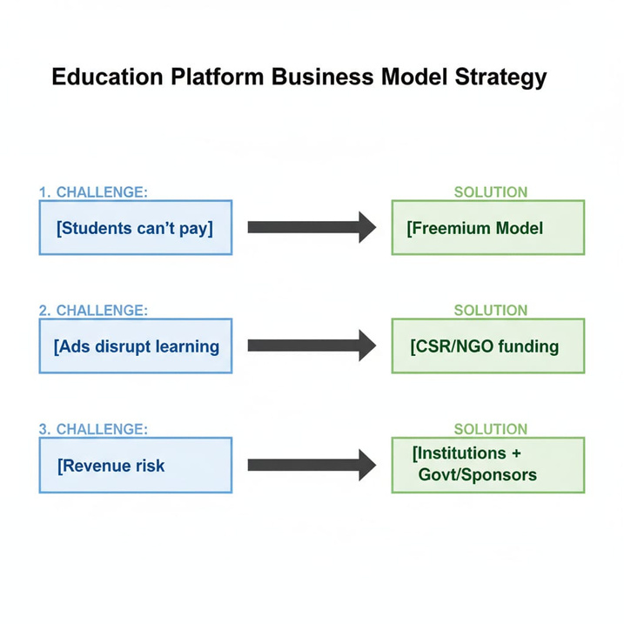
FEASIBILTY AND VIABILITY
Challenges (Problem)
Students can’t pay
Ads disrupt learning
Sustainability of revenue
.
Feasibility:
Aligned with NEP 2020 & SDGs
Win–win for schools, corporates & society
Solutions:
Freemium model
Institutions pay
CSR/NGO funding
Govt grants & Sponsorships

Slide 5

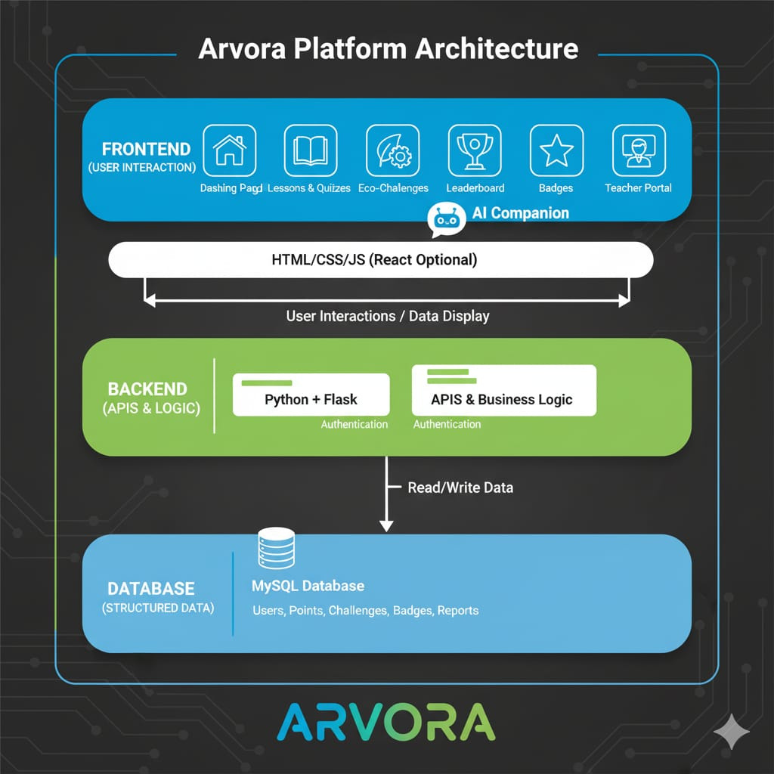
KEY TECHNOLOGIES
Frontend: HTML/CSS/JS
Backend/Logic: Python + Flask for APIs and Authentication.
​Database: MySQL (Structured Data: Users, Points, Challenges).
​
IMPLEMENTATION PROCESS (3-TIER MODEL)
Frontend: Handles User Interactions and Data Display.
​Backend: Manages APIs & Business Logic (Authentication).
​Database: Stores/Retrieves data via Read/Write requests.

Slide 6
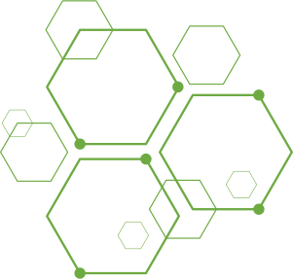

Research References – Gamified Environmental Education Platform
Gamification for Environmental Engagement – thedecisionlab.com
Gamified Learning Platform Using NASA PACE Data – irjmets.com
Effects of a Gamified Learning Environment – pmc.ncbi.nlm.nih.gov
Clean Games – en.wikipedia.org
Gamification for Sustainability Engagement – ecologi.com t

