Slide 1
USER
APPLICATION
MIDDLEWARE(ROS)
OPERATING SYSTEM
HARDWARE

Slide 2
ROS MASTER
REGISTRATION
REGISTRATION
MESSAGE
MESSAGE
ROS NODE 1
ROS NODE 2
ROS NODES N
MESSAGES

Slide 3
NODES:
MASTER NODE
NODE 1
NODE 2
NODE 2
PACKAGES:
ROSCORE
ROSCPP
ROSLANG
STD_MSG
LIB:
BOOST C++ LIB
XML RPCPP
MATH
LIBC
LIBC++
LINUX OS

Slide 4
OSI MODEL
ROS MODEL
APPLICATION
ROS MASTER
ROS NODE
PRESENTATION
XML-RPC
HTTP
SESSION
TRANSPORT
TCP
UDP
NETWORK
IP
DATA LINK
VNET
ETHERNET
PHYSICAL

Slide 5
1

Slide 7
1
2
3
1
2
Forward
Backward
Left
3
4
4
5
6
Right
Turning Right
Turning Left

Slide 9







1
$$α$$
$$α$$
3
$$Y_{R}$$
$$T_{X}$$
$$A_{1}$$
$$X_{R}$$
$$T$$
$$δ$$
$$T_{Y}$$
$$Z_{R}$$
$$T_{X}$$
$$α$$
$$Y$$
$$A_{2}$$
$$T_{Y}$$
2
$$α$$
4
$$Z$$
$$X$$

Slide 10




$$θ_{d}$$
Position Control Loop
$$ω_{d}$$
Velocity Control Loop
$$i_{d}$$
Current Control Loop
Power Converter
-
-
-
Motor & Load
$$ω_{ }$$
$$θ_{ }$$
$$i_{ }$$

Slide 11

















$$y$$
$$f_{i,i+1}(x)$$
$$y_{1}$$
$$y_{2}$$
$$y_{i−1}$$
$$y_{i}$$
$$y_{i+1}$$
$$y_{n−1}$$
$y_{n}$
$$x$$
$$x_{1}$$
$$x_{2}$$
$$x_{i−1}$$
$$x_{i}$$
$$x_{i+1}$$
$$x_{n−1}$$
$$x_{n}$$

Slide 12
Normal Motion
Motion including End Point Augmentation
Position 1
Position 2

Slide 13
Odometry Drift
Where robot was started
Dead Reckoning
/map_frame
Translation
/odom_frame
Translation
/base_frame
Orientation
Orientation
Estimated by AMCL

Slide 14
Sensors
Perception
Localization
Planning
Motion Control
Actuators

Slide 15
Data Communication
Area Exploration
∑
Sensors
Detection of Goal Position
Actuators
Obstacle Avoidance
Fusion
Follow Left/Right Wall

Slide 16
Odometry Drift
Where robot was started
Dead Reckoning
Position Update
Encoder
Matched Observations
Position Prediction
Position
Yes
Matching
Predicted Position
Map Database
Raw Sensor Data
Perception
Observation

Slide 17
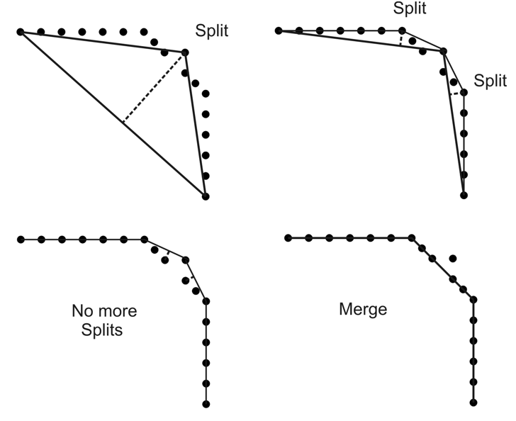
1
2
3
4

Slide 19
Environment
Sensing
Signal Treatment
Feature Extraction
Scene Interpretation

