Slide 1
Text Summarization using Deep Learning and Ridge Regression
Dr. CULOTTA & karthik

Slide 2
Motivation
To Summarize long documents
To study the Effectiveness of Deep Models

Slide 3
Problem
Sentence Ranking : Given a Document, Rank the sentences based on their Importance
Sentence Selection : Among the Important Sentences, select the ones that are Salient

Slide 4
Approach
Data Collection
Feature Extraction
First Sentence Baseline Model
Train/ Cross Validate/ Tune Hyperparams on below Modes:
Ridge Regression
Deep MLP
Epochs : 5,10,15,20
Optimizers : SGD, Adam, LBFGS
Hidden Layers : 1,2,3
Hidden Units/ Layer : 57
Identify the model with least Test Error
Predict the Summaries using the Best Model

Slide 5
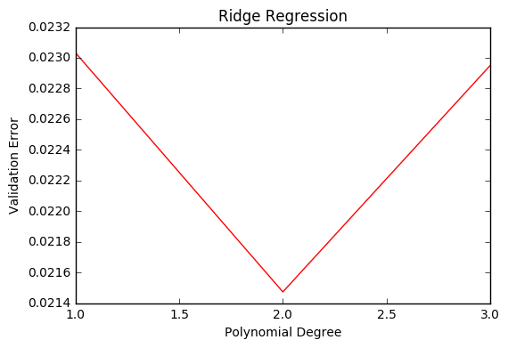
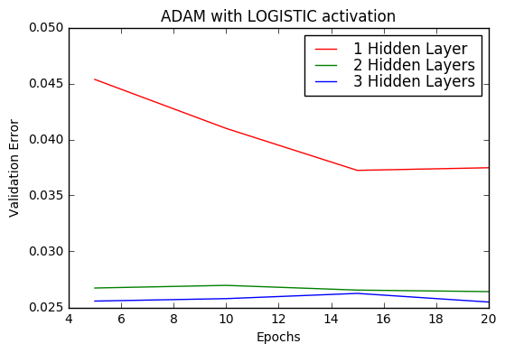
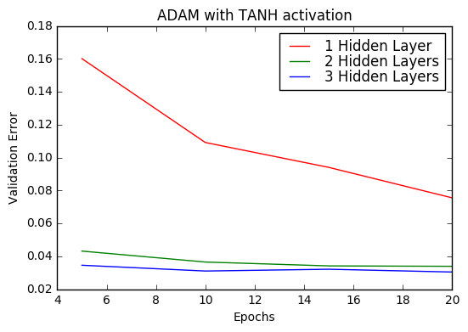
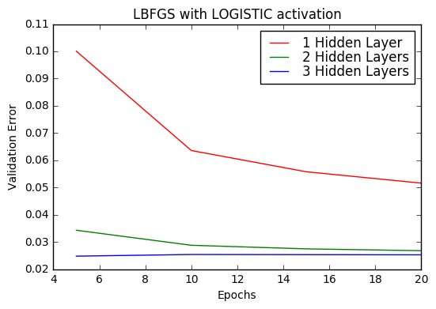
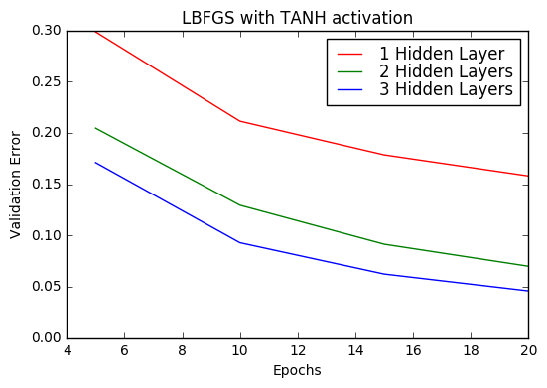
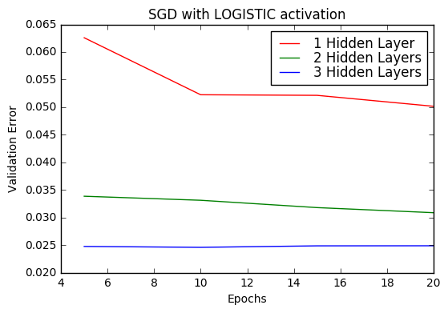
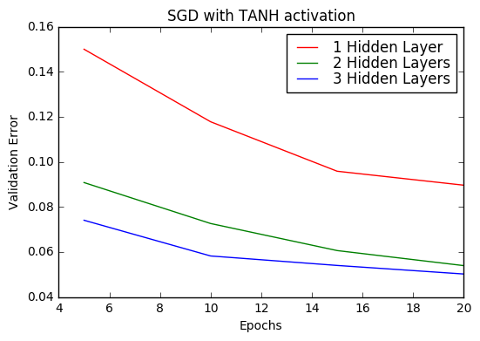
Result – Validation Errors
Optimizer | Activation | Hidden Layers
Adam | Logistic | 3
LBFGS | Logistic | 3
SGD | Logistic | 3

Slide 6
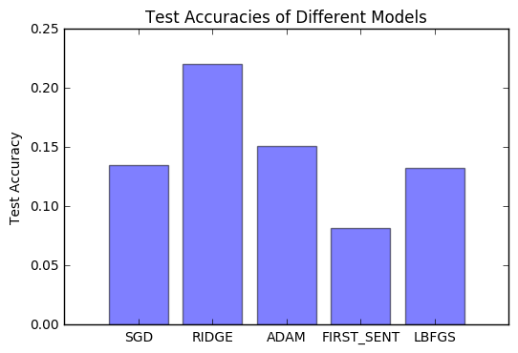
Result – Test Accuracy
Ridge is the Winner ☹

Slide 7
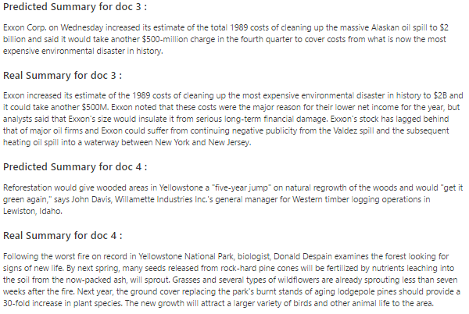
Result – Sample Summaries

Slide 8
Future Work
Generate the summary instead of extracting it
Learn the Features from Text instead of Hand-Crafting it
Train on all the DUC Datasets - DUC 2002, 2003....2006
Regularize Deep Models using Dropout
Work on Query Relevant Summarization

Slide 9
Questions ?

