Slide 1

Project Title: Face Recognition Based Attendance System
DE-2B
2018-19
Internal Guide: Bhagirath Sir
By- Vaibhav R Soni (160010107055)
Ankit J Sharda (160010107050)
Smit J Chavda (160010107006)
Hely P Parmar (160010107028)

Slide 2
Abstract
Attendance of the student is very important for every college, universities and school. Conventional method for taking attendance is by calling the name or roll number of the student and the attendance is recorded. Time consumption for this purpose is an important point of concern. Assume that the duration for one subject is around 60 minutes & to record attendance takes 5 to 10 minutes. For every tutor this is waste of time. To stay away from these losses, an automatic process is used in this project which is based on image processing. In this project face detection and face recognition is used. The database of all the students in the class is stored and when the face of the individual student matches with one of the faces stored in the database then the attendance is recorded.

Slide 3
Architecture of Project
The architecture of this face recognition based attendance system is shown in the below mentioned diagram. The working of this smart attendance system is very simple and easy to understand. To bring this system into work, we will need some hardware devices for our project. Firstly, we will need a high definition camera which has to be fixed in the classroom at a suitable location from where the whole class can be covered in the camera.
When the camera takes the picture of all students, that picture is enhanced for further processing. In the enhancement, the picture is first transformed in grayscale image, and then it will be equalized using histogram technique.
After enhancement, the picture will be given for detecting the faces of students which will be done by face detection algorithm.
Then after detection of faces, each student's face will be cropped from that image, and all those cropped faces will be compared with the database of faces. In that database, all students' information will be already maintained with their image. By comparing the faces one by one, the attendance of students will be marked on server.

Slide 4
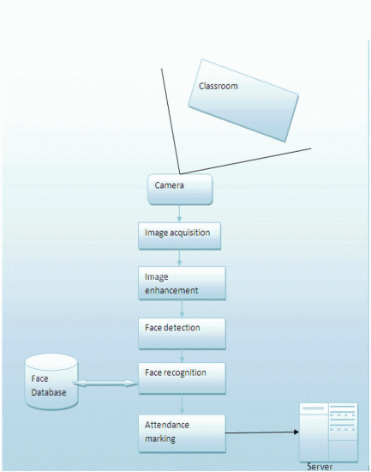
s

Slide 5
Steps for Face Recognition based Attendance System
Enrollment
Image Acquisition.
Converting the image into gray scale image.
Histogram Normalization.
Removing Noise.
Classification of Skin.
Face Detection.
Face Recognition.
Attendance marking

Slide 6
Enrollment
The student or person will be enrolled to the database using their general information and unique biometric features. This information will be saved in the form of templates. The enrollment includes:
Taking image by camera
Enhancement of that image
Feature extraction
Maintain Database
The image of person will be captured from the camera and then it will be enhanced using histogram equalization and noise filtering. Then after this process, the features are extracted from the image. The unique features will be stored in the face database and a particular id will be assigned to that person.
Image Acquisition
A high definition camera device will be installed in front of the classroom. The camera device will capture the image of whole classroom. This captured image is given as an input to the system.
Grayscale Conversion of Image
The image which is captured from the camera device sometimes may have the brightness in it which needs to be removed for the appropriate result. Therefore the Captured image is converted to grayscale image for the enhancement

Slide 7
Histogram Normalization
Histogram Normalization is a technique used for contrast enhancement. After this the image will be equalized for removing the contrast so that the students sitting on the back rows can be clearly seen and it will be easy to recognize them. Then it generates the histogram of the equalized image.
Noise Removal
When the input image is captured by camera, it may contain the noise which has to be filtered from image. The median filtering is one of efficient techniques for removing the noise.
Skin Classification
In the skin classification technique, all the pixels are made black except the pixels which are closely related to the skin. Those pixels become white. The accuracy of face detection algorithm is improved after skin classification.

Slide 8
Face Detection
After the enhancement of image, the image comes to face detection module. This module will detect the faces of students from image. The Viola and Jones Algorithm is used for the purpose of face detection. It is also known as the Ada-Boost algorithm for face detection which is created by Viola P. and M. J. Jones.
Face Recognition
Face recognition is the next step after face detection. The face recognition can be achieved by cropping the faces from the image and comparing them with the enrolled images in the face database. For the face recognition, the concept of selection of region of interest is used, and the faces are verified one by one using the EigenFace method.
Attendance
After the verification of faces and successful recognition is done, the attendance will be marked on the server.

Slide 9
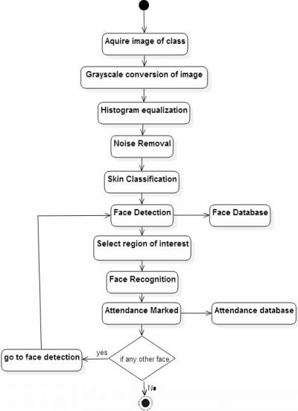

Slide 10
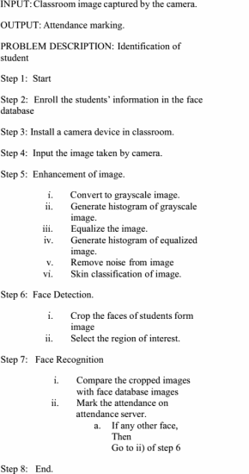
Algorithm

Slide 11
Conclusion
The smart and automated attendance system can be proven as an efficient system for classroom attendance. By using this system the chances of fake attendance and proxies can be reduced. There are a lots of Biometrics Systems which can be used for managing attendance, but the face recognition has the best performance. So we need to implement a reliable and efficient attendance system for classroom attendance which can work for multiple face recognition at one time. We found the solution for light intensity problem and head pose problem for which we can use the Illumination Invariant algorithm. Also to implement this system, no any specialized hardware is required. A camera device and a standalone PC, database servers are sufficient for constructing the smart attendance system.
Future Work:
Further work can be done on this project to alert the student by sending SMS regarding the attendance. For this purpose GSM module can be used. SMS alert can be given to the parent of the student.

Slide 12
References
https://ieeexplore.ieee.org/document/7380478/
http://ethesis.nitrkl.ac.in/7301/1/AUTOMATED_Mallik_2015.pdf

Slide 13
Thank you!!!

