Slide 1

Text Summarization System
Project – 2(2180706)
Guided by: Prof. Gopi Bhatt
Prof. Aniruddha Kurtkoti
Team-Members : Ankit Sharda(160010107050)
Dharmesh Vekariya(160010107062)
Vrundan Patel(160010107040)

Slide 2
Problem Summary
Text Summarization is the process of obtaining most important information from an authentic text document.
There is a wealth of textual content available on the internet. But, usually, the internet contribute more data than is desired.
Therefore, a twin problem is detected: Searching for appropriate document through a large number of documents offered, and extracting a high volume of important information.
The objective of automatic text summarization is to condense the original text into a precise version.
The main advantage of a text summarization is reading time of the user can be reduced as well as it becomes quite easy to search important document from large number of available documents.
A text summary system should reproduce the assorted theme of the document even as keeping repetition to a minimum.

Slide 3
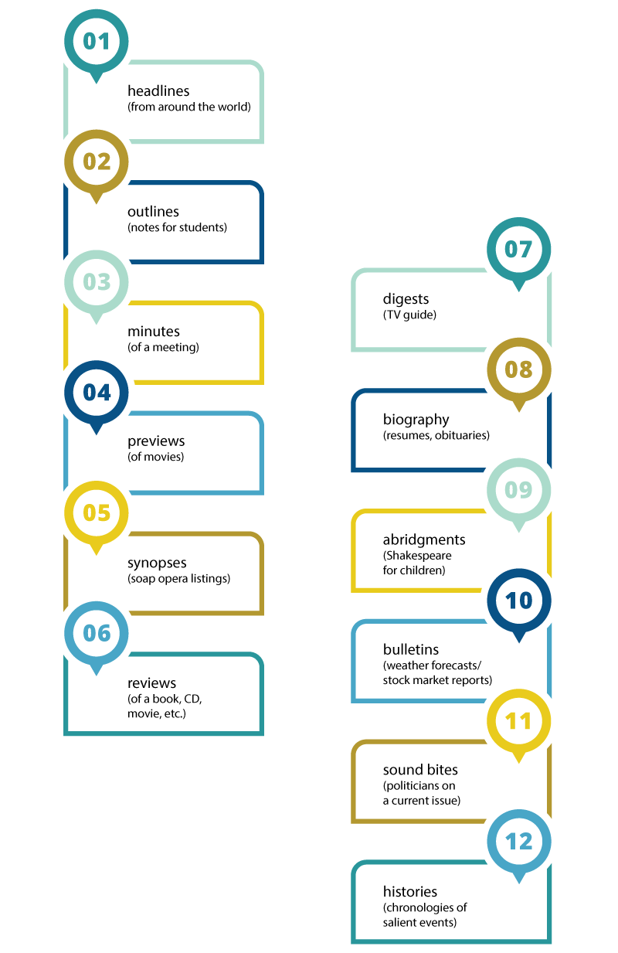

Slide 4
Advantages of Text Summarization
Financial research : Summarization systems tailored to financial documents like earning reports and financial news can help analysts quickly derive market signals from content.
Legal contract analysis : Summarizer might add value by condensing a contract to the riskier clauses, or help you compare agreements.
Social media marketing : Companies producing long-form content, like e-books and blogs, might be able to leverage summarization to break down this content and make it sharable on social media sites.
Medical cases : Summarization can be a crucial component in the medical field when it comes to analyzing medical cases and routing these to the appropriate health professional.
Books and literature : Summarization can help consumers quickly understand what a book is about as part of their buying process.
Science and R&D : Systems that can group papers and further compress abstracts can become useful for this task.
Patent research : Researching patents can be a tedious process. Whether we are doing market intelligence research or looking to file a new patent, a summarizer to extract the most salient claims across patents could be a time saver.

Slide 5
Text Summarization Approaches
Extractive summarization:
Extractive methods attempt to summarize articles by selecting a subset of words that retain the most important points.
This approach weights the important part of sentences and uses the same to form the summary.
Input document → sentences similarity → weight sentences → select sentences with higher rank.
Abstractive summarization:
Abstractive methods select words based on semantic understanding, in order to generate a new shorter text that conveys the most critical information from the original text.
Input document → understand context → semantics → create own summary.

Slide 6
Implementation
It is divided into 3 main parts:
1) Back-end : Back-end text summarizer code is coded in python using NLP’s NLTK(Natural Language ToolKit) library.
2) Front-end : Front-end User-interface is designed using HTML, CSS and JavaScript.
3) Front end Back end Connectivity : Front end UI and Back end python code is connected using Django which is a high-level Python Web Framework.

Slide 7
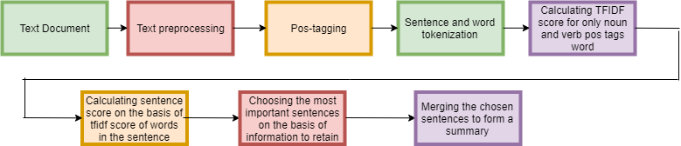
Text-Summarizer Code Workflow
We have implemented extractive text summarization using TF-IDF scoring mechanism and NLTK library for NLP.

Slide 8
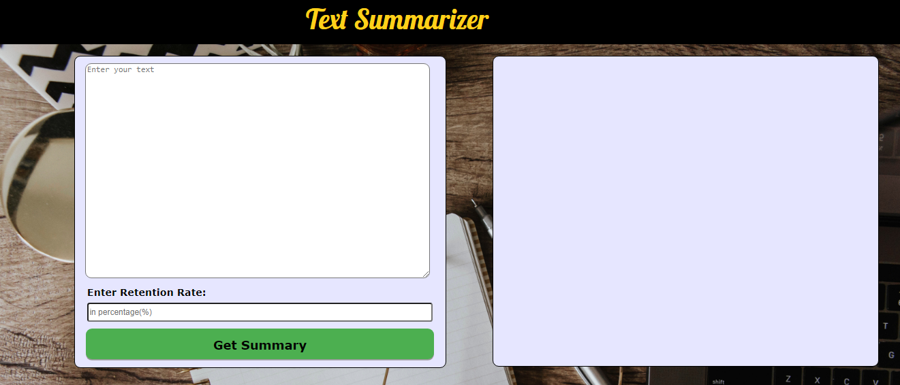
User- Interface

Slide 9
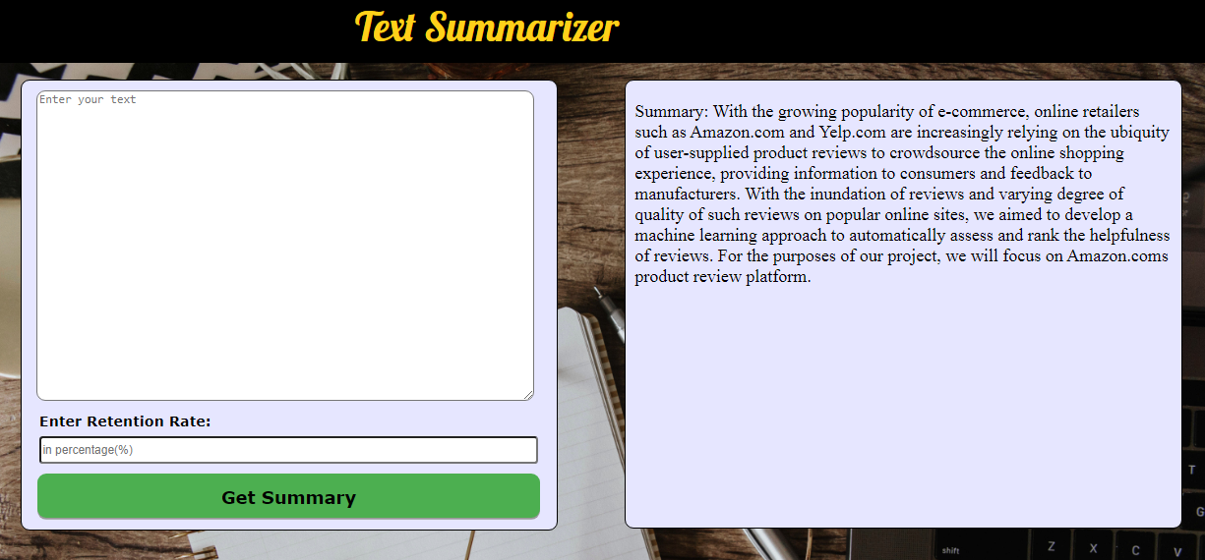
Output

Slide 10
Future Enhancements
Use abstractive text summarization.
Taking input in the speech form.
Adding data directly from pdf file.
Giving option to email the summary file.

Slide 11
Thank you!!!

