Slide 1


Slide 2
Agenda
What is Selenium?
How does it work?
What are the benefits of using Selenium?
How to set up Selenium with Java
How to write Selenium tests
How to run Selenium tests

Slide 3
What is Selenium?
Selenium is an open-source tool that automates web browsers. It provides a single interface that lets you write test scripts in programming languages like Ruby, Java, NodeJS, PHP, Perl, Python, and C#, among others.
Selenium can be used to automate a wide variety of tasks, including:
Logging in to a website
Filling out forms
Clicking on buttons
Scrolling through pages
Taking screenshots
Generating reports

Slide 4
How does it work?
Selenium works by interacting with the web browser's underlying APIs. This allows it to control the browser's actions, such as navigating to a page, clicking on a button, or entering text into a field.
Selenium can be used to automate any website that is accessible through a web browser. It is not limited to any specific programming language or framework.

Slide 5
What are the benefits of using Selenium?
Cross-Browser Testing
Language and Platform Support
Open Source Advantage
Automated Testing Efficiency
Reusability and Modularity
Parallel Test Execution
Integration with Testing Frameworks
Web Element Interaction
Continuous Integration Integration

Slide 6
How to set up Selenium with Java ?
Java JDK
Selenium WebDriver
A IDE (Eclipse or IntelliJ IDEA)
Once you have installed the required software, you can create a new Java project and start writing your test scripts.

Slide 7
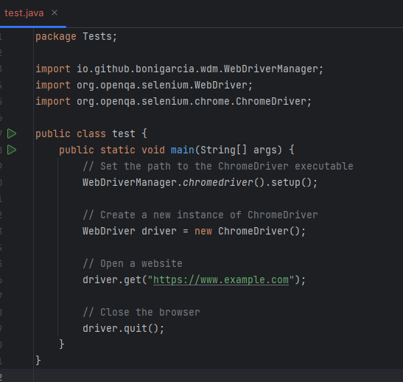
How to write Selenium tests ?
Create a New Java Project
Add Selenium Dependencies
Write Test Scripts
Handle Waits
Use Testing Frameworks
Run Tests
Review and Refine
Continuous Integration

Slide 8
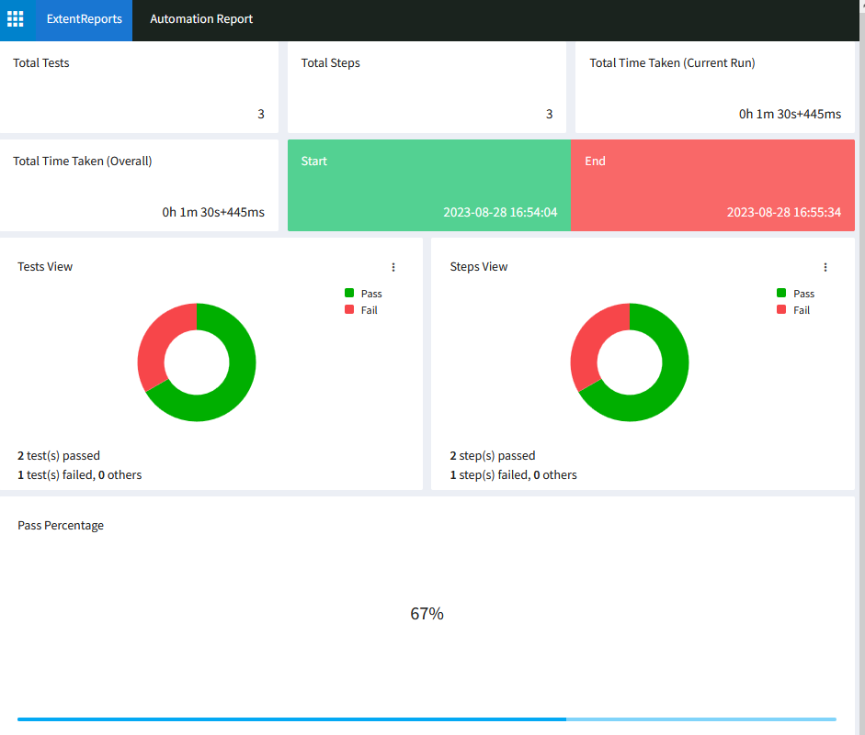
How to run Selenium tests ?
Once you have written your Selenium tests, you can run them using a variety of methods, including:
Running them manually
Running them from the command line
Running them using a continuous integration (CI) server
When you run your Selenium tests, you will get a report that shows the results of the tests. This report will indicate which tests passed and which tests failed.

Slide 9


Slide 10
Thanks

