Slide 1
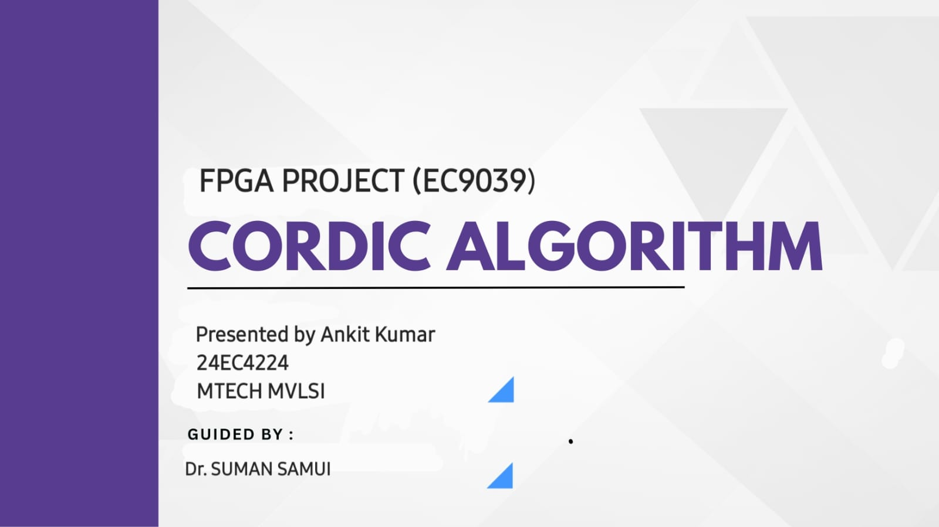
CORDIC ALGORITHM

Slide 2
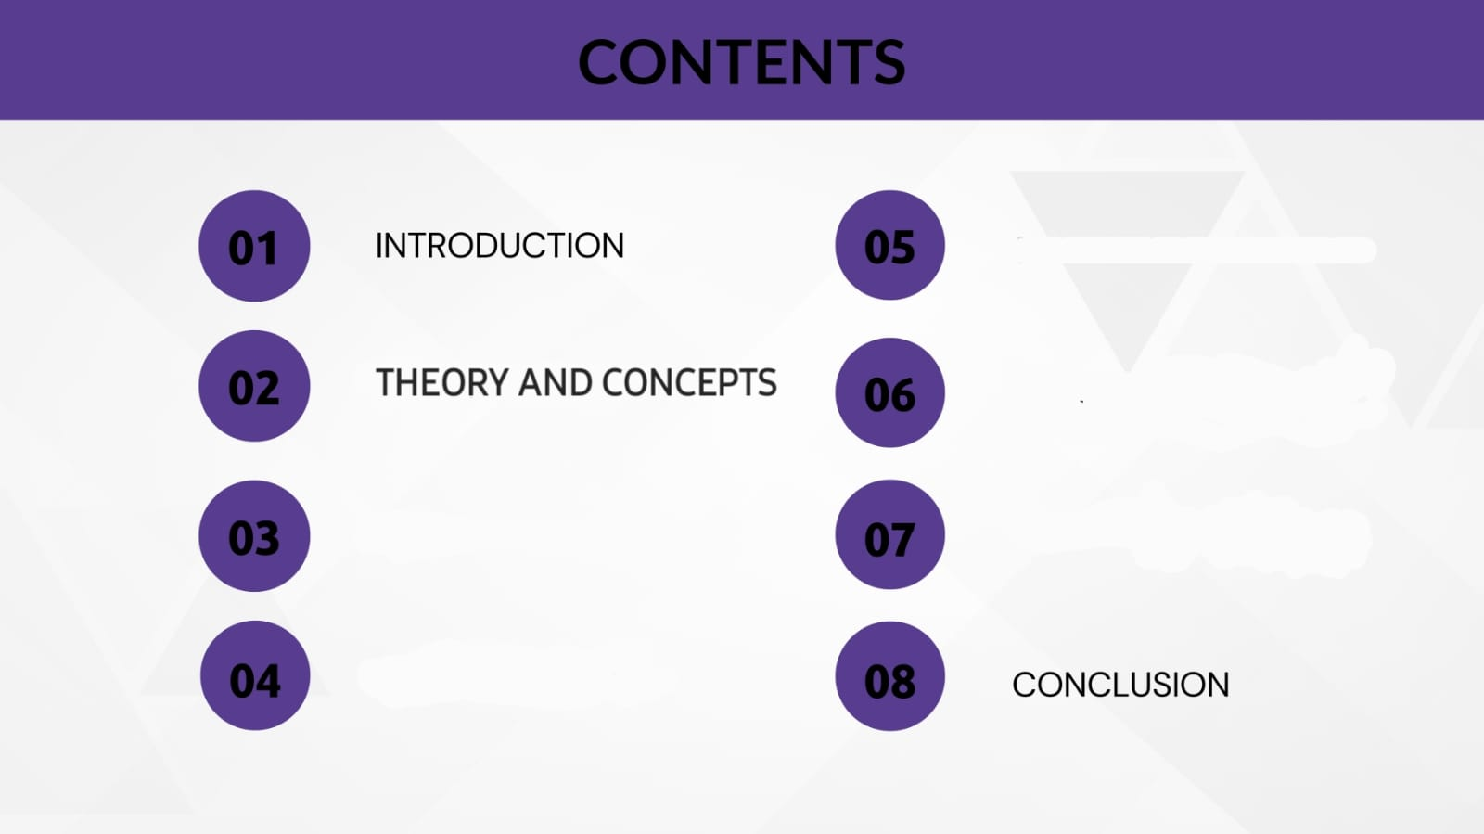
FPGA IMPLMENTATION OF SINE & COSINE
CORDIC MULTIPLICATION AND DIVISION
CORDIC MODES
FUTURE SCOPES
CORDIC APPLICATIONS

Slide 3
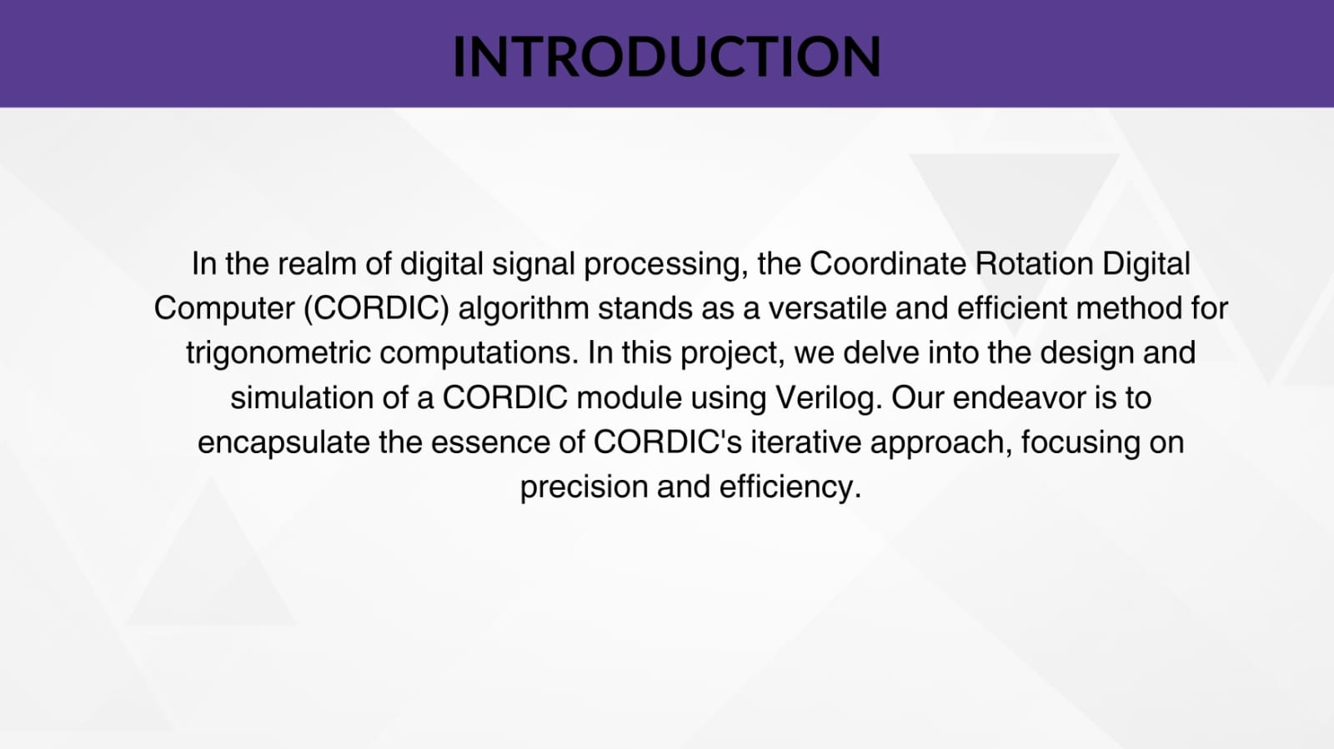

Slide 4
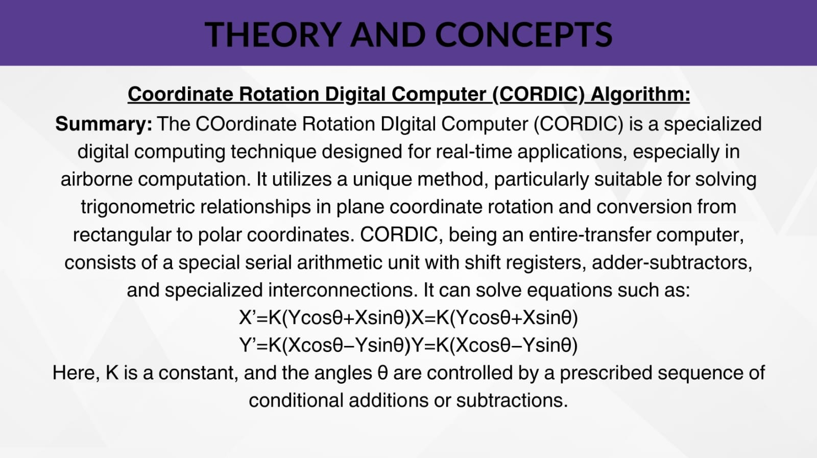

Slide 5
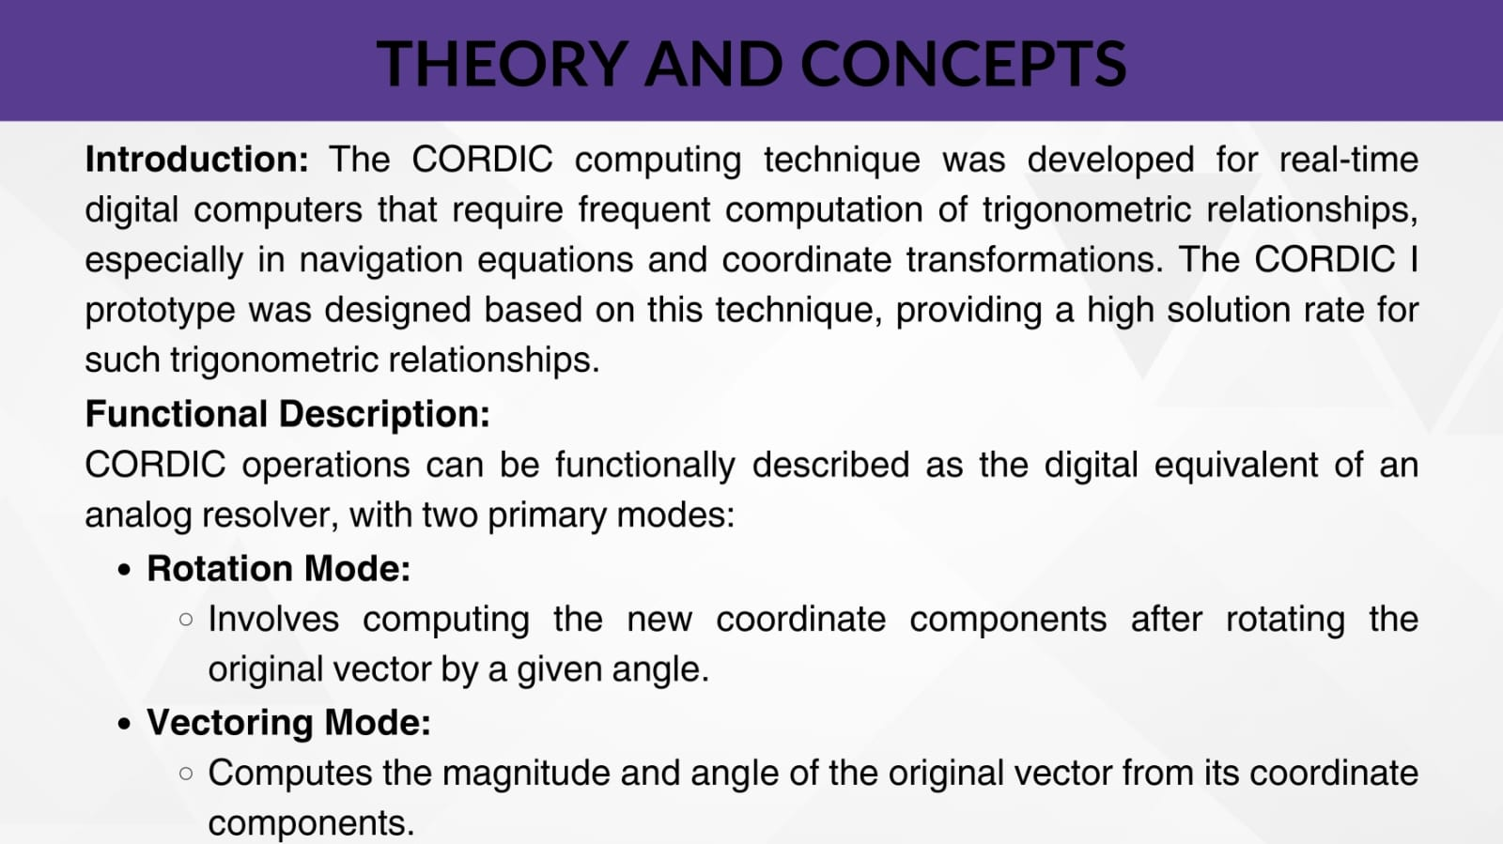

Slide 6

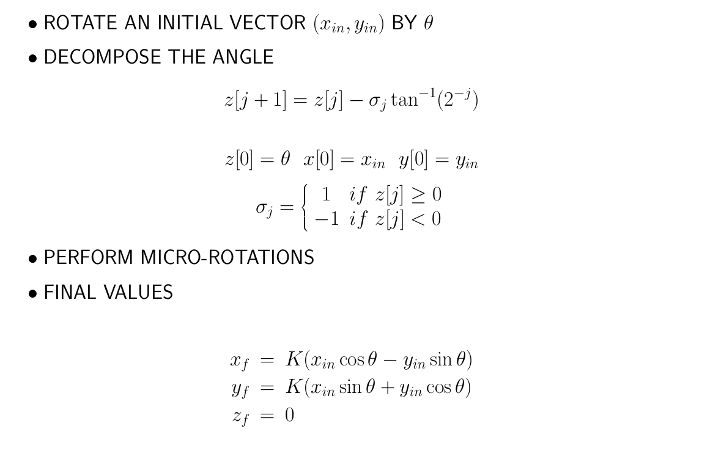
ROTATIONAL MODE

Slide 7
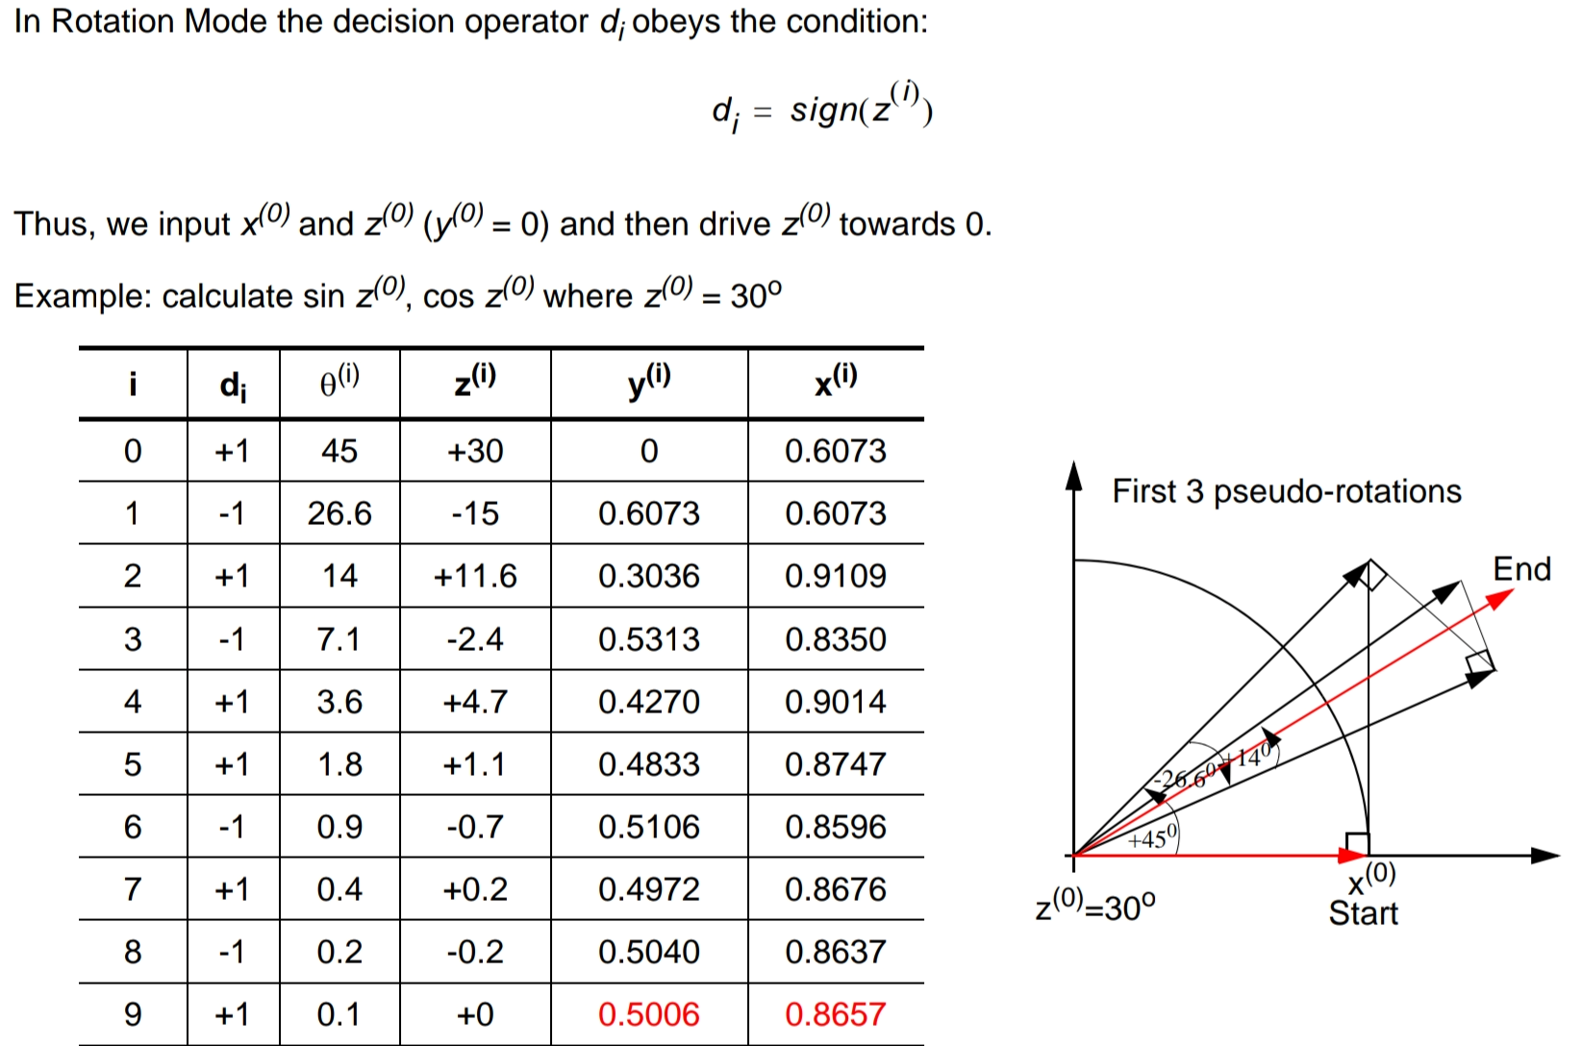
Micro rotations in rotational mode

Slide 8
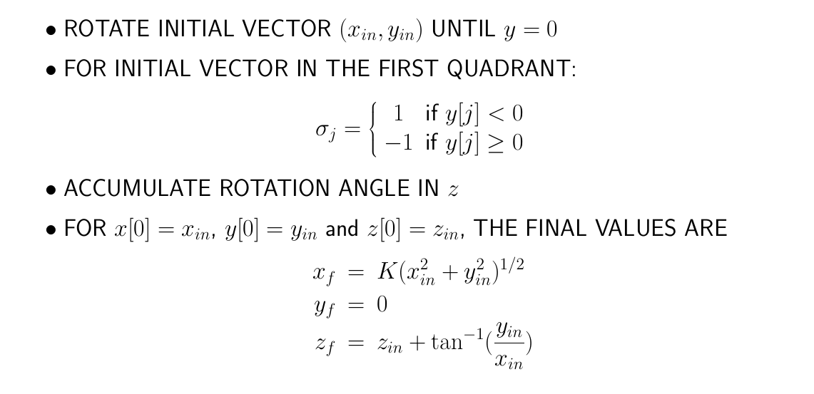
VECTOR MODE

Slide 9
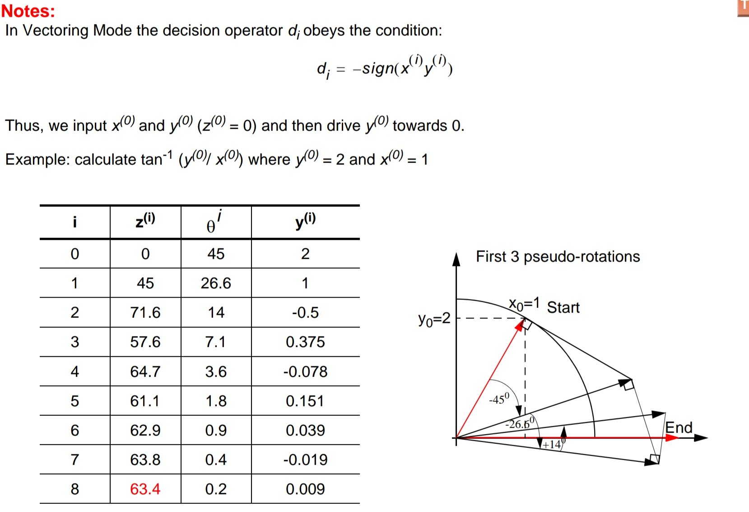
Micro rotations in vector mode

Slide 10
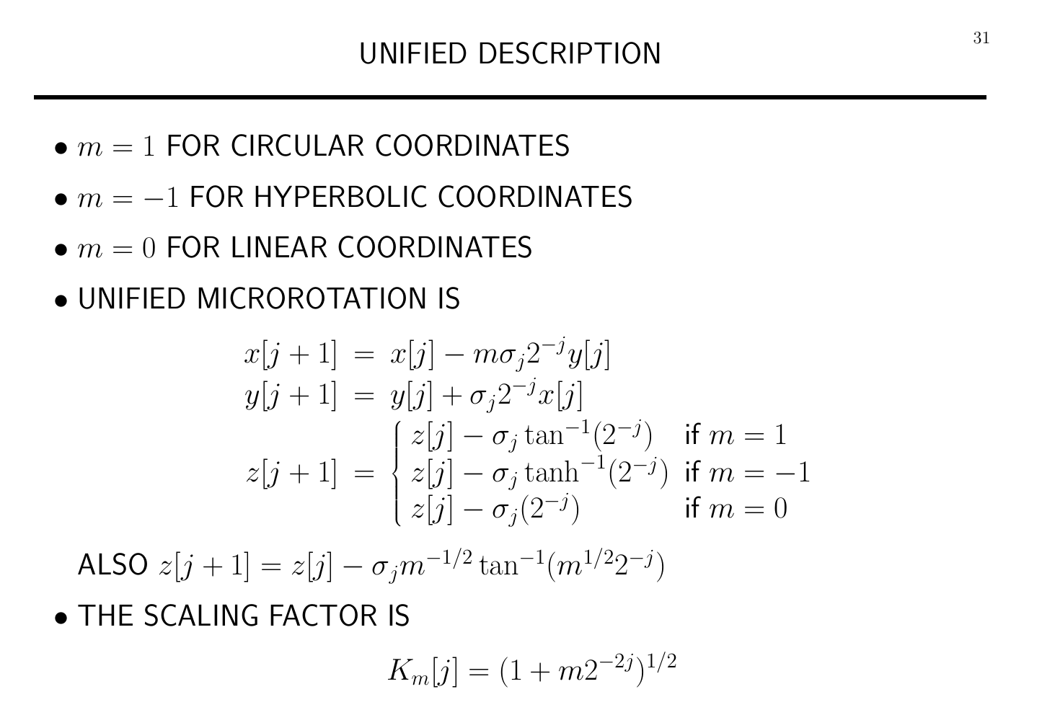

Slide 11
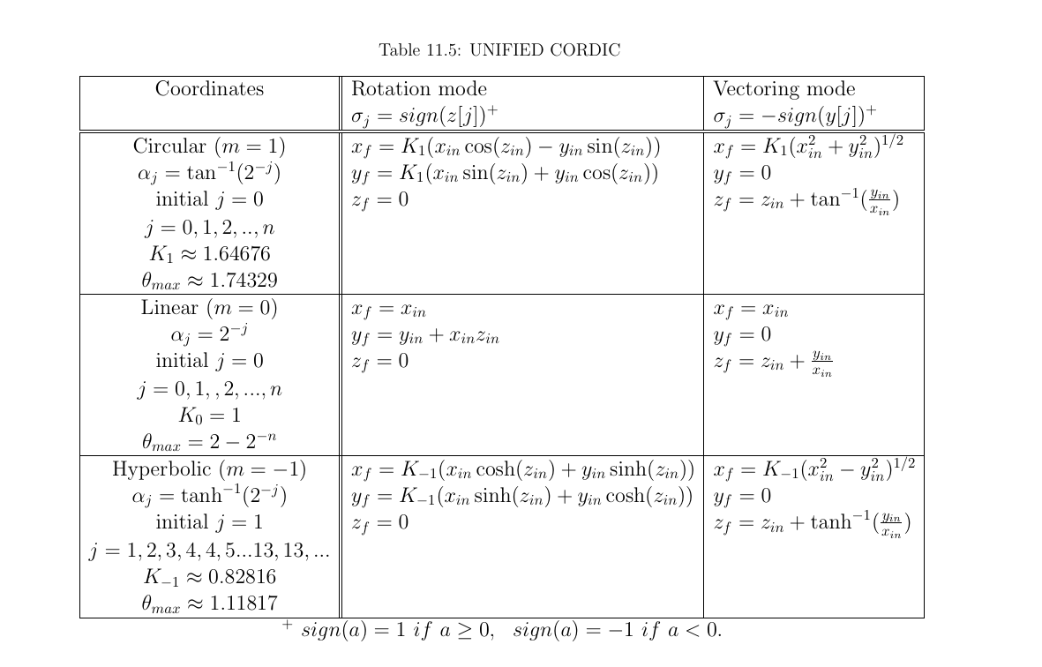
CORDIC MODES

Slide 12
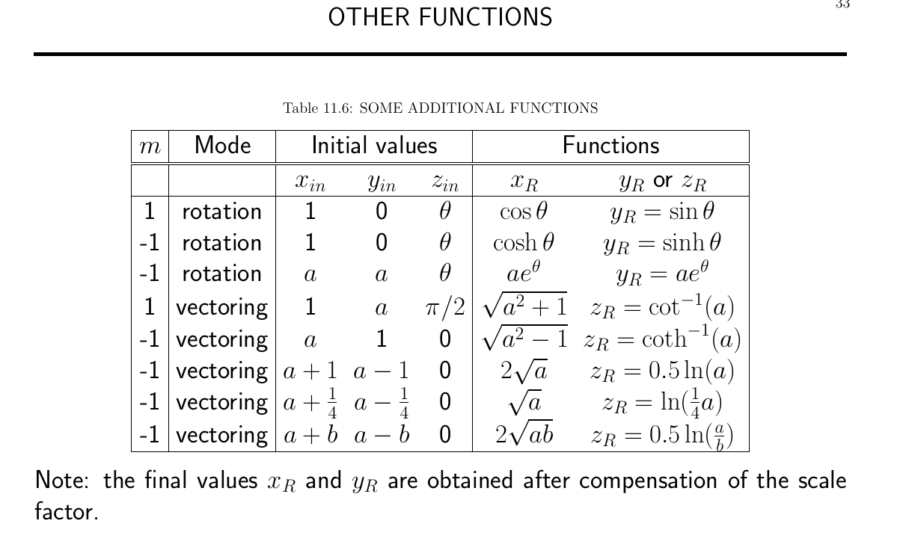

Slide 13
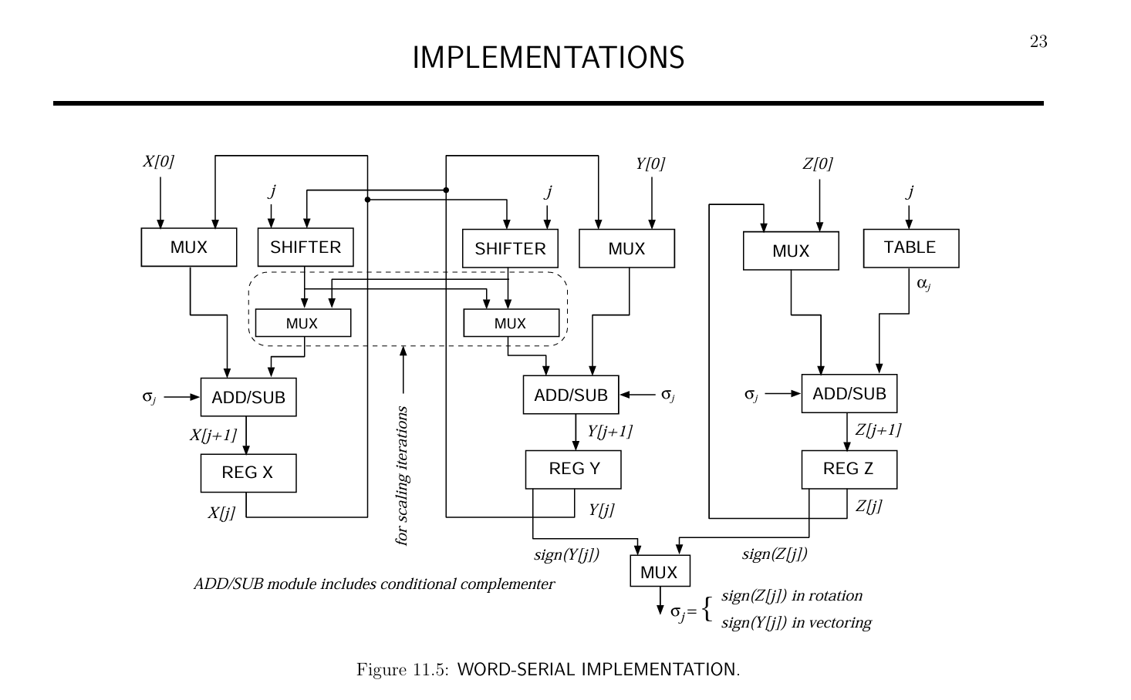

Slide 14
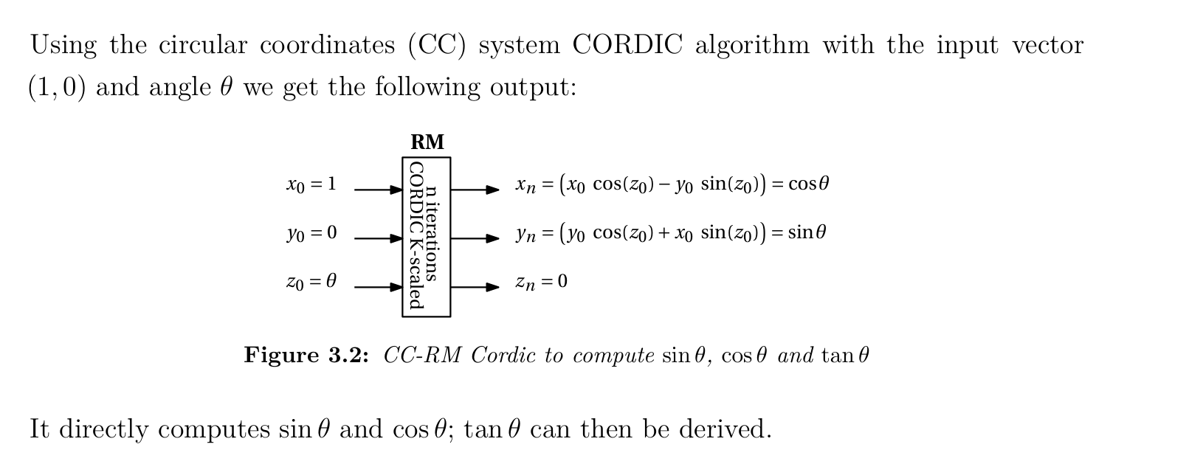
Computation of Sine and cosine using Cordic rotational mode

Slide 15
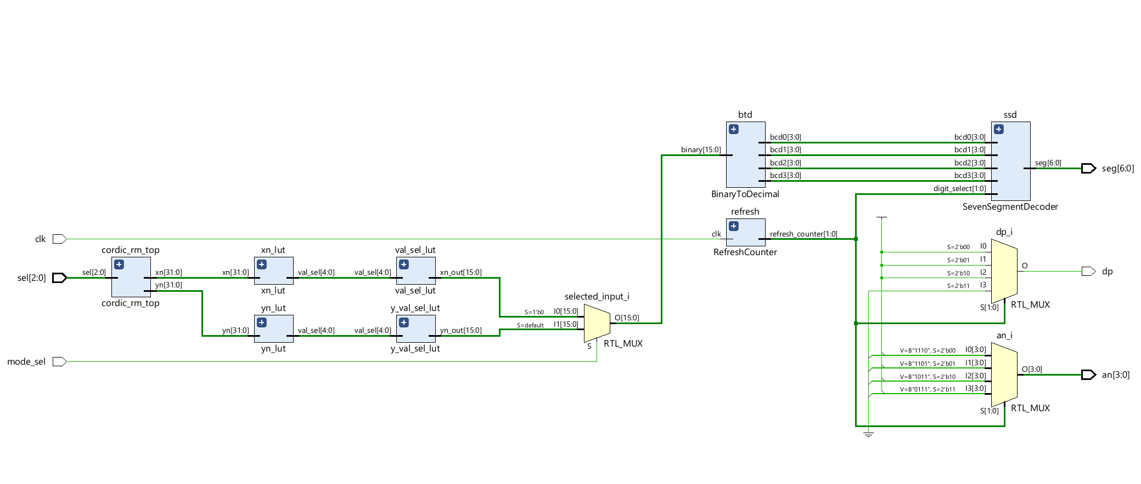
Datapath for Cordic in rotational mode Application – Sine and cosine functions

Slide 16
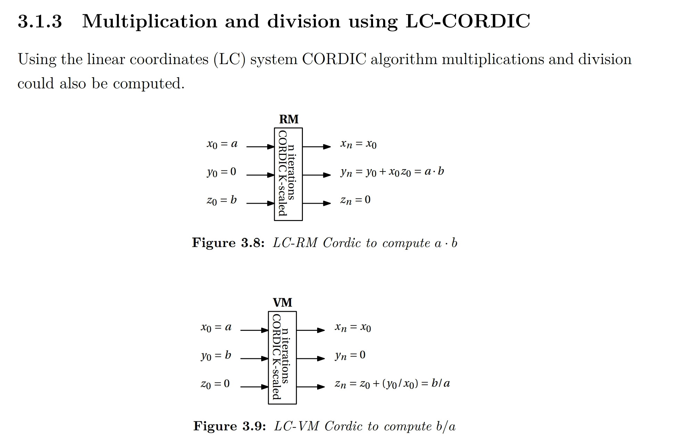


Slide 17
Datapath for Cordic in linear mode Application – Multiplication and division functions
CORDIC_LM_TOP
CORDIC_LM_TOP

Slide 18
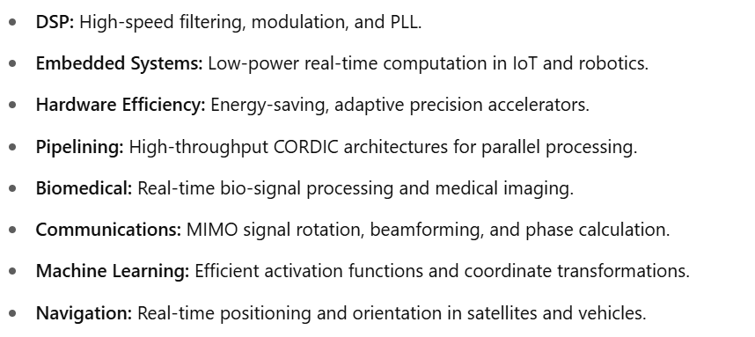
Future scopes

Slide 19
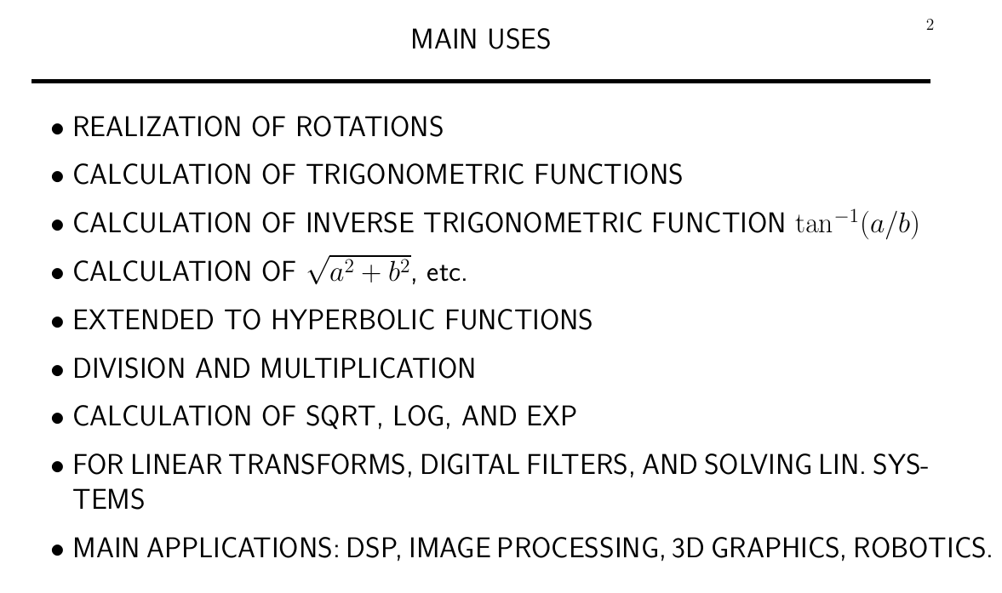

Slide 20
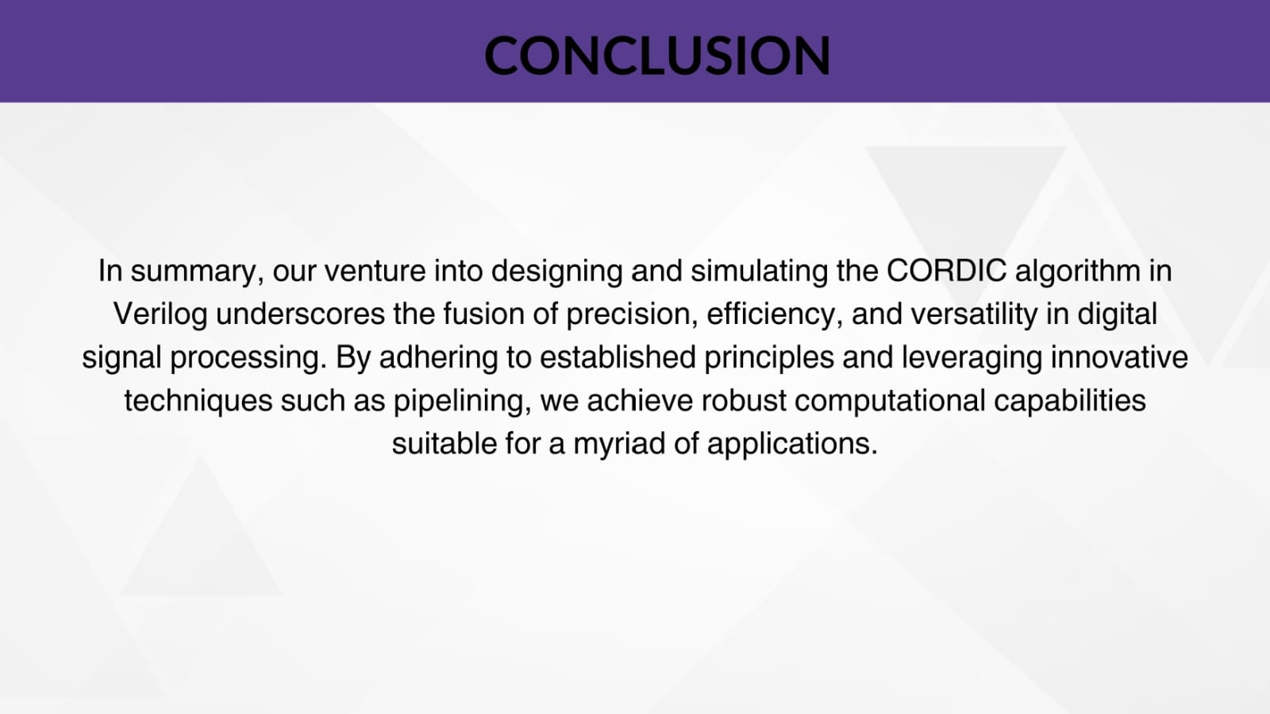

Slide 21
THANK YOU!

