Slide 1
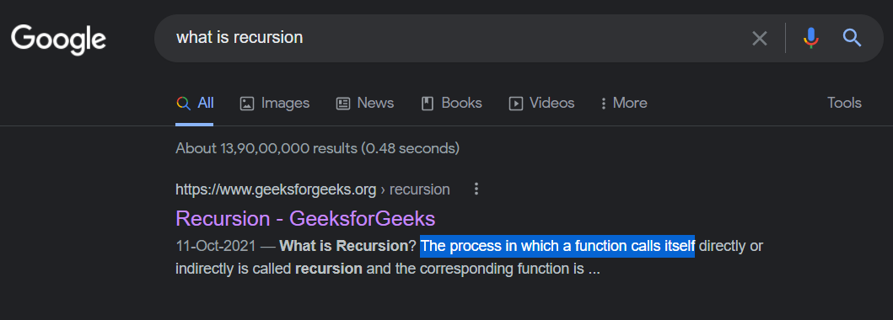
Recursion
LEARN THIS LECTURE FROM MY VIDEO INSTEAD
Quickest way to THOROUGHLY understand recursion for DSA/CP

Slide 2

About Me
Not Bragging, just telling it to learners so that they learn confidently with faith in the teacher.
Hi, I am Utkarsh Gupta.
Upcoming Google Software Engineer. (Offcampus, Google contacted me)
I am one of the best Competitive Programmers in India.
Subscribe to my YT Channel for more content
Achievements:
India Ranks 2, 2, 2, 3 in Google Kickstart Round A,B,C,D respectively.
Grandmaster on Codeforces (India Rank 2)
7 star coder on Codechef
Watch me do Leetcode Weekly Contest in less than half time

Slide 3
BENEFITS OF THIS SLIDE DECK
No prerequisites: just basic if-else, loop, function etc knowledge needed.
Recursion is a very important concept, used in the harder DSA concepts like Trees, Graphs, DP, etc also
Both C++ and Java users can understand (just try to read the codes)
A 2* coder and a 7* coder both know recursion, but the difference is in the way of thinking! This lecture is different from most other recursion lectures because I’ll teach how to THINK RECURSIVELY like a grandmaster.
Koi pooche ki itna accha recursion kaise aata hai? Bolna ki “Utkarsh bhaiyya se seekha hai.”

Slide 4
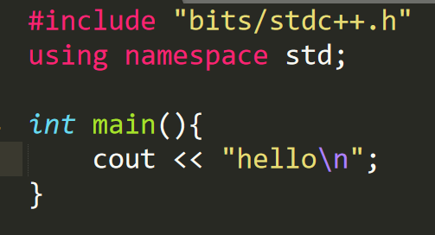
Simplest Program: Say Hello
OUTPUT:
hello

Slide 5
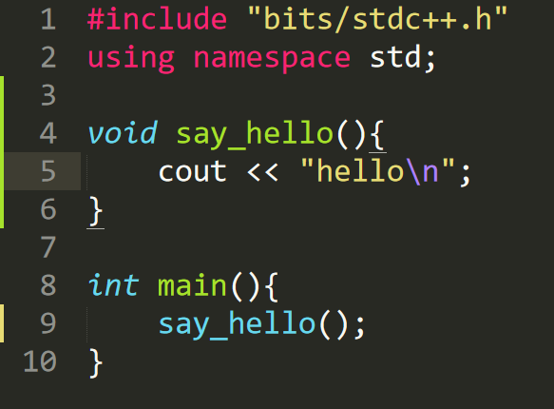
Same Program with Function: Say Hello
THIS TRUST IS VERY VERY IMPORTANT LATER
function does its work, we TRUST it
here we don’t think how the function works
OUTPUT:
hello

Slide 6
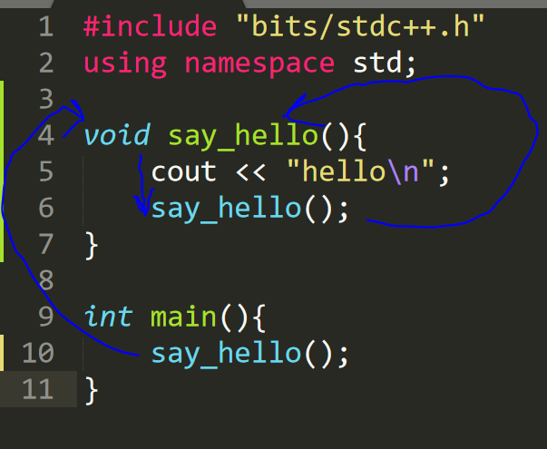
Google says: Recursion = function calls itself, ok let’s do it
GOES INFINITELY: hello
hello
hello
hello
hello
hello
hello
hello
.
.
.
LET’S TRY TO PRINT IT FIXED NUMBER OF TIMES

Slide 7
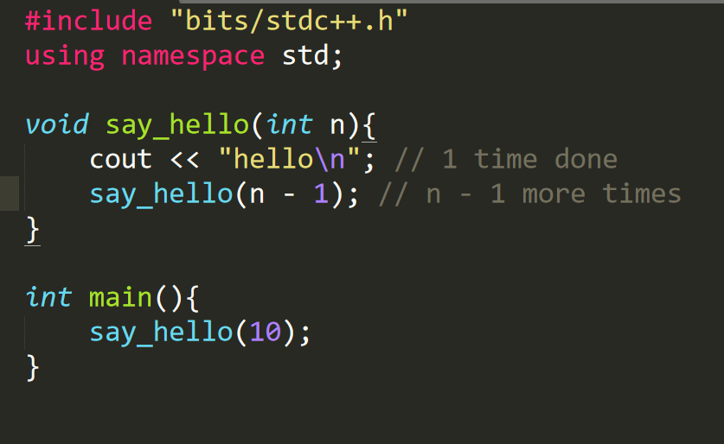
Print n times
Print 10 times
BUT Problem still not solved????! Why???!
Let’s print value of n also to debug

Slide 8
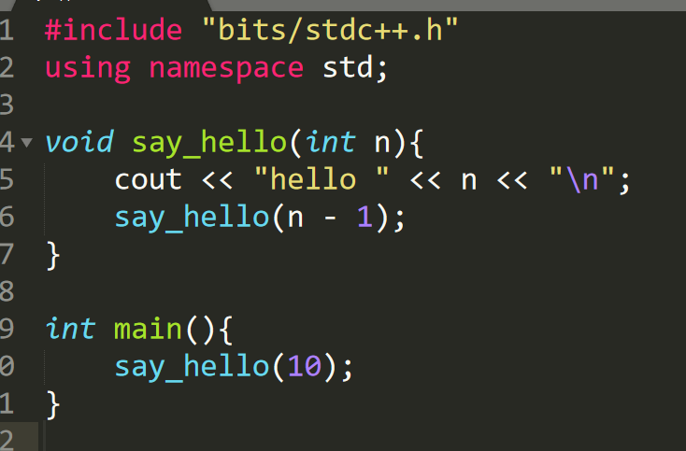
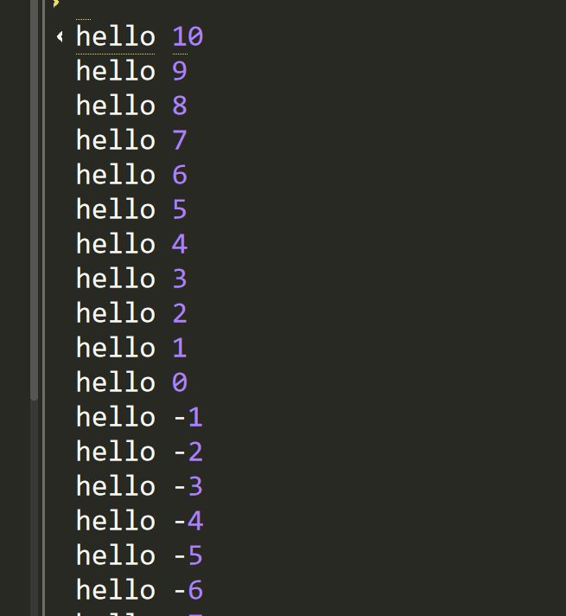
OUTPUT:
Printing n for debugging
Let’s add another line to stop at n = 0
SHOULD’VE STOPPED HERE

Slide 9
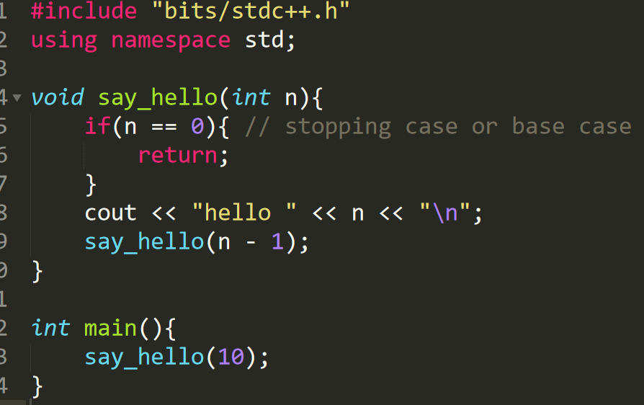
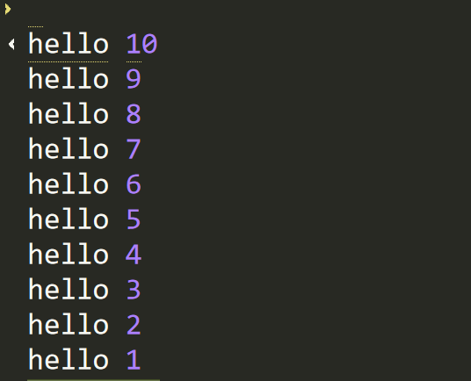
NOW OUTPUT IS CORRECT
Base case is compulsory for stopping the recursion
We’ll learn an amazing thing in the next slide

Slide 10
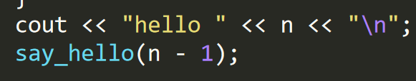
TRUST YOUR FUNCTION
VERY VERY IMPORTANT
Remember slide 5? I talked about TRUSTING your function!
This is useful here, just trust that say_hello(n-1) will print the green box, instead of doing dry run in your head
In the code from last slide, say_hello(n) prints:
hello n
hello n - 1
hello n - 2
hello n - 3
..
hello 1
This is exactly say_hello(n - 1)
Ok, let’s move to next slide:
Try to print:
hello 1
hello 2
…
hello n

Slide 11
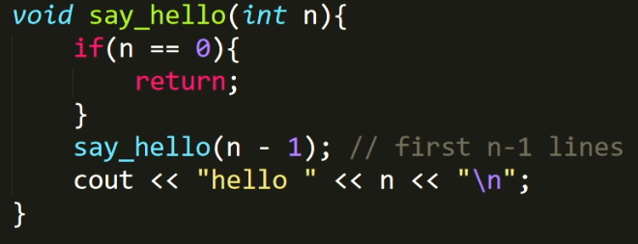
Print the numbers in increasing order instead of decreasing
hello 1
hello 2
hello 3
hello 4
.
.
hello (n-1)
hello n
Sub-Problem, just TRUST the function to solve it
say_hello(n-1)
cout << “hello “ << n << “\n”;

Slide 12
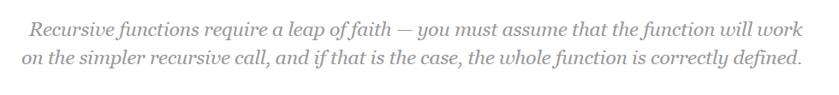
Why TRUSTING your function works?
For a more rigorous proof, think of mathematical induction, we know that the base case is correct, if we assume (or TRUST) the subproblem to be correct, and based on that if our bigger problem is correct, then it’ll be always correct.
For example, 0 is correct because base case, 1 is correct if 0 is correct, 2 is correct if 1 is correct and so on, hence it is always correct.
This Leap of Faith or Trust on your function is essential for recursion, because it is impossible to dry run a recursive code while writing it.
(source)

Slide 13
Practice: Use Recursion to-
Solutions and approach discussed in the video
Sum of numbers from 1 to n
Sum of digits of a number
Factorial of a number n
Pattern Printing:
1 1 2 1 2 3 1 2 3 … n
Fibonacci Sequence
Check if a string is palindrome
(Math based)Find nCr. [hint: nCr = (n-1)Cr + (n-1)C(r-1)]
1 2 3 … n 1 2 3 1 2 1 1 2 1 2 3 1 2 3 … n
1 2 3 … n 1 2 3 1 2 1

Slide 14
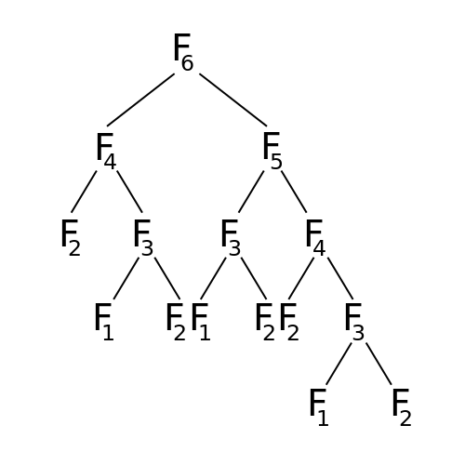
Time Complexity
Make a tree-like structure of the recursive calls to estimate the time complexity (harder techniques like Recurrence Relations, Master Theorem etc are usually not needed)
Fibonacci:
(for example)
Upon counting the elements, it can be estimated that it is exponential and loosely bounded by 2^{n}
Watch video for more explanation

Slide 15
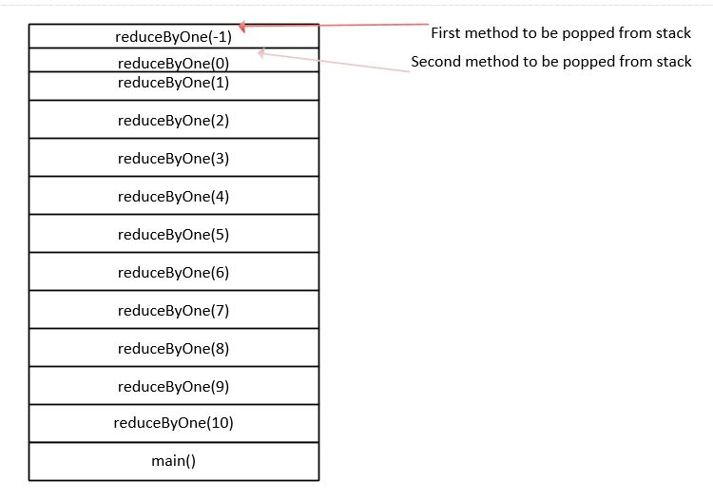
NOT NECESSARY FOR DSA:
Internal working of Recursion
Read in more detail
https://dotnettutorials.net/lesson/how-recursion-uses-stack/

Slide 16
Future Study
Once you know recursion, you can learn topics like Backtracking, Trees, Graphs, etc. (Will add links as soon as I teach those, subscribe to YT channel to stay updated)

