Slide 1
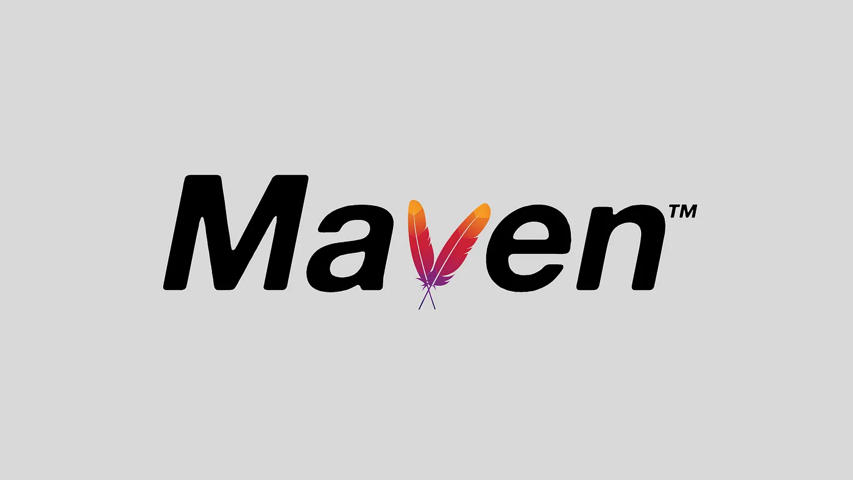
By Abhishek Negi and Ankit Mahalpure

Slide 2
What is Maven?
Maven is a powerful project management tool that is based on POM (project object model). It is used for projects build, dependency and documentation.

Slide 3
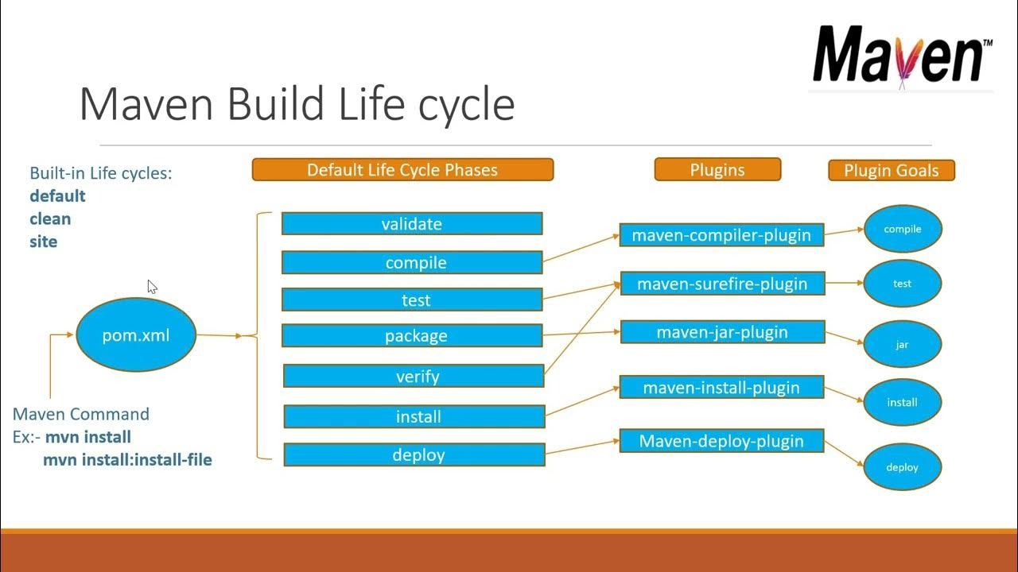
Maven Lifecycle:

Slide 4

Goals
In Maven, goals are specific tasks that can be executed during the build lifecycle.
1. Deletes the target directory, which contains the compiled bytecode and other generated files.
2. Validates the project configuration.
3. Compiles the source code of the project.
4. Runs the unit tests of the project.
5. Takes the compiled code and packages it into a
distributable format, such as a JAR or WAR file.

Slide 5
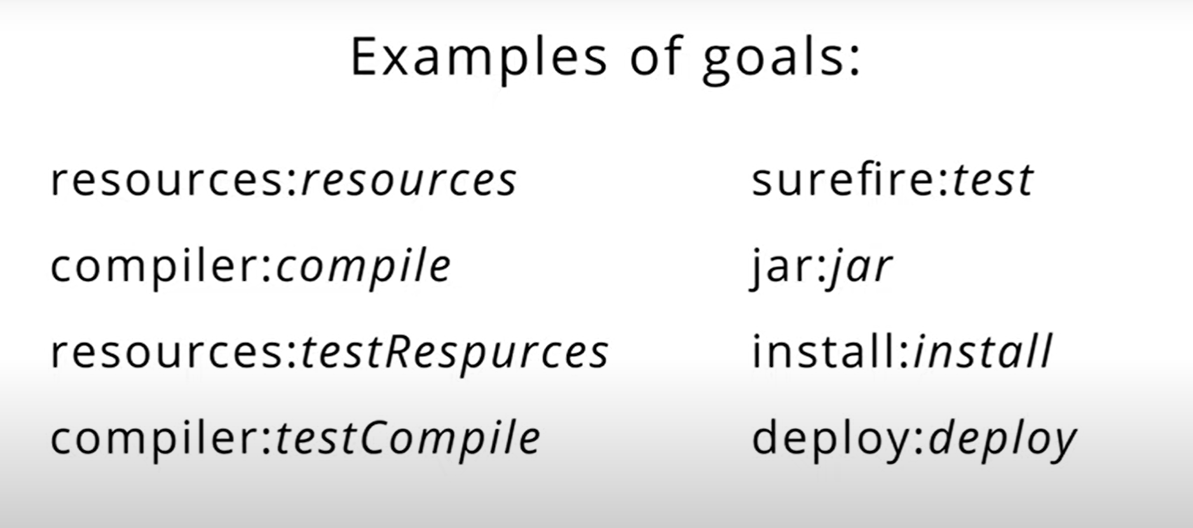

Slide 6
What is a Plugin?
"Maven" is really just a core framework for a collection of Maven Plugins. In other words, plugins are where much of the real action is performed, plugins are used to: create jar files, create war files, compile code, unit test code, create project documentation, and on and on. Almost any action that you can think of performing on a project is implemented as a Maven plugin.

Slide 7
Advantages of Maven
Maven can add all the dependencies required for the project automatically by reading pom file.
One can easily build their project to jar,war etc. as per their requirements using Maven.
Adding a new dependency is very easy. One has to just write the dependency code in pom file.
Centralized repository

Slide 8
THANK YOU

