Slide 1

A Report on
COURIER TARGETS MODEL FOR PREDICTING FAIR TARGETS
Submitted by
ANKIT MAHAWAR
ROLL NO.: 193370008
EMAIL-ID – 193370008@iitb.ac.in

Slide 2
1. Data Understanding & Data Cleaning
The couriers_target_assignment_data was read as a .csv file where there were NaN values being seen within the data set
The shape od the data frame was (28865,18)
A target variable as ‘Total Stops’ was initialized as a sum od Distribution Stops and Collection Stops
Preparation for a count for the rows which have Idle Time Minutes and stops Distance_median as NaN
A total of 8581 rows were eliminated

Slide 3
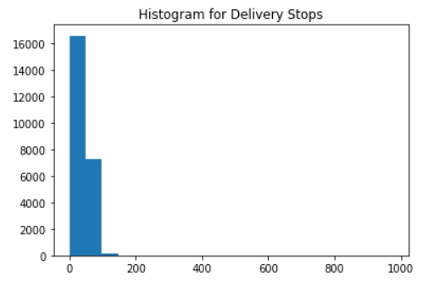
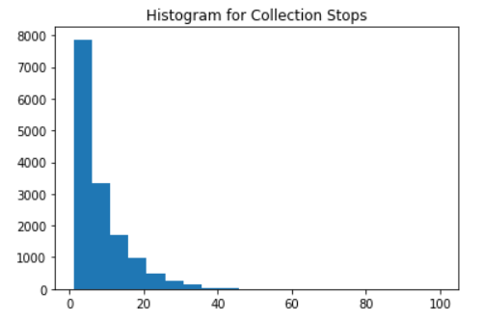
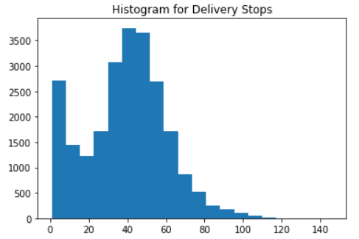
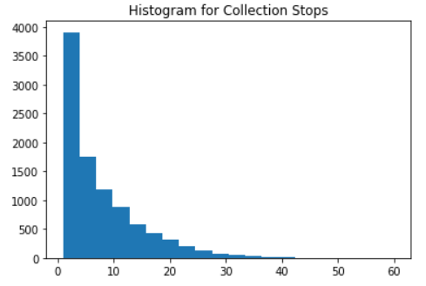
2. Exploratory Data Analysis & Visualization
Upon further going through the data it was observed that the values which constituted the Target Variable contained some outliers.
Hence the ‘Outlier Handling’ process was carried out.
Histograms were plotted with calculation of mean and standard deviation which on formulation gives the upper limit of the values to be included
Histograms before and after outlier handling are shown below
Formula Used : Mean + 6 * Standard Deviation
Before Outlier Handling
After Outlier Handling

Slide 4
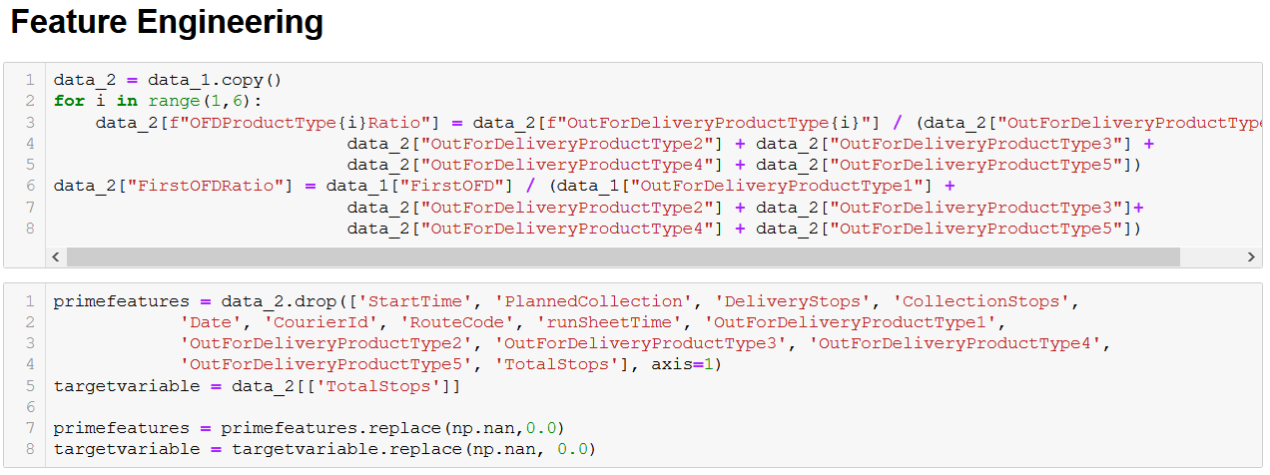
3. Feature Engineering
Feature Engineering for the based upon the addition of important predictors such as the
Ratio of the out for delivery for each shipment type over the total out for delivery
Ratio of shipments out for delivery for the first time i.e., First OFD / Total OFD
Prime Features and the Target variables were listed out by dropping features of less importance with replacement of NaN values with zero,
A snippet for the same is as shown

Slide 5
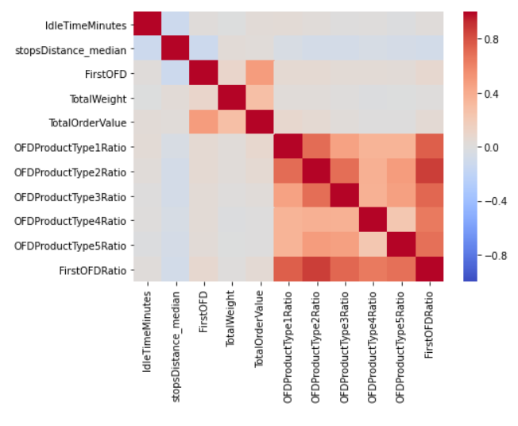
A Pearson’s Correlation Heat Map was also included to shoe the amount of correlation between the new set of selected features in the data set
The image for the same is shown as follows,

Slide 6
4. Modelling
Modelling for the cleaned data set was done by using three different regression techniques:
Decision Tree Regressor
Random Forest Regressor
Quantile Regression
A train - test split of 95% – 5% was done
Different values of predictors were calculated which are listed below (only for decision tree & random forest):
RMSE, test set
R-squared, test set
R-value, test set
MAE, test set
RMSE, train set
R-squared, train set
R-value, train set
MAE, train set
For Quantile Regression values for the fair targets was predicted for different quartile ranges of 10%, 30%, 50%, 70%, 90%

Slide 7
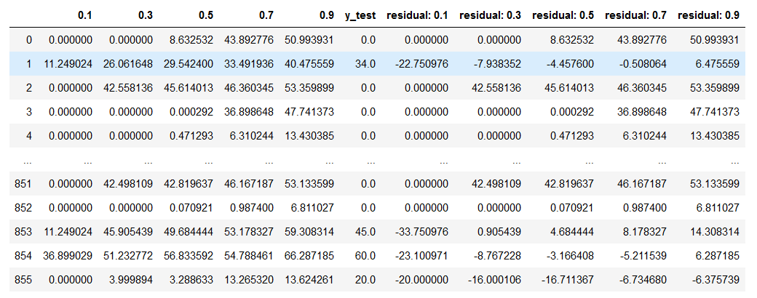
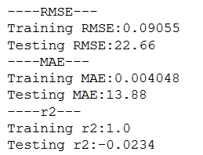
5. Results Analysis
Results for all the regression classifiers is as shown below:
Predictor Values for Decision Trees and Random Forest Regressor
Predicted Values of Fair Targets for a Courier in different Quartile Ranges

Slide 8
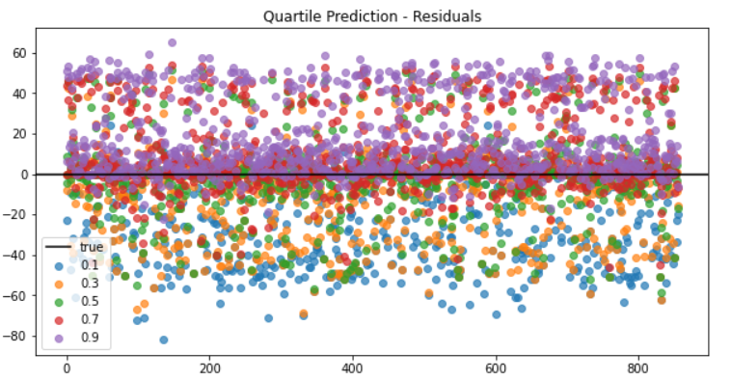
The plot for the Quartile Prediction for the Residuals is shown as below

