Slide 1

Data Analysis of indian housing dataset
Submitted by group-6
Huynh Trung Tru
Anup Painuly
Ankit Malviya
Nikhilesh Bhalerao

Slide 2

Content
Data Import
Data Preprocessing
Data Analysis
Data Visualization
Hypothesis Testing
Machine Learning Model

Slide 3

DATA IMPORT AND PREPROCESSING
L

Slide 4
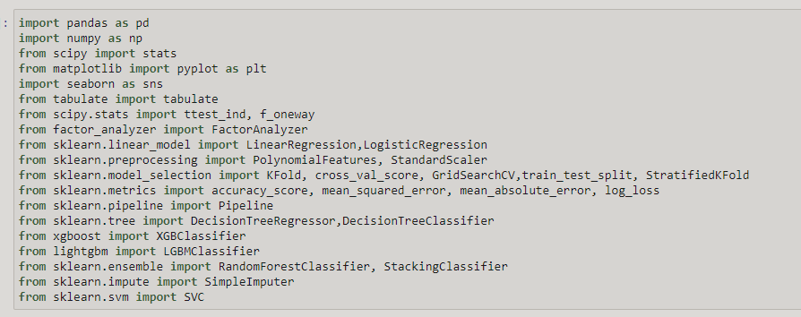
IMPORTS

Slide 5
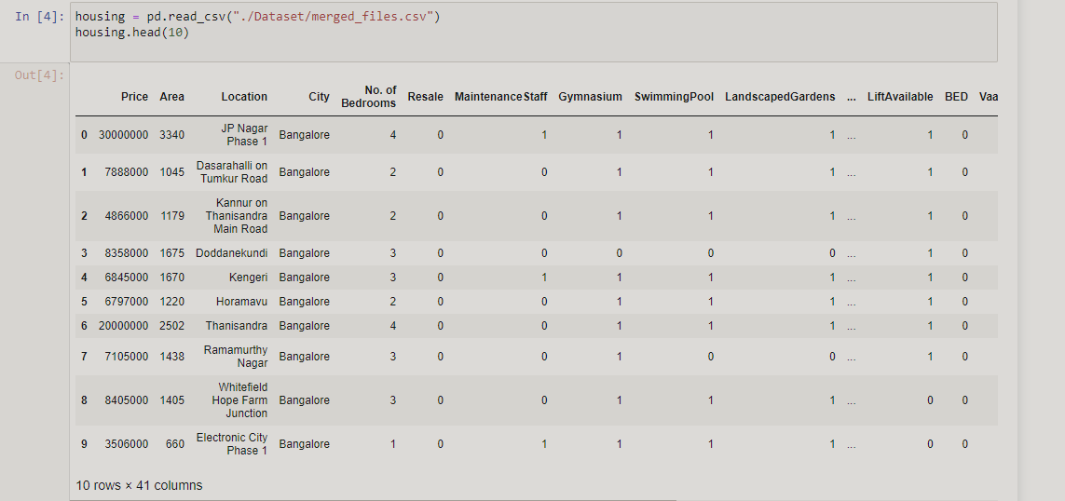
DATA IMPORTS

Slide 6
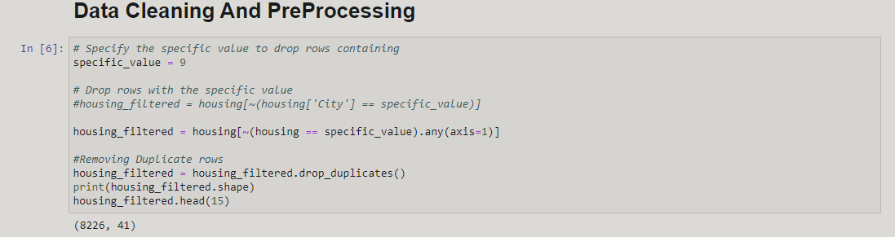
DATA PREPROCESSING

Slide 7
DATA ANALYSIS AND VISUALIZATION
L

Slide 8
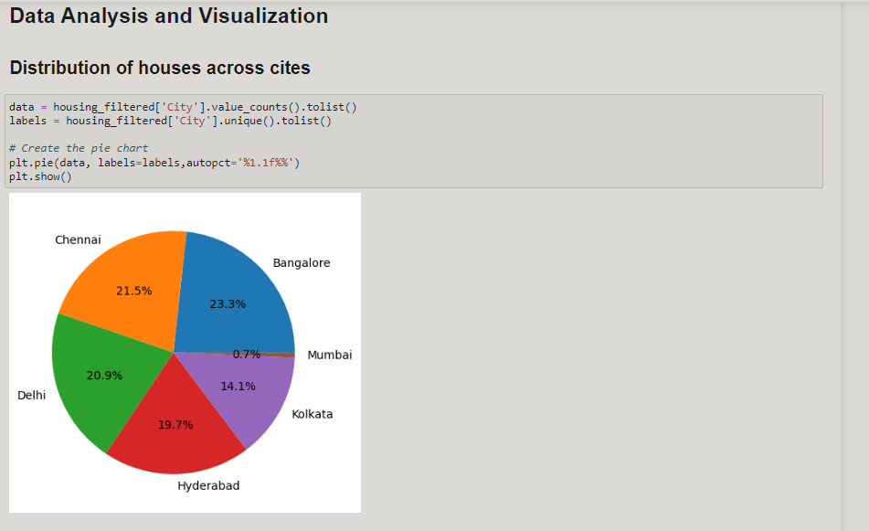

Slide 9
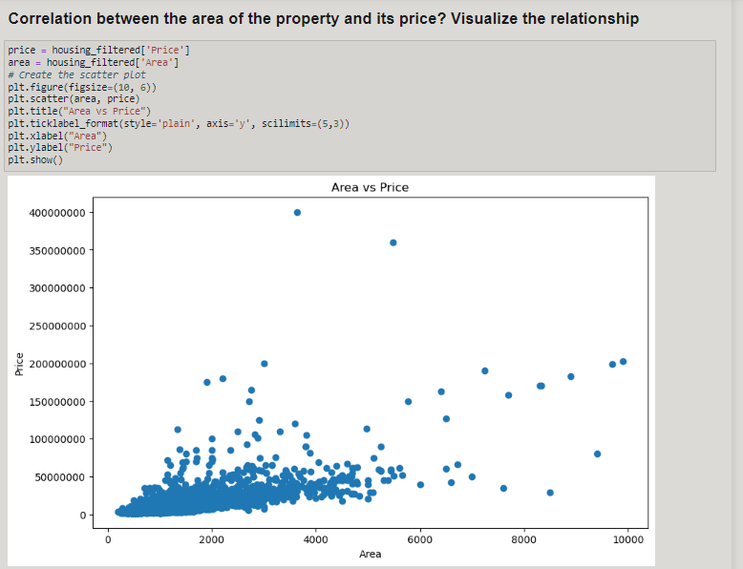

Slide 10
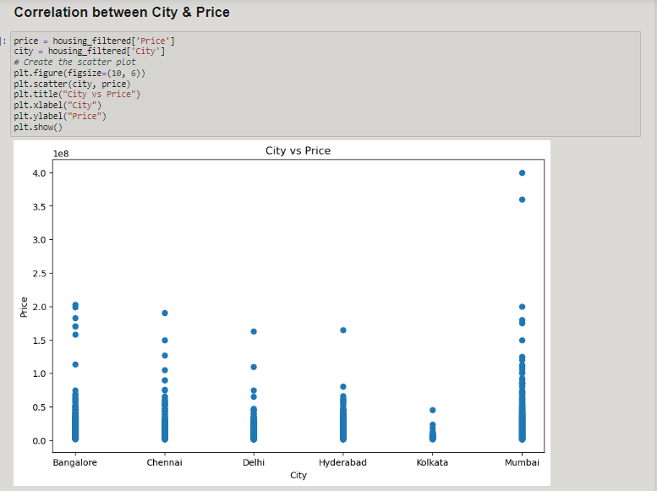

Slide 11
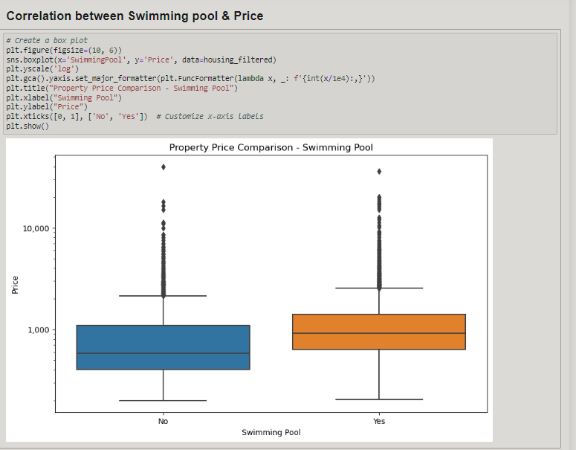

Slide 12
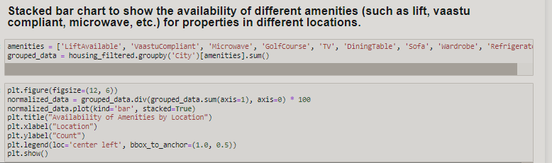
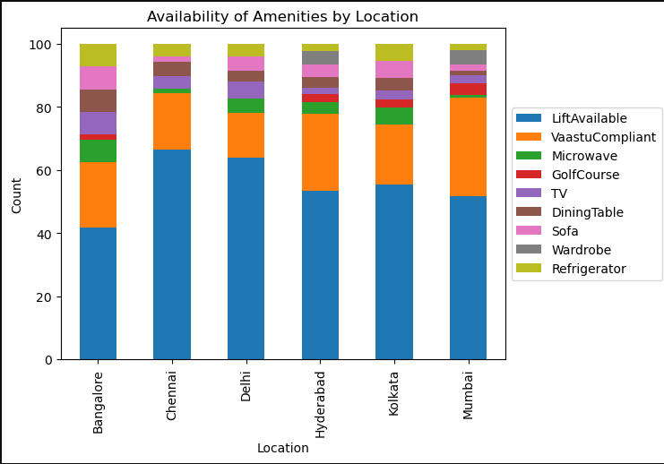

Slide 13
HYPOTHESIS TESTING
L

Slide 14
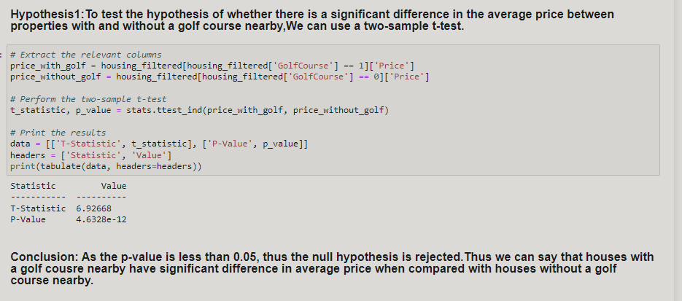

Slide 15
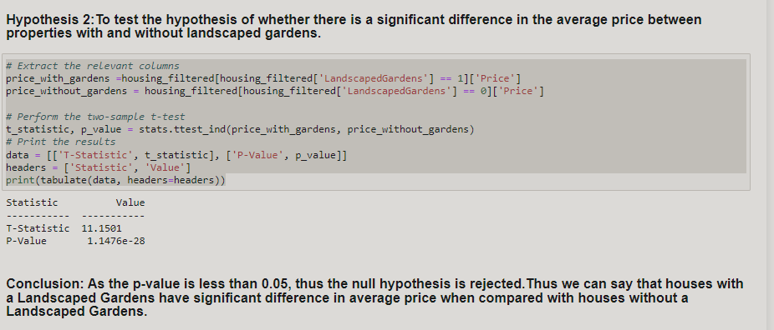

Slide 16
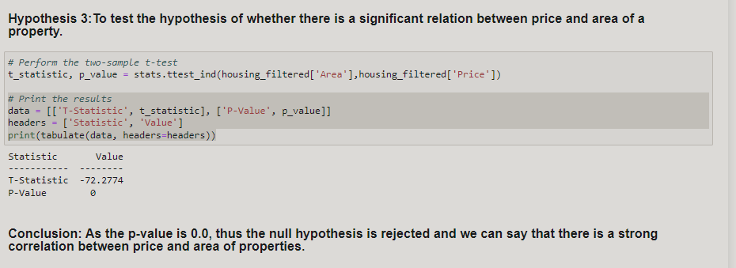

Slide 17
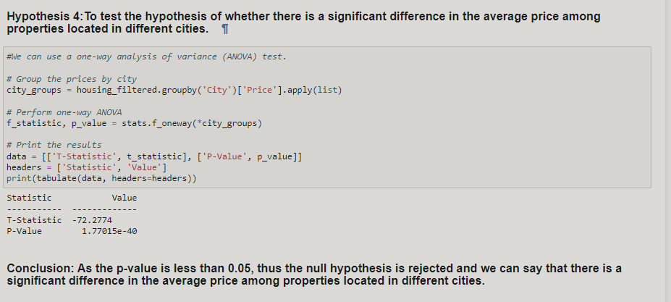

Slide 18
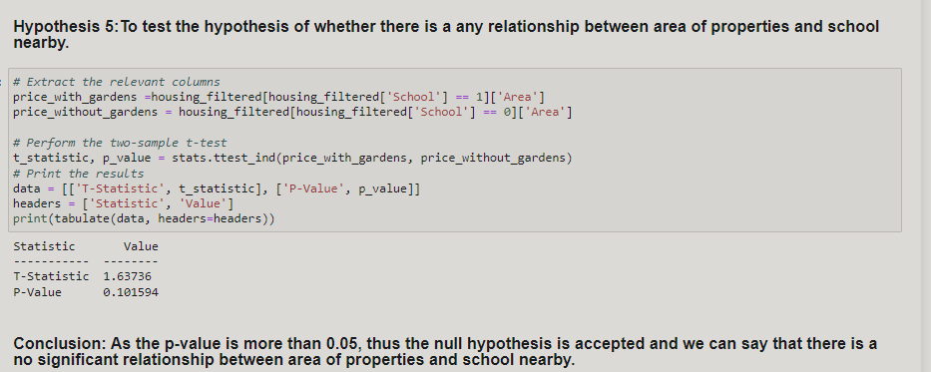

Slide 19
MACHINE LEARNING
L

Slide 20
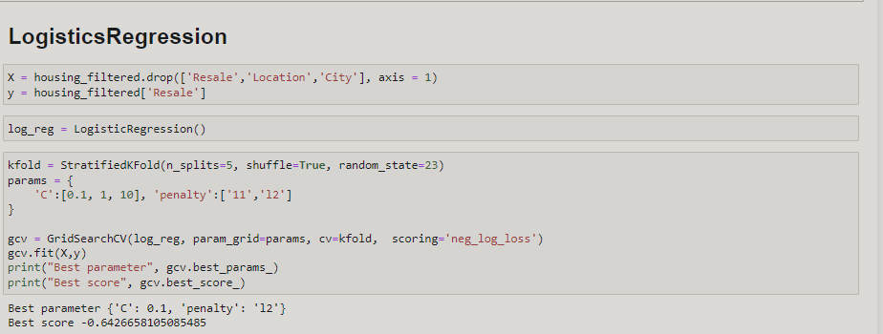

Slide 21
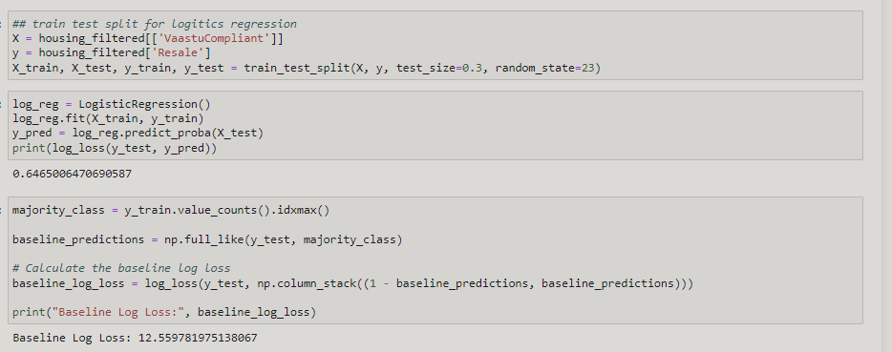

Slide 22
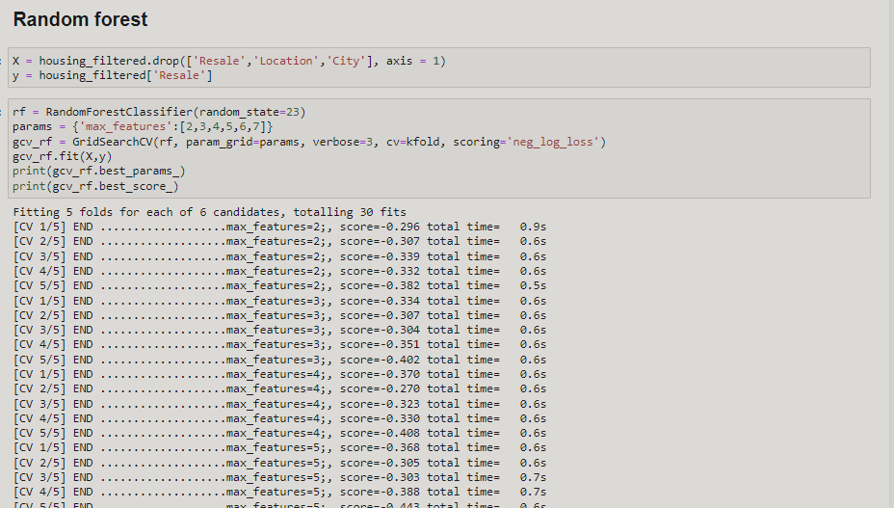

Slide 23
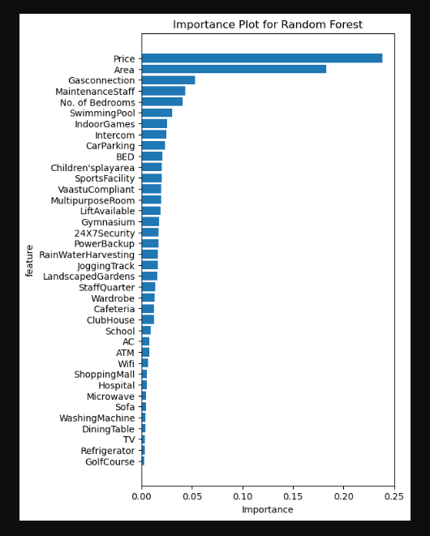
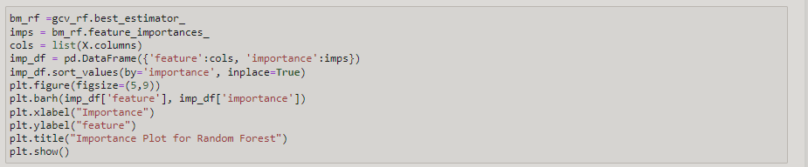
Random Forest Factor Analysis
Result For Random Forest
{'max_features': 2}
-0.33133466703423264

Slide 24
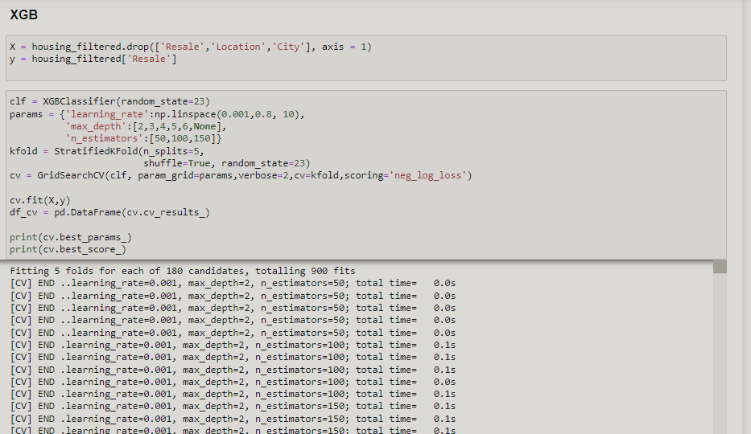

Slide 25
Result For XGB
{'learning_rate': 0.26733333333333337, 'max_depth': 6, 'n_estimators': 100}
-0.30457954005590965

Slide 26




team
Huynh Trung Tru
Nikhilesh Bhalerao
Ankit MaLVIYA
ANUP PAINULY
Data import
Data Cleaning
Data PreProcessing
Data Analysis
Data Visulaization
Hypothesis Testing
Machine Learning Algorithms

Slide 27

Thank you
dbda28@proton.me
https://www.kaggle.com/code/dbdaacts/notebooka75d50fe8a

