Slide 1


Voyager Bank
Your journey begins here…

Slide 2
OUTLINE
INTRODUCTION | A little insight to the Voyager Bank Team.
OBJECTIVES OF THE PROJECT | What are we set on achieving through this project.
TECH STACK | Technology used in the development of the project.
MODULE OVERVIEW | A bird’s-eye view of the components of the product.
SCREENSHOTS AND DEMO | Demonstration of the working of both user and administrative roles.
CONCLUSION | Special thanks and a view of the future.

Slide 3
Introduction
Meet The Team
Our primary objective is to create a platform to perform basic banking activities without needing to physically be present at a bank.
These include checking bank balance, transferring funds, opening an account, etc.
Ankit
Aamir
Aayushi
Anubhab
Mihir
Vaishnavi

Slide 4
TECH STACK
Frontend: ReactJs
Backend: Spring Boot, JPA, REST
Database: MariaDB
Testing: JUnit Test Framework

Slide 5
MODULE OVERVIEW
01
02
03
04
05
06
07
USER MODULE
ADMIN DASHBOARD
ACCOUNTS MGMT
FUND TRANSFER
TRANSACTION HISTORY
TESTING
CODE COVERAGE

Slide 6

USER MANAGEMENT MODULE
User in this application are customers of the bank.

Slide 7
USER MANAGEMENT
This module contains the following pages:
Home page
Login page
Open an account page
Set New Password
Admin Page

Slide 8

ADMIN DASHBOARD
Administrative privileges are given to bank employees to maintain consistent records.

Slide 9
ADMIN DASHBOARD
This module contains the following pages/functionalities:
Home page
It is intended for use by authorized bank personnel only.
User Approval page
Admins have the responsibility of authorizing registrations of new users.
Delete User
Admins have the power of deleting of users.

Slide 10

ACCOUNTS MANAGEMENT
Users need to perform actions , these are contained within this module.

Slide 11
ACCOUNT MANAGEMENT
This module will have following pages:
Dashboard page
Account Statement
Account Summary
Change Password

Slide 12

FUND TRANSFER
Sending and receiving money is an integral part of a bank’s role as a mediator between goods exchange.

Slide 13
FUND TRANSFER
This module has two buttons which redirect the user to the respective pages.
Fund Transfer page
There are three modes for transferring the amount to the beneficiary’s account. Which are –
Through NEFT
Through RTGS
Through IMPS

Slide 14

TRANSACTION HISTORY
Online banking provides this unique feature, it negates the need for a passbook as transaction history is a click away at all times.

Slide 15
TRANSACTION HISTORY
The module contains the following functionalities:
Lists previous transactions on the request of the user.
Information contained in this table includes:
Amount sent/received
Recipient or Source of funds
An internal mechanism checks whether the transaction is valid or not.

Slide 16

TESTING
Testing is an important part of a project.

Slide 17
TESTING
Testing for 3 controllers:
AccountDetails Controller
User Controller
Transaction Controller

Slide 18

CODE COVERAGE

Slide 19
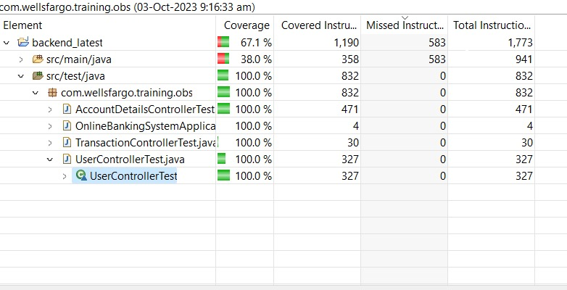
CODE COVERAGE

Slide 20
TIME FOR A DEMO
Please wait for a few minutes for the setup

Slide 21
Acknowledgements
Learnings
This project was an excellent learning experience which included full-stack development.
Teamwork was also was an important part of this project and was an opportunity for us to get a glimpse of what the future holds.
We would like to thank Raj for all the help and guidance. As a bootcamp before starting our professional life, this was a great time to hone in on our skills. The tutorials (and the tutor!) came in very handy for clearing out doubts.

