Slide 1
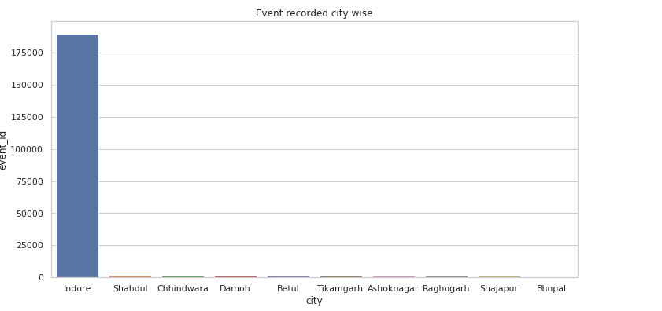
Events_data observations - Madhya Pradesh - huge event count for Indore

Slide 2
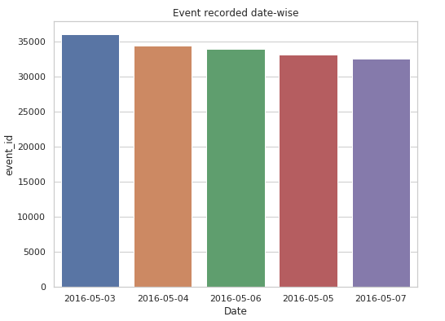
Events_data observations - Madhya Pradesh - date wise event recorded

Slide 3
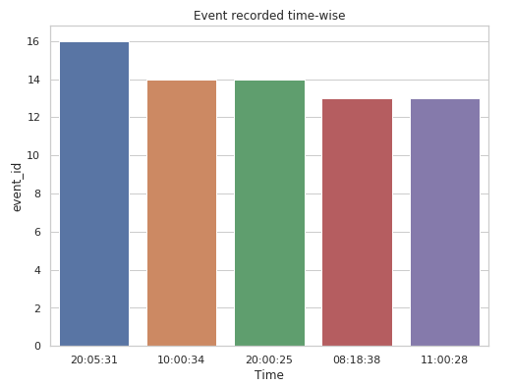
Events_data observations - Madhya Pradesh - time wise event recorded

Slide 4
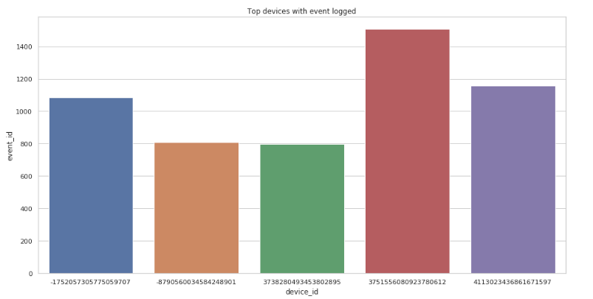
Events_data observations - Madhya Pradesh - top devices for event recorded

Slide 5
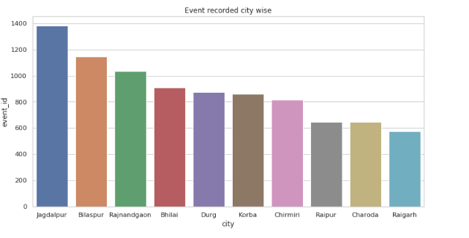
Events_data observations - Chattisgarh - city wise event count

Slide 6
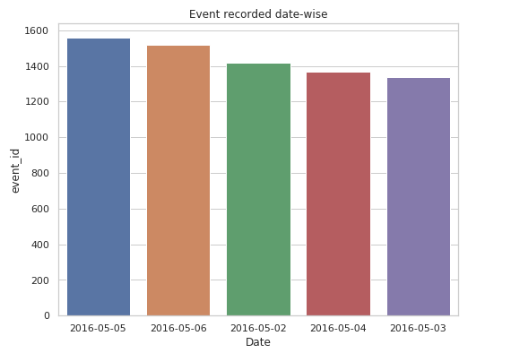
Events_data observations - Chattisgarh - date wise event recorded

Slide 7
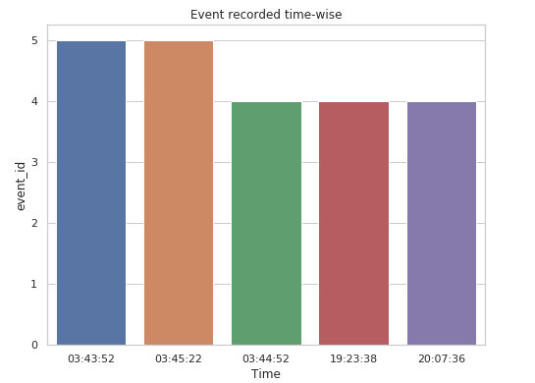
Events_data observations - Chattisgarh - time wise event recorded

Slide 8
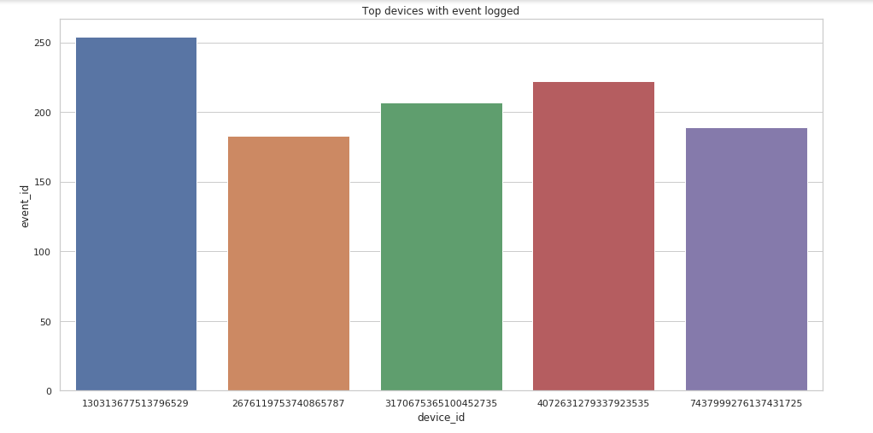
Events_data observations - Chattisgarh - top devices for event recorded

Slide 9
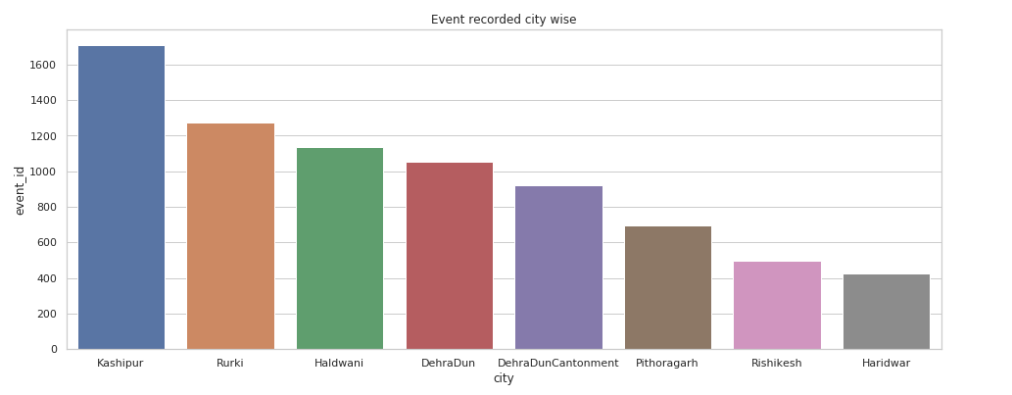
Events_data observations - Uttrakahnd - city wise event count

Slide 10
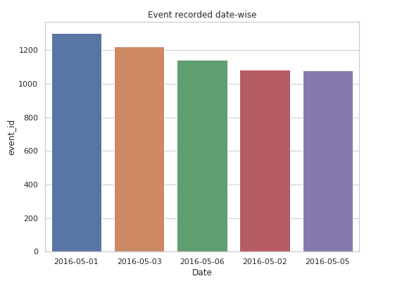
Events_data observations - Uttrakhand- date wise event recorded

Slide 11
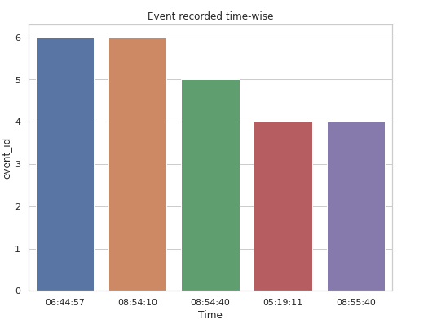
Events_data observations - Uttrakhand- time wise event recorded

Slide 12
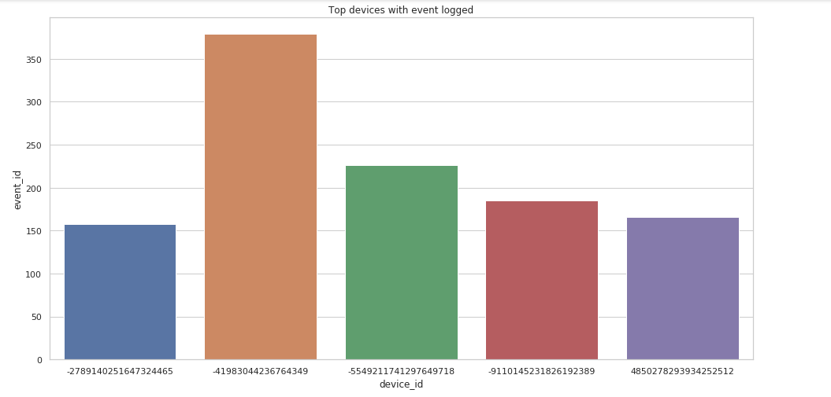
Events_data observations - Uttrakhand- top devices for event recorded

Slide 13
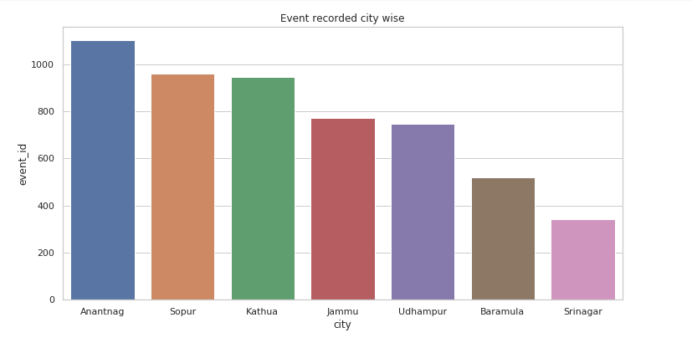
Events_data observations - Jammu and Kashmir - city wise event count

Slide 14
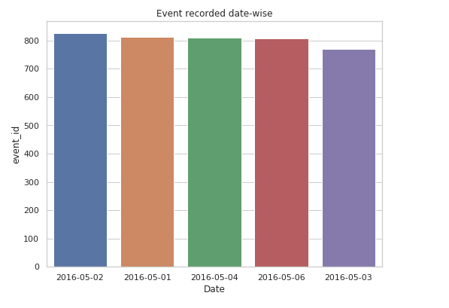
Events_data observations - Jammu and Kashmir - date wise event recorded

Slide 15
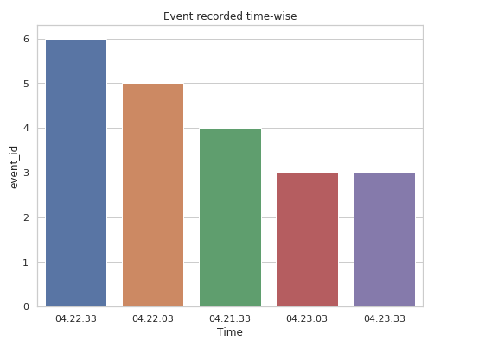
Events_data observations - Jammu and Kashmir - time wise event recorded

Slide 16
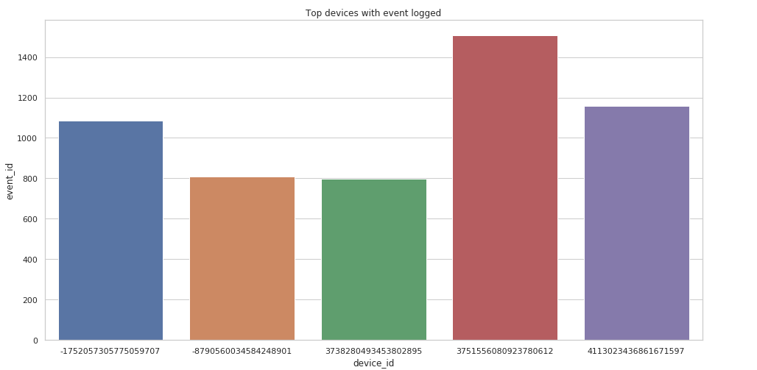
Events_data observations - Jammu and Kashmir- top devices for event recorded

Slide 17
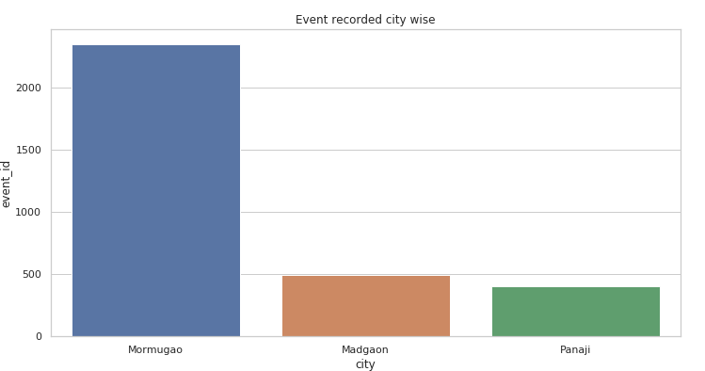
Events_data observations - Goa - city wise event count

Slide 18
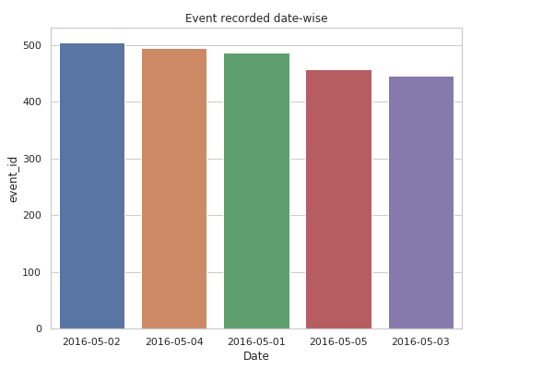
Events_data observations - Goa - date wise event recorded

Slide 19
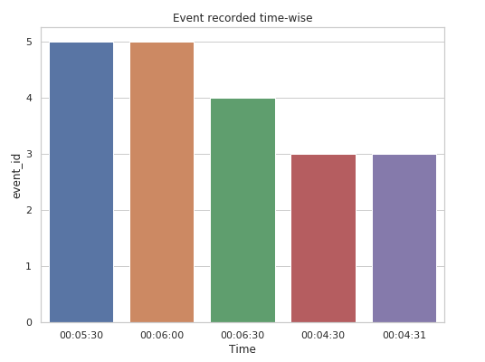
Events_data observations - Goa - time wise event recorded

Slide 20
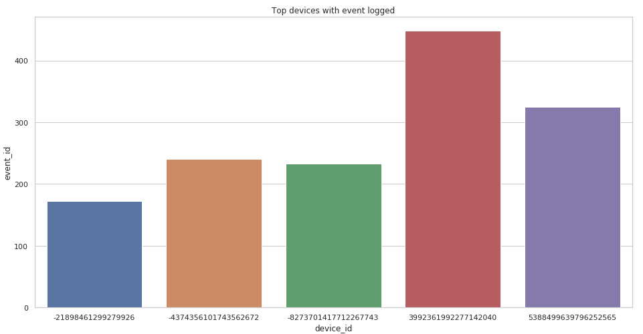
Events_data observations - Goa - top devices for event recorded

Slide 21
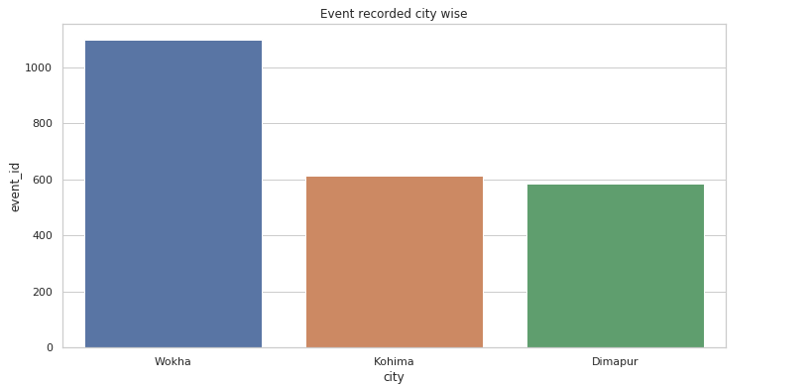
Events_data observations - Nagaland- city wise event count

Slide 22
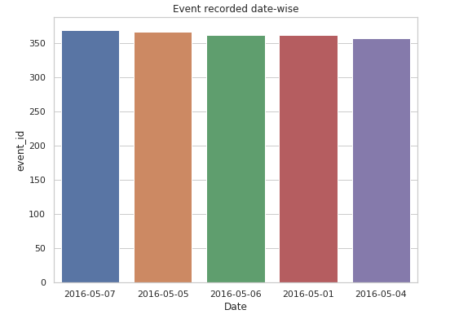
Events_data observations - Nagaland- date wise event recorded

Slide 23
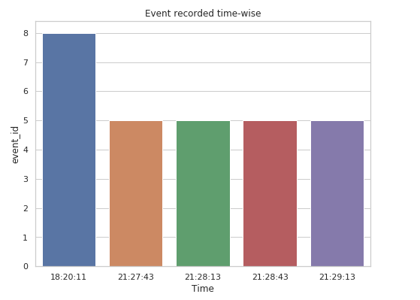
Events_data observations - Nagaland- time wise event recorded

Slide 24
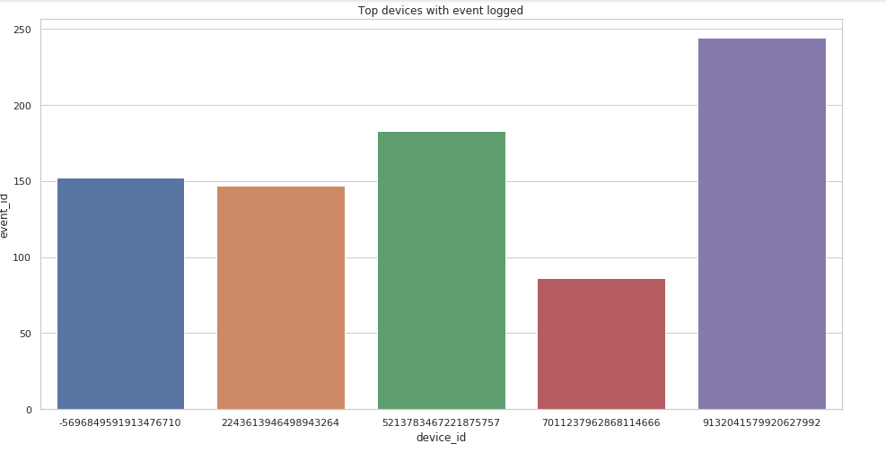
Events_data observations - Nagaland- top devices for event recorded

Slide 25
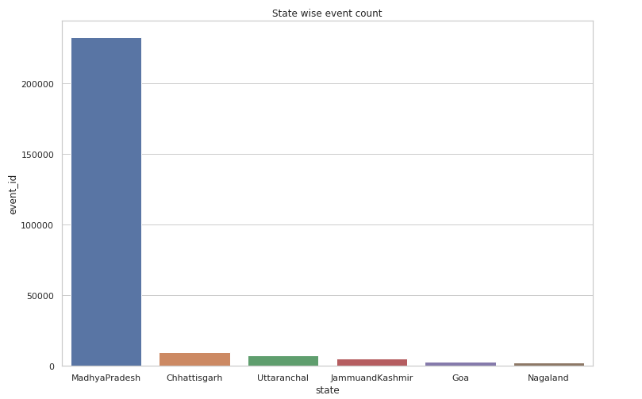
Events_data observation - Madhya Pradesh has major share of events recorded

Slide 26
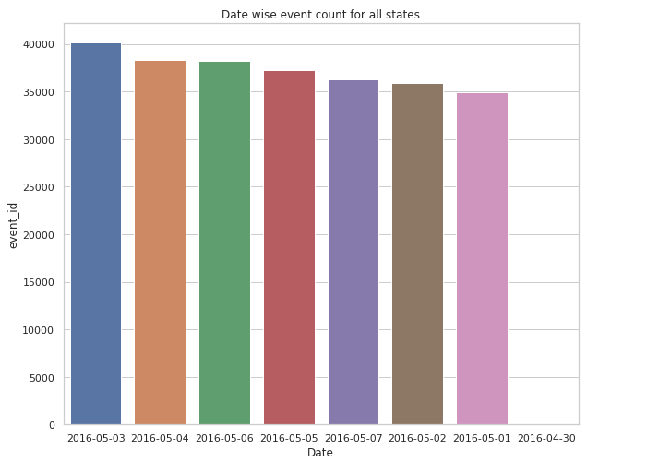
Events_data observation - Date wise event for all states

Slide 27
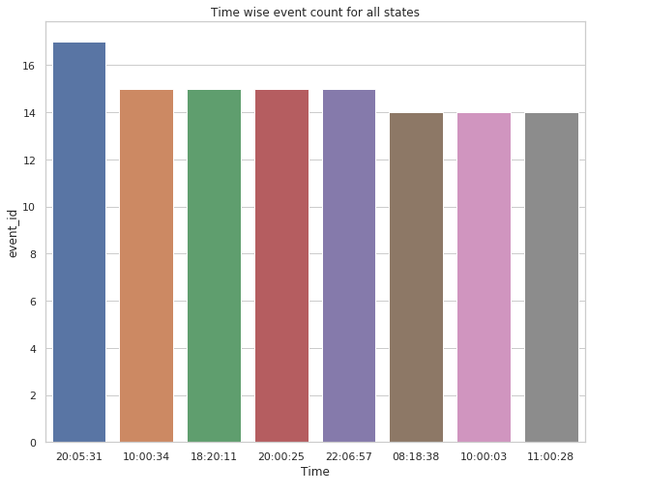
Events_data observation - time wise event for all states

Slide 28
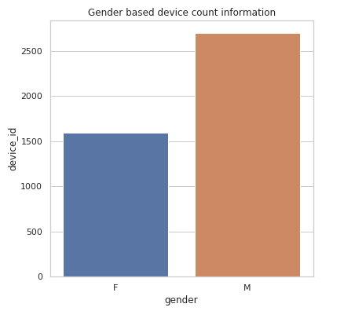
gender_age_train observation - gender wise device count

Slide 29
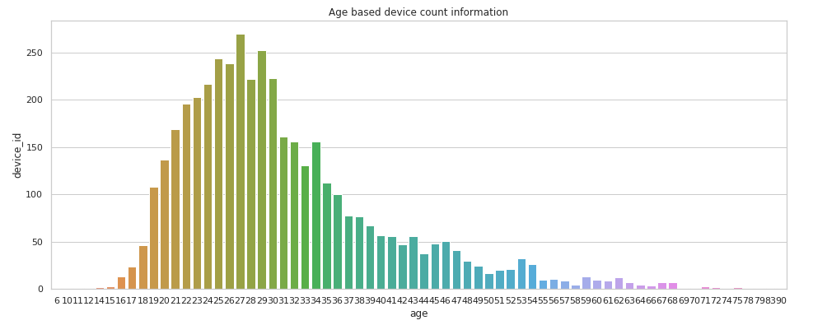
gender_age_train observation - age wise device count

Slide 30
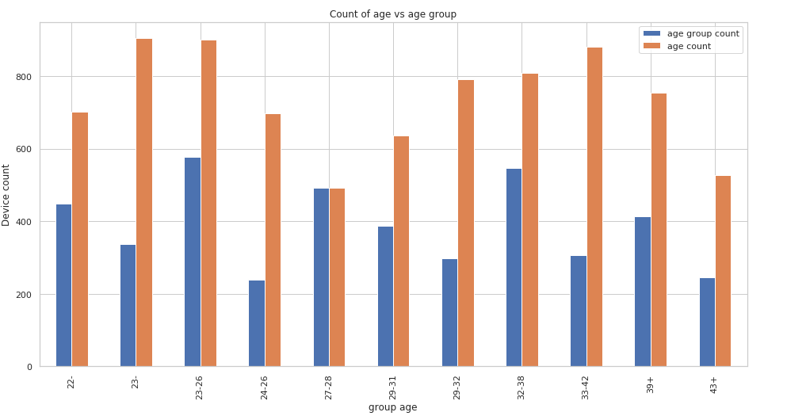
gender_age_train observation - count of devices for age and age group

Slide 31
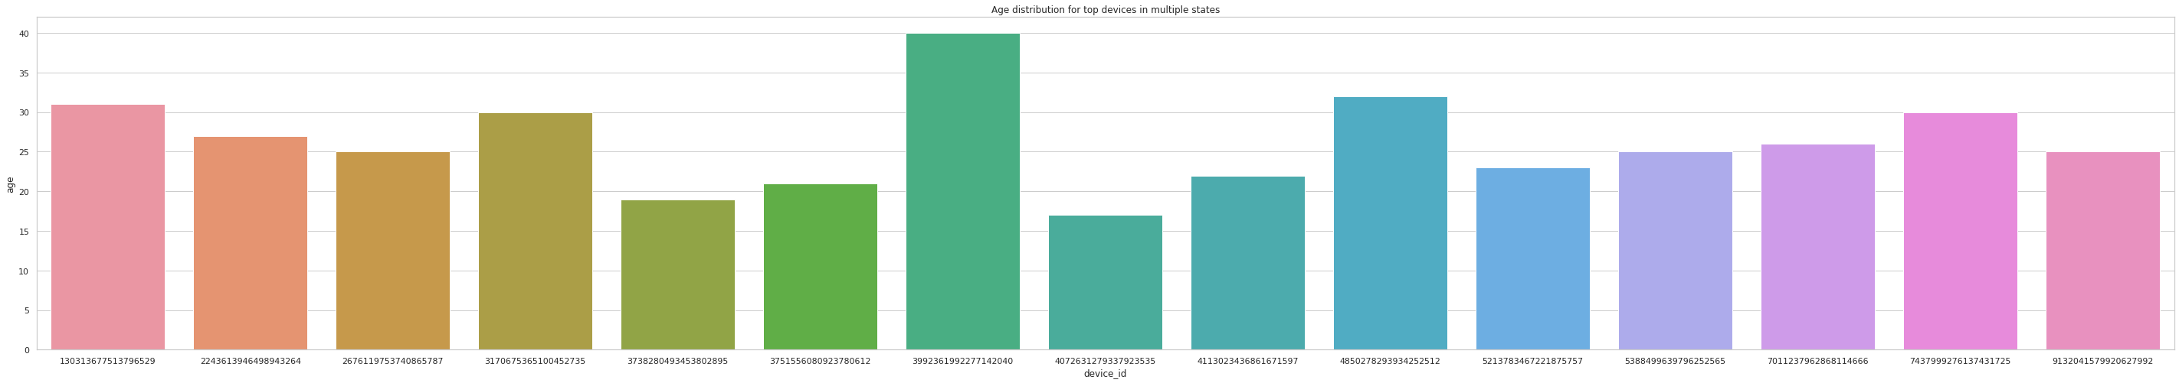
Age for top devices in states

