Slide 1
OPEN SOURCE HANDBOOK
AI Tools Cheatsheets
I Built an Open-Source
AI Coding Handbook
Why swipe
• Tool fit
• AGENTS.md
• Review workflow
• MCP risk
• Team rollout
Claude Code • Codex • Cursor • Copilot • MCP • AGENTS.md
One vendor-neutral, security-conscious reference for tool selection, repository instructions, workflows, and team adoption.
For developers and engineering teams
AI Tools Cheatsheets
1/7

Slide 2
TOOL COMPARISON
Which AI Coding Tool Fits
Your Workflow?
Condensed from the handbook's comparison matrix. The full matrix adds team-fit, verification, and configuration context.
Tool
Best suited for
Claude Code
Deep terminal and repository work
OpenAI Codex
OpenAI-first agentic development
Cursor
IDE-first AI coding
GitHub Copilot
GitHub-centered engineering teams
Open workflows
Provider flexibility and control
Compare by workflow, security, integrations, and team fit ->
AI Tools Cheatsheets
2/7

Slide 3
AGENTS.MD
Your Coding Agent Needs
Repository Instructions
The handbook positions AGENTS.md as the main shared repository instruction file when teams want one durable source of truth across coding agents.
Architecture
Build and test commands
Coding standards
Restricted files
Security boundaries
Definition of done
# AGENTS.md
## Build
npm ci
npm test
## Rules
- Follow existing architecture
- Never expose secrets
- Run focused tests before completion
Keep it small and durable. The docs warn against turning AGENTS.md into a long architecture book or dumping ground.
Give every coding agent the same repository context.
AI Tools Cheatsheets
3/7

Slide 4
CODE REVIEW
AI Should Follow Engineering
Process - Not Replace It
1
Inspect the change
List findings first
Prompt card
2
Review this diff for correctness, authorization risks,
regressions and missing tests.
List findings by severity before summarizing.
3
Separate facts from suspicions
4
Validate high-risk findings
5
Run focused tests
The handbook's team standard is findings-first review, with human reviewers owning correctness and merge approval.
6
Require human approval
AI review is advisory. Humans own approval.
AI Tools Cheatsheets
4/7

Slide 5
MCP SECURITY
MCP Servers Are Privileged
Integrations
The handbook frames MCP as powerful and risky because a connected agent can ask external systems for more context or trigger actions through tools.
Before approval
Safer starting point
Identify the implementation and maintainer
Review requested permissions
Understand data access
Inspect credential handling
Define revocation steps
Read-only access
Specific repositories
No unnecessary shell execution
Human approval for writes
Logged tool calls
Treat MCP access like production access - not like a harmless plugin.
AI Tools Cheatsheets
5/7

Slide 6
TEAM ROLLOUT
How Engineering Teams Can
Adopt AI Safely
The rollout guide is phased: evaluate one tool for one workflow, run a time-boxed pilot, then expand only if the evidence says it is useful and safe.
Discover
->
Pilot
->
Secure
->
Standardize
Train
->
Measure
->
Govern
Select approved tools and target one workflow first
Add repository instructions and review shared prompts
Approve MCP servers and write access separately
Train a pilot group, measure quality, then expand with controls
Move from individual experimentation to governed team adoption.
AI Tools Cheatsheets
6/7

Slide 7
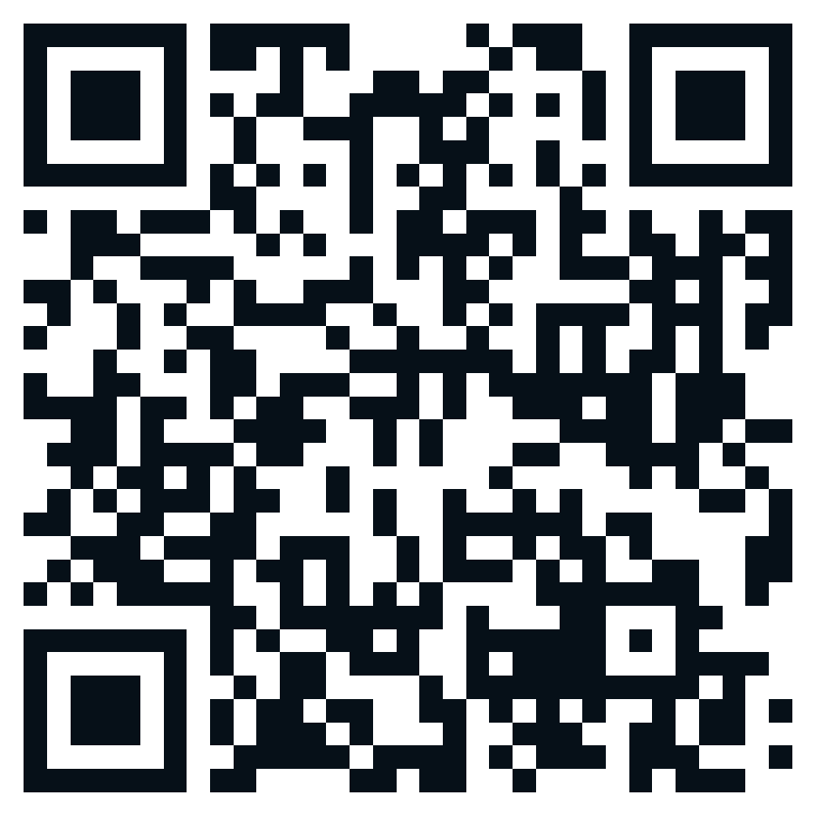
CALL TO ACTION
Explore the Open-Source
Handbook
Tool comparisons
Coding workflows
Prompts and templates
MCP security
Team governance
Angular and Java guidance
Read it • Star it • Fork it • Contribute
Live handbook
ankitparekh007.github.io/ai-tools-cheatsheets
GitHub repository
github.com/AnkitParekh007/ai-tools-cheatsheets
What should I expand next?
AI Tools Cheatsheets
7/7

