Slide 1
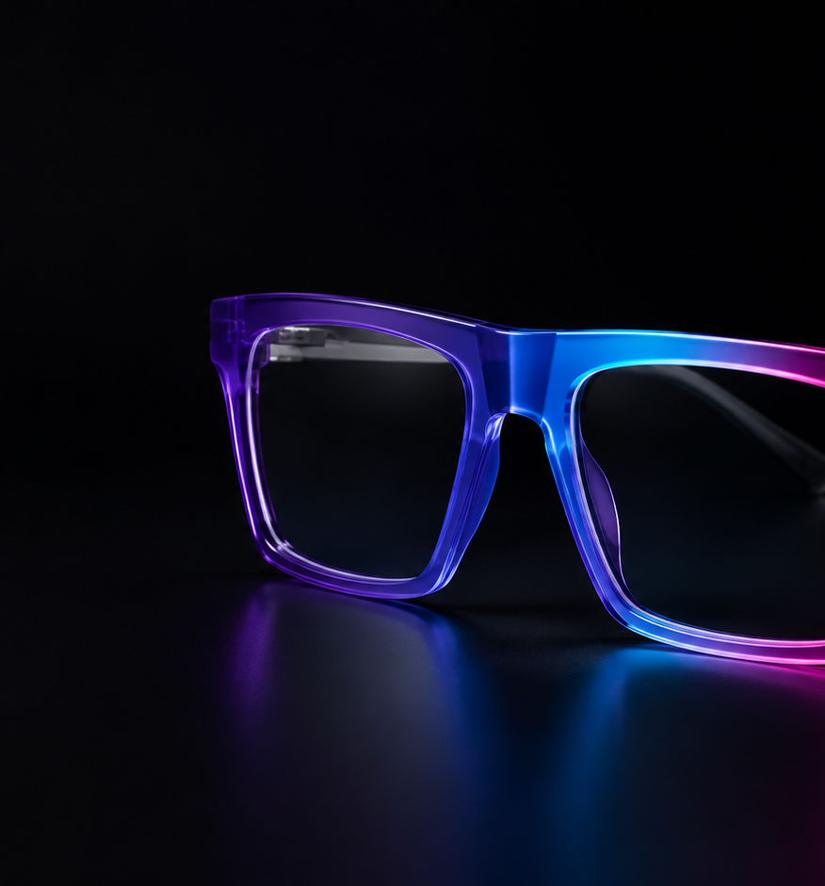
INVESTOR PRESENTATION • 2026
SHADE
SHIFTER
One frame. Every version of you.
App-controlled eyewear that changes frame color on demand.
CONFIDENTIAL
Notes:
[Sources]
Visual: OpenAI-generated concept image created for Shade Shifter; no external source.

Slide 2
THE OVERLOOKED CONSTANT
Eyewear is worn every day—yet its identity stays fixed.
People change
But eyewear—the object sitting at the center of the face—still requires another physical frame to change the look.
clothes
shoes
watch faces
The category solved vision. It has not solved self-expression.
SHADE SHIFTER
02
Notes:
[Sources]
Narrative statement based on the product thesis; no external source.

Slide 3
THE PRODUCT
One frame becomes a wardrobe.
01
02
03
CHOOSE
SHIFT
WEAR
A curated solid, shade or gradient in the app.
Frame zones coordinate over Bluetooth.
Prescription-compatible lenses stay conventional.
No clips. No interchangeable shells. No compromise to the lens.
SHADE SHIFTER
03
Notes:
[Sources]
Product features are target-state concepts and remain subject to prototype validation.

Slide 4

THE EMOTIONAL PAYOFF
Match the moment,
not the inventory.
Work
→ quiet graphite
Dinner
→ deep ultraviolet
Festival
→ electric gradient
A functional device becomes a daily fashion platform.
SHADE SHIFTER
04
Notes:
[Sources]
Visual: OpenAI-generated lifestyle concept image created for Shade Shifter; no external source.

Slide 5
THE MARKET WHITESPACE
Existing winners validate the behavior—not our exact product.
PAIR EYEWEAR
CHAMELO
SHADE SHIFTER
People want to change
frame appearance
Electronic eyewear
can attract attention
The frame body
changes digitally
Physical magnetic overlays
Color-changing lenses
Prescription-compatible • seamless • app-controlled
Our opening: own the recolorable frame category before it becomes obvious.
SHADE SHIFTER
05
Notes:
[Sources]
Pair Eyewear — https://paireyewear.com/
CES Innovation Awards 2025, Chamelo Aura — https://www.ces.tech/ces-innovation-awards/2025/aura-the-world-s-first-color-changing-glasses/

Slide 6
INDIA-FIRST OPPORTUNITY
A large need, a visible product and a digital-native buyer.
500M+
people in India need vision correction
₹79K Cr
reported India eyewear market opportunity
₹14,999–₹19,999
target flagship retail price
The launch wedge is premium, fashion-forward and prescription-compatible—not mass-market electronics.
SHADE SHIFTER
06
Notes:
[Sources]
Lenskart Q3 FY26 shareholder letter — https://assets.lenskart.com/documents/2026/02/11/Reg30-ShareholderLetter.pdf
Retail price is Shade Shifter's current planning target, not a market fact.

Slide 7
DE-RISKING THE HARD PART
Two prototypes answer two different questions.
EXPERIENCE POC
MATERIAL POC
Can customers feel
the magic?
Can the frame become
a premium product?
RGB + light guide • BLE app • solids and gradients
Reflective color • curvature • sweat • UV • cycle life
The LED build proves the experience. It does not predetermine production architecture.
SHADE SHIFTER
07
Notes:
[Sources]
Prototype strategy from Shade Shifter research-analysis plan.

Slide 8
12-WEEK PROOF ROADMAP
Spend grows only when evidence does.
W0–2
W3–5
W6–9
W10–12
DESIRABILITY
BENCH PROOF
WEARABLE ALPHA
INVESTOR DEMO
Landing test + interviews
USB-powered BLE color
Fit print + safe electronics
3 units + evidence pack
₹0.5–1.5L
₹1–2L
₹3–6L
₹3.5–5.5L
Recommended dual-track POC envelope: ₹8–15 lakh
SHADE SHIFTER
08
Notes:
[Sources]
Budget and schedule are planning estimates from Shade Shifter's research and POC blueprint; vendor quotes required.

Slide 9
BUSINESS MODEL
Premium hardware first. A platform as the moat.
₹14,999–₹19,999
EXPANSION
New frame silhouettes
Target Gen-1 retail price
Limited-edition palettes
No mandatory subscription
Designer collaborations
The product must earn trust as eyewear—not as a recurring-fee gadget.
Retail + optical partnerships
SHADE SHIFTER
09
Notes:
[Sources]
Pricing and revenue paths are Shade Shifter planning assumptions; no revenue has been generated.

Slide 10
GO-TO-MARKET
Launch as fashion innovation, distribute as eyewear.
01
CREATE DESIRE
Creator-led demos; color changes tied to outfits and moments.
02
PROVE FIT
Pop-ups and optical partners reduce the friction of buying frames.
03
BUILD TRUST
Prescription compatibility, safety evidence and easy servicing.
04
SCALE SELECTIVELY
India-first flagship, then design-led global communities.
SHADE SHIFTER
10
Notes:
[Sources]
GTM sequence is Shade Shifter's current strategic proposal.

Slide 11
THE RAISE
Fund the proof that turns a striking idea into a defensible category.
₹1.5 Cr
35%
Material R&D + testing
30%
Wearable engineering
PRE-SEED TARGET
20%
Industrial design + IP
15%
Customer validation + pilots
12-month outcome
Validated alpha • protected IP position • manufacturing path • launch evidence
SHADE SHIFTER
11
Notes:
[Sources]
Raise amount and use of funds are proposed planning figures and should be finalized by the founder before circulation.

Slide 12
SHADE SHIFTER
Eyewear is about to
become expressive.
One frame. Every version of you.
BUILD WITH US
Materials • Eyewear • Engineering • Capital
SHADE SHIFTER
12
Notes:
[Sources]
No external sources.

