Slide 1
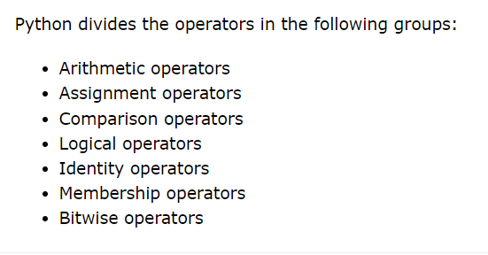

Slide 2
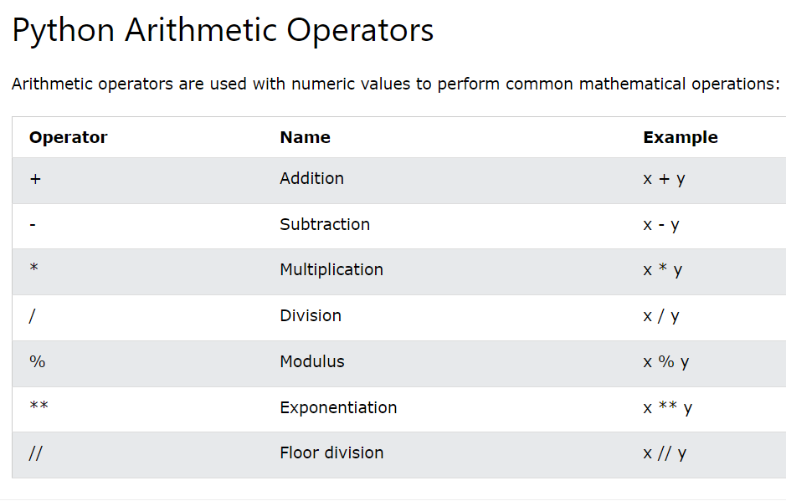

Slide 3
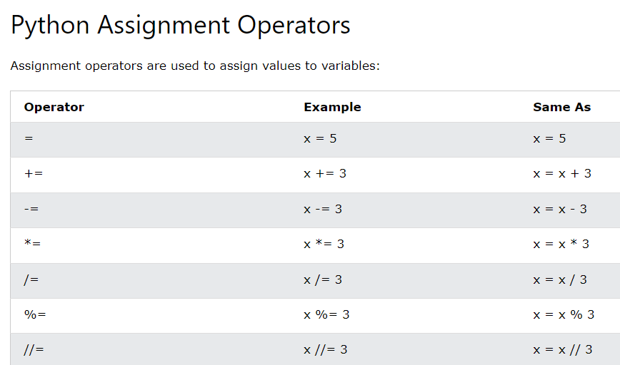

Slide 4
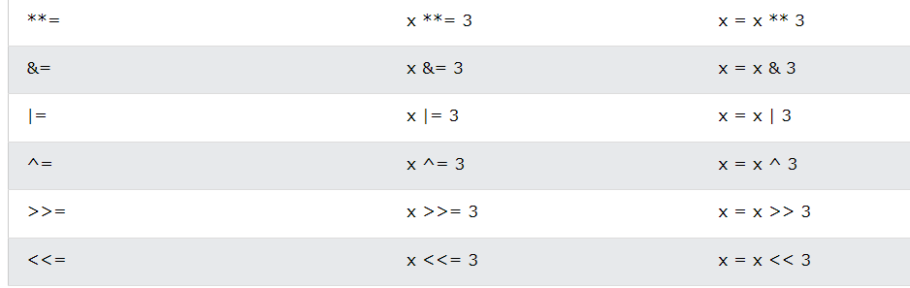

Slide 5
Decimal Number (0123456789 reason for 10) | Binary Number (01 reason for 2)
22 => 2*10^{^1}+2*10^{^0} | 6 = 110 = 1*(2^2) + 1*(2^1) + 0*(2^0) = 6
169 => 9*(10^0) + 6*(10^1) + 1*(10^2) | 5 = 101 = 1*(2^2) + 0*(2^1) + 1*(2^0) = 5
 | 7 = 111 = 1*(2^0) + 1*(2^1) + 1*(2^2)
Steps to get the Binary format
A = 5
B0 =A%2
B0=1
A = A//2
A = 2
A = 2
B1 = A%2
B1 = 0
A = A//2
A = 1
A = 1
B2 = A%2 = 1%2
B2 = 1
A = A//2
A = 0
Steps to get the decimal format
B0 =A %10 B0==9
A = A//10 16.9 == 16
B1 =A %10 B1== 6
A = A//10 1.6 == 1
B2 = A%10 B2== 1
A = A//10 = 0

Slide 6
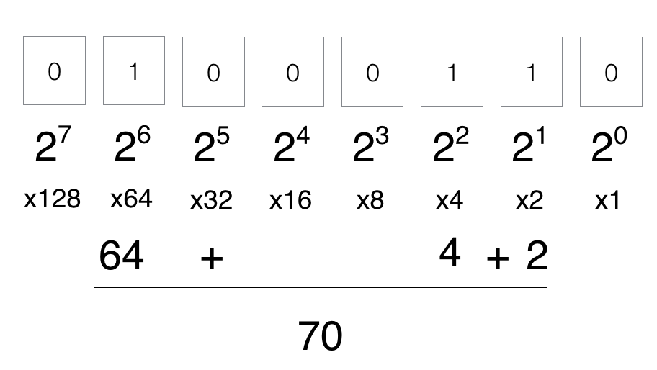

Slide 7
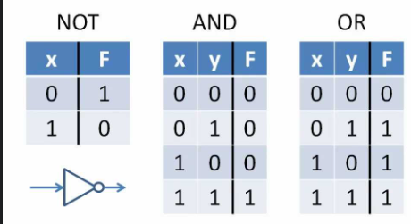
Let x be i have money
Let y be i have car
(X and Y => Rich ) means if i have money and if i have a car ,then i am rich

Slide 8
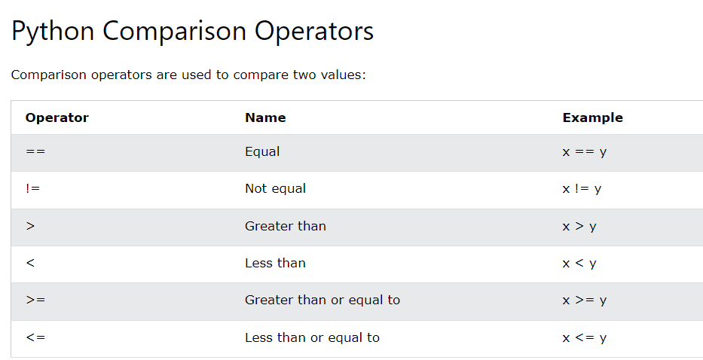

Slide 9
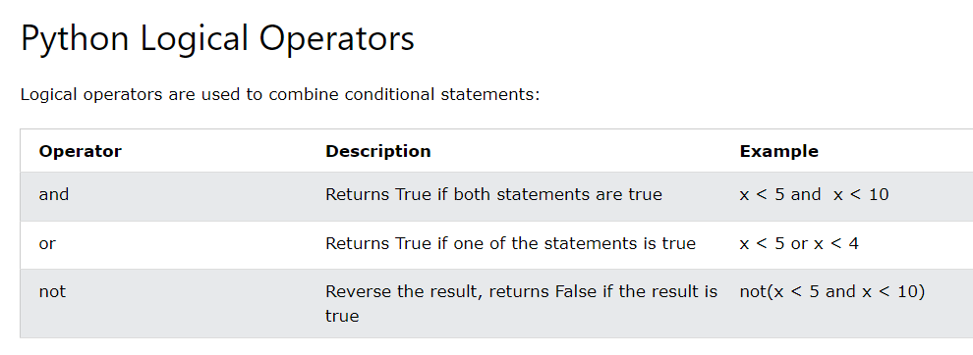

Slide 10
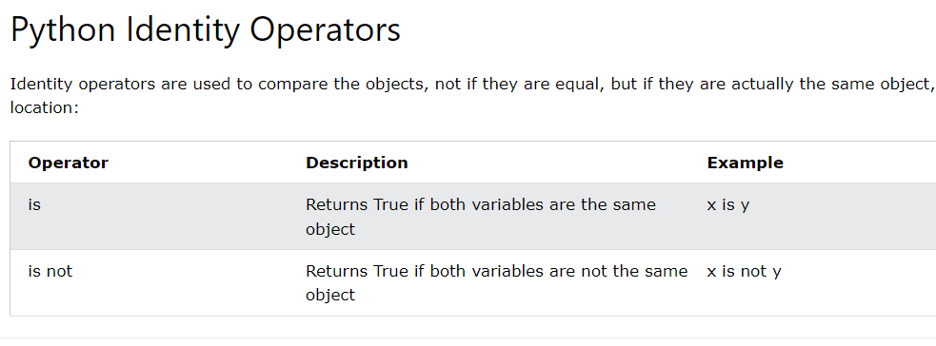

Slide 11
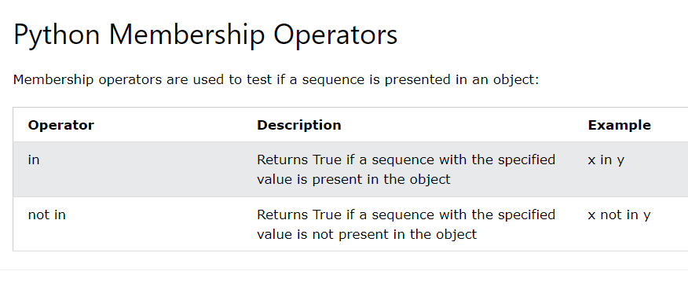

Slide 12
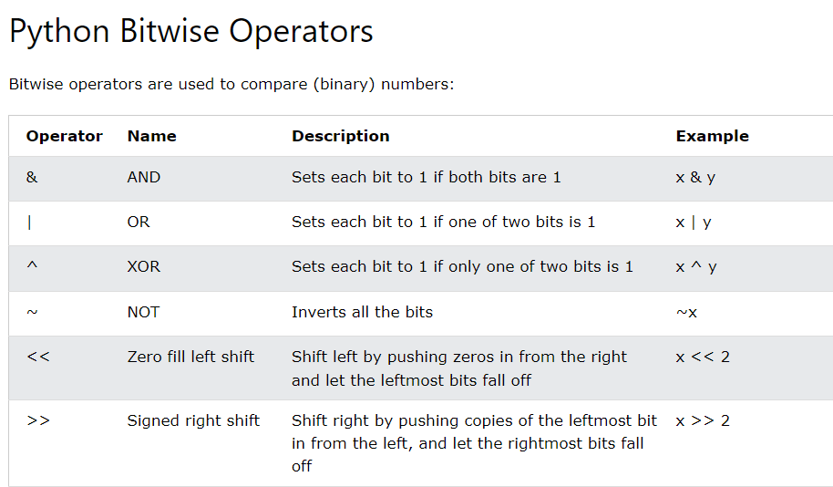

Slide 13
Precedence and Associativity
print(3*4+12/6)
print(12+12/6)
print(12+2)
print(14)
# left to right

