Slide 1


PARUL INSTITUTE OF TECHNOLOGY
FACULTY OF ENGINEERING & TECHNOLOGY
PARUL UNIVERSITY
B.Tech. 6th Semester Minor project presentation
“Safe-Drive Guardian: A Real-time Driver Drowsiness and Safety Prediction System”
Presented by:
Ankit Porwal (210305124106)
Divyanshu Mishra (210305124090)
Mayank Patidar (210305124102)
Shivam Patel (210305124101)
Supervisors:
Mr. S.W. Thakare
PARUL INSTITUTE OF TECHNOLOGY, PARUL UNIVERSITY
NAME OF THE INSTITUTE, PARUL UNIVERSITY

Slide 2

Content of Presentation
Abstract
Introduction (front end technology/back end technology/Aim and Objectives project/application etc.)
Problem Statement
Literature Review
Proposed Methodology
Use case diagram/ER diagram/Flow diagram
Hardware and software Requirement
Excepted Outcome of the Project
Limitation
Conclusion and Future Work
References
PARUL INSTITUTE OF TECHNOLOGY, PARUL UNIVERSITY
NAME OF THE INSTITUTE, PARUL UNIVERSITY

Slide 3
Abstract
The Safe Drive Guardian project serves as a real-time safety net and also contributes to a comprehensive understanding of driver behavior through continuous data collection and analysis. The implementation of this intelligent system has the potential to significantly reduce road accidents caused by avoidable human errors, thereby promoting a safer driving environment for all road users.
PARUL INSTITUTE OF TECHNOLOGY, PARUL UNIVERSITY
NAME OF THE INSTITUTE, PARUL UNIVERSITY

Slide 4
Introduction
Aim: The Safe Drive Guardian project aims to enhance road safety by employing deep learning techniques to analyze real-time inputs from a driver-facing camera. The system focuses on detecting potential risks associated with drowsiness, sleepiness, and distracted driving, such as smartphone usage.
Objective:
The primary objective is to prevent accidents by triggering timely alarms and alerts when unsafe driving behaviors are identified.
It can also be used as a proof against or in favor of driver for proper law implication.
PARUL INSTITUTE OF TECHNOLOGY, PARUL UNIVERSITY
NAME OF THE INSTITUTE, PARUL UNIVERSITY

Slide 5
Problem Statement
Drowsy and distracted driving pose significant threats to road safety, contributing to a high number of preventable accidents. The absence of a proactive and real-time system to monitor and address these issues creates a critical gap in ensuring driver attentiveness. The Safe Drive Guardian project aims to address this gap by leveraging deep learning technologies to analyze live inputs from a driver-facing camera, detecting signs of drowsiness and distracted driving, and triggering immediate alarms to prevent potential accidents. The lack of such a system increases the risk of road incidents caused by human factors that can be mitigated through timely intervention and awareness.
PARUL INSTITUTE OF TECHNOLOGY, PARUL UNIVERSITY
NAME OF THE INSTITUTE, PARUL UNIVERSITY

Slide 6
Literature Review
Paper Title | Authors | Published In | Future Scope
Machine learning and deep learning techniques for driver fatigue and drowsiness detection: a review | Samy Abd El-Nabi, Walid El-Shafai, El-Sayed M. El-Rabaie, Khalil F | Multimedia tools and application, 2023 | Sets the foundation for future enhancements in safety systems through comprehensive analysis and identification of effective techniques
Real-Time Driver Drowsiness Detection Using Multi-Modal Sensor Fusion and Machine Learning | H. Zhang, J. Wang, L. Chen, et al | IEEE Sensors Journal, 2022 | Paves the way for advanced, integrated safety systems in vehicles that can accurately detect drowsiness in diverse driving conditions
Drowsy Driver Detection through Facial Movement Analysis using Deep Learning | R. Rangarajan, N. Manivasagam, S. Raja, et al | Procedia Computer Science, 2019 | Opens possibilities for non-intrusive, camera-based drowsiness detection systems with high accuracy in real-world scenarios
PARUL INSTITUTE OF TECHNOLOGY, PARUL UNIVERSITY
NAME OF THE INSTITUTE, PARUL UNIVERSITY

Slide 7
Literature Review
Paper Title | Authors | Published In | Future Scope
DeepEyes: End-to-End Driver Drowsiness Monitoring Using Convolutional Neural Networks | S. Abtahi, S. H. Mousavi, M. S. Hossain, et al | IEEE Transactions on Intelligent Transportation Systems, 2018 | Highlights the potential for fully automated, real-time monitoring systems that require minimal human intervention and offer scalability
Real-Time Driver Drowsiness Detection System Using Convolutional Neural Networks | Zhiwei Luo, Fangwei Zhu, Jianming Jiang | IEEE Access, 2018 | Demonstrates the effectiveness of CNNs in real-time applications, suggesting a future where drowsiness detection systems can be easily integrated into existing vehicle architectures
A Novel Approach for Real-time Driver Drowsiness Detection using Hybrid Algorithm | S. Chaurasia, P. Singhai, A. Namdeo | Procedia Computer Science, 2015 | Suggests a future direction for hybrid models that combine multiple algorithms for improved accuracy and reliability in drowsiness detection
PARUL INSTITUTE OF TECHNOLOGY, PARUL UNIVERSITY
NAME OF THE INSTITUTE, PARUL UNIVERSITY

Slide 8
Disadvantages and limitations till now
All these journal papers shows that the research that has happened for this project focuses only on one thing that is the face of driver, and detects whether he is feeling sleepy or not but there can be more things a driver could be doing which will compromise the safety of both driver and other people on road.
That can be driver using mobile phone while driving.
Driver may be awake but is not looking in front while driving.
We would be attempting to address these problems too in our project.
PARUL INSTITUTE OF TECHNOLOGY, PARUL UNIVERSITY
NAME OF THE INSTITUTE, PARUL UNIVERSITY

Slide 9
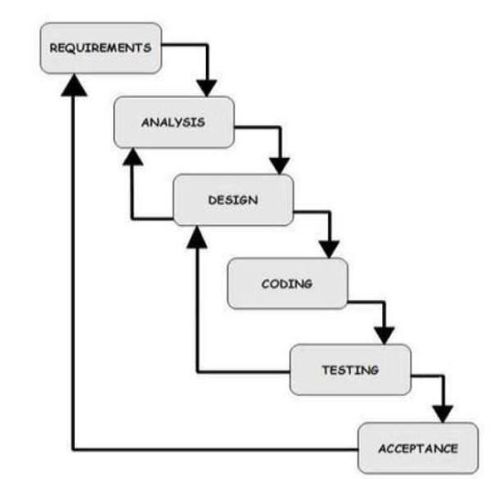
Proposed Methodology
WATERFALL MODEL
PARUL INSTITUTE OF TECHNOLOGY, PARUL UNIVERSITY
NAME OF THE INSTITUTE, PARUL UNIVERSITY

Slide 10
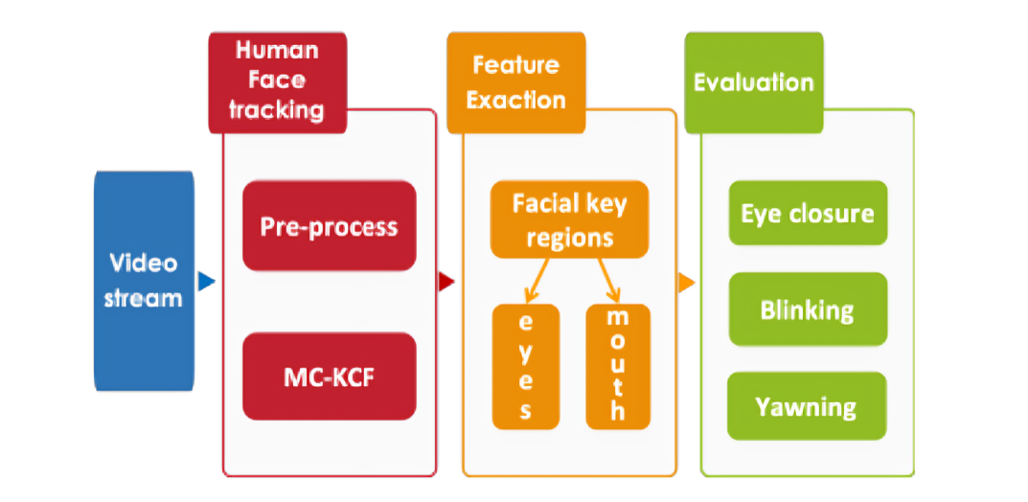
System Workflow
PARUL INSTITUTE OF TECHNOLOGY, PARUL UNIVERSITY
NAME OF THE INSTITUTE, PARUL UNIVERSITY

Slide 11
Hardware and Software Requirement
Hardware Requirement:
Web camera,
any connection between camera and the detection machine,
GPU
Software Requirements:
Trained models like, YOLO, labelimg, etc
Python libraries like TensorFlow, Pytorch
Storage to store images and videos of driver
PARUL INSTITUTE OF TECHNOLOGY, PARUL UNIVERSITY
NAME OF THE INSTITUTE, PARUL UNIVERSITY

Slide 12
Expected Outcomes of Project
Accurate Drowsiness Detection:
Develop a deep learning model capable of accurately detecting signs of driver drowsiness in real-time through analysis of facial expressions, eye movements, and other relevant features.
Real-time Monitoring:
Establish a system capable of continuous and real-time monitoring of the driver, ensuring timely intervention when unsafe behaviors are detected.
Timely Alarm Triggering:
Integrate an effective alarm system that promptly alerts the driver upon detecting signs of drowsiness or distraction, thereby preventing potential accidents.
Reduced Accidents and Improved Safety:
Demonstrate a measurable reduction in accidents attributed to drowsy or distracted driving, thereby contributing to improved overall road safety.
PARUL INSTITUTE OF TECHNOLOGY, PARUL UNIVERSITY
NAME OF THE INSTITUTE, PARUL UNIVERSITY

Slide 13
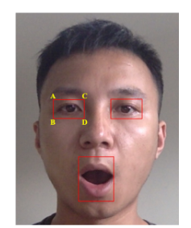
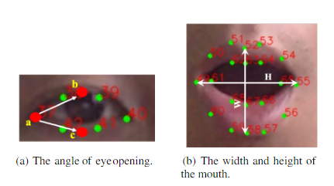
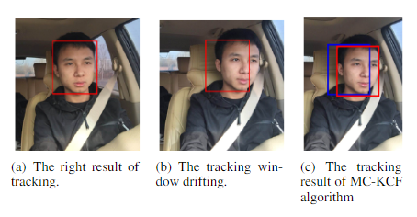
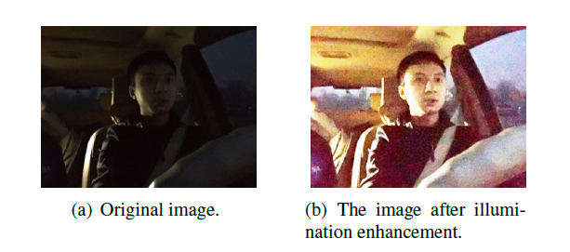
Expected Outcomes of Project
PARUL INSTITUTE OF TECHNOLOGY, PARUL UNIVERSITY
NAME OF THE INSTITUTE, PARUL UNIVERSITY

Slide 14
Limitations
Individual Differences:
Drivers exhibit diverse behaviors, and the effectiveness of the model may vary across different individuals, making it challenging to create a one-size-fits-all solution.
Environmental Factors:
Variations in lighting conditions, weather, and other environmental factors could impact the accuracy of the system's predictions.
Hardware Dependency:
The system relies on the availability and functionality of hardware components (e.g., cameras) in the vehicle. Malfunctions or limitations in these components may affect the system's performance.
Privacy Concerns:
Continuous monitoring of drivers raises privacy concerns. Striking a balance between ensuring safety and respecting privacy rights is crucial for user acceptance and legal compliance.
PARUL INSTITUTE OF TECHNOLOGY, PARUL UNIVERSITY
NAME OF THE INSTITUTE, PARUL UNIVERSITY

Slide 15
Future Work and Upgrades
Integrating the detection system with IOT so that the alarm that goes off during detection should be a different device from the detection app.
Adding the mic features in our device, which will take audio input too, to check if the driver is listening to loud music, which can also lead to safety compromission.
PARUL INSTITUTE OF TECHNOLOGY, PARUL UNIVERSITY
NAME OF THE INSTITUTE, PARUL UNIVERSITY

Slide 16
Conclusion
The project on real-time drowsiness detection and safety implementation represents a significant step forward in enhancing road safety and reducing accidents caused by driver fatigue. By leveraging cutting-edge technologies such as machine learning, deep learning, and sensor fusion, the project has successfully developed a system capable of accurately identifying signs of driver drowsiness in real-time. The incorporation of facial movement analysis, convolutional neural networks, and multi-modal sensor data has allowed for the creation of a comprehensive and effective drowsiness detection system.
The implementation of this system in vehicles can greatly contribute to the prevention of accidents related to driver fatigue by providing timely alerts to drivers, prompting them to take necessary breaks or rest, thus ensuring their own safety and that of others on the road. The project's success not only showcases the potential of advanced technologies in enhancing vehicle safety features but also sets a precedent for future research and development in the field of automotive safety systems.
In conclusion, the real-time drowsiness detection and safety implementation project stands as a testament to the power of technological innovation in addressing critical safety issues. As we move forward, it is imperative that such technologies continue to be refined, customized, and integrated into mainstream automotive safety systems, paving the way for safer roads and saving lives.
PARUL INSTITUTE OF TECHNOLOGY, PARUL UNIVERSITY
NAME OF THE INSTITUTE, PARUL UNIVERSITY

Slide 17
References
https://ieeexplore.ieee.org/document/7729629
https://www.sciencedirect.com/science/article/pii/S2212017317303342
https://www.ncbi.nlm.nih.gov/pmc/articles/PMC6154053/
https://www.researchgate.net/publication/282078820_A_survey_of_drowsy_driver_detection_systems
https://ieeexplore.ieee.org/document/9049331
https://ieeexplore.ieee.org/document/8420801
https://www.sciencedirect.com/science/article/pii/S0960077919302109
https://ieeexplore.ieee.org/document/9137562
https://ieeexplore.ieee.org/document/7799075
https://www.sciencedirect.com/science/article/pii/S0957417420312884
https://ieeexplore.ieee.org/document/8592158
https://www.researchgate.net/publication/323211648_Drowsiness_Detection_and_Alert_System_for_Drivers_Using_Smart_Glasses
https://www.mdpi.com/1424-8220/21/19/6371
PARUL INSTITUTE OF TECHNOLOGY, PARUL UNIVERSITY
NAME OF THE INSTITUTE, PARUL UNIVERSITY

Slide 18


Closing
Thank You!
PARUL INSTITUTE OF TECHNOLOGY, PARUL UNIVERSITY
NAME OF THE INSTITUTE, PARUL UNIVERSITY

