Slide 1
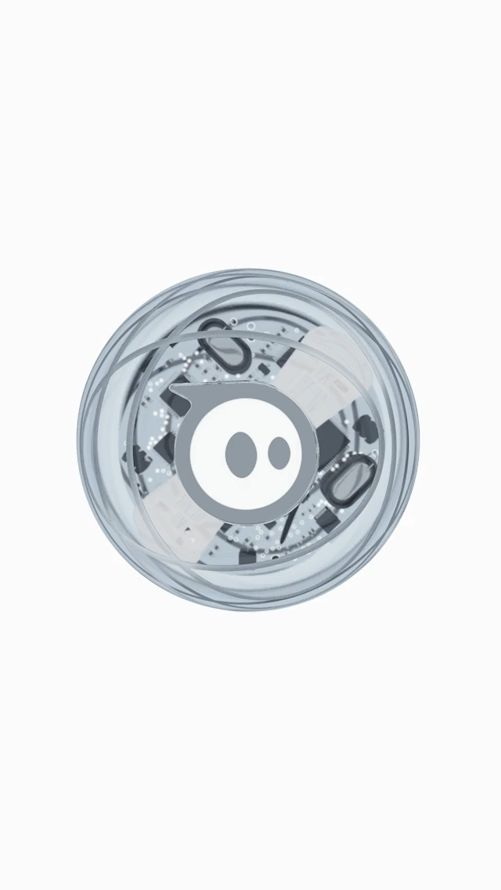
SPHERO
Async and await
Presented by
Ankit Prakash
Rahul Reddy Dayam
Venkat Akhil Pendem
Ramesh Nutulapathi
Keerthi Sree Kukunoor

Slide 2
AGENDA
In this tutorial you will be able to learn:
What is a Sphero? Different types of sphero available in the market.
Some of the important features of sphero.
Getting started with sphero and about sphero edu app.
Different ways to code this little beast.
What is ASYNC and AWAIT function?
The role of ASYNC and AWAIT function in coding sphero.
To create a small fun game using sphero.

Slide 3
ASYNC & AWAIT

Slide 4
Before jumping directly to Async consider this
Suppose if we want to do a task after completing a different task or if we want to perform tasks one after the other and not simultaneously. How will you achieve this without using Async function.

Slide 5
CALLBACKS
setTimeout(function() {
console.log('This runs after 5 seconds');
}, 5000);
console.log('This runs first');
But if we want to do things sequentially that is one after another
doThingOne(function() {
doThingTwo(function() {
doThingThree(function() {
doThingFour(function() {
// What the hell?
});
});
});
});
This is called Callback hell.

Slide 6
What is an Async function?
An asynchronous function is a function which operates asynchronously via the event loop, using an implicit Promise to return its result.

Slide 7
Understanding a Promise

