Slide 1
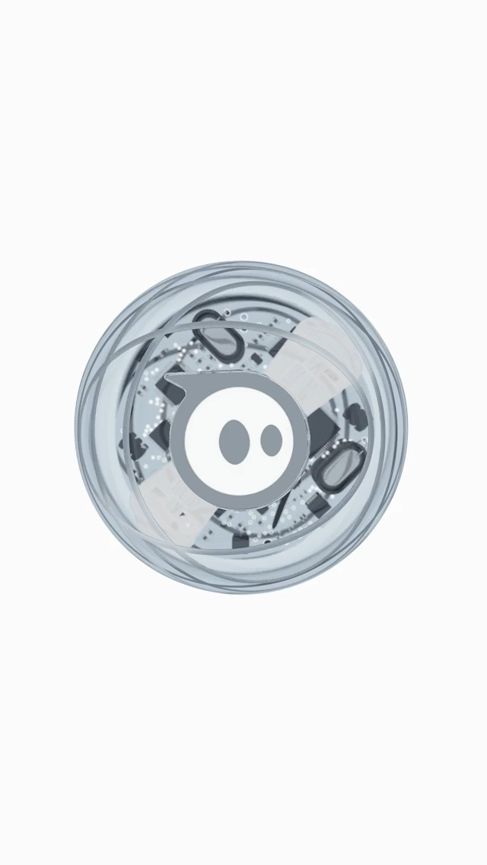
SPHERO
Async and await

Slide 2
AGENDA
In this tutorial you will be able to learn:
What is a Sphero? Different types of sphero available in the market.
Some of the important features of sphero.
Getting started with sphero and about sphero edu app.
Different ways to code this little beast.
What is ASYNC and AWAIT function?
The role of ASYNC and AWAIT function in coding sphero.
To create a small fun game using sphero.

