Slide 1

System Overview
A complete pipeline that transforms scanned hospital reports into searchable, intelligent data. Doctors can query the system to find similar patient cases instantly.
Input
Output
Scanned PDFs, images, handwritten reports
Ranked list of matching patient records with similarity scores
Core Idea
Convert unstructured documents → structured metadata → searchable vectors

Slide 2


Stage 1: OCR (Optical Character Recognition)
What it does
Reads scanned images and converts them into machine-readable text.
Technologies
Tesseract, EasyOCR, PaddleOCR
Real Example
Input: Scanned diabetes report (image file)
Output: "Patient Name: John Doe, Disease: Diabetes Type 2, HbA1c: 8.5%, Date: 2024-08-08"
Without OCR, doctors can't search old paper records. With OCR, everything becomes digital and searchable.

Slide 3

Stage 2: Text Cleaning
OCR output is rarely perfect. This stage removes noise so downstream stages work accurately.
What it does
Before Cleaning
After Cleaning
Removes noise from OCR output — extra spaces, OCR mistakes, special symbols, and formatting issues.
Tools: Python Regex, spaCy preprocessing
"P@tient N@me: J0hn D0e Dis@@se: Diab3tes"
"Patient Name: John Doe Disease: Diabetes"
Clean text = better accuracy in every subsequent stage. Garbage in, garbage out.

Slide 4

Stage 3: Medical NLP & Named Entity Recognition (NER)
What it does
Extracted Entities
Identifies and extracts structured medical information from raw text.
Tools
spaCy, SciSpaCy, MedSpaCy, BioBERT
Disease
Doctor
Input Text
Diabetes Type 2
Dr. Smith
"Dr. Smith diagnosed John Doe with Type 2 Diabetes. HbA1c test shows 8.5%. Prescribed Metformin. Referred to Endocrinology."
Instead of storing entire 10-page reports, we extract only the important medical facts.
Patient
Test
John Doe
HbA1c (8.5%)
Medicine
Department
Metformin
Endocrinology

Slide 5
Stage 4: Semantic Metadata Extraction
Structures extracted entities into a clean, searchable JSON format — replacing verbose report text with precise, queryable fields.
Instead of storing this...
We store this structured metadata:
"Dr. Smith diagnosed John Doe with Type 2 Diabetes on August 8, 2024. HbA1c test shows 8.5%. Prescribed Metformin. Referred to Endocrinology Department."
{
"Disease": "Diabetes Type 2",
"Report_Type": "Blood Report",
"Department": "Endocrinology",
"Tests": ["HbA1c", "Glucose"],
"Medicine": "Metformin",
"Doctor": "Dr. Smith",
"Date": "2024-08-08"
}
Why it matters
Structured data is searchable. A doctor can now query "Show all Diabetes patients in Endocrinology" instantly — no full-text scanning required.

Slide 6




Stage 5: Embedding Generation
Converts structured metadata into numerical vectors — the language computers use to measure meaning and similarity.
Metadata Input
Disease=Diabetes, Department=Endocrinology, Test=Glucose
Model Processing
Sentence Transformers, BioBERT, or ClinicalBERT encode the meaning of the text
Vector Output
[0.21, -0.45, 0.88, 0.12, 0.56, -0.33, ...]
Two similar reports will have similar vectors — enabling mathematical comparison.

Slide 7

Stage 6: Store in FAISS Vector Database
What FAISS stores
Vector ID + Embedding vector only. Not PDFs, images, or full text.
Real Example
Report 101 → [0.21, -0.45, 0.88, ...]
Report 204 → [0.19, -0.43, 0.90, ...]
Report 876 → [0.05, 0.12, 0.34, ...]
Why it matters
FAISS is optimized for speed. Searching 1 million vectors takes milliseconds, not hours. It's purpose-built for nearest-neighbor lookups at scale.

Slide 8
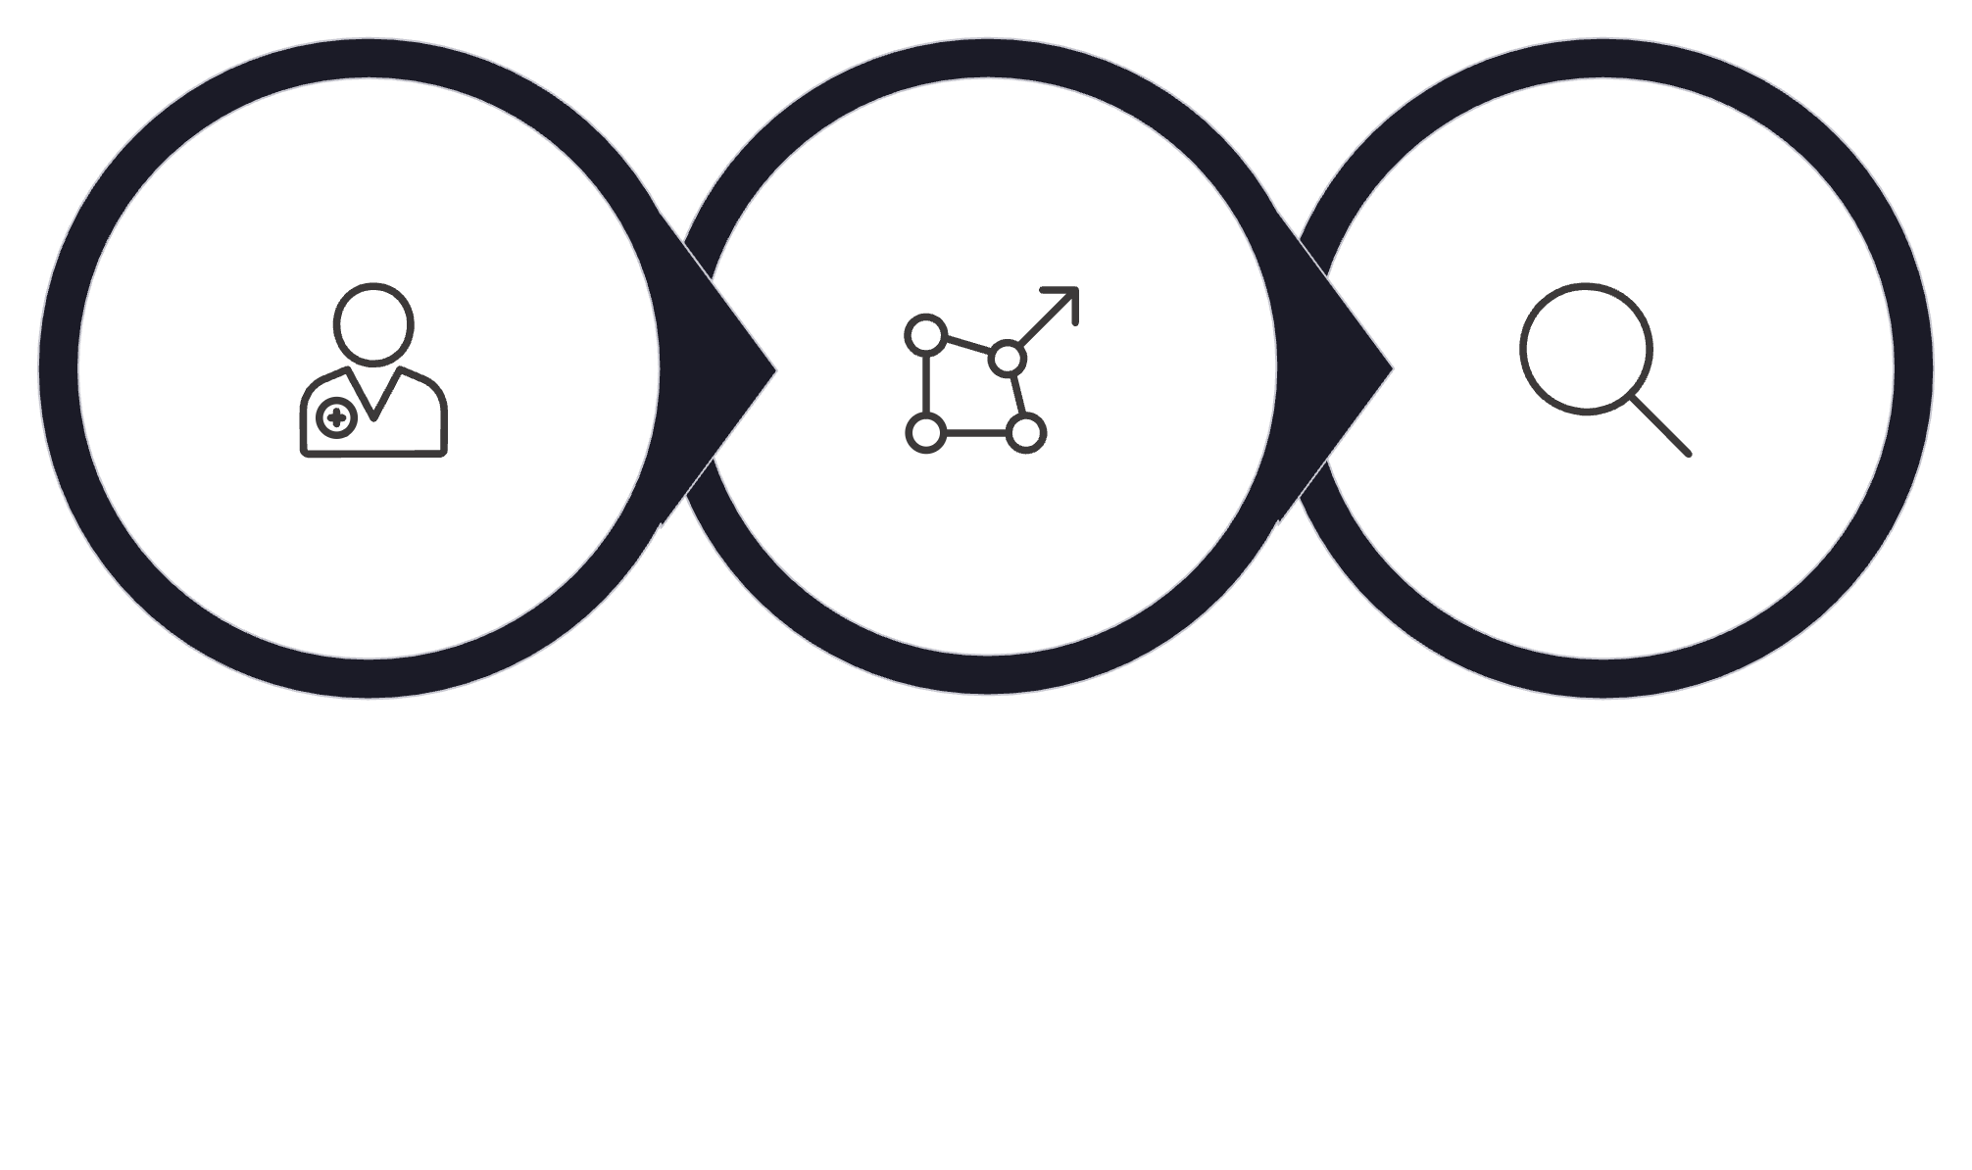
Stage 7: Similarity Search with Cosine Similarity
Finds reports that are semantically similar to a doctor's natural-language query by comparing vectors mathematically.
Convert to Vector
Submit Query
FAISS Search
Doctor Query
Report 101 ✓
"Show me diabetic patients with high glucose levels"
Query vector: [0.20, -0.44, 0.87, ...]
Cosine Similarity = 0.98
Very similar — strong match
Report 204 ✓
Report 876 ✗
Cosine Similarity = 0.95
Similar — good match
Cosine Similarity = 0.12
Not similar — filtered out

Slide 9
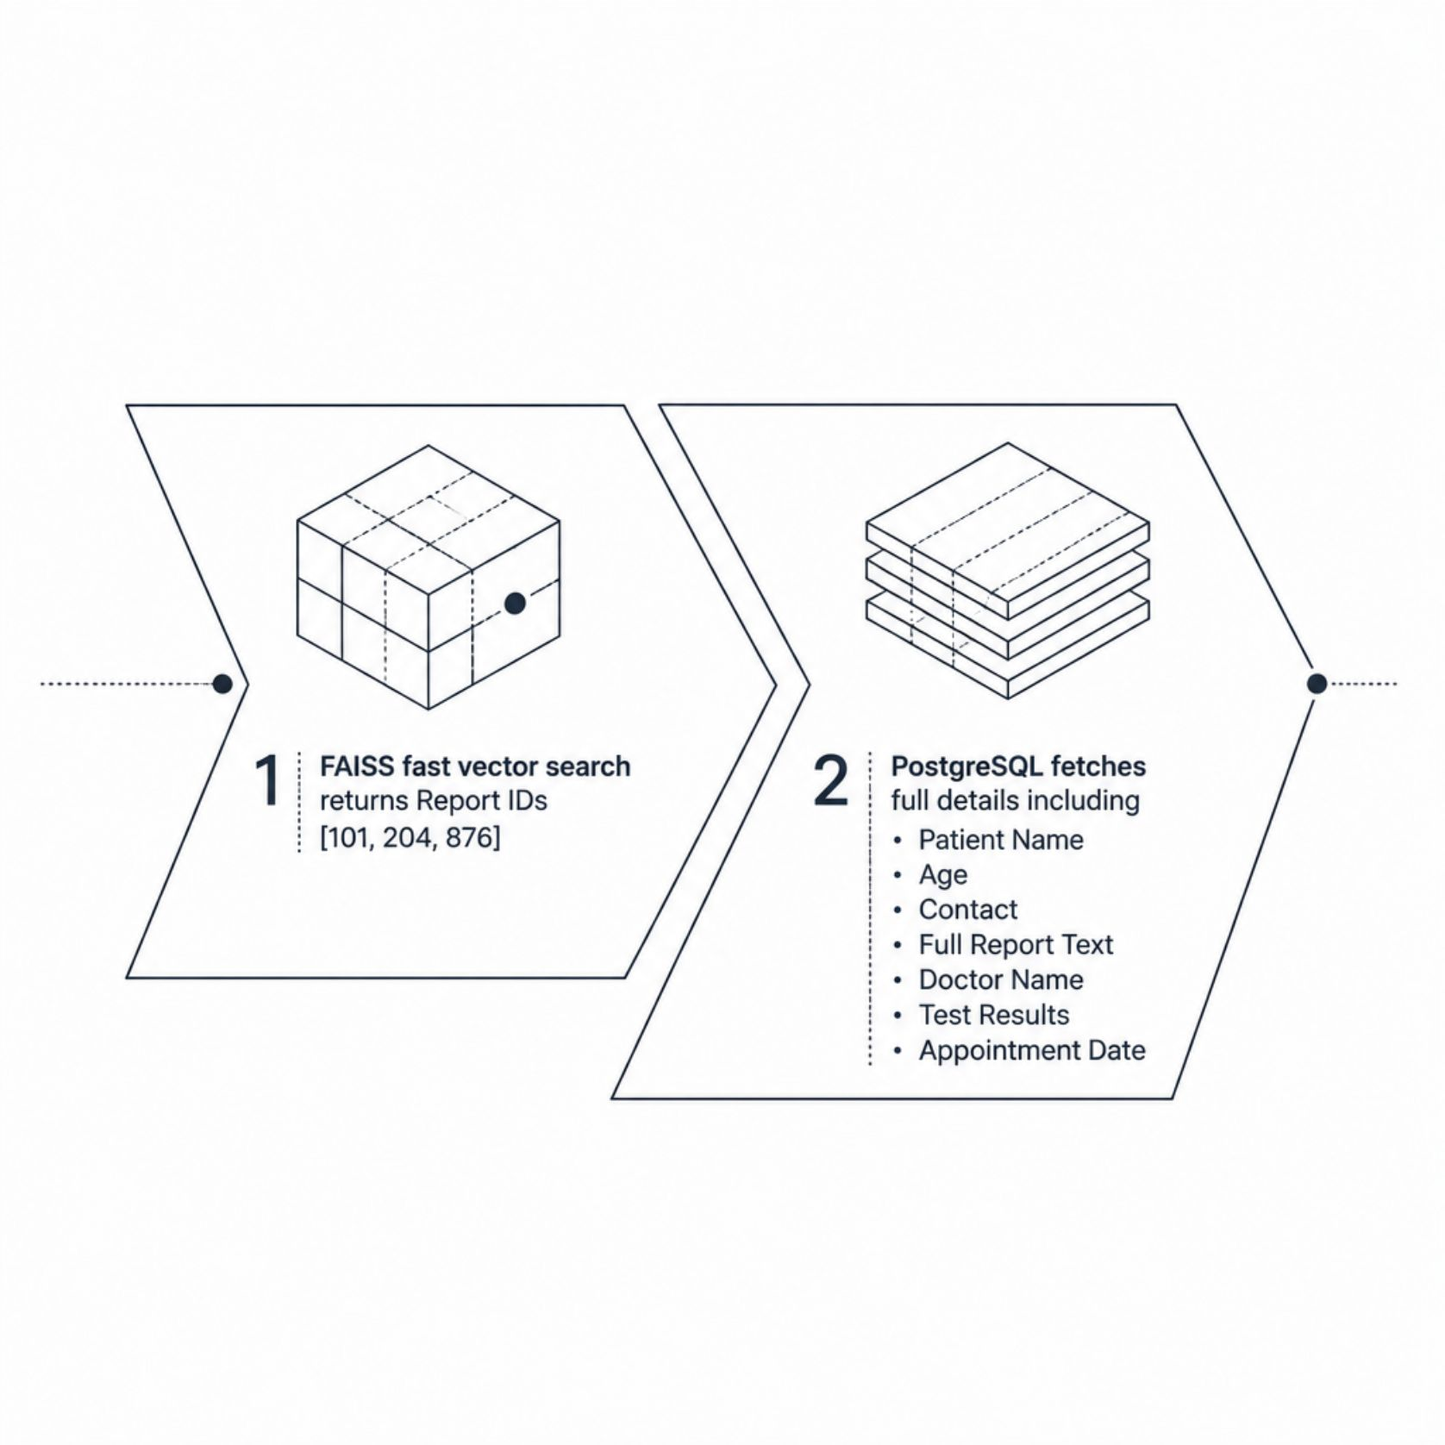
Stage 8: Retrieve from Data Warehouse
FAISS returns matching Report IDs — then PostgreSQL fetches the full patient details behind each ID.
Why two systems?
FAISS is blazing fast but stores only vectors. PostgreSQL stores the actual patient data — names, test results, appointment history, full report text.
Together, they combine speed with completeness. Neither system alone could do both jobs efficiently.
Think of FAISS as the index of a book, and PostgreSQL as the book itself.

Slide 10

Stage 9: Priority Ranking Engine
Ranks results by relevance, not just similarity. The formula: Final Score = Similarity Score + Recency Score + Priority Score
🥇 Patient A — Rank #1
🥈 Patient C — Rank #2
Similarity 98% + Last Visit Yesterday + Emergency Case
Score: 0.98 + 0.9 + 1.0 = 2.88
Similarity 95% + Last Visit Today + Routine
Score: 0.95 + 1.0 + 0.5 = 2.45
🥉 Patient B — Rank #3
Similarity 99% + Last Visit 2 Years Ago + Routine
Score: 0.99 + 0.2 + 0.5 = 1.69
A recent emergency case ranks above an older, technically more similar case. Ranking makes results actionable, not just accurate.

