Slide 1
PowerBi/Tableau Projects
Business Intelligence Project Submission (Bring your own task 1, BI Category) For (Sr Business Analyst , Tiger Analytics ) Dataset : PowerBi – Tiger dataset , Tableau : Stock trends analysis (PFA) (Ankit Tiwary)

Slide 2
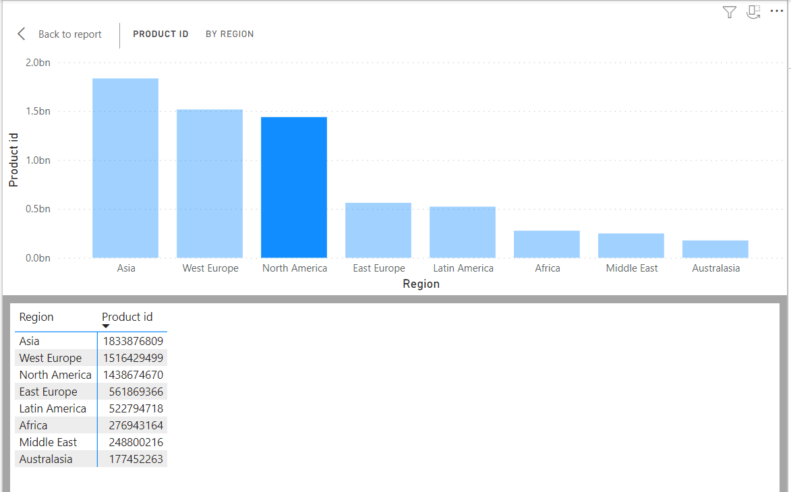
Region Vs Product Id trend analysis

Slide 3
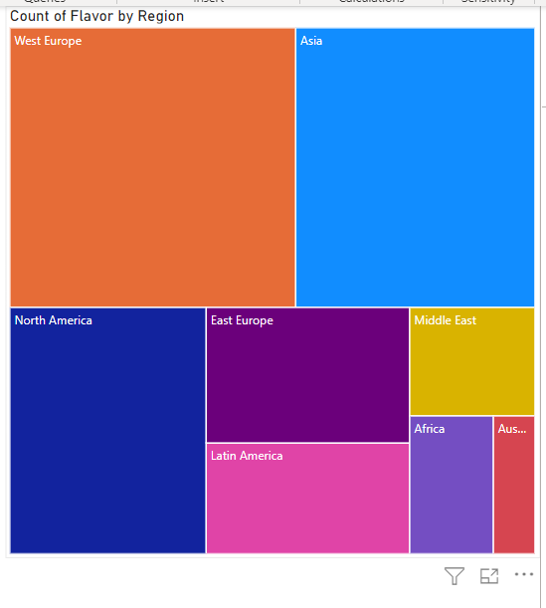
Heat Map : PowerBi (Flavour by region)

Slide 4
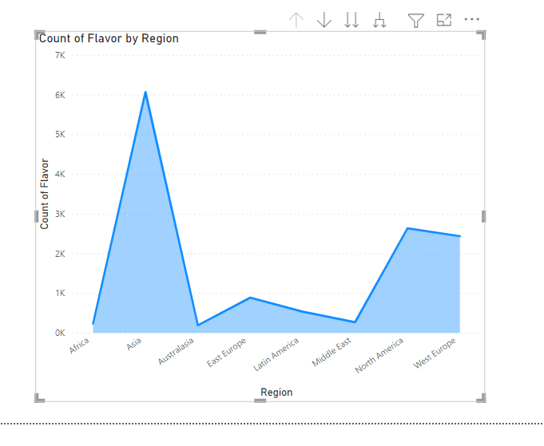
Count(flavour) by region - iced Tea

Slide 5
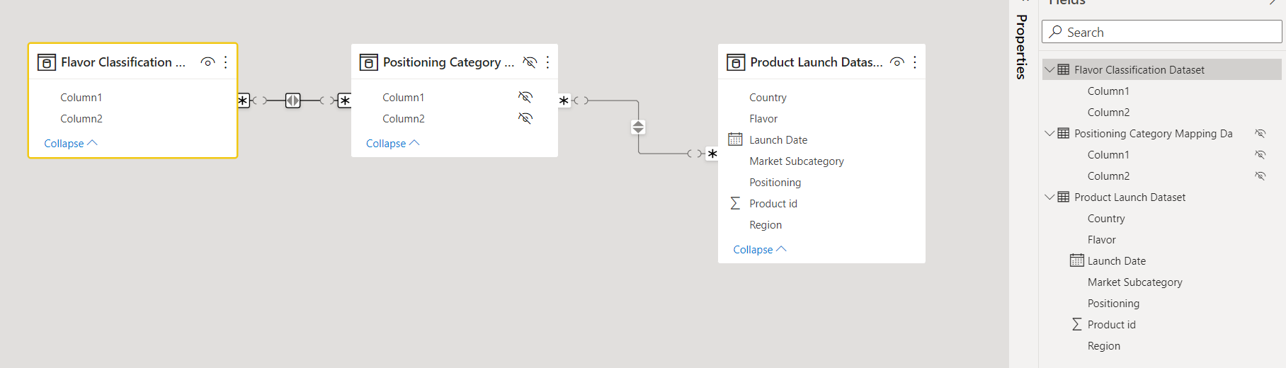
Table Join – Tiger Dataset

Slide 6
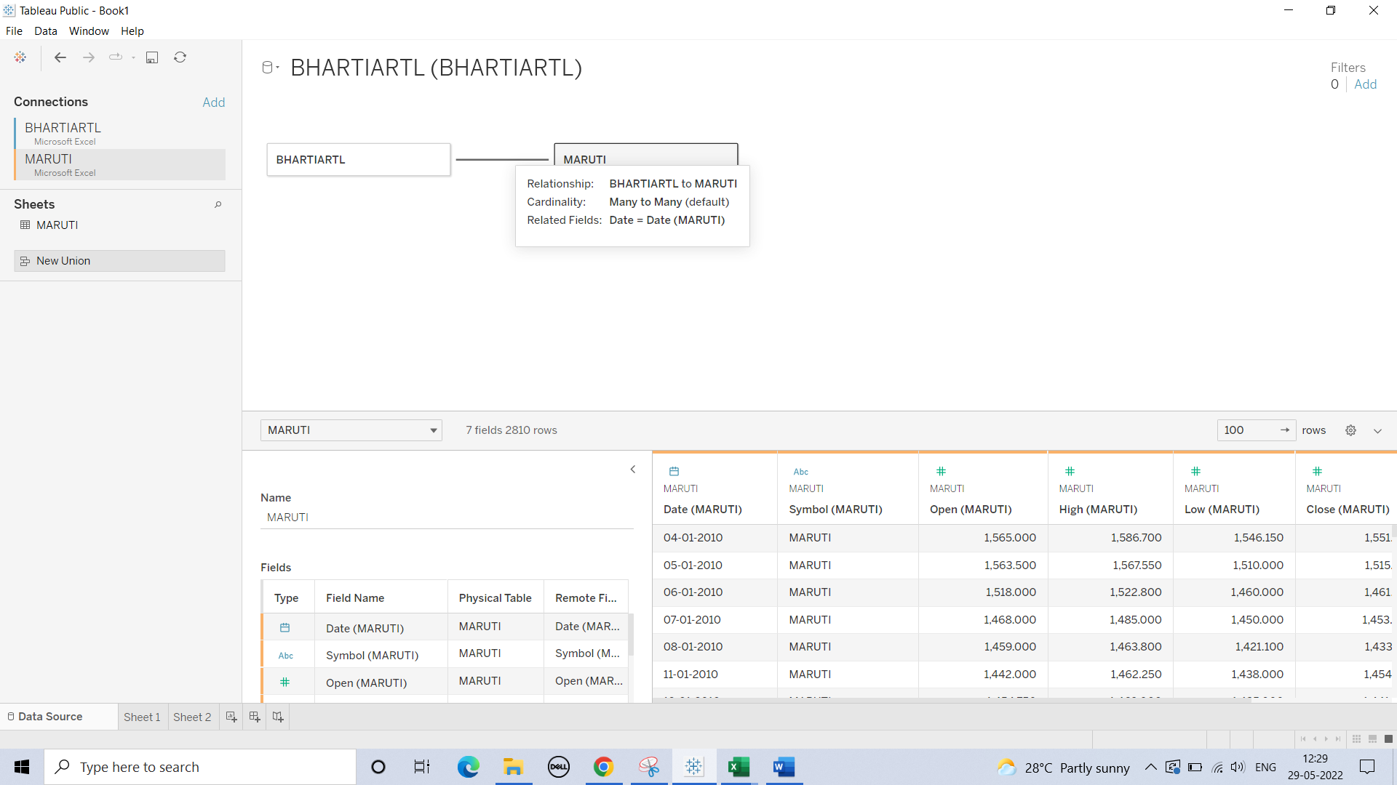
Portfolio Analysis (Table join on date):Tableau

Slide 7
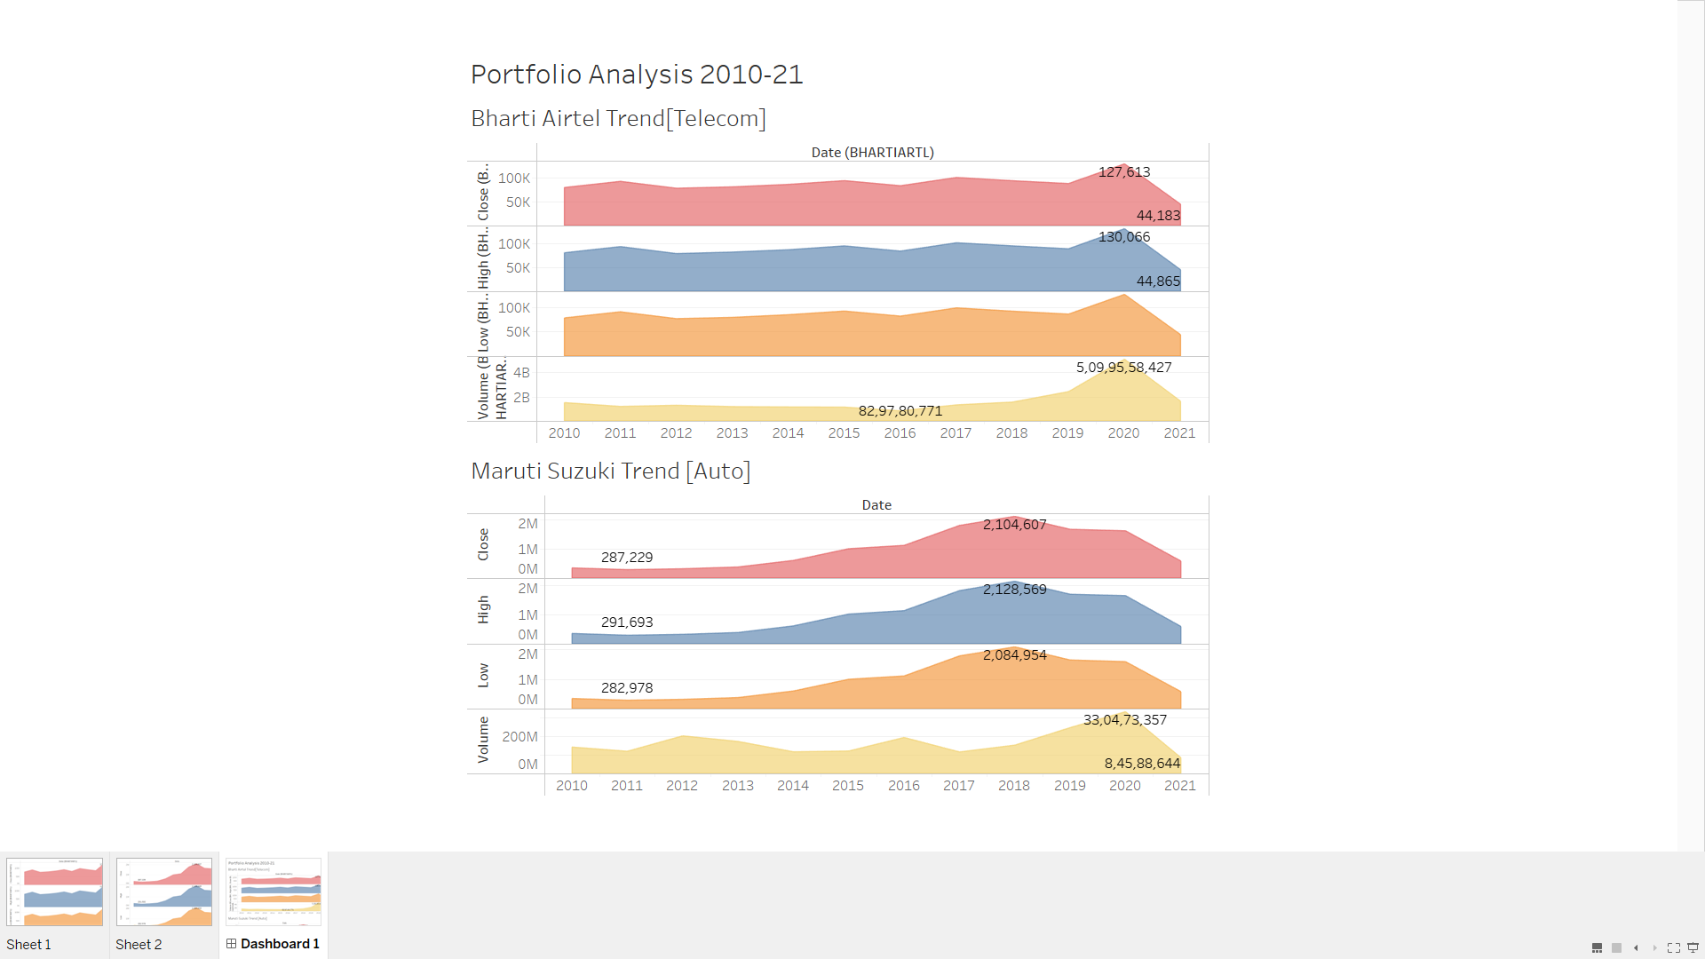
Dashboard : Portfolio Analysis A dashboard has been created using data from Maruti and airtel datasets containing stock market investment trends with usage of labels for max and min values for identification sorted by year covering 4 important trends as measured and date as dimension.

Slide 8
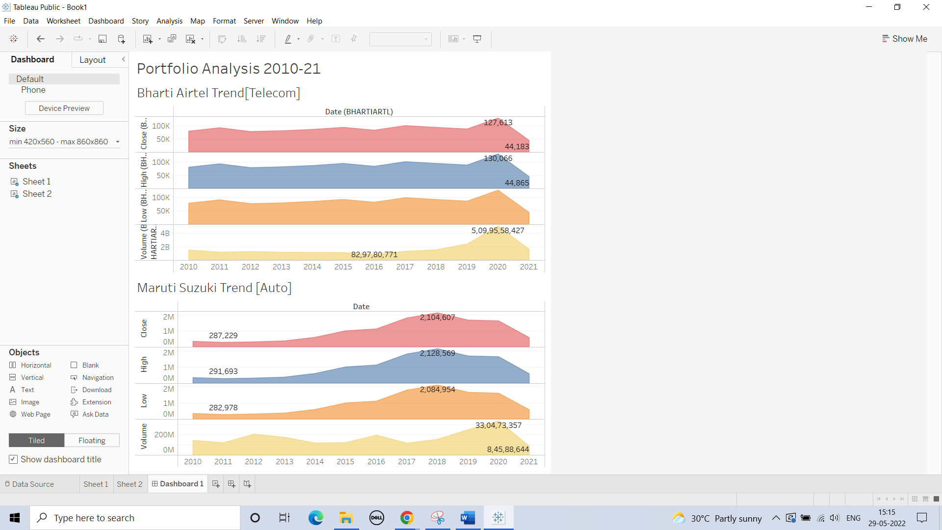
Tableau : Bharti Airtel , Maruti configuration

Slide 9
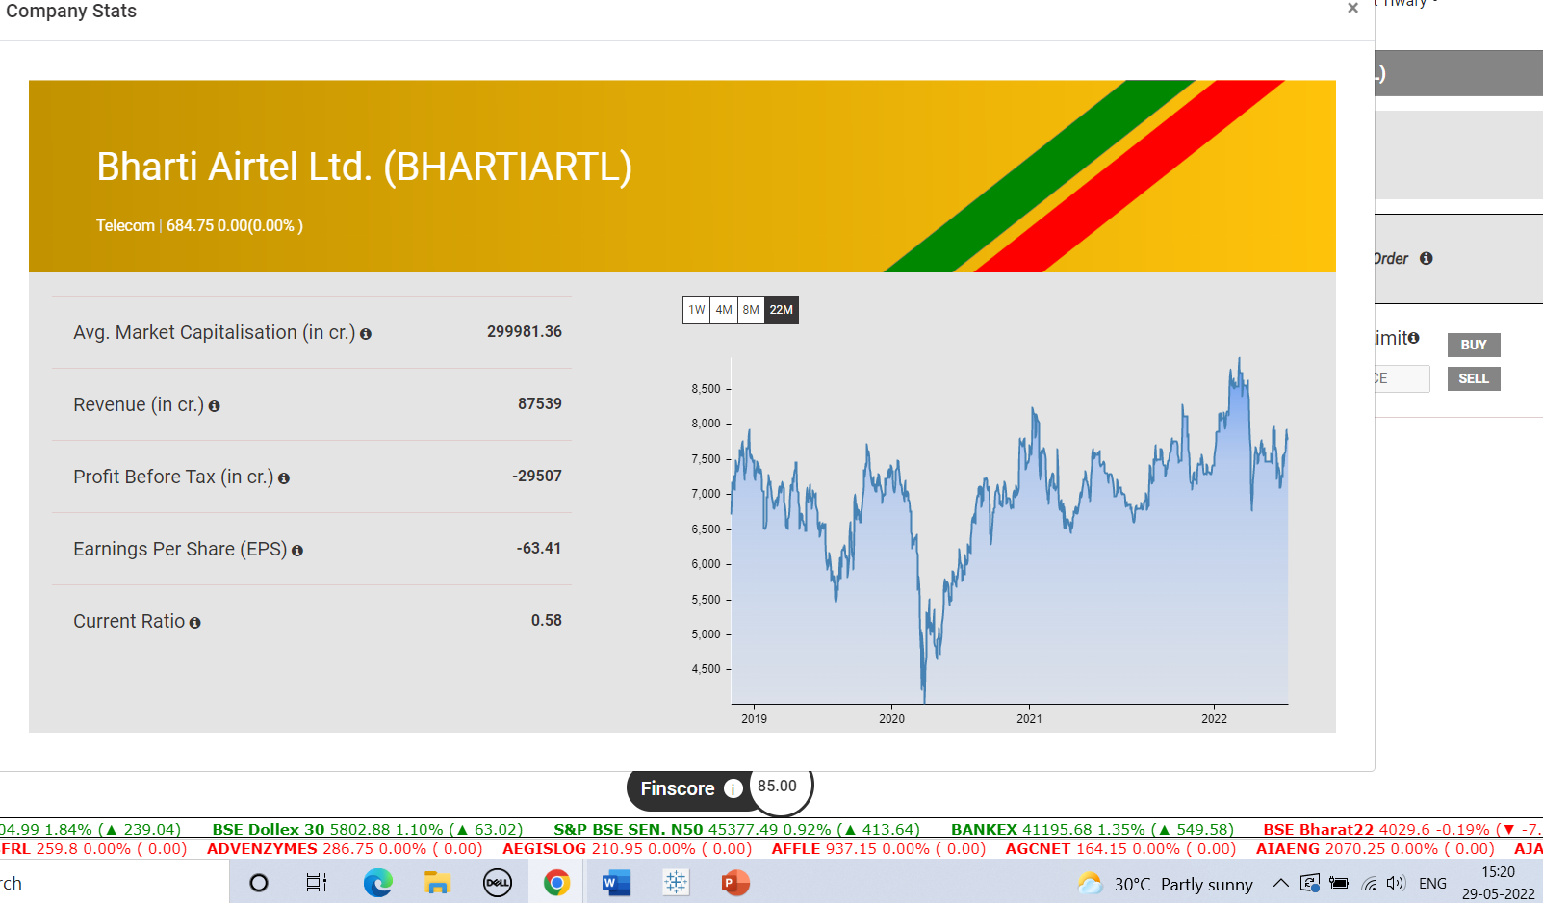
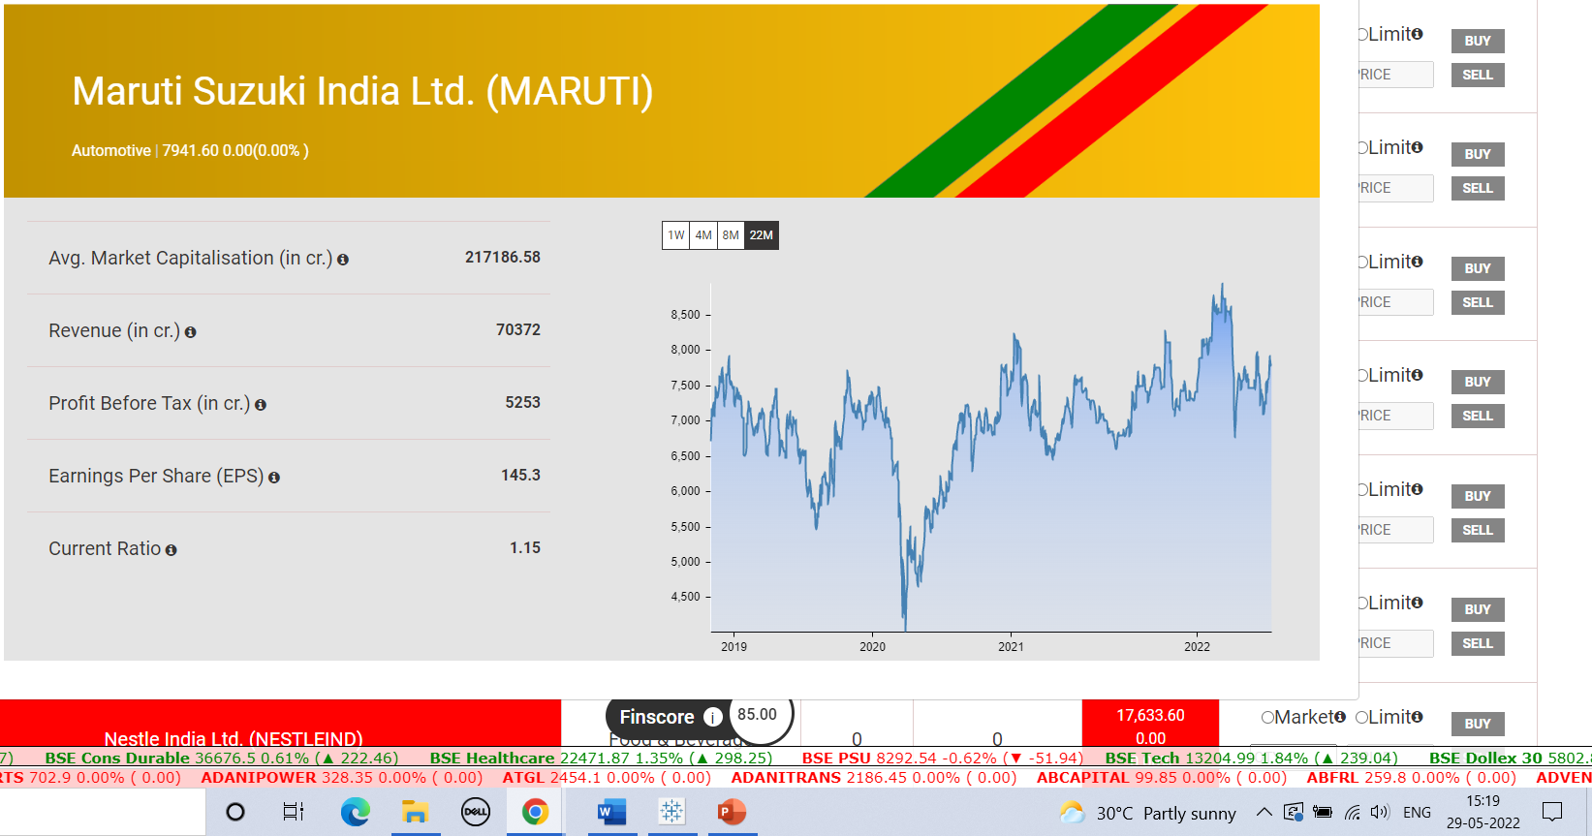
Real Time Stock Profile Real time trend for comparision: Source ( as an intern with finlatics I have access to real time data based on BSE index)

Slide 10
Thankyou
Status of application:
*This is submission for “bring your own case” competition for my application for business analyst role with tiger analytics
*SQL assessment and other submission are pending (Case submission) as requested. PFA details in mail. POC : divya.jayaprakas@tigeranalytics.com

