Slide 1


Web Application Security
Ramp up Plan
Ankit Trivedi
Thanks
Server-S
Advance
Client-S
Target
about

Slide 2
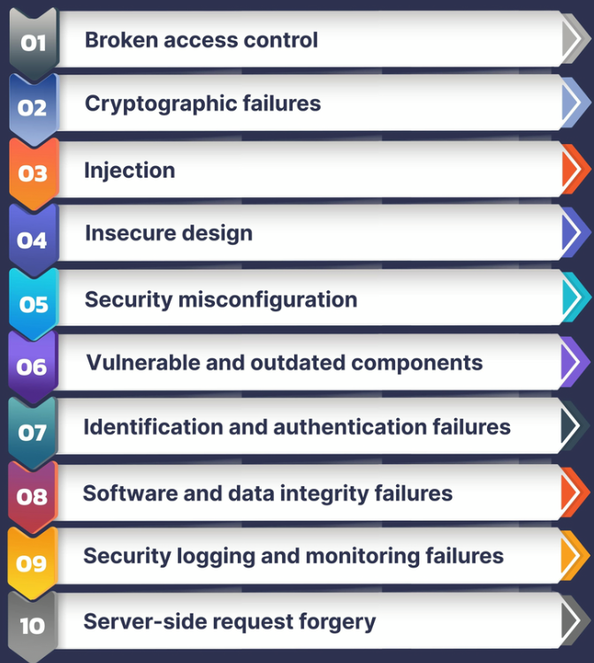

OWASP TOP10 -2021
Thanks
Client-S
Server-S
Advance
Target
about

Slide 3

Server-Side Vulnerabilities
SQL Injection | vulnerability that allows an attacker to interfere with the queries that an application makes to its database.
Authentication Vulnerabilities | allow attackers to gain access to sensitive data and functionality.
Directory Traversal | enable an attacker to read arbitrary files on the server that is running an application
Command Injection | allows an attacker to execute operating system (OS) commands on the server
Business Logic Vulnerabilities | flaws in the design and implementation of an application that allow an attacker to elicit unintended behavior
Information Disclosure | unintentionally reveals sensitive information to its users
Access Control Vulnerabilities | Broken access control
File Upload Vulnerabilities | web server allows users to upload files to its filesystem without sufficiently validating
Server-Side Request Forgery (SSRF) | vulnerability that allows an attacker to cause the server-side application to make requests to an unintended location
XXE Injection | vulnerability that allows an attacker to interfere with an application's processing of XML data
Thanks
Server-S
Advance
Client-S
Target
about

Slide 4







Injection: Types of injection
SQL Labs
Duration: 4 Days
Authentication:
Different types of authentication
Impact of vulnerable authentication
Authentication Labs Duration: 4 Days
Access Control:
Different types of access control
what is Insecure direct object references (IDOR)
Access Control Labs Duration: 4 Days
Thanks
Server-S
Advance
Client-S
Target
about
Directory Traversal:
What is Directory Traversal
Directory traversal Labs Duration: 2 Days
File Upload:
What are file upload vulnerabilities
What is the impact of upload vulnerabilities
File upload Labs Duration: 3 Days

Slide 5

Cross Site Scripting XSS
Duration: 5 Days
Cross-site request forgery(CSRF)
Duration: 4 Days
Thanks
Server-S
Advance
Client-S
Target
about
Cross-origin resource sharing (CORS)
Duration: 3 Days

Slide 6








Web LLM Attack
GraphQL API Vulnerabilities
Server-Side Template Injection
Web Cache Poisoning
HTTP Request Smuggling
Thanks
Advance
Server-S
Client-S
Oath Authentication
Target
about
JWT Attacks

Slide 7
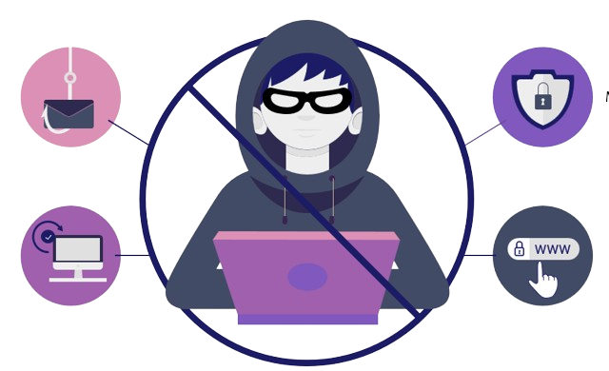
Thanks
Server-S
Advance
Client-S
Target
about

