Slide 1

DexLab www.dexlabanalytics.com +91 9315 725 902
Demo
Mega Artificial Intelligence Course In Python

Slide 2
Basic Features of Course
No specific educational background required
Everything taught from Scratch
Repeat course – no boundation
Complete notes will be provided
Classroom Videos will be provided
Kaggle.com- Hackathon Orientation
Makes you a Super Data Scientist

Slide 3
PYTHON PROGRAMMING for Data Analytics Introduction
Course Introduction
Course Curriculum Overview & python3
Installation Notes
Quick Note on Jupyter Notebook
Python Installation --- Windows, ubuntu , Mac
IDE Selection
Jupyter (iPython) Notebooks

Slide 4
Basic Command
Numbers
Strings
Print Formatting
Lists
Dictionaries
Tuples
Files
Sets and Booleans
Resources for More Basic Practice

Slide 5
Condition, Expression and Loop
Introduction to Python Statements
if, elif, and elif Statements
for Loops
while Loops
range()
Exception Handling: try, except, finally

Slide 6
Functions
Introduction to functional programming
Generators & Decorators
Function parameters and reuse
Recursive functions
Creating modules
Def & Lambda

Slide 7
NumPy & SciPy
Arrays
Matrices
Mathematical functions
Scientific functions
Data slicing
reshape

Slide 8
Pandas
Import & Export
Text file
CSV
Excel
JSON
HTML
Websites
PDF etc

Slide 9
Exploratory Data Analysis
Data wrangling and cleaning
Data Exploration
Data Manipulation
Data Querying
Data Mining
PivotTables
Time Series Data exploration
Missing Data Analysis

Slide 10
Visualization & Dashboards
Matplotlib
Seaborn
Plotly
Dashboard with Dash
Live Dashboards of Stock Market Prices
Self updating Dashboards

Slide 11
Regular Expression
RegEx
Pattern Matching And replacement
Phone number query
Email query
All kind of text data exploration

Slide 12
Web Scraping using Python
Requests
Beautiful Soup
Xpath
Selenium
Cardekho.com
Instagram
Twitter etc

Slide 13
Databases
MySQL
WorkBench
MySQL + Python
MongoDB
MongoDB + Python

Slide 14
Projects
Election Analysis
Stock market analysis
911 calls
MoneyBall
Titanic
Financial Risk
Blockchain - Cryptocurrency

Slide 15
AI (Artificial Intelligence) Statistics Machine Learning Deep Learning

Slide 16
Statistics
Introduction to Analytics
Evolution of Analytics
Definition of Analytics
Scope of analytics in different industries
Types of Analytics
Descriptive Analysis
Predictive Analysis
Prescriptive Analysis

Slide 17
Concepts of Analytics
Confirmatory & Exploratory Analysis
Different Scale of Measurement-Nominal, Ordinal, Interval
Ratio Attribute and Variable concept
Graphical Representation of Data
Measures of Central Tendency-Mean, Median, Mode
Measures of Dispersion-Range, Variance, Standard Deviation
Measures Of Location-Quartiles, Interquartile Range
Outliers & Box Plot Graphs

Slide 18
Probability
Concept of Probability
Probability mass function
Random Variables-Discrete and Continuous
Binomial Distribution
Poisson Distribution
Normal Distribution

Slide 19
Statistics
Sampling Theory
Parametric Test
Association between Variables
Analysis Of Variance (ANOVA)
Hypothesis Testing
Coding & Projects
Non Parametric Test

Slide 20
Machine Learning using Python
Type of Machine Learning Algorithms
Supervised
Unsupervised
Reinforcement Learning

Slide 21
Supervised Learning
Classification
Decision Trees
Naïve Bayes
Gaussian Naïve Bayes
Logistic Regression
Linear Discriminant Analysis
K- Nearest Neighbour ( KNN )
Support Vector Machine (SVM)
LVQ

Slide 22
Supervised Learning
Regression
Linear Regression
Ridge Regression
LASSO Regression
ElasticNet Regression
Decision Tree Regressor
KNN Regressor
Support Vector Regressor
SGDRegressor

Slide 23
Ensemble Algorithm
Bagging
Boosting
Random Forest
Extra Trees
AdaBoost
Gradient Boosting Machine
XgBoost

Slide 24
Unsupervised Learning Clustering
Dimension Reduction using PCA
K Mean Clustering
Hierarchical Clustering
DBSCAN
Autoencoders

Slide 25
Projects
3 end to end Projects with pipeline
Recommender System (recommend movies to watch)
Titanic (EDA and ML)
SMS spam classification
Yelp reviews classification
Boston House price prediction
Irish data classification
Sonar vs Rock data classification
Election data analysis
Cancer classification
Customer Churn out prediction
Stock Market Prediction
+ 10 More Projects

Slide 26
Mega Projects
Credit Risk Modelling
Customer Lifetime Value Prediction
Creating Dream Team with ML

Slide 27
Recommender Systems
PageRank Algorithm ( Google )
Collaborative filtering ( Amazon)
Matrix Factorization ( Netflix )
Restricted Boltzmann Machine
Content based filtering
Singular value decomposition

Slide 28
Deep Learning (Neural Network) MLP CNN RNN LSTM GRU

Slide 29
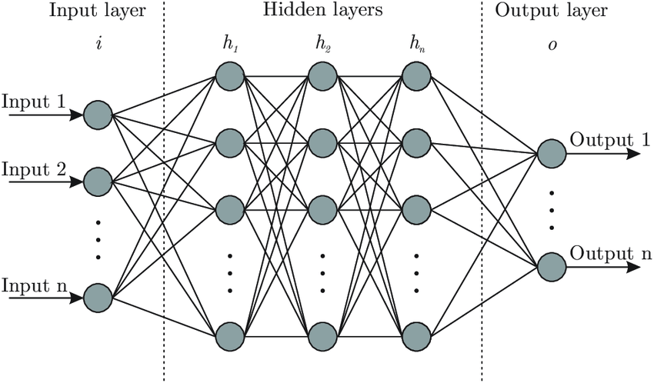
Neural Network
Detailed Mathematical Study of Neural Networks
MLP , CNN , RNN , LSTM , GRU

Slide 30
Multilayer Perceptron
Cancer patient prediction
House price Prediction
Fraud Detection
Risk Prediction
+ 5 Projects

Slide 31
Deep Learning for Computer Vision
Introduction to Computer Vision
Image Data Preparation
How to Load and Manipulate Images With PIL/Pillow
Manually Scale Image Pixel Data
Load and Manipulate Images with Keras
Scale Image Pixel Data with Keras
Load Large Datasets From Directories with Keras
Image Data Augmentation in Keras
Use Different Color Channel Ordering Formats
Convolutions and Pooling

Slide 32
Milestone Model Architectural Innovations
LeNet-5
AlexNet
VGG
Inception and GoogLeNet
Residual Network or ResNet

Slide 33
Mega Projects
Image Classification
Classify Small Photos of Objects
Classify Photographs of Dogs and Cats
Label Satellite Photographs of the Amazon Rainforest
Object Detection
R-CNN Model Family
YOLO Model Family

Slide 34
Mega Projects
Mask R-CNN
Face Recognition
Detect Faces in Photographs
Face Detection With OpenCV
Face Identification and Verification with VGGFace2
Face Classification with FaceNet

Slide 35
OpenCV
Detailed Study
Face Detection
Video Analysis
Mega Project
-> Vehicle Counter at Toll Plaza

Slide 36
Deep Learning For Natural Language Processing
The Bag-of-Words Model
Word Counts with CountVectorizer
Word Embedding
Text Generation
Language Translation
Chatbot

Slide 37
Mega Projects
Movie Review Data for Sentiment Analysis
Develop a Neural Bag-of-Words Model for Sentiment Analysis
Develop an Embedding + CNN Model for Sentiment Analysis
Project: Develop an n-gram CNN Model for Sentiment Analysis

Slide 38
Mega Projects
Text Generation
Create blogs , music etc
Develop a Neural Language Model for Text Generation
Image Captioning
Neural Image Caption Generation Model
German to English translation
Chatbot

Slide 39
Reinforcement Learning
Deep Q-Networks
Tabular Q-learning
Deep Q-learning
DQN on Pong
Stocks Trading Using RL
Games optimization
AlphaGo Zero
Cartpole games
Frozen lake

Slide 40
Mega Projects
Portfolio Analysis
Vehicle routing shortest path
Minimize cost
Maximize revenue
Stock market prediction
Chatbot using RL
Human Body Activity Recognition

Slide 41
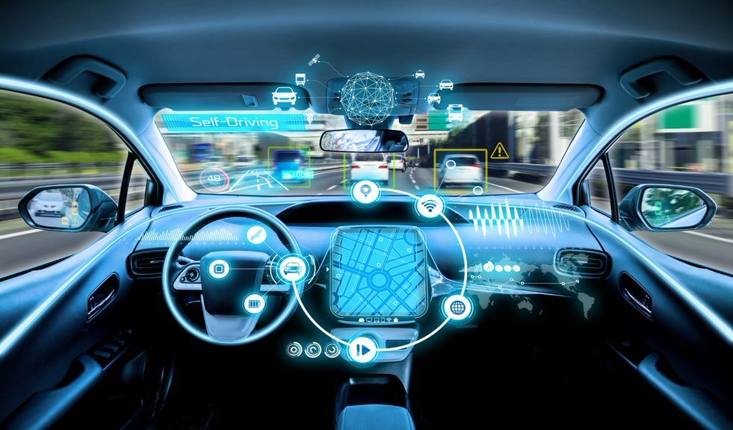
Mega Projects
Automating Robots
Self Driving Cars

Slide 42
BigData
PySpark
Data Analysis & machine learning Projects
Spark Streaming
Databricks – complete usage guide
Connection with MongoDB database

Slide 43
CUDA Computing
C Programming
Visual Studio
GPU programming
Multi GPU Programming
C & Python
PyCUDA
Tensorflow with CUDA
Complete Installation and Machine Setup

Slide 44
AWS with Sagemaker
Complete Guide to start
Create account
IAM users
Machine Learning Models
Create
Deploy & Production
Use Dockers of AWS to use inbuilt models

Slide 45
Quantum Computing
Study the core concepts and principles of quantum computing
Uncover the areas in which quantum principles can be applied
Design programs with quantum logic
Understand how a quantum computer performs computations
Work with key quantum computational algorithms including Shor's algorithm and Grover's algorithm
Develop the ability to analyze the potential of quantum computing in your industry

Slide 46
contact us : +91 9315 725 902 www.dexlabanalytics.com Thank You

