Slide 1
INPUT OUTPUT ORGANIZATION
UNDER THE GUIDANCE OF DR. SARVESH PANDEY
PRESENTED BY
ANCHAL JAISWAL (20229PHY001)
ANUSHA MISHRA (20229MAT008)
ARTI CHAUDHARY (20229MAT001)
KOMAL SHARMA (20229CMP009)
SHRUTI CHAURASIA(20229MAT012)
SHWETA SINGH (20229MAT013)

Slide 2
Input output organization
Peripheral Devices:
The Input / output organization of computer depends upon the size of computer and the peripherals connected to it. The I/O Subsystem of the computer, provides an efficient mode of communication between the central system and the outside environment.
The most common input output devices are:
i) Monitor
ii) Keyboard
iii) Mouse

Slide 3
iv) Printer
v) Magnetic tapes
The devices that are under the direct control of the computer are said to be connected online.

Slide 4
Input - Output Interface
Input Output Interface provides a method for transferring information between internal storage and external I/O devices. Peripherals connected to a computer need special communication links for interfacing them with the central processing unit. The purpose of communication link is to resolve the differences that exist between the central computer and each peripheral.
The Major Differences are:-
1. Peripherals are electromechnical and electromagnetic devices and CPU and memory are electronic devices. Therefore, a conversion of signal values may be needed.

Slide 5
2. The data transfer rate of peripherals is usually slower than the transfer rate of CPU and consequently, a synchronization mechanism may be needed.
3. Data codes and formats in the peripherals differ from the word format in the CPU and memory.
4. The operating modes of peripherals are different from each other and must be controlled so as not to disturb the operation of other peripherals connected to the CPU.
To Resolve these differences, computer systems include special hardware components between the CPU and Peripherals to supervises and synchronizes all input and out transfers
■ These components are called Interface Units because they interface between the processor bus and the peripheral devices.

Slide 6
I/O BUS and Interface Module
It defines the typical link between the processor and several peripherals.
The I/O Bus consists of data lines, address lines and control lines.
The I/O bus from the processor is attached to all peripherals interface.
To communicate with a particular device, the processor places a device address on address lines.
Each Interface decodes the address and control received from the I/O bus, interprets them for peripherals and provides signals for the peripheral controller.
It is also synchronizes the data flow and supervises the transfer between peripheral and processor.

Slide 7
Each peripheral has its own controller.
For example, the printer controller controls the paper motion, the print timing The control lines are referred as I/O command.
The commands are as following:
Control command- A control command is issued to activate the peripheral and to inform it what to do.
Status command- A status command is used to test various status conditions in the interface and the peripheral.
Data Output command- A data output command causes the interface to respond by transferring data from the bus into one of its registers.

Slide 8
Data Input command- The data input command is the opposite of the data output.
In this case the interface receives on item of data from the peripheral and places it in its buffer register. I/O Versus Memory Bus

Slide 9
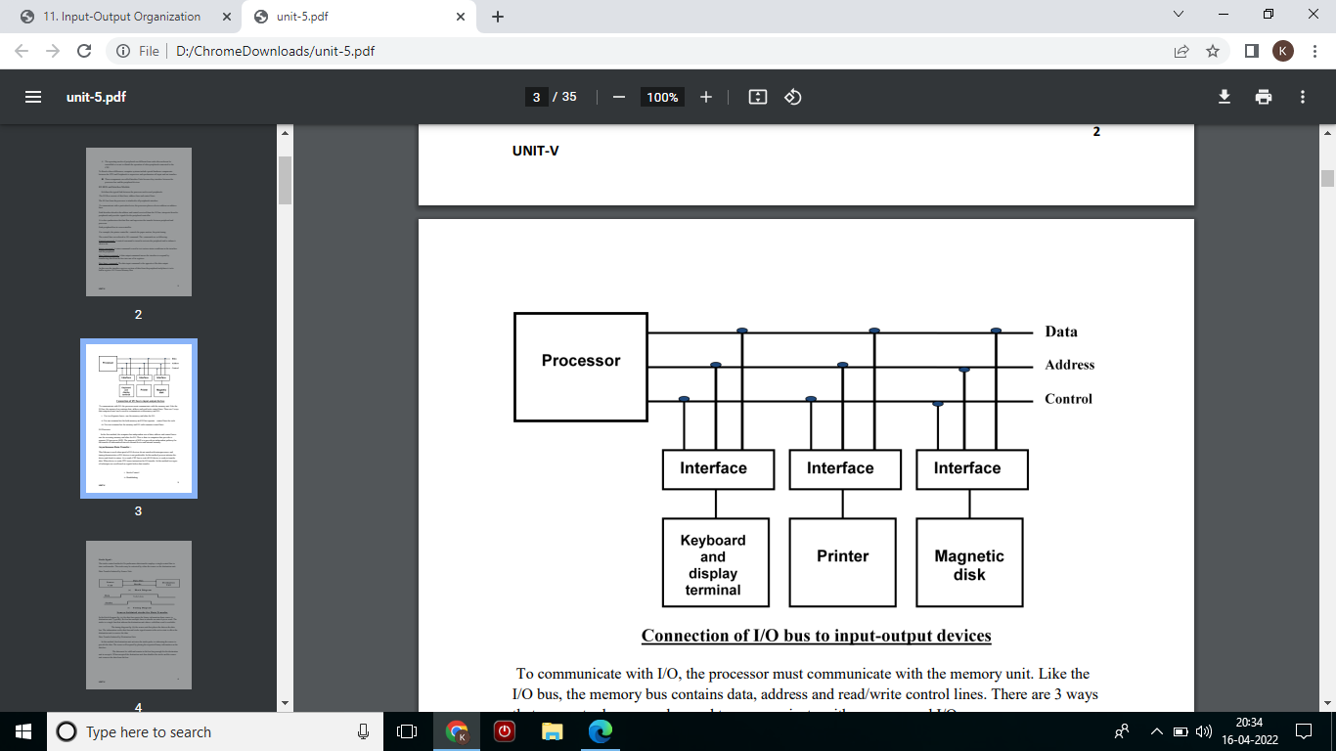

Slide 10
To communicate with I/O, the processor must communicate with the memory unit. Like the I/O bus, the memory bus contains data, address and read/write control lines.
There are 3 ways that computer buses can be used to communicate with memory and I/O:
i. Use two Separate buses , one for memory and other for I/O.
ii. Use one common bus for both memory and I/O but separate control lines for each.
iii. Use one common bus for memory and I/O with common control lines.

Slide 11
I/O Processor
In the first method, the computer has independent sets of data, address and control buses one for accessing memory and other for I/O. This is done in computers that provides a separate I/O processor (IOP). The purpose of IOP is to provide an independent pathway for the transfer of information between external device and internal memory.

Slide 12
Asynchronous Data Transfer :
This Scheme is used when speed of I/O devices do not match with microprocessor, and timing characteristics of I/O devices is not predictable. In this method, process initiates the device and check its status. As a result, CPU has to wait till I/O device is ready to transfer data. When device is ready CPU issues instruction for I/O transfer. In this method two types of techniques are used based on signals before data transfer.
i. Strobe Control
ii. Handshaking

Slide 13
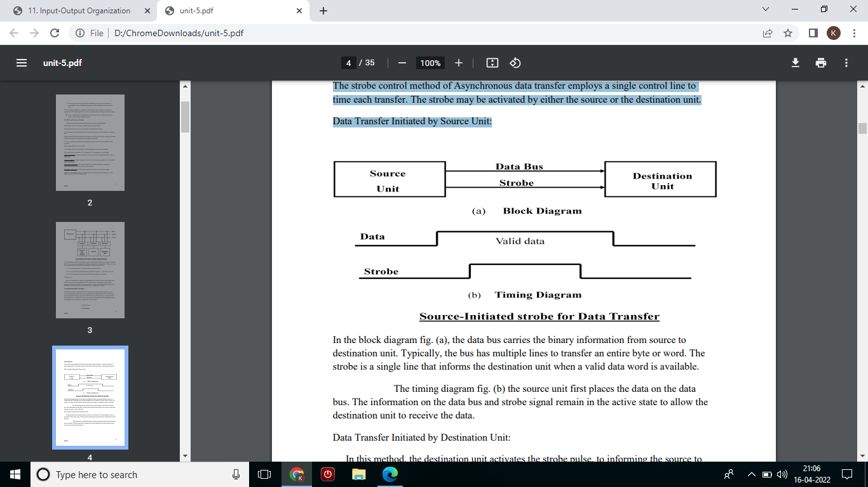
Strobe Signal :
The strobe control method of Asynchronous data transfer employs a single control line to time each transfer. The strobe may be activated by either the source or the destination unit. Data Transfer Initiated by Source Unit:

Slide 14
In the block diagram fig. (a), the data bus carries the binary information from source to destination unit. Typically, the bus has multiple lines to transfer an entire byte or word. The strobe is a single line that informs the destination unit when a valid data word is available.
The timing diagram fig. (b) the source unit first places the data on the data bus. The information on the data bus and strobe signal remain in the active state to allow the destination unit to receive the data.
Data Transfer Initiated by Destination Unit:
In this method, the destination unit activates the strobe pulse, to informing the source to provide the data. The source will respond by placing the requested binary information on the data bus.

Slide 15
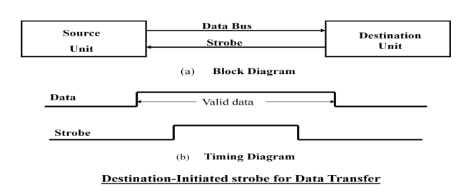
The data must be valid and remain in the bus long enough for the destination unit to accept it. When accepted the destination unit then disables the strobe and the source unit removes the data from the bus.

Slide 16
Disadvantage of Strobe Signal :
The disadvantage of the strobe method is that, the source unit initiates the transfer has no way of knowing whether the destination unit has actually received the data item that was places in the bus. Similarly, a destination unit that initiates the transfer has no way of knowing whether the source unit has actually placed the data on bus. The Handshaking method solves this problem.

Slide 17
Handshaking:
The handshaking method solves the problem of strobe method by introducing a second control signal that provides a reply to the unit that initiates the transfer.
Principle of Handshaking:
The basic principle of the two-wire handshaking method of data transfer is as follow:
One control line is in the same direction as the data flows in the bus from the source to destination. It is used by source unit to inform the destination unit whether there a valid data in the bus. The other control line is in the other direction from the destination to the source. It is used by the destination unit to inform the source whether it can accept the data. The sequence of control during the transfer depends on the unit that initiates the transfer

Slide 18
Source Initiated Transfer using Handshaking: The sequence of events shows four possible states that the system can be at any given time. The source unit initiates the transfer by placing the data on the bus and enabling its data valid signal. The data accepted signal is activated by the destination unit after it accepts the data from the bus. The source unit then disables its data accepted signal and the system goes into its initial state.

Slide 19
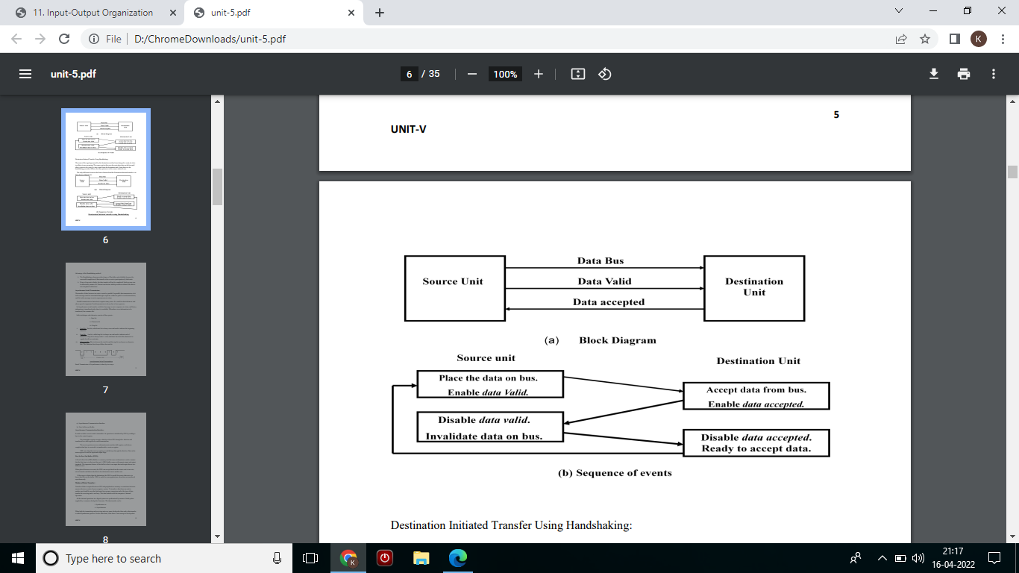

Slide 20
Destination Initiated Transfer Using Handshaking:
The name of the signal generated by the destination unit has been changed to ready for data to reflects its new meaning. The source unit in this case does not place data on the bus until after it receives the ready for data signal from the destination unit. From there on, the handshaking procedure follows the same pattern as in the source initiated case.
The only difference between the Source Initiated and the Destination Initiated transfer is in their choice of Initial sate.

Slide 21
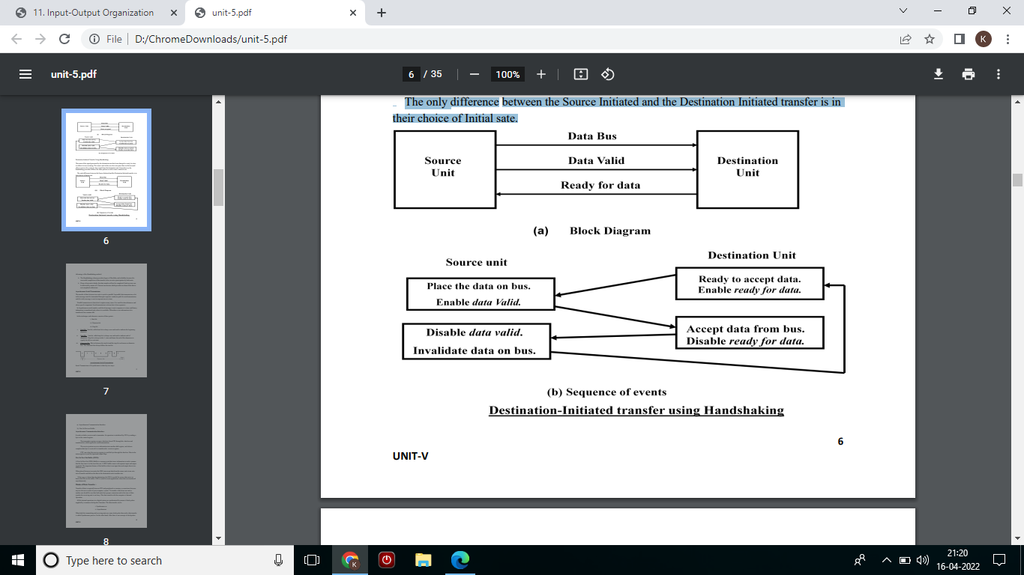

Slide 22
Advantage of the Handshaking method:
The Handshaking scheme provides degree of flexibility and reliability because the successful completion of data transfer relies on active participation by both units.
If any of one unit is faulty, the data transfer will not be completed. Such an error can be detected by means of a Timeout mechanism which provides an alarm if the data is not completed within time.

Slide 23
Asynchronous Serial Transmission:
The transfer of data between two units is serial or parallel. In parallel data transmission, n bit in the message must be transmitted through n separate conductor path. In serial transmission, each bit in the message is sent in sequence one at a time.
Parallel transmission is faster but it requires many wires. It is used for short distances and where speed is important. Serial transmission is slower but is less expensive.
In Asynchronous serial transfer, each bit of message is sent a sequence at a time, and binary information is transferred only when it is available. When there is no information to be transferred, line remains idle.

Slide 24
In this technique each character consists of three points :
i. Start bit
ii. Character bit
Iii. Stop bit
I. Start Bit- First bit, called start bit is always zero and used to indicate the beginning character.
ii. Stop Bit- Last bit, called stop bit is always one and used to indicate end of characters. Stop bit is always in the 1- state and frame the end of the characters to signify the idle or wait state.
iii. Character Bit- Bits in between the start bit and the stop bit are known as character bits. The character bits always follow the start bit.

Slide 25
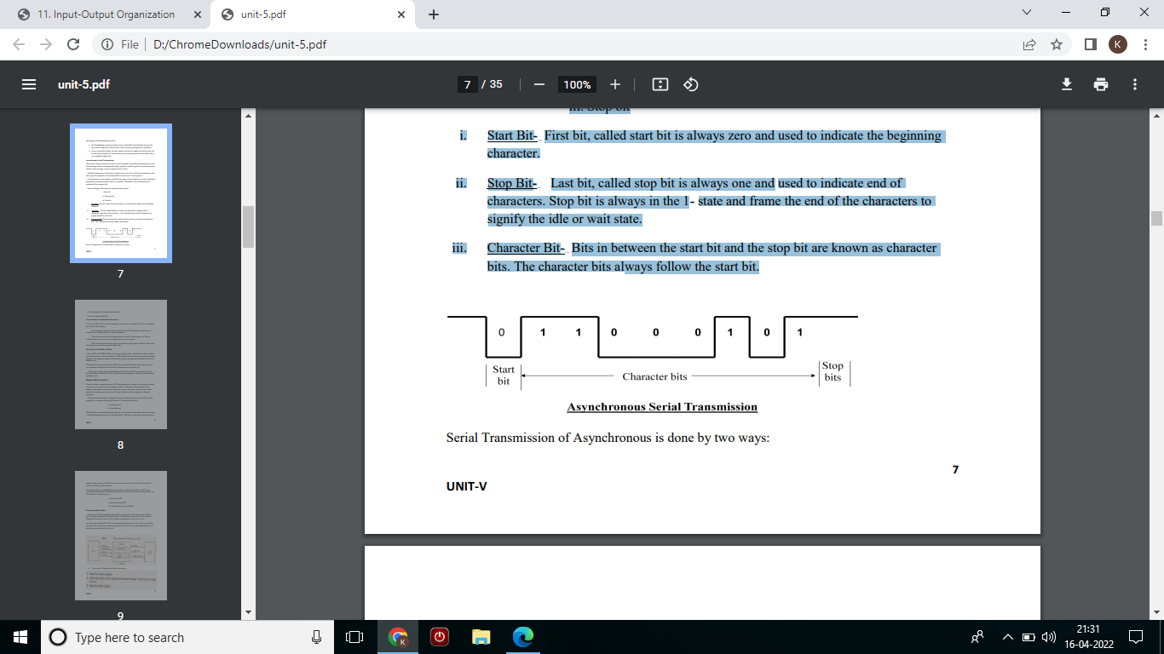
a) Asynchronous Communication Interface
b) First In First out Buffer

Slide 26
Asynchronous Communication Interface:
It works as both a receiver and a transmitter. Its operation is initialized by CPU by sending a byte to the control register.
The transmitter register accepts a data byte from CPU through the data bus and transferred to a shift register for serial transmission.
The receive portion receives information into another shift register, and when a complete data byte is received it is transferred to receiver register.
CPU can select the receiver register to read the byte through the data bus. Data in the status register is used for input and output flags.

Slide 27
First In First Out Buffer (FIFO):
A First In First Out (FIFO) Buffer is a memory unit that stores information in such a manner that the first item is in the item first out. A FIFO buffer comes with separate input and output terminals. The important feature of this buffer is that it can input data and output data at two different rates. When placed between two units, the FIFO can accept data from the source unit at one rate, rate of transfer and deliver the data to the destination unit at another rate. If the source is faster than the destination, the FIFO is useful for source data arrive in bursts that fills out the buffer. FIFO is useful in some applications when data are transferred asynchronously.

Slide 28
Modes of Data Transfer :
Transfer of data is required between CPU and peripherals or memory or sometimes between any two devices or units of your computer system. To transfer a data from one unit to another one should be sure that both units have proper connection and at the time of data transfer the receiving unit is not busy. This data transfer with the computer is Internal Operation.
All the internal operations in a digital system are synchronized by means of clock pulses supplied by a common clock pulse Generator. The data transfer can be
i. Synchronous or
ii. Asynchronous

Slide 29
When both the transmitting and receiving units use same clock pulse then such a data transfer is called Synchronous process. On the other hand, if the there is not concept of clock pulses and the sender operates at different moment than the receiver then such a data transfer is called Asynchronous data transfer.
The data transfer can be handled by various modes. some of the modes use CPU as an intermediate path, others transfer the data directly to and from the memory unit and this can be handled by 3 following ways:
i. Programmed I/O
ii. Interrupt-Initiated I/O
iii. Direct Memory Access (DMA)

Slide 30
Programmed I/O Mode:
In this mode of data transfer the operations are the results in I/O instructions which is a part of computer program. Each data transfer is initiated by a instruction in the program. Normally the transfer is from a CPU register to peripheral device or vice-versa.
Once the data is initiated the CPU starts monitoring the interface to see when next transfer can made. The instructions of the program keep close tabs on everything that takes place in the interface unit and the I/O devices.

Slide 31
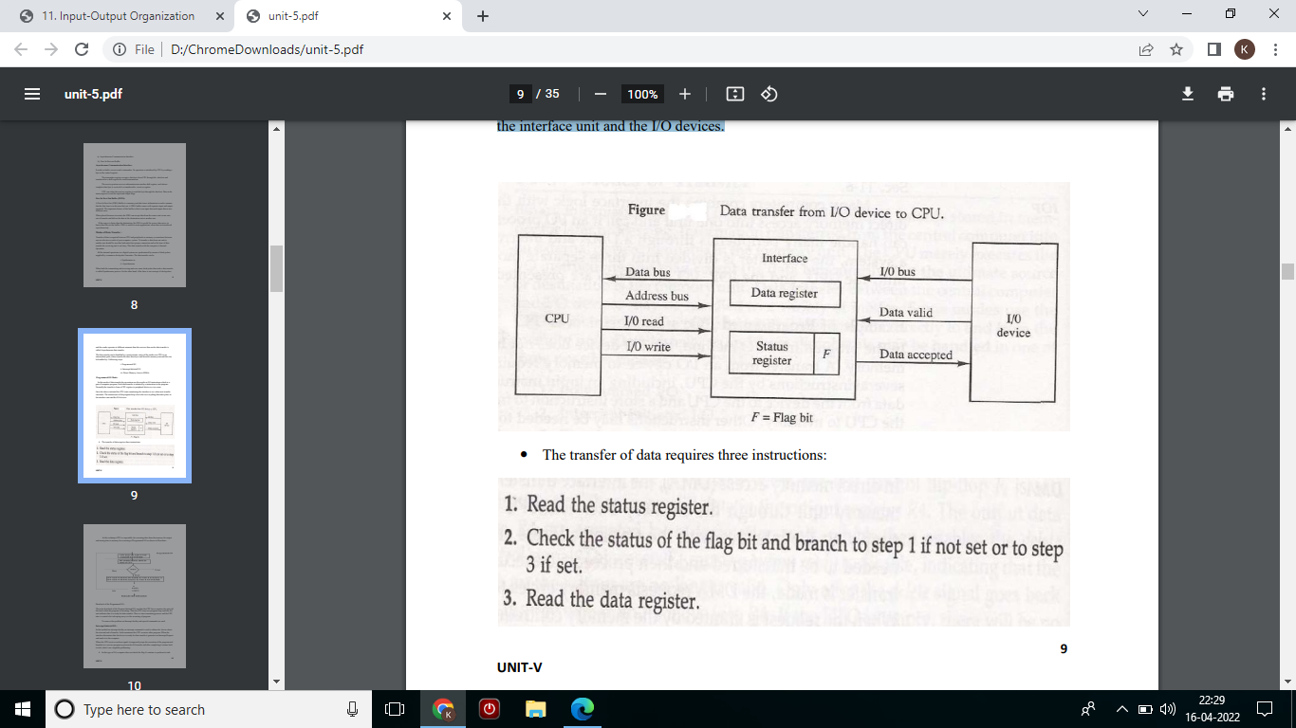

Slide 32
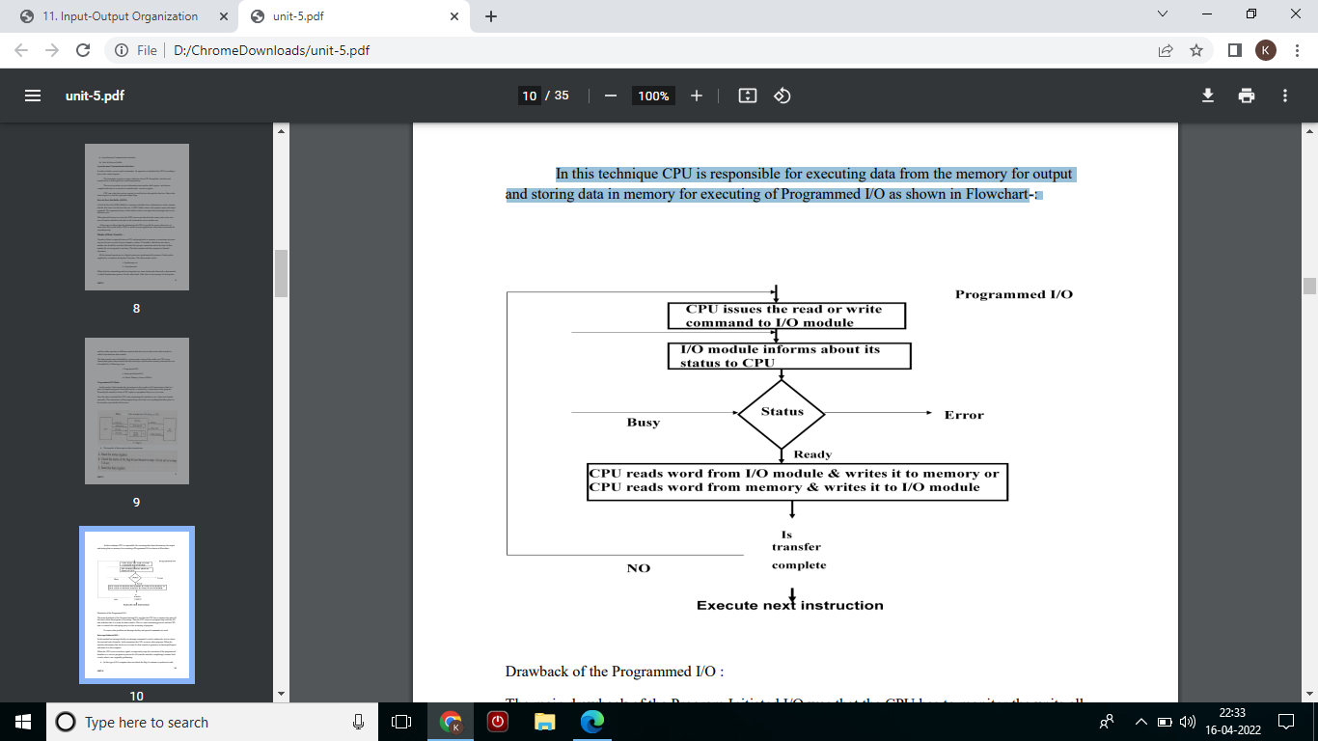
In this technique CPU is responsible for executing data from the memory for output and storing data in memory for executing of Programmed I/O as shown in Flowchart-:

Slide 33
Drawback of the Programmed I/O :
The main drawback of the Program Initiated I/O was that the CPU has to monitor the units all the times when the program is executing. Thus the CPU stays in a program loop until the I/O unit indicates that it is ready for data transfer. This is a time consuming process and the CPU time is wasted a lot in keeping an eye to the executing of program.
To remove this problem an Interrupt facility and special commands are used

Slide 34
Interrupt-Initiated I/O :
In this method an interrupt facility an interrupt command is used to inform the device about the start and end of transfer. In the meantime the CPU executes other program. When the interface determines that the device is ready for data transfer it generates an Interrupt Request and sends it to the computer.
When the CPU receives such an signal, it temporarily stops the execution of the program and branches to a service program to process the I/O transfer and after completing it returns back to task, what it was originally performing.
In this type of IO, computer does not check the flag. It continue to perform its task

Slide 35
Whenever any device wants the attention, it sends the interrupt signal to the CPU.
CPU then deviates from what it was doing, store the return address from PC and branch to the address of the subroutine.
There are two ways of choosing the branch address:
Vectored Interrupt
Non-vectored Interrupt
in vectored interrupt the source that interrupt the CPU provides the branch information. This information is called interrupt vectored.
In non-vectored interrupt, the branch address is assigned to the fixed address in the memory.

Slide 36
Software Considerations
I/O routines
software routines for controlling peripherals and for transfer of data between the processor and peripherals
I/O routines for standard peripherals are provided by the manufacturer (Device driver, OS or BIOS)
I/O routines are usually included within the operating system
I/O routines are usually available as operating system procedures ( OS or BIOS function call)

Slide 37
Priority Interrupt
Identify the source of the interrupt when several sources will request service simultaneously Determine which condition is to be serviced first when two or more requests arrive simultaneously :
1) Software : Polling
2) Hardware : Daisy chain, Parallel priority

Slide 38
Polling
Identify the highest-priority source by software means
One common branch address is used for all interrupts
Program polls the interrupt sources in sequence
The highest-priority source is tested first
Polling priority interrupt
If there are many interrupt sources, the time required to poll them can exceed the time available to service the I/O device Hardware priority interrupt

Slide 39
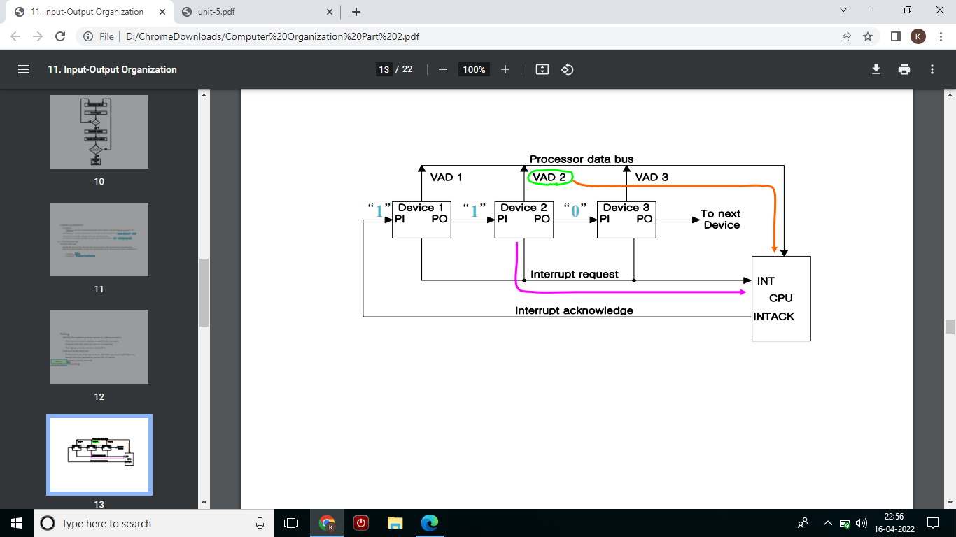
Daisy-Chaining :

Slide 40
One stage of the daisy-chain priority arrangement :
 No interrupt request
Invalid : interrupt request, but no acknowledge
No interrupt request : Pass to other device (other device requested interrupt )
Interrupt request

Slide 41
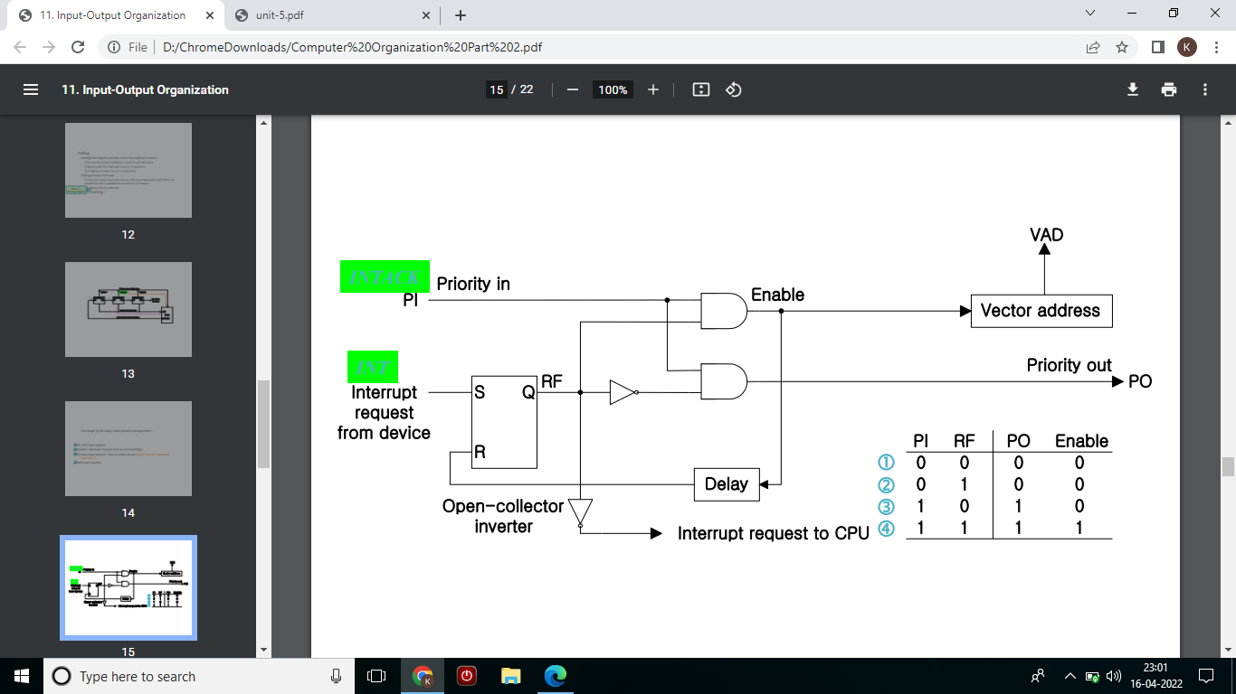

Slide 42
Parallel Priority
Priority Encoder Parallel Priority :
Interrupt Enable F/F (IEN) : set or cleared by the program
Interrupt Status F/F (IST) : set or cleared by the encoder output

Slide 43
Interrupt Cycle
At the end of each instruction cycle, CPU
checks IEN and IST
if both IEN and IST equal to “1”
CPU goes to an Instruction Cycle Sequence of microoperation during Instruction Cycle

Slide 44
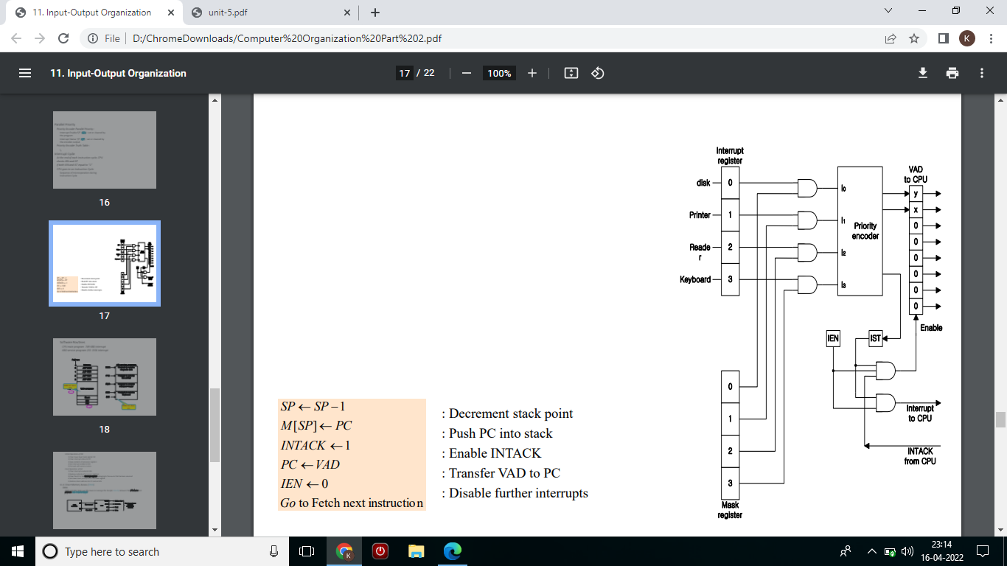

Slide 45
Direct Memory Access (DMA):
In the Direct Memory Access (DMA) the interface transfer the data into and out of the memory unit through the memory bus. The transfer of data between a fast storage device such as magnetic disk and memory is often limited by the speed of the CPU. Removing the CPU from the path and letting the peripheral device manage the memory buses directly would improve the speed of transfer. This transfer technique is called Direct Memory Access (DMA).
During the DMA transfer, the CPU is idle and has no control of the memory buses. A DMA Controller takes over the buses to manage the transfer directly between the I/O device and memory.

Slide 46
■ Bus Request (BR)
Bus Grant (BG)
These two control signals in the CPU that facilitates the DMA transfer. The Bus Request (BR) input is used by the DMA controller to request the CPU. When this input is active, the CPU terminates the execution of the current instruction and places the address bus, data bus and read write lines into a high Impedance state. High Impedance state means that the output is disconnected

Slide 47
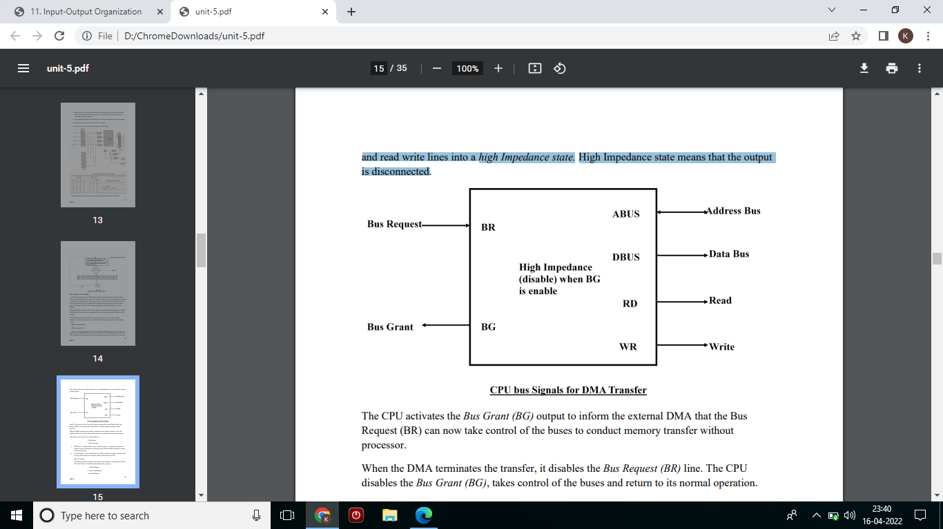

Slide 48
The CPU activates the Bus Grant (BG) output to inform the external DMA that the Bus Request (BR) can now take control of the buses to conduct memory transfer without processor.
When the DMA terminates the transfer, it disables the Bus Request (BR) line. The CPU disables the Bus Grant (BG), takes control of the buses and return to its normal operation.
The transfer can be made in several ways that are:
i. DMA Burst
ii. Cycle Stealing

Slide 49
i) DMA Burst :- In DMA Burst transfer, a block sequence consisting of a number of memory words is transferred in continuous burst while the DMA controller is master of the memory buses.
ii) Cycle Stealing :- Cycle stealing allows the DMA controller to transfer one data word at a time, after which it must returns control of the buses to the CPU.
DMA Controller: The DMA controller needs the usual circuits of an interface to communicate with the CPU and I/O device. The DMA controller has three registers:
i. Address Register
ii. Word Count Register
iii. Control Register

Slide 50
REFERENCE :
1. COMPUTER SYSTEM ARCHITECTURE, MORRIS M. MANO, 3RD EDITION, PRENTICE HALL INDIA.
2. HTTP://NPTEL.AC.IN/COURSES
3. Mano, M. Morris (October 1992). Computer System Architecture (3rd ed.). Prentice-Hall. ISBN 0-13-175563-3
4. Lecture notes of Dept. of Info. & Comm., Korea Univ. of Tech. & Edu., Korea

