Slide 1
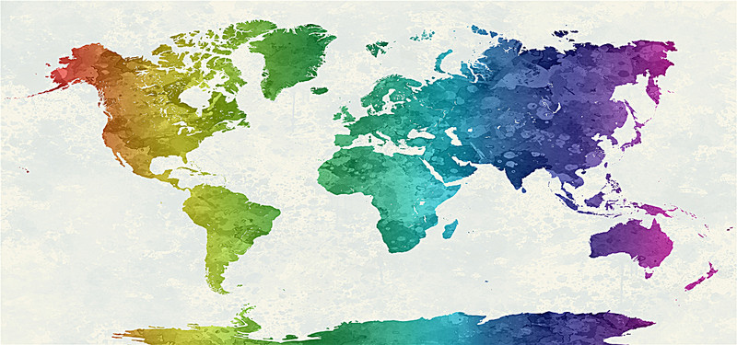
World Happiness Report

Slide 2
Why?
Given a chance to settle anywhere, ANYWHERE in the entire world to, where would you want? Why do you choose that particular country? What makes you think you will be happier there? What factors influence your decision?
.
.
.
Economy (GDP per Capita)
The total revenue generated by the country
1
Health (Life Expectancy)
3
Freedom
The freedom to make life decisions and choose to live in a certain way
4
Trust (Government Corruption)
5
Generosity
It is measured by the recent donations made by the country to social causes
6
Dystopia Residual
Residue of comparison between the world’s unhappiest place to other countries
7
Family
Social factor
2

Slide 3
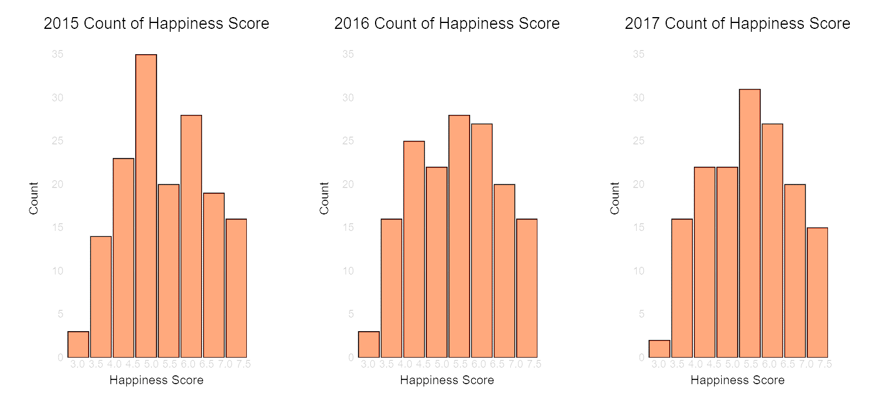
Happiness is both social and personal. This year’s report emphasizes the importance of the social foundations of happiness. This can be seen by comparing the life experiences between the top and bottom ten countries in this year’s happiness rankings. There is a four-point happiness gap between the two groups of countries, of which three-quarters is explained by the six variables, half due to differences in having someone to count on, generosity, a sense of freedom, and freedom from corruption. The other half of the explained difference is attributed to GDP per capita and healthy life expectancy, both of which, as the report explains, also depend importantly on the social context.

Slide 4
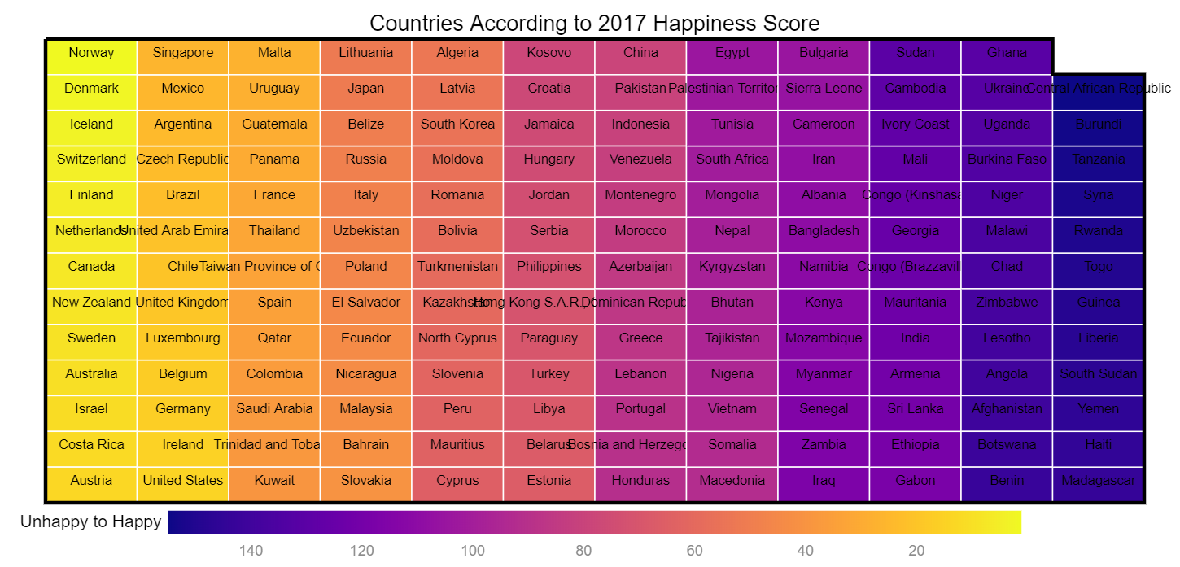

Slide 5
Market map
Represents where countries stand in happiness rank. Darker the color gets, unhappier the countries are.
Norway is the happiest country with a score of 7.54 while Central African Republic is the unhappiest with a low score of 2.69.
We see that African Republic has lesser corruption than Norway but economy is almost equal to 0 while Norway obviously has a higher economy rate at 1.63 but it’s not the highest. Luxembourg has the highest economy but holds a ranking of 18 but it has higher corruption than Norway.
We can see from this representation that many attributes/factors contribute to the happiness of a country.

Slide 6
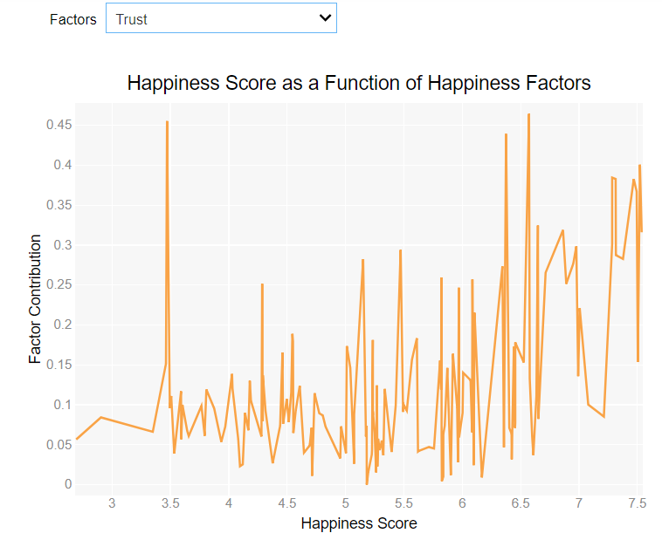
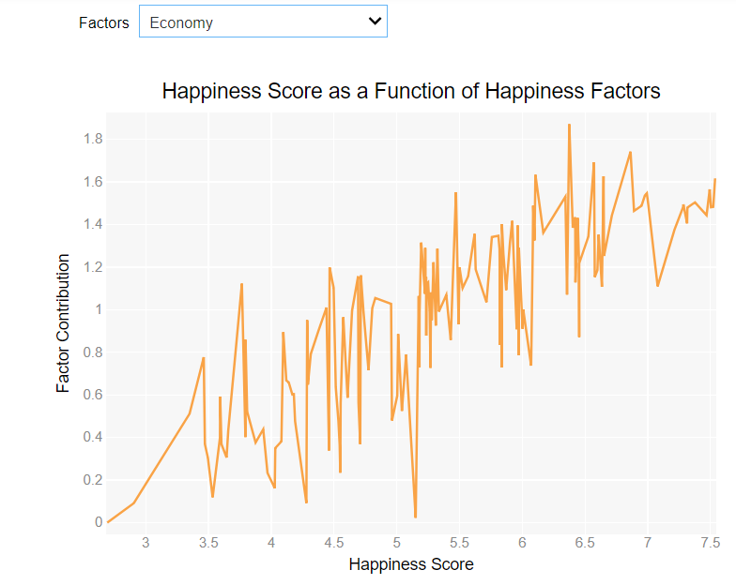
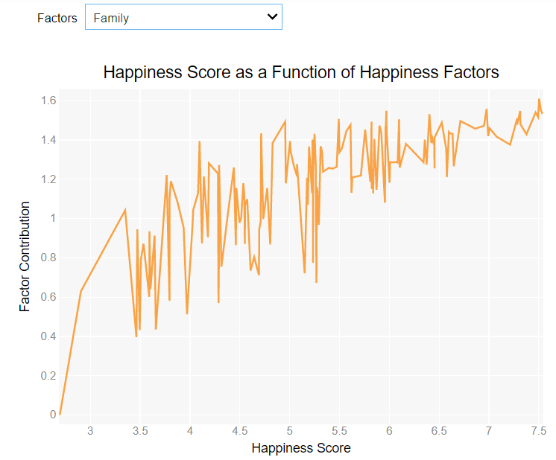
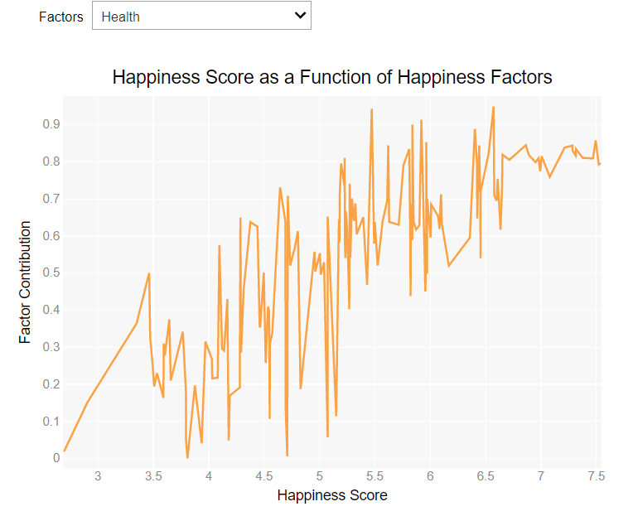
Norway has jumped from 4th place in 2016 to 1st place this year, followed by Denmark, Iceland and Switzerland. All of the top four countries rank highly on all the main factors found to support happiness: freedom,
generosity, health, income and good governance.
Economy and Family affect the happiness scores more than others
Health and Trust are the two major factors that seem to bring down the score drastically
However 80% of the variance of happiness across the world
occurs within countries. In richer countries the
within-country differences are not mainly explained by
income inequality, but by differences in mental health,
physical health and personal relationships: the biggest single source of misery is mental illness (see Chapter 5). Income differences matter more in poorer countries, but even their mental illness is a major source of misery.

Slide 7
Thank you!

