Slide 1
Design and Study of a Human-Human Interaction System to Control the Movement of Paralyzed Hand
Presented by
Ankita Sanjiv Giroti
M. Sc. Semester IV
Under the Guidance of
Dr. Mrs. A. D. Sakhare
Department of Electronics and Computer Science,
Rashtrasant Tukadoji Maharaj Nagpur University, Nagpur

Slide 2
Contents
Introduction
Review of Literature
Problem Statement
Objectives
Requirement Specifications
Planning and Scheduling
System Design
Experimental Work
Results
Future Scope
References

Slide 3
Introduction
Arm and hand paralysis can lead to permanent damage if does not treat properly
Traditional methods like mirror therapy can be used to regain muscle strength, but are not that effective
A system is designed to control the movements of the patient with hand paralysis by replicating the therapist actions

Slide 4
Review of Literature
Sr. No. | Title | Author | Source | Description
1 | Machine Learning for Detection of Muscular Activity from Surface EMG Signals | Francesco Di Nardo, Antonio Nocera, Alessandro Cucchiarelli, Sandro Fioretti and Christian Morbidoni | Sensors, 1(1), pp. 1-4, 2022 | Surface EMG was used to detect muscle contraction. The researcher predicted onset/offset timing of muscular recruitment of the machine learning based methods.
2 | Design of an Exoskeleton for Hand Rehabilitation | Ankita L. Dharmik, S. K. Atre, S. J. Sharma | IEEE Conference and Interdisciplinary Approach in Technology and Management for Social Innovation (IATMS), 1(1), pp. 1-4, 2022 | An exoskeleton was designed to assist a person with disability using EMG sensor. Microcontroller was programmed to rotate servo motor.
3 | Explainable Machine Learning Techniques to Predict Muscle Injuries in Professional Soccer Players through Biomechanical Analysis | Mailyn Calderon-Diaz, Rony Silvestre Aguirre, Juan P. Vasconez, Roberto Yanez, Matias Roby, Marvin Querales, Rodrigo Salas | Sensors, 24(119), pp. 1-13, 2024 | Paper presented a Hamstring strain injury detection technique using various Machine Learning techniques to find the accurate result.

Slide 5
Review of Literature
Sr. No. | Title | Author | Source | Description
4 | I Want to Control Your Move: Human-Human Interface (HHI) Neuromuscular Electrical Stimulator (NMES) | Ching Yee YONG and Terence Tien Lok SIA | Conference of Electronics, Communication and Networks (CECNet), 1(1), pp. 724-730, 2022 | The system implemented Neuromuscular Electrical Stimulator (NMES) integrated with Human-Human Interaction (HHI) for hand rehabilitation using IoT.
5 | A Systematic Review of EMG Applications for the Characterization of Forearm and Hand Muscle Activity during Activities of Daily Living: Results, Challenges, and Open Issues | Nestor J. Jarque-Bou, Joaquin L. Sanche-Bau, Margarita Vergara | Sensors, 24(119), pp. 1-13, 2024 | The paper had studied EMG to characterized muscle activity of the hand. It focuses on human hand behavior , improve rehabilitation, control prothesis, etc.

Slide 6
Review of Literature
Sr. No. | Title | Author | Source | Description
6 | A New Wrist-forearm Rehabilitation Protocol Integrating Human Biomechanics and SVM-Based Machine Learning for Muscle Fatigue Estimation | Yassine Bouteraa, Ismail Ben Abdallah, Khalil Boukthir | Bioengineering, 10(219), pp. 1-22, 2023 | Designed a remote rehabilitation system that integrates IoT based connected robot for wrist and forearm rehabilitation using Support Vector Machine (SVM) to predict muscle strain from the feature extracted from the EMG signals of the patient.
7 | IoT Based Cost Efficient Muscle Stimulator for Biomedical Application | Md. Latifur Rahman, Md. Jahin Alam, Nayeed Rashid, Lamiya Hassan Tithy, Alfaj Uddin Ahmed, and M Tarik Arafat | 2020 IEEE Region 10 Symposium (TENSYMP), 1(1), pp. 1-5, 2020 | Design a low-cost muscle stimulator integrated with IoT and a feedback system to receive voltages which was send to the IoT device to determine muscle strength.
8 | Towards AI-controlled FES-restoration of arm movements: Controlling for progressive muscular fatigue with Gaussian state-space models | Nat Wannawas and Aldo Faisal | 11th International IEEE Conference on Neural Engineering (NER), 1(1), pp. 1-4, 2023 | Used Reinforcement Learning to observe muscle strength. The Reinforcement Learning – Gaussain State Space Model (RL-GSSM) was trained to control arm movements through muscle stimulator.

Slide 7
Review of Literature
Sr. No. | Title | Author | Source | Description
9 | Posture Guardian With Smart Muscle Strain Detection And Correction Using TINYML | Dr. G. Sophia Reena | Journal of Propulsion Technology, 44(4), pp. 5187-5194, 2023 | TinyML was used to detect and correct improper posture using wearable EMG and Flex sensors. The data fed to the Arduino UNO for signal processing.
10 | Development of Wireless Microcontroller Based Functional Electronic Stimulation Device for Drop Foot Correction | DERVİŞ PAŞA | Near East University, Nicosia, pp. 1-87, 2014 | A stimulator was developed for a person with drop foot problem using Force Sensitive Resistor (FSR), programmable microcontroller, transmitter, receiver, and electrodes.
11 | Soft Exoskeleton Glove for Hand Assistance Based on Human-Machine Interaction and Machine Learning | Xiaoshi Chen, Li Gong, Lirong Zheng, and Zhuo Zou | IEEE International Conference on Human-Machine Systems (ICHMS), Rome, Italy, 1(1), 2020 | Developed a human-machine interaction system based on the concept of mirror therapy. Surface EMG were used to collect muscle signals by training a ML model. Flex and pressure sensors were used to process the EMG signals. SVM, k-NN, and subspace k-NN were used for pattern recognition.

Slide 8
Review of Literature
Sr. No. | Title | Author | Source | Description
12 | A Wearable Hand Rehabilitation System with Soft Glove | Xiaoshi Chen, Li Gong, Liang Wei, Shih-Ching Yeh, and Li Da Xu | IEEE Transactions on Industrial Information, 17(2), pp. 943-952, 2020 | A tendon-driven motor glove was designed using DC motor controlled by STM32F103 microcontroller. Wi-Fi sensors were implemented on both sides to send and receive EMG signals.
13 | Flexo-glove: A 3D Printed Soft Exoskeleton Robotic Glove for Impaired Hand Rehabilitation and Assistance | Alireza Mohammadi, Jim Lavranos, Peter Choong, and Denny Oetomo | 40th Annual International Conference of the IEEE Engineering in Medicine and Biology Society (EMBC), Honolulu, USA, pp. 2120-2123, 2018 | Designed the portable tendon-driven soft exoskeleton glove for hand rehabilitation and assistance using thermoplastic polyurethane. DC motor were implemented on each finger controlled by ATmega2500 microcontroller.

Slide 9
Review of Literature
Sr. No. | Title | Author | Source | Description
14 | Wearable Hand-Rehabilitation System with Soft Gloves for Patient with Face Paralysis and Disability | Waqas Ahmed, Muhammad Kashif Sattar, Wajeeha Shahnawaz, Umair Saeed, Shahbaz Mehmood Khan, and Neha Amon Khan | Engineering Proceedings, 12(56), pp. 1-5, 2021 | Designed a robotic hand controlled by the soft glove placed on the healthy hand. Used feature extraction to recognize different gestures. Servo motors was used to perform different hand movements implemented on robotic hand.
15 | Design and Control of a Tendon-Driven Robotic Finger Based on Grasping Task Analysis | Xuanyi Zhou, Hoa Fu, Baoqing Shentu, Weidong Wang, Shibo Cai, and Guanjan Bao | Biomimetics, 9(370), pp. 1-17, 2024 | The tendon-driven robotic finger was developed, controlled by soft glove worn on a human hand to collect data from the hand. Servo motors were implemented on the base of the robotic finger to drive the motion of the tendons.

Slide 10
Problem Statement
The loss of hand function due to stroke, injury, neurological conditions, or other medical conditions presents a profound challenge affecting millions worldwide. The present system aims to assist them in regaining hand functionality by facilitating fine-motor activities and mimic the movements of the unaffected hand.

Slide 11
Objectives
To design a rehabilitation system for an individual with hand paralysis to regain functionality of their hand
To design a system that captures electromyography (EMG) signals of the hands of the therapist
To train a machine learning model to recognize hand movements
To mimic the hand movement of the therapist
To increase flexibility of the patient’s hand

Slide 12
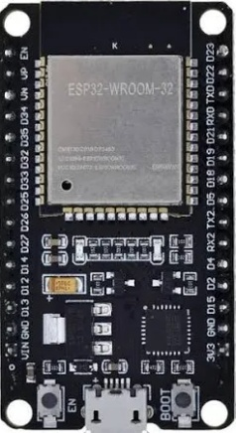
Requirement Specification
1. Hardware Required
ESP32 WROOM
  32-bit LX6 microprocessors
  ROM: 448 KB (for booting and core functions)
  SRAM: 520 KB
  BLE (Bluetooth Low Energy) and Bluetooth Classic
  Wi-Fi: 150.0 Mbps data rate with HT40
  Low power consumption
Fig. 1: ESP32 WROOM

Slide 13
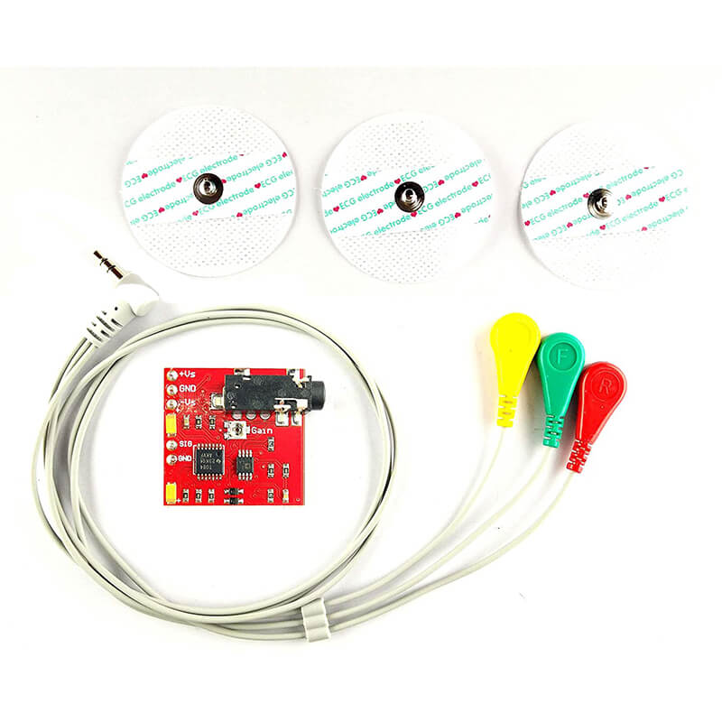
EMG Sensor
  Enables the translation of these electrical signals into numerical values
  Specially designed for microcontroller
  Needs dual power supply for +9V & -9V
  Used in Human-Computer interactions, Robotics, and Biomedical devices
Fig. 2: EMG Sensor

Slide 14
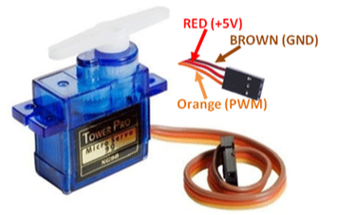
Servo Motor
  Used to control the linear motion of the object
  It consist of 3 wires:
    Brown: Ground wire
    Red: Connected to +5V
    Orange: PWM signal connected to the Arduino
  Rotation: 0º to 180º
Fig. 3: Servo Motor

Slide 15
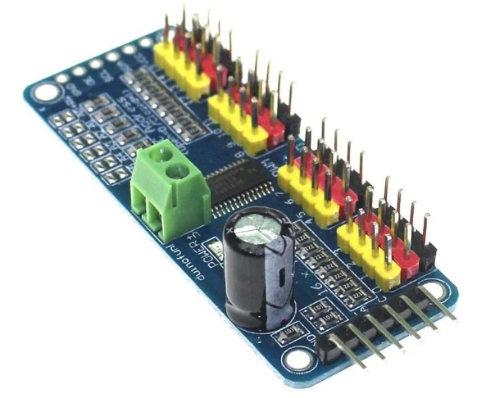
PCA9685 Servo Motor Driver
PCA9685 module is a 16 Channel Servo Motor Driver
It can control upto 16 servo motors with just two pins of the ESP32 microcontroller with I2C.
Servos can be plugged in directly to the board with no additional circuits or connectors required.
Fig. 4: PCA9685 Servo Motor Driver

Slide 16
2. Software Specification
Arduino IDE: Arduino IDE is a cross-platform application that allows users to write, compile, debug, and upload code to Arduino boards. It also includes a serial monitor for communication with Arduino boards.
PyCharm IDE: PyCharm is a cross-platform integrated development environment (IDE) designed specifically for Python programming.

Slide 17
3. Libraries Required
NumPy: Numerical Python is a Python library that adds support for large, multi-dimensional arrays and matrices
Pandas: It is a Python library used to work with datasets for analyzing, cleaning, exploring, and manipulating data
Scikit-learn: It is a machine learning library, supports various algorithms like SVM, Decision tree, and Random forest
Keras: It is a high-level API for TensorFlow and can be used to deploy models on microcontrollers using TensorFlow Lite

Slide 18
TensorFlow: It is an open-source library for numerical computation, large-scale machine learning, deep learning, and other statistical and predictive analytics workloads.
Matplotlib: It is an open-source library used to plot graphs in python and visualize data in a variety of formats.
Serial: It is a python library that facilitates communication between two devise via serial port.

Slide 19
4. Input
  The input of the system is the gesture performed by the hand through EMG sensor in real time.
5. Dataset
  The dataset has been collected from the healthy hand using EMG sensors for open and closed hand gestures. The dataset contains raw values of the EMG ranging from 500 to 2000. Total of 10000 samples are collects from one hand to process the data into a csv file.

Slide 20
6. Algorithm
Artificial Neural Network
  Computational models inspired by the human brain's biological neural networks
  Used in various applications: classification, regression, clustering, etc
  Composed of neurons that receive, process, and produce information, where each neuron has an associated weight that can be adjusted during learning
  Organized into three distinct layers
    Input layer
    Hidden layer
    Output layer
  Can handle complex tasks like pattern recognition, predictive analysis, and large datasets

Slide 21
Long Short Term Memory
It can maintain long-term dependencies in sequential data to process and analyze it
Use memory cells to store information
It consists of three key gates to control information flow:
  Input Gate
  Forget Gate
  Output Gate

Slide 22
Support Vector Machine
Supervised machine learning technique, which classifies data by finding optimal lines or hyperplanes
For non-linear data, kernel functions are used
Kernel functions transform data into high-dimensional space, enabling linear separation of non-linear data
The primary goal of SVM is to find the optimal decision boundary

Slide 23
Planning and Scheduling
Understanding the problem domain and the difficulties people facing with hand paralysis
Gathering information related to the specified problem
Collection of the required hardware components and software applications
Analyzing the feasibility of the project
Study of the suitable Machine Learning model that can be deployed on the system

Slide 24
Designing the present system and verifying whether it is accepting inputs
Collect or create dataset
Training the Machine Learning model using suitable algorithm
Deploying the ML model on the designed system
Analyzing the results obtained by giving real time input to the system
The system mimicking the gesture performed by the healthy

Slide 25
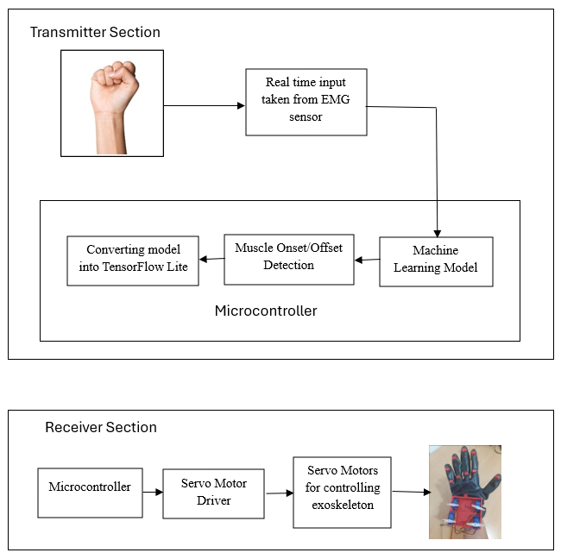
System Design
Fig. 5: Block Diagram of the System

Slide 26
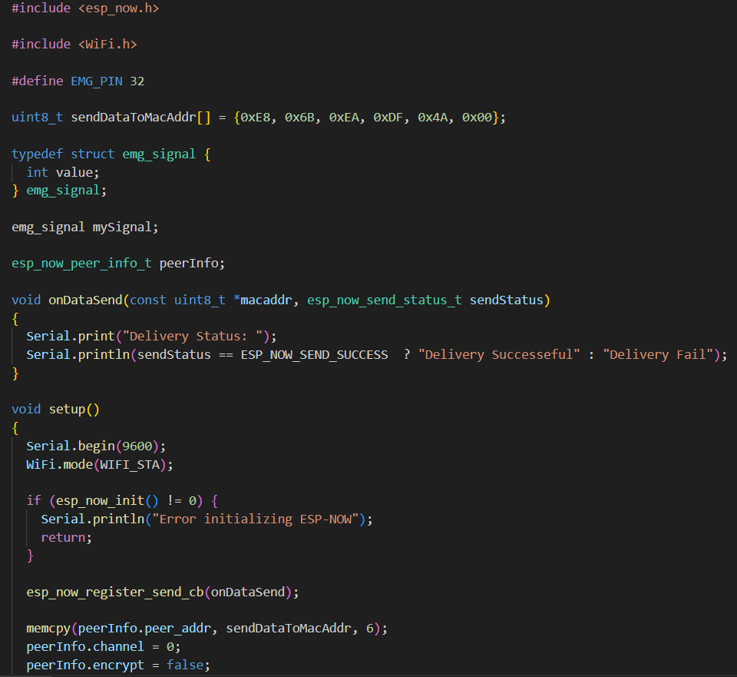
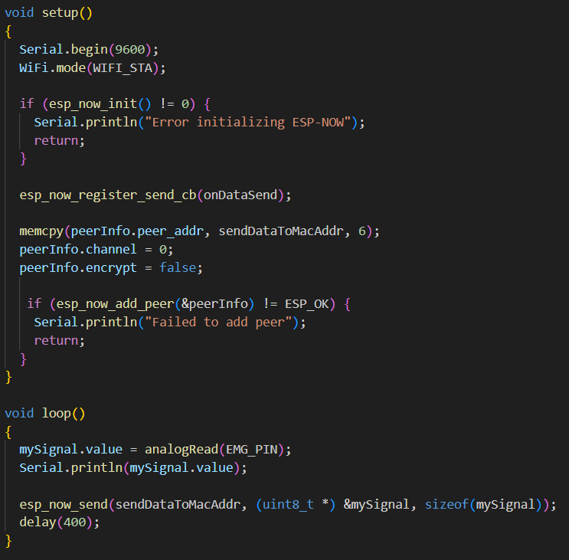
Experimental Work
Fig. 6: Reading EMG Data

Slide 27
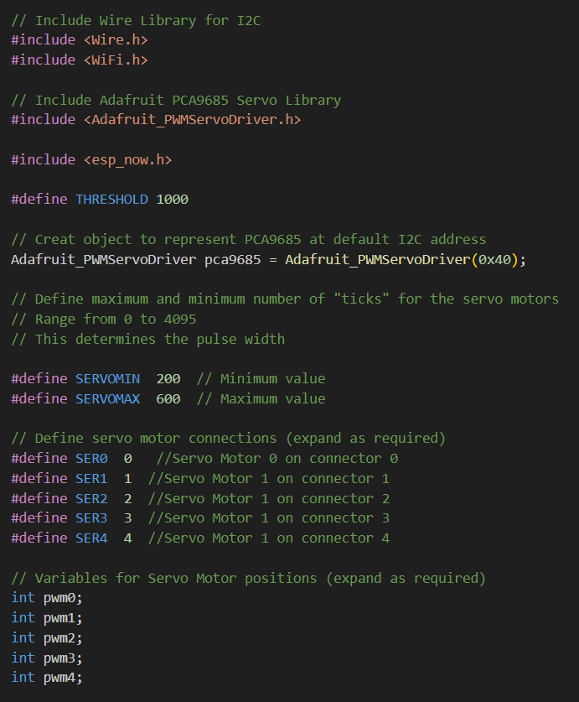
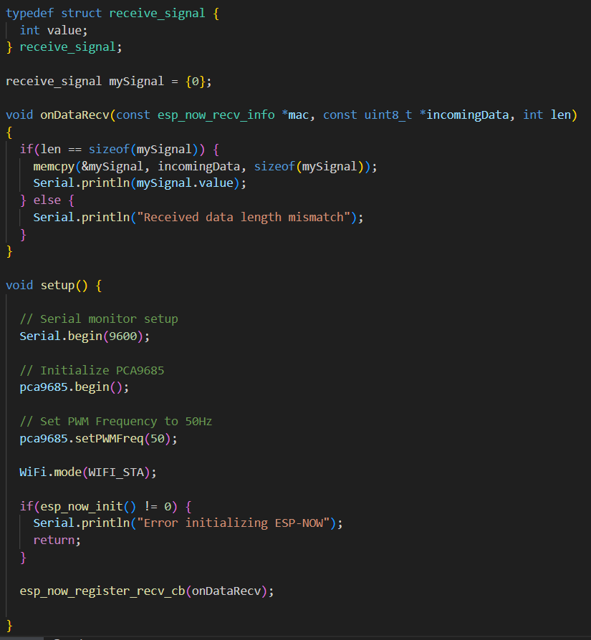
Experimental Work
Fig. 7 (a): Rotating Servo Motor

Slide 28
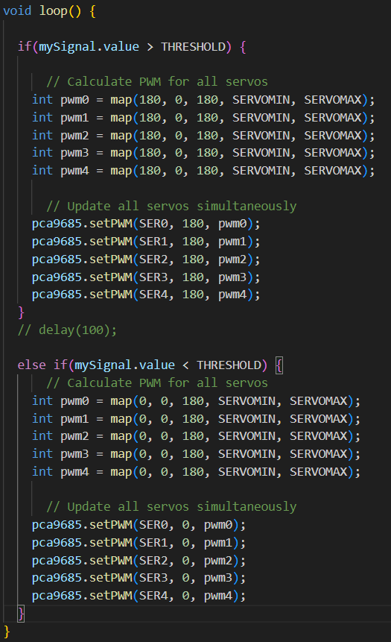
Experimental Work
Fig. 7 (b): Rotating Servo Motor

Slide 29
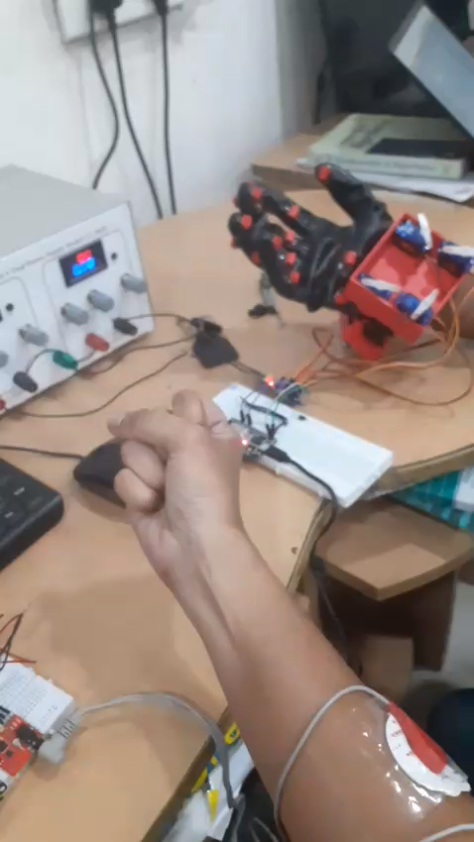
Experimental Work

Slide 30
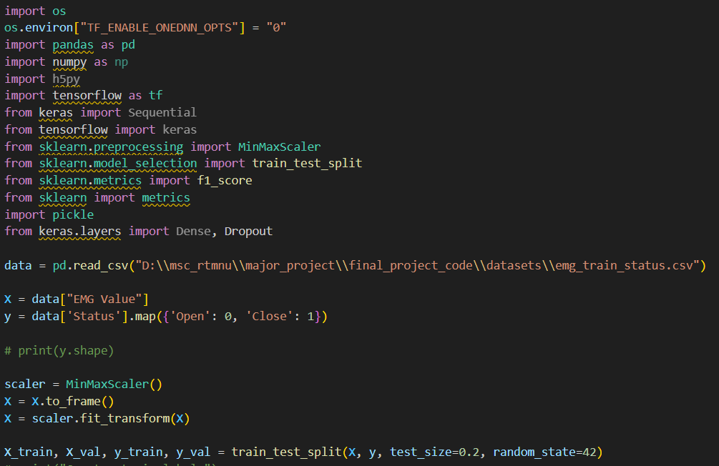
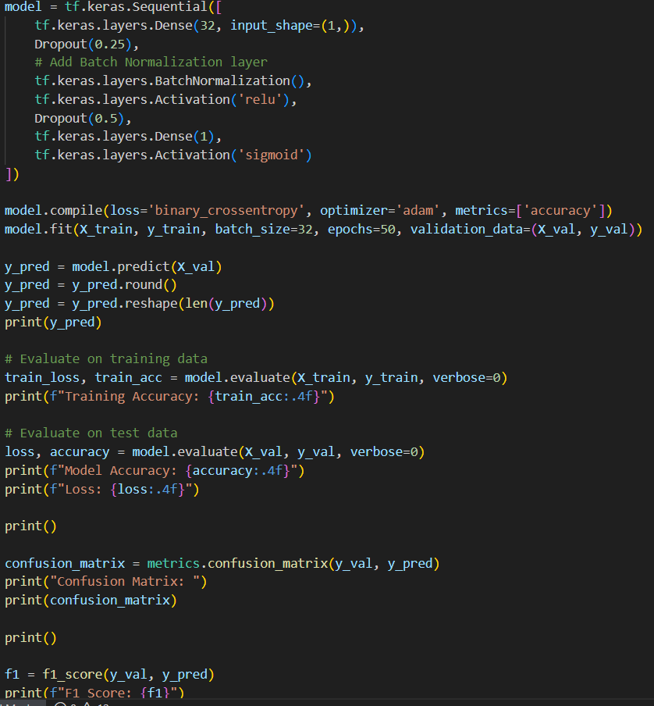
Experimental Work
Fig. 8: ANN Model

Slide 31
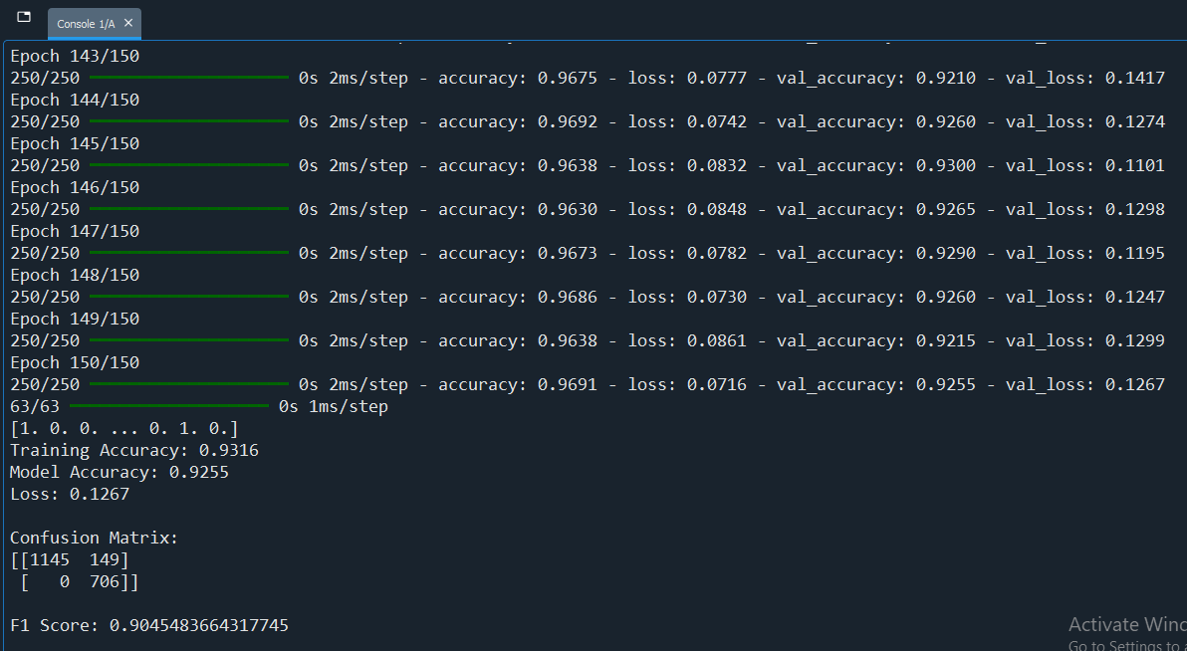
Experimental Work
Fig. 9: ANN Model Training Accuracy

Slide 32
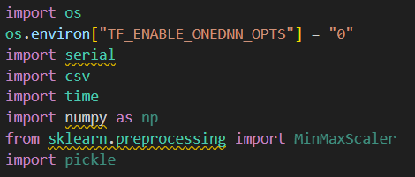
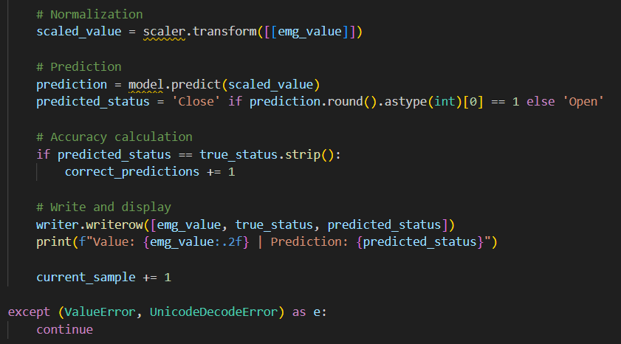
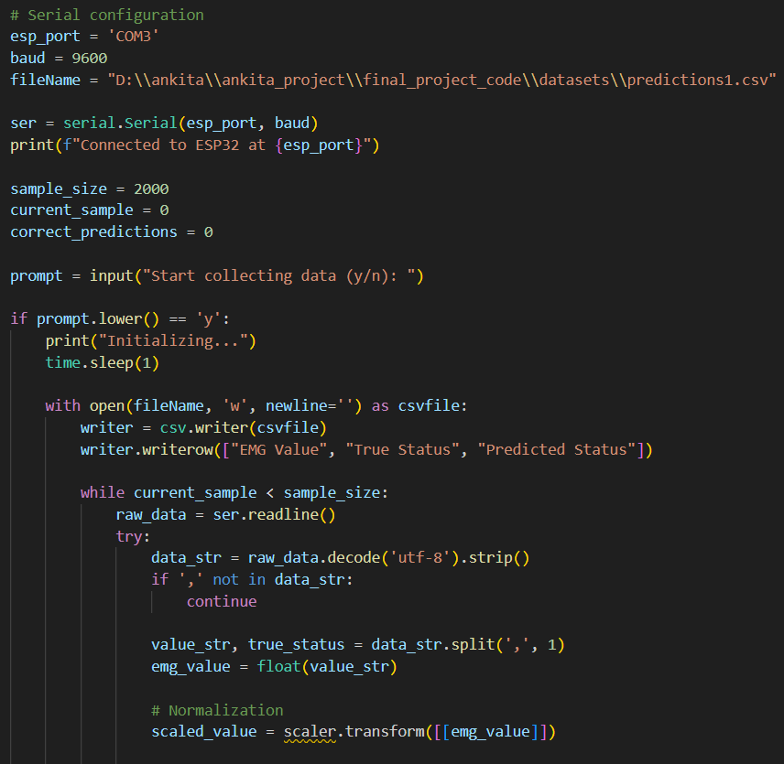
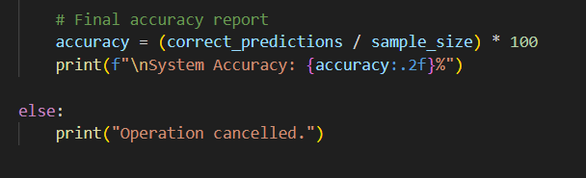
Experimental Work
Fig. 10: ANN Test on Real Time Data

Slide 33
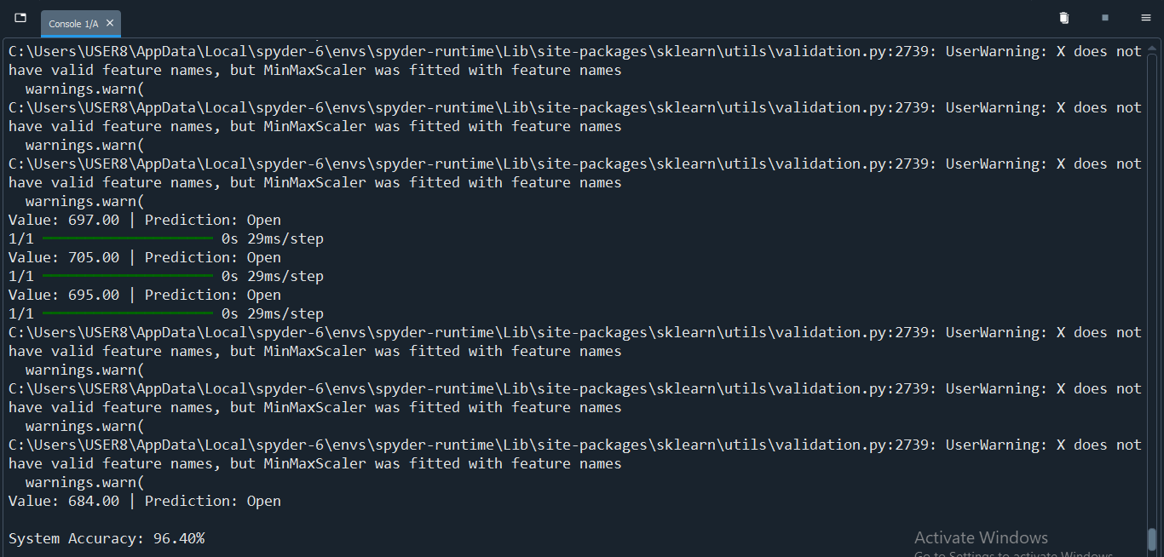
Experimental Work
Fig. 11: Accuracy on real time data

Slide 34
Results
The present system mimics the action of the healthy hand
The system uses ESP NOW protocol for communication between two ESP NOW protocols
Machine Learning approach is being implemented, which is able to classify hand gesture as open or close
Artificial Neural Networks has been trained and gives accuracy of 93%
The model gives 96% accuracy on real time data by classifying gestures as open or close

Slide 35
Future Scope
The system can be expanded to control individual finger movements for specific hand gesture
A reliable exoskeleton can be designed with more Degree of Freedom (DoF)
More servo motors can be implemented to perform wrist movement
It can be extended to other parts of the body
A more reliable machine learning technique can be used and deployed to the system to get more accurate results

Slide 36
References
[1] Francesco Di Nardo, Antonio Nocera, Alessandro Cucchiarelli, Sandro Fioretti and Christian Morbidoni, “Machine Learning for Detection of Muscular Activity from Surface EMG Signals”, Sensors, 22(3393), pp. 1-17, April 2022
[2] Ankita L. Dharmik, S. K. Atre, S. J. Sharma, “Design of an Exoskeleton for Hand Rehabilitation”, IEEE Conference and Interdisciplinary Approach in Technology and Management for Social Innovation (IATMS), 1(1), pp. 1-4, 2022
[3] Mailyn Calderon-Diaz, Rony Silvestre Aguirre, Juan P. Vasconez, Roberto Yanez, Matias Roby, Marvin Querales, Rodrigo Salas, “Explainable Machine Learning Techniques to Predict Muscle Injuries in Professional Soccer Players through Biomechanical Analysis”, Sensors, 24(119), pp. 1-13, 2024;
[4] Ching Yee YONG and Terence Tien Lok SIA, “I Want to Control Your Move: Human-Human Interface (HHI) Neuromuscular Electrical Stimulator (NMES)”, Conference of Electronics, Communication and Networks (CECNet), 1(1), pp. 724-730, 2022

Slide 37
References
[5] Nestor J. Jarque-Bou, Joaquin L. Sanche-Bau, Margarita Vergara, “A Systematic Review of EMG Applications for the Characterization of Forearm and Hand Muscle Activity during Activities of Daily Living: Results, Challenges, and Open Issues”, Sensors, 21(3035), pp. 1-26, 2021
[6] Yassine Bouteraa, Ismail Ben Abdallah, Khalil Boukthir, “A New Wrist-forearm Rehabilitation Protocol Integrating Human Biomechanics and SVM-Based Machine Learning for Muscle Fatigue Estimation”, Bioengineering, 10(219), pp. 1-22, 2023
[7] Md. Latifur Rahman, Md. Jahin Alam, Nayeed Rashid, Lamiya Hassan Tithy, Alfaj Uddin Ahmed, and M Tarik Arafat, “IoT Based Cost Efficient Muscle Stimulator for Biomedical Application”, 2020 IEEE Region 10 Symposium (TENSYMP), 1(1), pp. 1-5, 2020
[8] Nat Wannawas and Aldo Faisal, “Towards AI-controlled FES-restoration of arm movements: Controlling for progressive muscular fatigue with Gaussian state-space models”, 11th International IEEE/EMBS Conference on Neural Engineering (NER), 1(1), pp. 1-4, 2023

Slide 38
References
[9] Dr. G. Sophia Reena, “Posture Guardian With Smart Muscle Strain Detection And Correction Using TINYML”, Journal of Propulsion Technology, 44(4), pp. 5187-5194, 2023
[10] DERVİŞ PAŞA, “Development of Wireless Microcontroller Based Functional Electronic Stimulation Device for Drop Foot Correction”, Near East University, Nicosia, pp. 1-87, 2014
[11] Xiaoshi Chen, Li Gong, Lirong Zheng, and Zhuo Zou, “Soft Exoskeleton Glove for Hand Assistance Based on Human-Machine Interaction and Machine Learning”, IEEE International Conference on Human-Machine Systems (ICHMS), Rome, Italy, 1(1), 2020
[12] Xiaoshi Chen, Li Gong, Liang Wei, Shih-Ching Yeh, and Li Da Xu, “A Wearable Hand Rehabilitation System with Soft Glove”, IEEE Transactions on Industrial Information, 17(2), pp. 943-952, 2020

Slide 39
References
[13] Alireza Mohammadi, Jim Lavranos, Peter Choong, and Denny Oetomo, “Flexo-glove: A 3D Printed Soft Exoskeleton Robotic Glove for Impaired Hand Rehabilitation and Assistance”, 40th Annual International Conference of the IEEE Engineering in Medicine and Biology Society (EMBC), Honolulu, USA, pp. 2120-2123, 2018
[14] Waqas Ahmed, Muhammad Kashif Sattar, Wajeeha Shahnawaz, Umair Saeed, Shahbaz Mehmood Khan, and Neha Amon Khan, “Wearable Hand-Rehabilitation System with Soft Gloves for Patient with Face Paralysis and Disability”, Engineering Proceedings, 12(56), pp. 1-5, 2021
[15] Xuanyi Zhou, Hoa Fu, Baoqing Shentu, Weidong Wang, Shibo Cai, and Guanjan Bao, “Design and Control of a Tendon-Driven Robotic Finger Based on Frasping Task Analysis”, Biomimetics, 9(370), pp. 1-17, 2024

Slide 40
Thank You

