Slide 1
Design and Study of a Human-Human Interaction System to Control the Movement of Paralyzed Hand
Presented by
Ankita Giroti
M. Sc. Semester III
Under the Guidance of
Dr. Satish J. Sharma
Department of Electronics and Computer Science,
Rashtrasant Tukadoji Maharaj Nagpur University, Nagpur

Slide 2
Contents
Introduction
Aim
Objectives
Literature Review
Proposed System
Excepted Outcomes
Significance
Social Impact
References

Slide 3
Introduction
Arm and hand paralysis can lead to permanent paralysis if does not treated properly
There are various techniques used by therapist for rehabilitation of the hand and muscles which are very costly
A system can be designed to control the moves of the patient with hand paralysis by replicating the therapist actions

Slide 4
Aim
To develop a system that allows therapists to assist patient’s hand movements by replicating the therapist's own hand motions. A machine learning model will recognize and interpret the therapist's hand movements, and these signals will be processed by a microcontroller that controls a stimulator device to trigger the patient's muscle contractions.

Slide 5
Objectives
To design a rehabilitation system for an individual with hand paralysis to regain functionality of their hand
To design a system that senses electromyography (EMG) signals of the hands of the therapist
To train a machine learning model to recognize hand movements
To mimic the hand movement of the therapist
To increase flexibility of the patient’s hand

Slide 6
Literature Review
Sr. No. | Title | Author | Source | Description
1 | Machine Learning for Detection of Muscular Activity from Surface EMG Signals | Francesco Di Nardo, Antonio Nocera, Alessandro Cucchiarelli, Sandro Fioretti and Christian Morbidoni | Sensors, 1(1), pp. 1-4, 2022 | Used surface EMG to detect muscle contraction. The proposed system predicted onset/offset timing of muscular recruitment of the machine learning based methods.
2 | Design of an Exoskeleton for Hand Rehabilitation | Ankita L. Dharmik, S. K. Atre, S. J. Sharma | IEEE Conference and Interdisciplinary Approach in Technology and Management for Social Innovation (IATMS), 1(1), pp. 1-4, 2022 | An exoskeleton was designed to assist a person with disability using EMG sensor to acquire signals from the muscles and convert into voltage. Microcontroller was programmed to rotate servo motor.
3 | Explainable Machine Learning Techniques to Predict Muscle Injuries in Professional Soccer Players through Biomechanical Analysis | Mailyn Calderon-Diaz, Rony Silvestre Aguirre, Juan P. Vasconez, Roberto Yanez, Matias Roby, Marvin Querales, Rodrigo Salas | Sensors, 24(119), pp. 1-13, 2024 | Paper presented a Hamstring strain injury detection technique using various Machine Learning techniques to find the accurate result.

Slide 7
Literature Review
Sr. No. | Title | Author | Source | Description
4 | I Want to Control Your Move: Human-Human Interface (HHI) Neuromuscular Electrical Stimulator (NMES) | Ching Yee YONG and Terence Tien Lok SIA | Conference of Electronics, Communication and Networks (CECNet), 1(1), pp. 724-730, 2022 | The system implemented Neuromuscular Electrical Stimulator (NMES) integrated with Human-Human Interaction (HHI) for hand rehabilitation using IoT.
5 | A Systematic Review of EMG Applications for the Characterization of Forearm and Hand Muscle Activity during Activities of Daily Living: Results, Challenges, and Open Issues | Nestor J. Jarque-Bou, Joaquin L. Sanche-Bau, Margarita Vergara | Sensors, 24(119), pp. 1-13, 2024 | The paper had studied EMG to characterized muscle activity of the hand. It focuses on human hand behavior , improve rehabilitation, control prothesis, etc.

Slide 8
Literature Review
Sr. No. | Title | Author | Source | Description
6 | A New Wrist-forearm Rehabilitation Protocol Integrating Human Biomechanics and SVM-Based Machine Learning for Muscle Fatigue Estimation | Yassine Bouteraa, Ismail Ben Abdallah, Khalil Boukthir | Bioengineering, 10(219), pp. 1-22, 2023 | A remote rehabilitation system that integrates a IoT based connected robot for wrist and forearm rehabilitation using Support Vector Machine (SVM) to predict muscle strain from the feature extracted from the EMG signals of the patient.
7 | IoT Based Cost Efficient Muscle Stimulator for Biomedical Application | Md. Latifur Rahman, Md. Jahin Alam, Nayeed Rashid, Lamiya Hassan Tithy, Alfaj Uddin Ahmed, and M Tarik Arafat | 2020 IEEE Region 10 Symposium (TENSYMP), 1(1), pp. 1-5, 2020 | Design a low cost muscle stimulator integrated with IoT and a feedback system to receive voltages which was send to the IoT device to determine muscle strength.
8 | Towards AI-controlled FES-restoration of arm movements: Controlling for progressive muscular fatigue with Gaussian state-space models | Nat Wannawas and Aldo Faisal | 11th International IEEE Conference on Neural Engineering (NER), 1(1), pp. 1-4, 2023 | Used Reinforcement Learning to observe muscle strength. The Reinforcement Learning – Gaussain State Space Model (RL-GSSM) was trained to control arm movements through muscle stimulator.

Slide 9
Literature Review
Sr. No. | Title | Author | Source | Description
9 | Posture Guardian With Smart Muscle Strain Detection And Correction Using TINYML | Dr. G. Sophia Reena | Journal of Propulsion Technology, 44(4), pp. 5187-5194, 2023 | TinyML was used to detect and correct improper posture using wearable EMG and Flex sensors. The data fed to the Arduino UNO for signal processing.
10 | Development of Wireless Microcontroller Based Functional Electronic Stimulation Device for Drop Foot Correction | DERVİŞ PAŞA | Near East University, Nicosia, pp. 1-87, 2014 | A stimulator was developed for a person with drop foot problem using Force Sensitive Resistor (FSR), programmable microcontroller, transmitter, receiver, and electrodes.

Slide 10
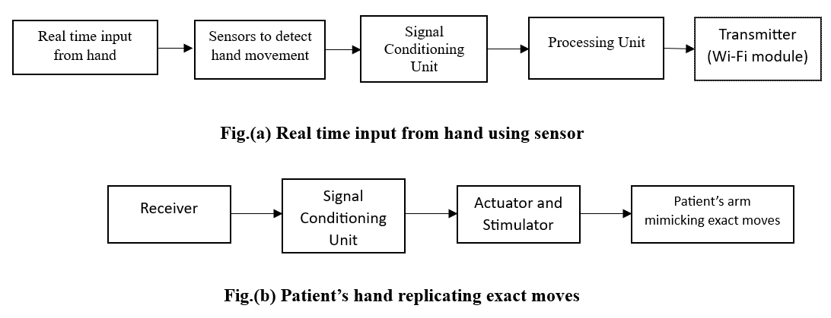
Proposed System
Fig. Block Diagram of a Proposed System

Slide 11
Excepted Outcome
The developed system will be able to mimic the hand movements of normal hand to the paralyzed hand by using EMG sensors to sense the muscle contractions and actuators to accelerate the motion of the weak hand.

Slide 12
Significance
The developed system will be able to:
  Help individuals with hand paralysis
  Provide accurate and effective rehabilitation exercises
  Help individuals to regain functional abilities
  Increase independence in daily activity

Slide 13
Social Impact
To help individuals with hand paralysis
Reduce treatment cost
Reduce long term treatment process
Increase independence of individuals in daily life

Slide 14
References
[1] Francesco Di Nardo, Antonio Nocera, Alessandro Cucchiarelli, Sandro Fioretti and Christian Morbidoni, “Machine Learning for Detection of Muscular Activity from Surface EMG Signals”, Sensors, 22(3393), pp. 1-17, April 2022
[2] Ankita L. Dharmik, S. K. Atre, S. J. Sharma, “Design of an Exoskeleton for Hand Rehabilitation”, IEEE Conference and Interdisciplinary Approach in Technology and Management for Social Innovation (IATMS), 1(1), pp. 1-4, 2022
[3] Mailyn Calderon-Diaz, Rony Silvestre Aguirre, Juan P. Vasconez, Roberto Yanez, Matias Roby, Marvin Querales, Rodrigo Salas, “Explainable Machine Learning Techniques to Predict Muscle Injuries in Professional Soccer Players through Biomechanical Analysis”, Sensors, 24(119), pp. 1-13, 2024;
[4] Ching Yee YONG and Terence Tien Lok SIA, “I Want to Control Your Move: Human-Human Interface (HHI) Neuromuscular Electrical Stimulator (NMES)”, Conference of Electronics, Communication and Networks (CECNet), 1(1), pp. 724-730, 2022

Slide 15
References
[5] Nestor J. Jarque-Bou, Joaquin L. Sanche-Bau, Margarita Vergara, “A Systematic Review of EMG Applications for the Characterization of Forearm and Hand Muscle Activity during Activities of Daily Living: Results, Challenges, and Open Issues”, Sensors, 21(3035), pp. 1-26, 2021
[6] Yassine Bouteraa, Ismail Ben Abdallah, Khalil Boukthir, “A New Wrist-forearm Rehabilitation Protocol Integrating Human Biomechanics and SVM-Based Machine Learning for Muscle Fatigue Estimation”, Bioengineering, 10(219), pp. 1-22, 2023
[7] Md. Latifur Rahman, Md. Jahin Alam, Nayeed Rashid, Lamiya Hassan Tithy, Alfaj Uddin Ahmed, and M Tarik Arafat, “IoT Based Cost Efficient Muscle Stimulator for Biomedical Application”, 2020 IEEE Region 10 Symposium (TENSYMP), 1(1), pp. 1-5, 2020

Slide 16
References
[8] Nat Wannawas and Aldo Faisal, “Towards AI-controlled FES-restoration of arm movements: Controlling for progressive muscular fatigue with Gaussian state-space models”, 11th International IEEE/EMBS Conference on Neural Engineering (NER), 1(1), pp. 1-4, 2023
[9] Dr. G. Sophia Reena, “Posture Guardian With Smart Muscle Strain Detection And Correction Using TINYML”, Journal of Propulsion Technology, 44(4), pp. 5187-5194, 2023
[10] DERVİŞ PAŞA, “Development of Wireless Microcontroller Based Functional Electronic Stimulation Device for Drop Foot Correction”, Near East University, Nicosia, pp. 1-87, 2014

Slide 17
Thank You

