Slide 1


College Logo
Government College Of Engineeing And Research Avasari
Department Of Computer Engineering
Project On
“Emotion Based Music Recommendation System”
By
Guide Name: Dr.S.U.Ghumbre
Sr no | Name of Team Member | Roll No
1. | Tejashri Shivaji Bachkar | 20221080
2. | Ankita Budhaji Gholap | 20221076
3. | Shubham Jayant Patil | 19121041
Thursday 13 Oct 2022

Slide 2
Project Details
Project Title : Emotion based music recommendation system
Project Domain: AI/ML
Project Group Members:
20221080, Tejashri Bachkar
20221076 , Ankita Gholap
19121041 , Shubham Patil
2

Slide 3
Contents
Introduction to domain & topic
Project Motivation
Problem statement
Literature Survey
Software Requirement Specifications
Project Design
- Project Analysis - UML diagrams - DFD's
Project Planning and Prototyping
Conclusion
References
1

Slide 4
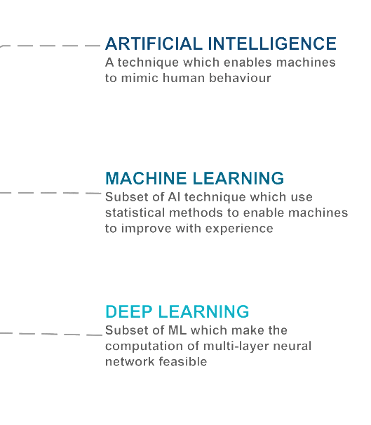
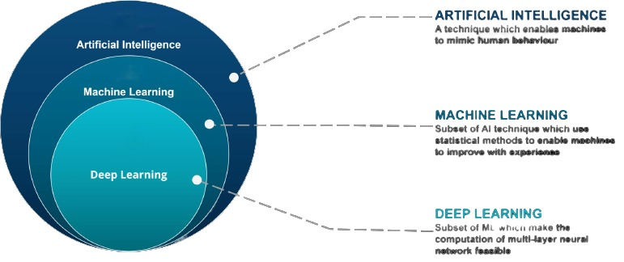
Introduction to Domain

Slide 5
Motivation
To implement and solve one of the most important problems that no one around notice, music is taking a very huge part of our everyday routine and we choose what to listen to base on many things one of them is Emotions.
Music can reduce your stress levels
Music can influence your mood
Music can improve mental health
2

Slide 6
Problem Statement
To reduce the efforts of users in creating and managing playlist. We develop a system that presents a cross platform music player, which recommends music based on the real-time mood of the user through a web camera using machine learning algorithm.
5

Slide 7
Aim and Objectives of the Project
The aim of the project :
The aim of our proposed system is to provide a music playlist automatically based on current mood of user.
Project objectives :
To helps users automatically play songs based on the emotions.
To recommend music based on mood of the users.
To implement the machine learning model on emotion based on recommendation system.
To change emotional state of user.
6

Slide 8
Introduction
Human emotions can be broadly classified as: fear, disgust, anger, surprise, sad, happy and neutral.
We use facial expressions to propose a recommender system for emotion recognition that can detect user emotions and suggest a list of appropriate songs.
Neural networks and machine learning have been used for these tasks and have obtained good results.
OpenCV used for face detection.
CNN algorithm used for image classification and recognition.
2

Slide 9
Literature Survey
Sr. No. | Reference Name | Work description | Problem found
1. | Emotion recognition using facial expressions (2021) (Paweł Tarnowski, Marcin Kołodziej, Andrzej Majkowski, Remigiusz J.Rak) | This system recognizing seven emotional states (neutral, joy, sadness, surprise, anger, fear, and disgust) based on facial expressions. The characteristics were classified using a k-NN classifier. | Three dimensional model difficult to classify the features of facial expressions.
2. | Music Recommender System for users used on Emotion Detection Through Facial Features.(2021) (Ahlam Alrihaili , Alaa Alsaedi, Kholood Albalawi , Liyakathunisa Syed) | This system recognizing four emotional states. Using PCA algorithm emotion are detected. | Classification and feature extraction is difficult.
9

Slide 10
Sr. No. | Reference Name | Work description | Problems found
3. | Music Recommendation Based on Face Emotion Recognition (2021) (M. Athavle, D. Mudale, U. Shrivastav and M. Gupta ) | Capture image using OpenCV. Haar classifier used for face detection. They create their own song database playlist. | This system does not perform well in bad light conditions and poor camera resolution.
4. | Emotion Integrated Music Recommendation System Using Generative Adversarial Networks (2020) (Mrinmoy Bhaumik, Patricia U Attah , Dr. Faizan Javed) | Classify emotions through using SVM. For music dataset they directly uses spotify API. | They do not point to any definitive conclusion on emotion. There was no statistical significance between the model with or without emotion.

Slide 11
Software: 1) Python 3.6 2) Jupyter Notebook / PyCharm IDE 2021.2 Libraries: 1) OpenCV 3.1 2) Tensorflow 2.10.0 3) Keras 2.8.0 Framework: 1) Flask 2.0.0 Languages : 1) Backend- Python 2) Frontend -JS,HTML,CSS
Software Requirement Specifications

Slide 12
Contents of the Project
Steps involved in emotion recognisation
Working of CNN
Music recommendation
Architecture diagram
Use case diagram
Data flow diagram
Application

Slide 13
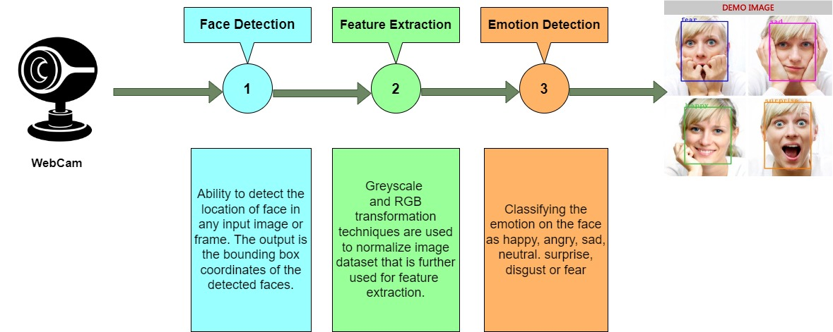
Steps Involved in Emotion Recognition

Slide 14
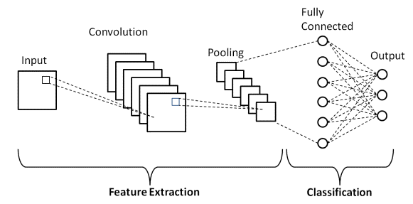
Working of CNN
CNN
Input layer
Hidden layer
Pooling layer
Fully connected layer
Output layer

Slide 15
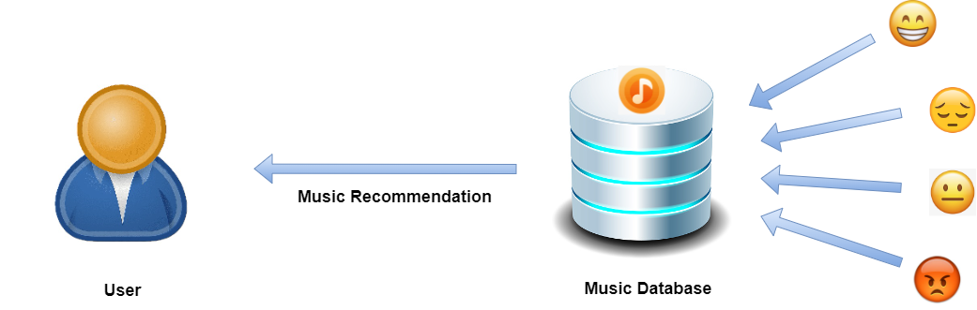
Music Recommendation

Slide 16
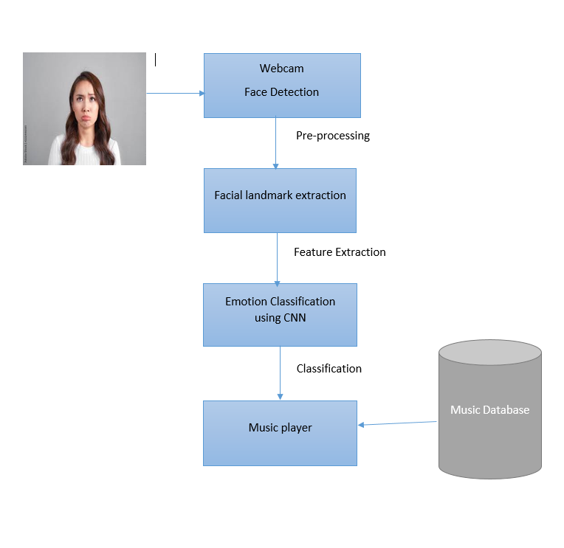
Architecture Diagram
Fig.Architecture Diagram

Slide 17
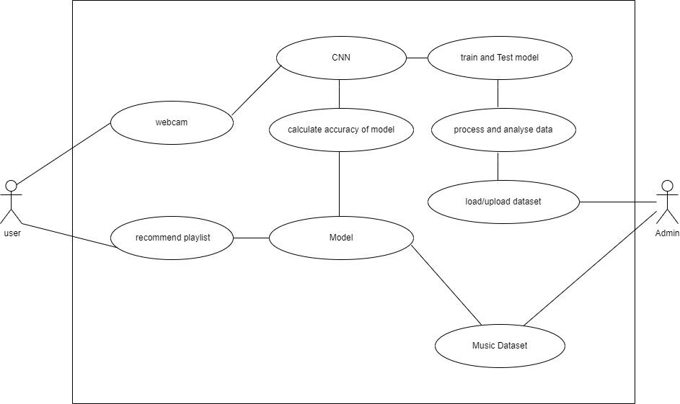
Use Case Diagram

Slide 18
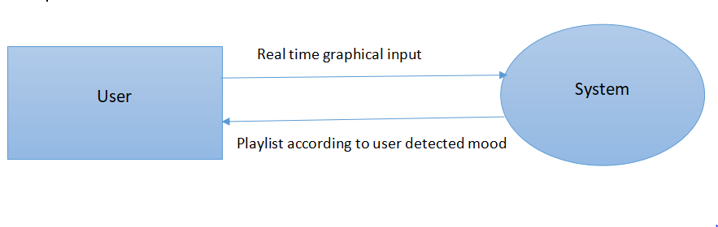
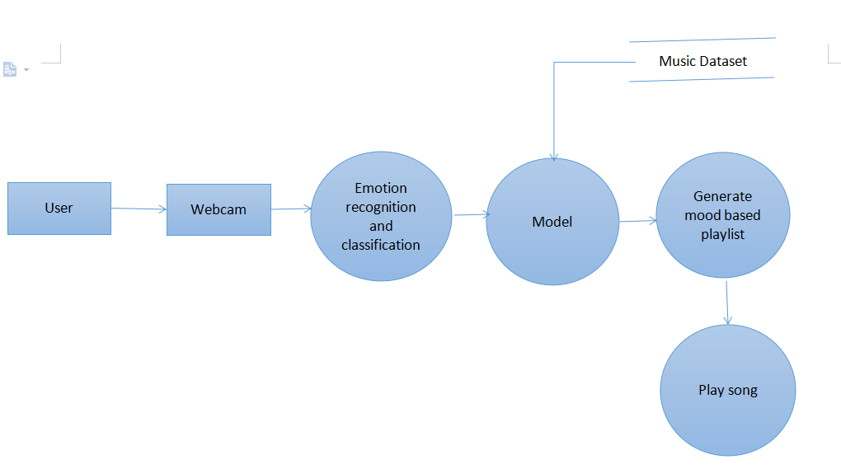
Data Flow Diagram
DFD level- 0
DFD level- 1

Slide 19
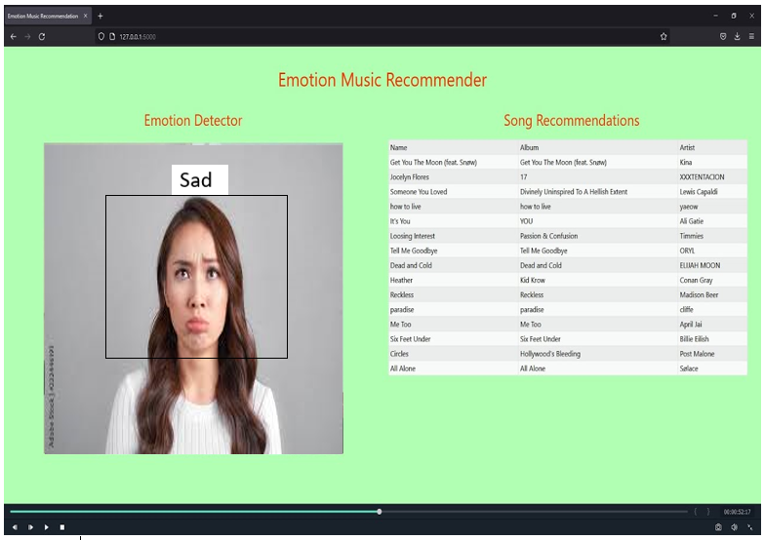
Prototyping

Slide 20
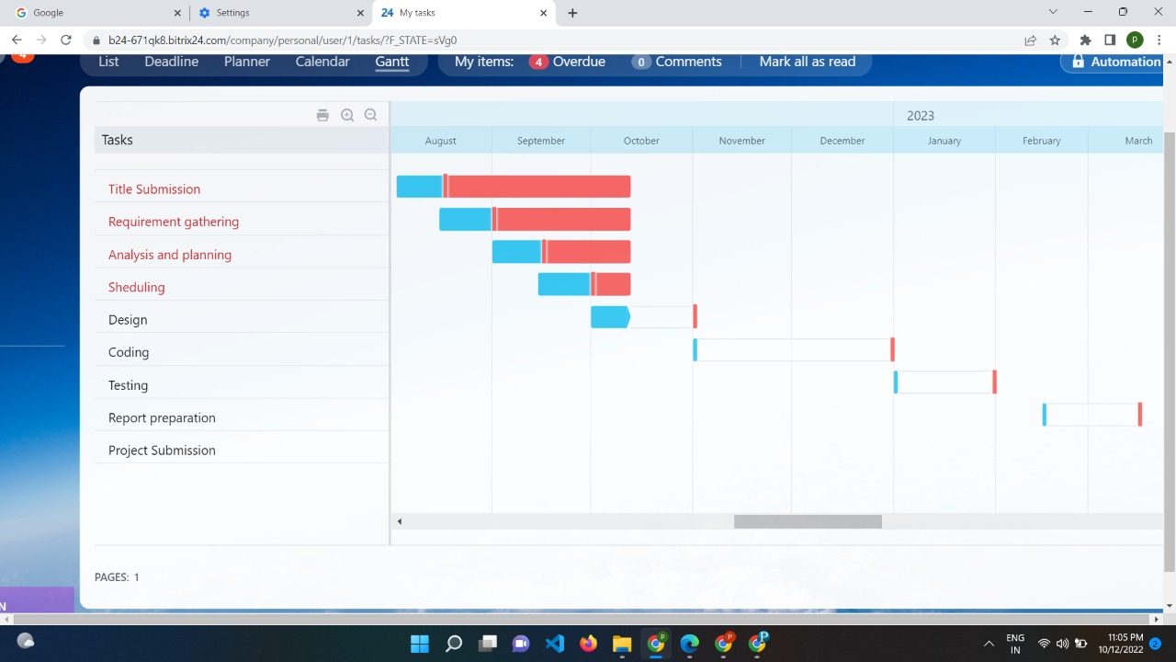
Planning

Slide 21




Applications
Entertainment
Workout
Celebration
Mood setting
11

Slide 22
Conclusion
The emotions that the system can detect were happy, sad, angry, neutral, or surprised.
The music are one that has the power to heal any stress or any kind of emotions.
Thus the proposed system presents Face based emotion recognition system to detect the emotions and play music from the emotion detected.
12

Slide 23
References
1.https://ieeexplore.ieee.org/document/9596276
Sunil Kumar,Shikha Sharma( 2021)
2.https://www.irjet.net/archives/V6/i3/IRJET-V6I3403.pdf
H. Immanuel James1, J. James Anto Arnold (2021)
3.https://ieeexplore.ieee.org/document/9073556
Ahlam Alrihaili , Alaa Alsaedi ,Kholood Albalawi , Liyakathunisa
4. https://scholar.smu.edu/datasciencereview/vol5/iss3/4
Mrinmoy Bhaumik, Patricia U Attah , Dr. Faiza
5.https://www.researchgate.net/publication/354855186_Music_Recommendation_Based_on_Face_Emotion_Recognition
M.Athavle, D. Mudale, U. Shrivastav and M. Gupta (2021)
6.https://www.sciencedirect.com/science/article/pii/S1877050917305264
Paweł Tarnowski, Marcin Kołodziej, Andrzej Majkowski

Slide 24
Thank You!
14

