Slide 1


Go-To-Market (G2M) Strategy for Cab Investment Firm
Ankita Jadhav

Slide 2

Agenda
Executive Summary
Problem Statement
Approach
EDA (Exploratory Data Analysis)
EDA Summary
Hypothesis Testing
Building Models
Recommendations

Slide 3
Description
XYZ is a private equity firm in US. Due to remarkable growth in the Cab Industry in last few years and multiple key players in the market, it is planning for an investment in Cab industry.
Provide actionable insights to help XYZ firm in identifying the right company for making investment.
Cab Companies:
Yellow Cab
Pink Cab
Analysis includes:
Data Understanding,
Data Visualization,
Creating multiple hypothesis,
Building models and finding the best fit model based on Accuracy.

Slide 4
Data Preparation
There are 4 datasets:
Cab_Data.csv – Includes details of transaction for 2 cab companies.
Customer_ID.csv – Provides mapping of unique identifier which links the customer’s demographic details.
Transaction_ID.csv – Provides mapping of transaction to customer mapping and payment mode.
City.csv – Contains list of US cities, their population and number of cab users.

Slide 5
Exploratory Data Analysis (EDA)

Slide 6
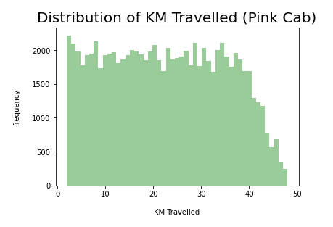
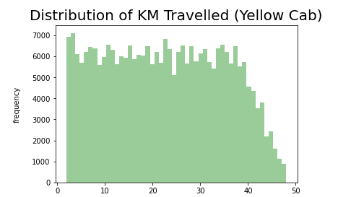
Distribution of KM Travelled for both Cabs
From the above graphs, we can see that for both Pink and Yellow Cab most of the rides are in the range of approximately 2 to 48 KM.

Slide 7
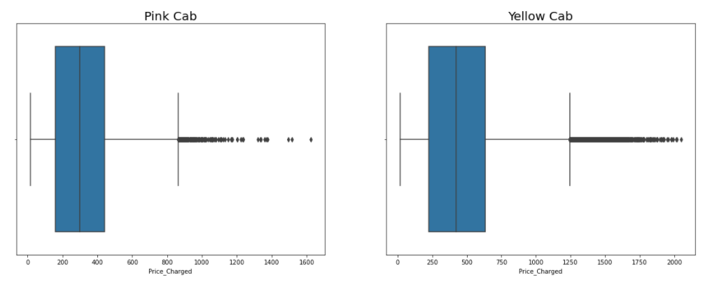
Distribution of Price Charged for both Cabs
The Price Charge range for Yellow cab is more than the Pink cab.
The outliers are due to use of high-end cars.

Slide 8
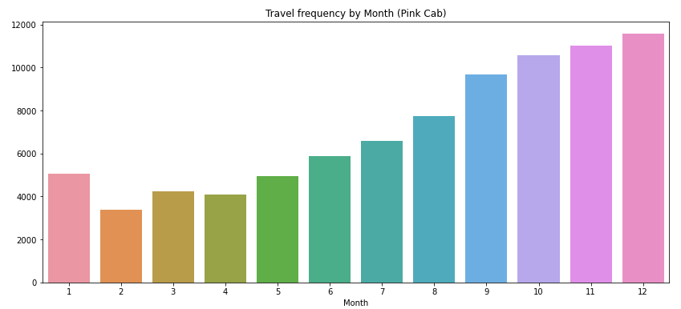
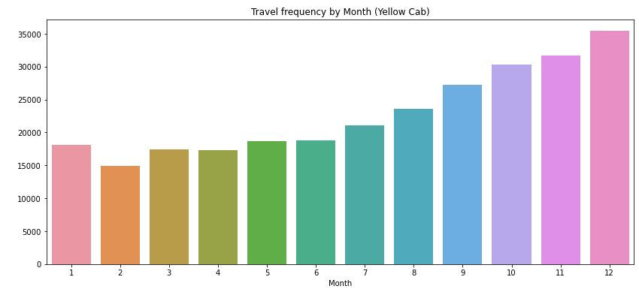
Travel Frequency per Month
Yellow Cab has higher travels (35000) in the month of December which is the holiday season compared to Pink Cab (11000).

Slide 9
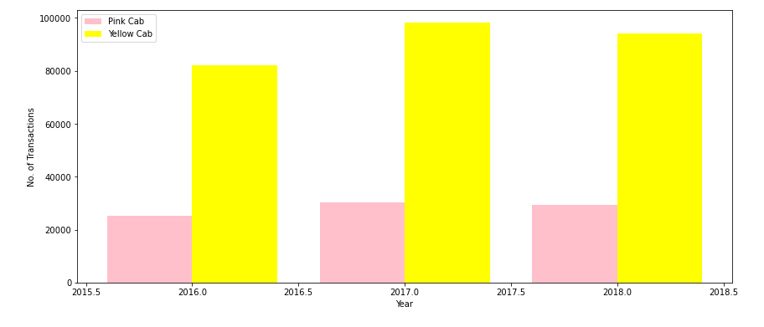
Transaction per Year for both Cabs
From the graph it shows that on yearly basis no. of transactions for Yellow cab is higher than Pink cab.

Slide 10
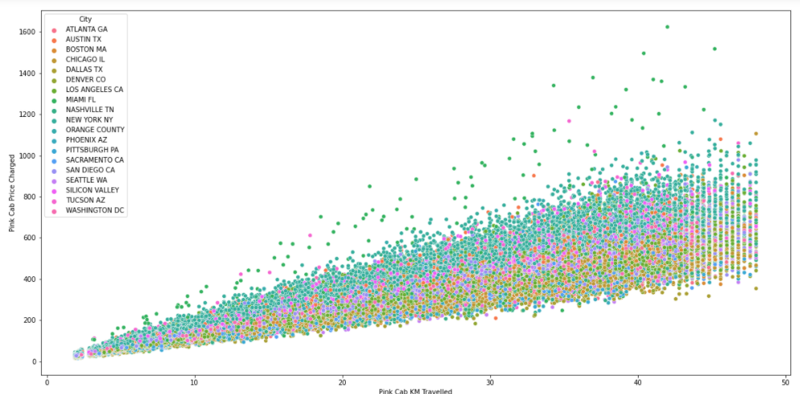
Pink Cab: Price Charged per KM per City
For Pink cab all the cities have the same increase in price charge with increase in distance

Slide 11
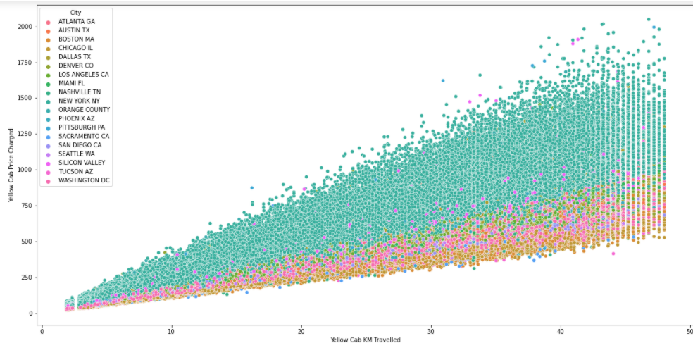
Yellow Cab: Price Charged per KM per City
In New York City the Price charged for Yellow Cab is more in comparison to the other cities

Slide 12
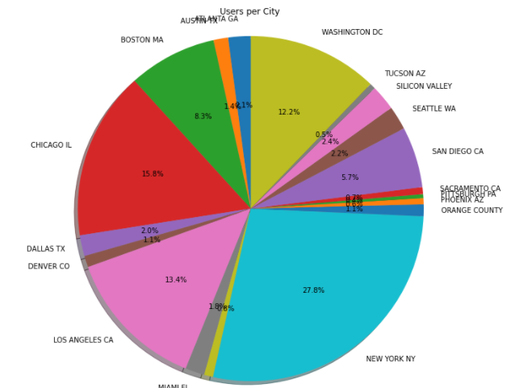
Cab Users per City
New York City has the highest Cab users with 28% followed by Chicago with 16% and Los Angeles with 13%

Slide 13
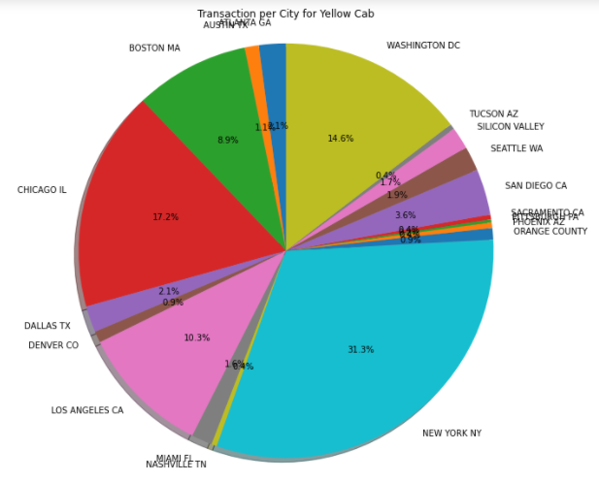
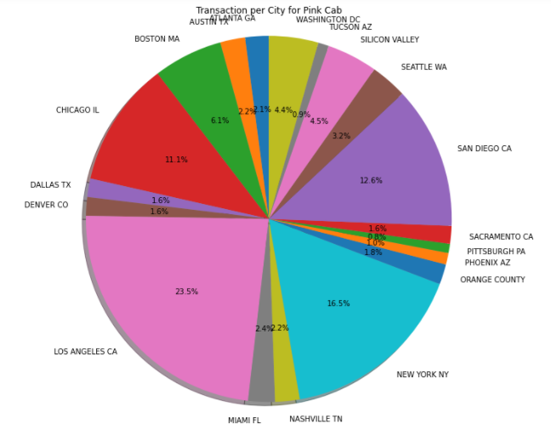
Transaction per City for both Cabs
Transaction for Yellow Cab is highest in New York City(31%) and New York City has the highest Cab Users of 28% as per the previous slide.
Transaction for Pink Cab is highest in Los Angeles City.

Slide 14
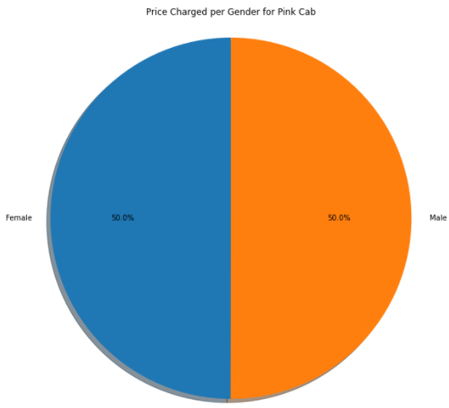
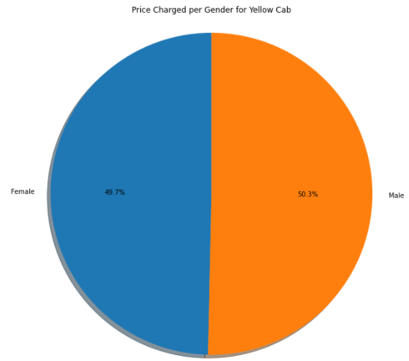
Price Charged per Gender for both Cabs
Yellow Cab charge less from Female Customers whereas Pink Cab charges same for both Male and Female Customers.

Slide 15
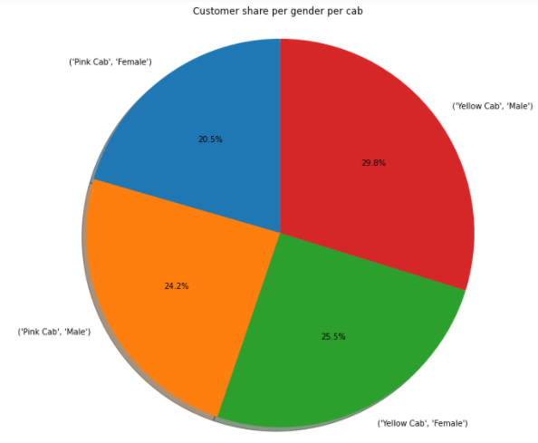
Customer Share per Gender for both Cabs
Female Customers in Yellow Cab(25.5%) is higher compared to Pink Cab (20.5%)

Slide 16
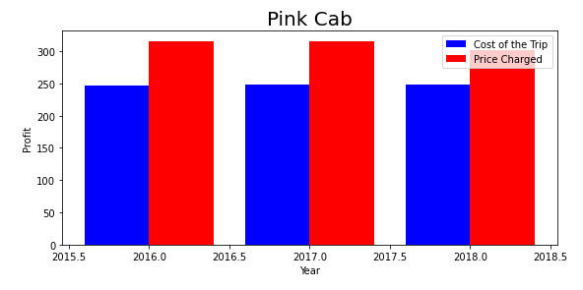
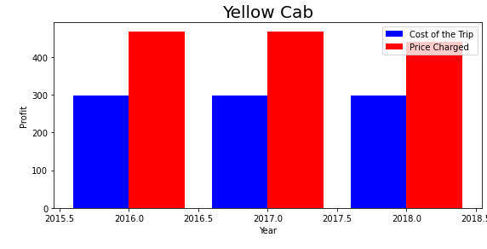
Profit Margin per year for both Cabs
From the Graphs, it shows that the Yellow cab has a higher Profit Margin (Price Charged - Cost of Trip) compared to Pink cab.

Slide 17
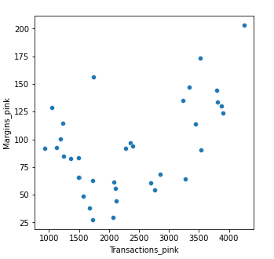
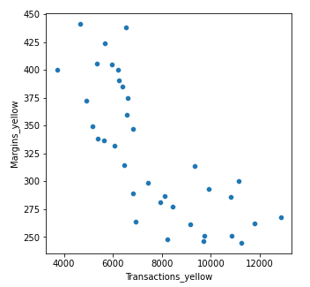
Margins per Transactions
Margins: Price Charged – Cost of Trip
Pink Cabs increase margins with increase in number of Transactions.
Yellow Cab decrease Margins with the increase in Transaction.

Slide 18
EDA Summary

Slide 19


Rides are in the range of approximately 2 to 48 KM.
Rides are in the range of approximately 2 to 48 KM.
Price Charge range from 150 to 450 dollars.
Price Charge range from 250 to 600 dollars.
In December which is the holiday season, no. of travels was around 11000.
In December which is the holiday season, no. of travels was around 35000.
Transaction per year:
2016: 20000 – 40000
2017: 20000 – 40000
2018: 20000 – 40000
Transaction per year:
2016: 80000 – 100000
2017: 80000 – 100000
2018: 80000 – 100000
All the cities have the same increase in price charge with increase in distance.
In New York City the Price charged for Yellow Cab is more in comparison to the other cities.

Slide 20
Pink Cab charges same for both Male and Female Customers.
Yellow Cab charge less from Female Customers.
Female customers are around 20.5% out of the total Customers.
Female customers are around 25.5% out of the total Customers.
Profit Margin is low each year (2016-2018) compared to Yellow Cab.
Profit Margin is high each year (2016-2018) compared to Pink Cab.
Pink Cabs increase margins with increase in number of Transactions.
Yellow Cab decrease Margins with the increase in Transaction.

Slide 21
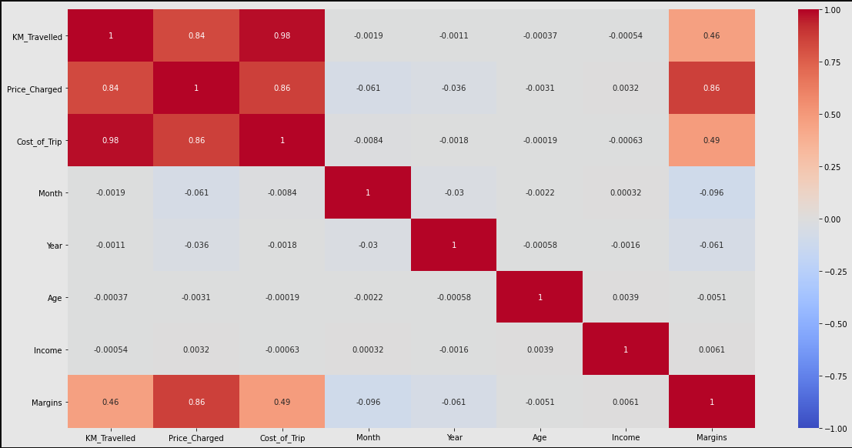
Correlation
As per the graph, there is a positive correlation between Margin & Price Charged

Slide 22
Hypothesis Testing

Slide 23

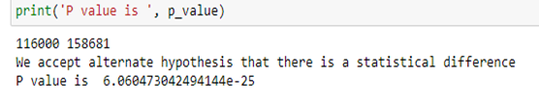



Slide 24

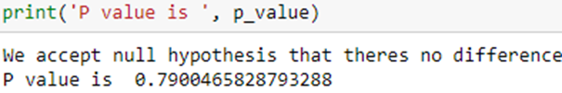



Slide 25
Building Predictive Models:
Linear Regression
Decision Tree
Random Forest

Slide 26
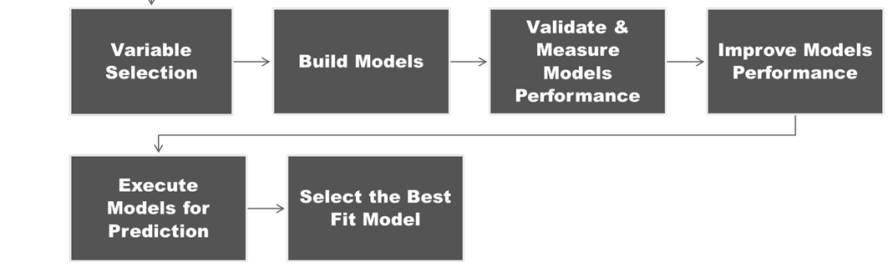
Model Building Steps

Slide 27
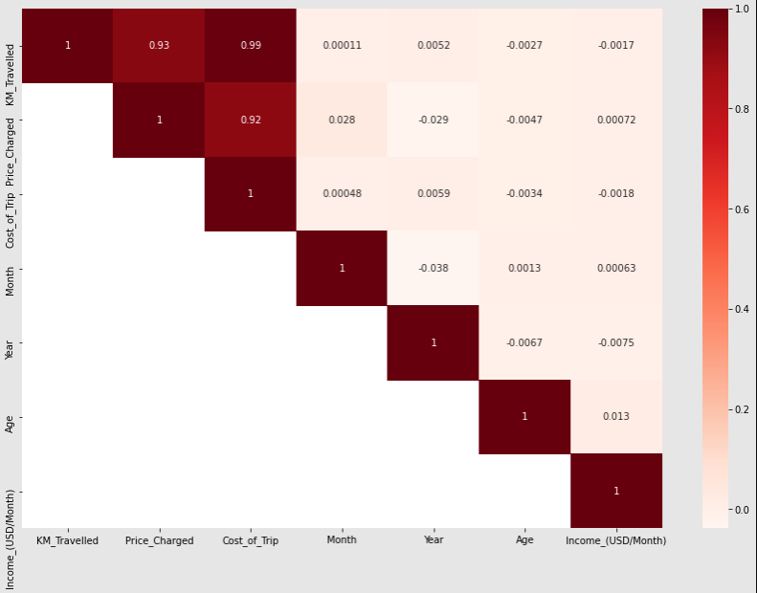
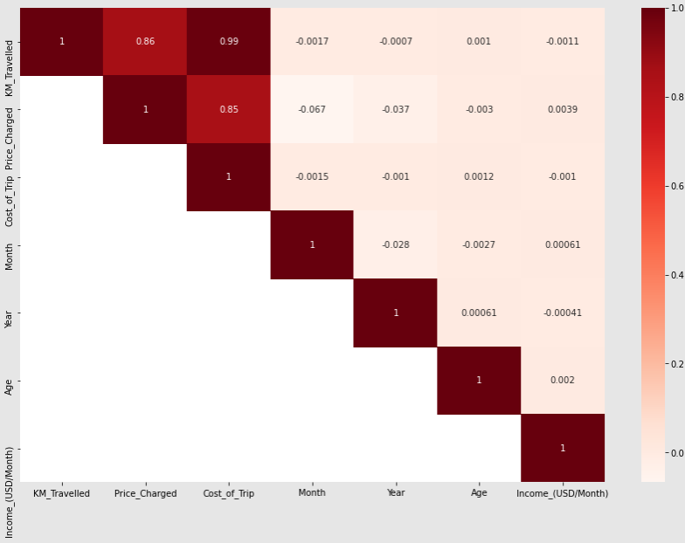
Correlation
Pink Cab
Yellow Cab
From the correlation graph, we can see KM travelled is correlated with Price Charged followed by Cost of trip.
Year, Month, Age, Income are not correlated.

Slide 28
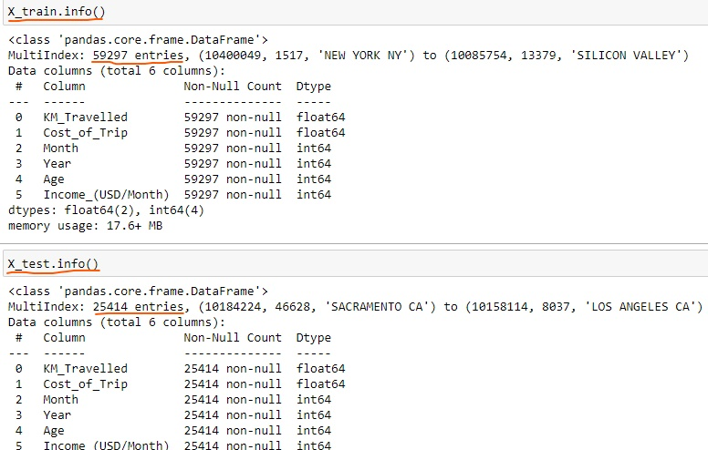
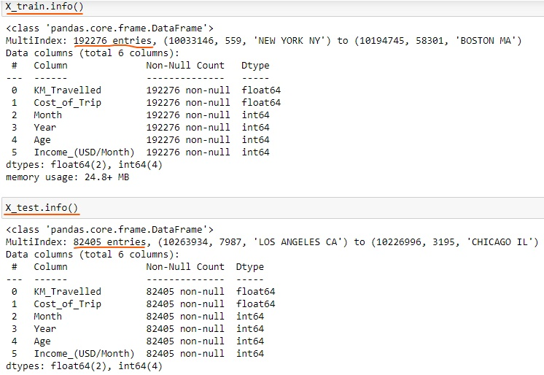
Model-1: Linear Regression
Linear Regression is a method for predicting target value and attempts to model the linear relationship between target and one or more predictors.
In our dataset, Price Charge is the target value and all the other variables are predictors.
Splitting the data into a training set (75%), and test set (25%).
Yellow Cab
Pink Cab

Slide 29
Model-2: Decision Tree
Decision Tree
Builds regression models in the form of a tree structure. It breaks down a dataset into smaller and smaller subsets while at the same time an associated decision tree is incrementally developed.
The final result is a tree with decision nodes and leaf nodes.
The topmost decision node in a tree which corresponds to the best predictor for the target value (Price Charged).
Model-3: Random Forest
Random Forest
A Random Forest operates by constructing several Decision trees.
A prediction from the Random Forest is an average of the predictions produced by the Decision trees in the forest.

Slide 30
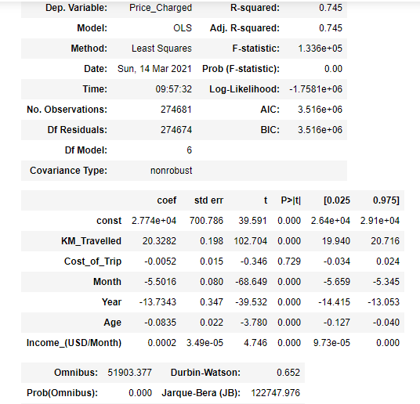
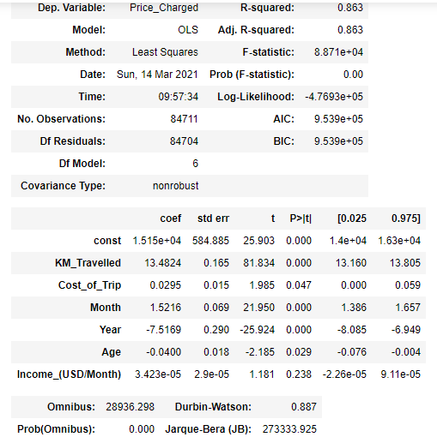
Base Model
Yellow Cab
Pink Cab
As per Base Model:
Cost of Trip, Month, Year, Age, Income are significant variable for Yellow Cab which are the best predictors for Price Charged.
Cost_of_Trip, Year, Age, Income are significant variable for Pink Cab which are the best predictors for Price Charged. Month is not considered significant.

Slide 31
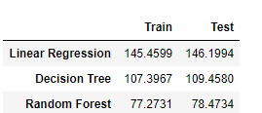
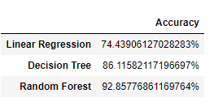
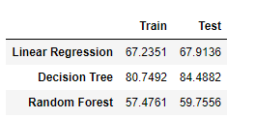
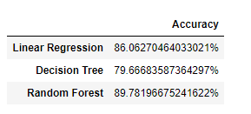
Best Fit Model: RMSE Value & Accuracy
RMSE or root mean square error measures the error which is Prediction values – Actual values.
Lower the RMSE value the better is the Model.
RMSE values & Accuracy for Yellow Cab
RMSE values & Accuracy for Pink Cab
As per the above RMSE data and Accuracy, Random Forest Model is the best fit model for further deployment.
Interpreting Random Forest Model: Cost of Trip, Month, Year, Age, Income are the best predictors for Price Charged.

Slide 32
Recommendations
Transaction per year: For Yellow Cab Transaction per year from 2016 to 2018 is almost double than Pink Cab.
Margin per Gender: For Yellow Cab there is difference in Margin between Male and Female Customers due to which Female Customer percentage is higher in Yellow Cab in comparison to Pink Cab.
Profit Margin: For Yellow Cab the Profit Margin is higher per year from 2016 to 2018 in comparison to Pink Cab.
Margin per Age: In Yellow Cab there is difference in Margin for people older than 50 yrs, whereas in Pink Cab there is no difference in Margin of all age group.
Yellow Cab decreases Margins with the increase in Transaction, hence for Yellow Cab the travel frequency during the Month of December which is the holiday season is 3 times more than Pink Cab.
Customers for Yellow Cab is highest in New York City which has the highest Cab Users of 28%.
On the basis of the above points, Yellow Cab is recommended for investment

Slide 33
Thank You

