Slide 1
Engineering Psychology
Signal Detection Theory Recap

Slide 2
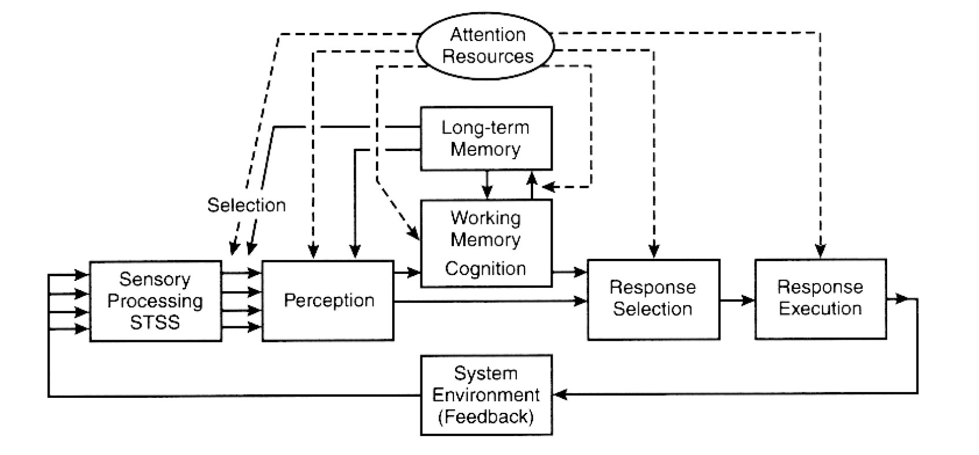
Human Information Processing Model
Where does detection occur?

Slide 3
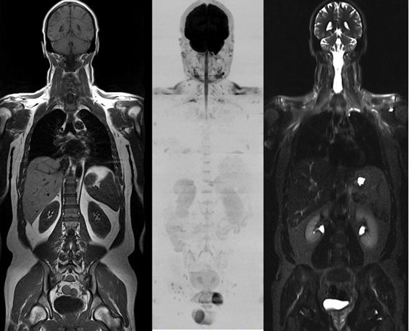
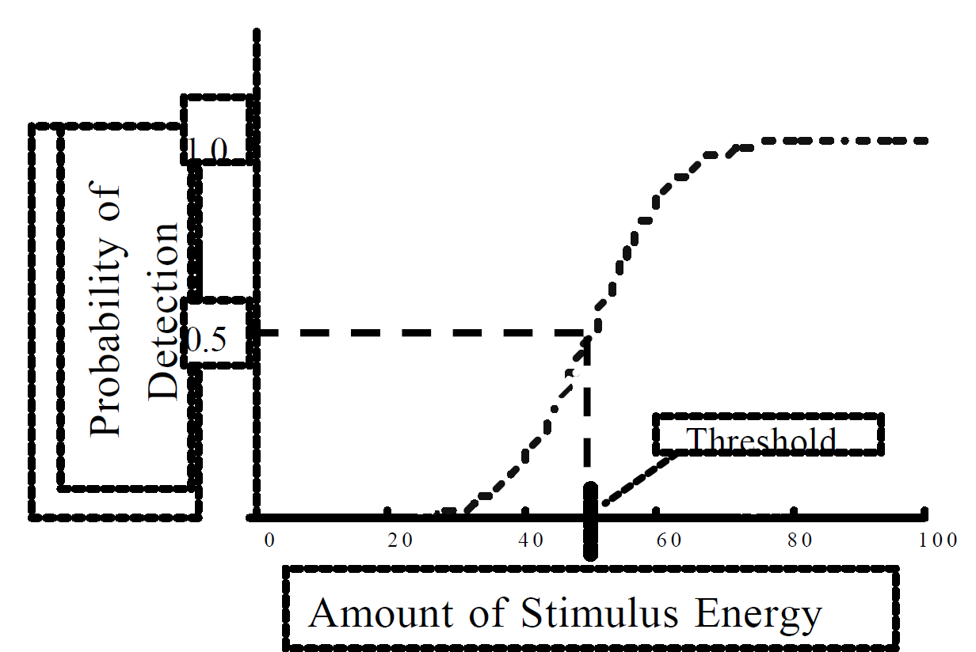
What is Signal Detection?
Signal embedded in noise
Yes or No Judgement
Threshold
amount of stimulus energy that detected 50% of the time

Slide 4
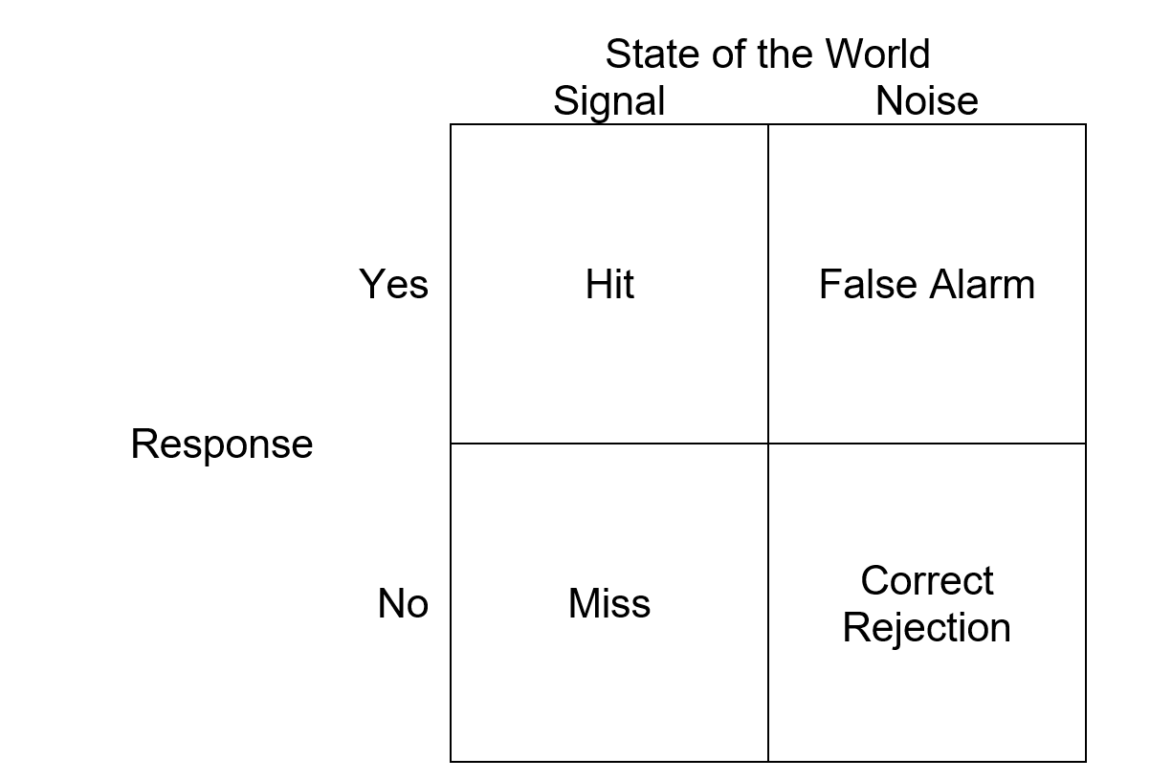
Signal Detection Paradigm
Applicable when there are two discrete states of the world (signal and noise) that cannot be easily discriminated

Slide 5
SDT Model
The SDT model (Green & Swets, 1966) assumes that there are two stages of information processing in the task of detection:
Sensory evidence is aggregated concerning the presence or absence of the signal
A decision is made about whether this evidence indicates a signal or not
P(H) + P(M) = 1
P(FA) + P(CR) = 1

Slide 6
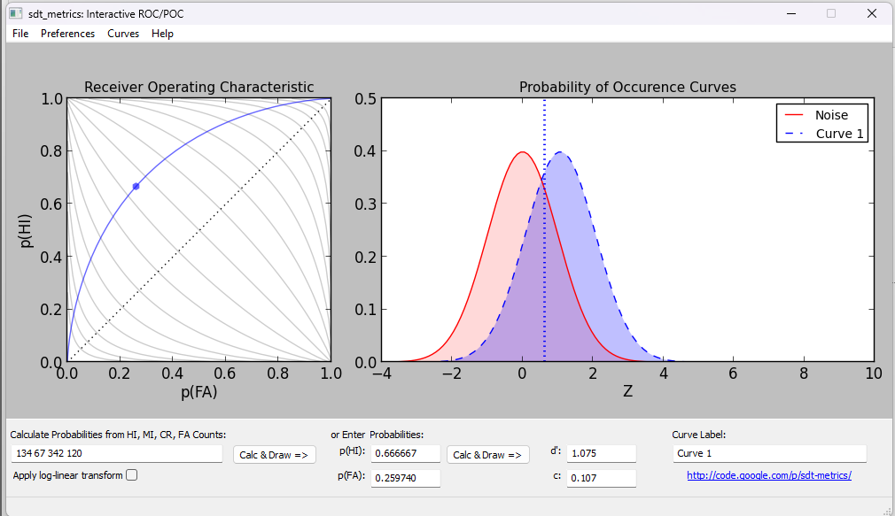
Sensitivity and Bias

Slide 7
What is Sensitivity
Ability to distinguish signal from noise

Slide 8
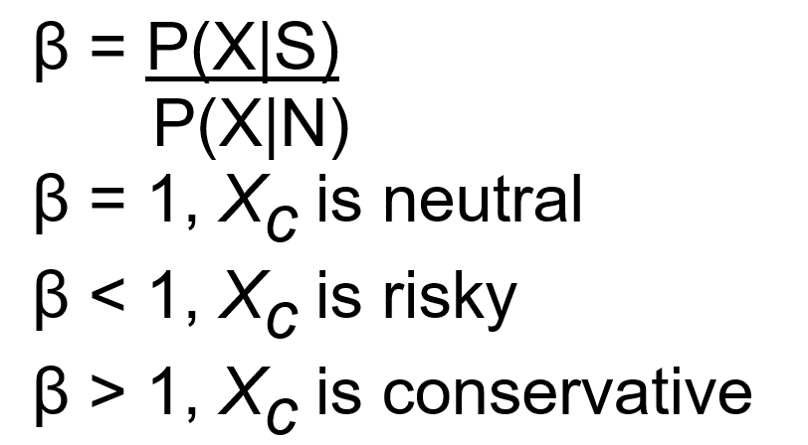
What is Bias
Propensity to say whether the signal is present or absent given the evidence
“Liberal” or “risky” more prone to saying “yes”
More hits but more false alarms
“Conservative” more prone to saying “no”
More correct rejections but more misses

Slide 9
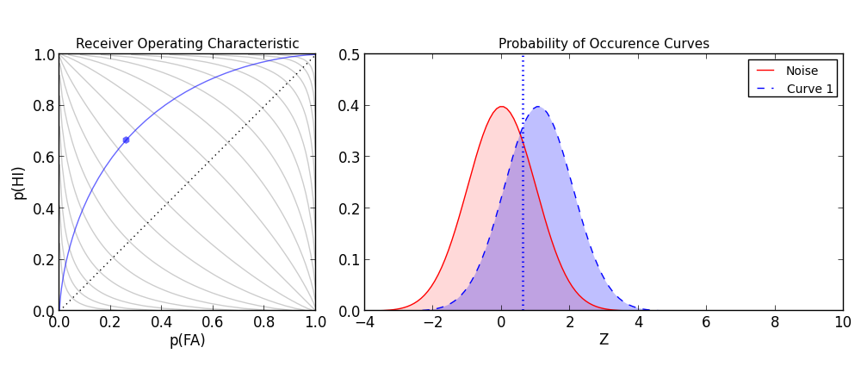
Bias
risky
conservative

Slide 10
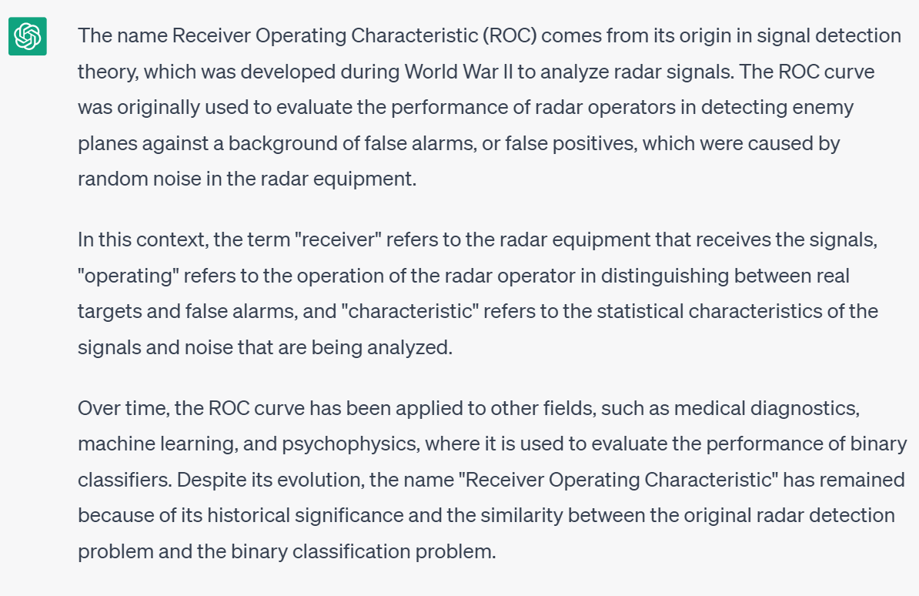
Receiver Operating Characteristic Curve
Used to portray the equivalence of detection performance with same sensitivity and changing bias
Maps the Probability of a Hit and the Probability of a False Alarm with changing bias
What do single points represent?

Slide 11
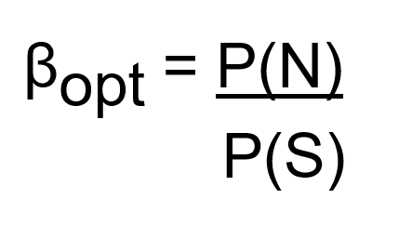
Signal Probability
When the signals occur just as often as they do not, βopt = 1
However, if the signal is more likely, the criterion should be lowered.
Conversely, if signal probability is reduced, β should be adjusted conservatively

Slide 12
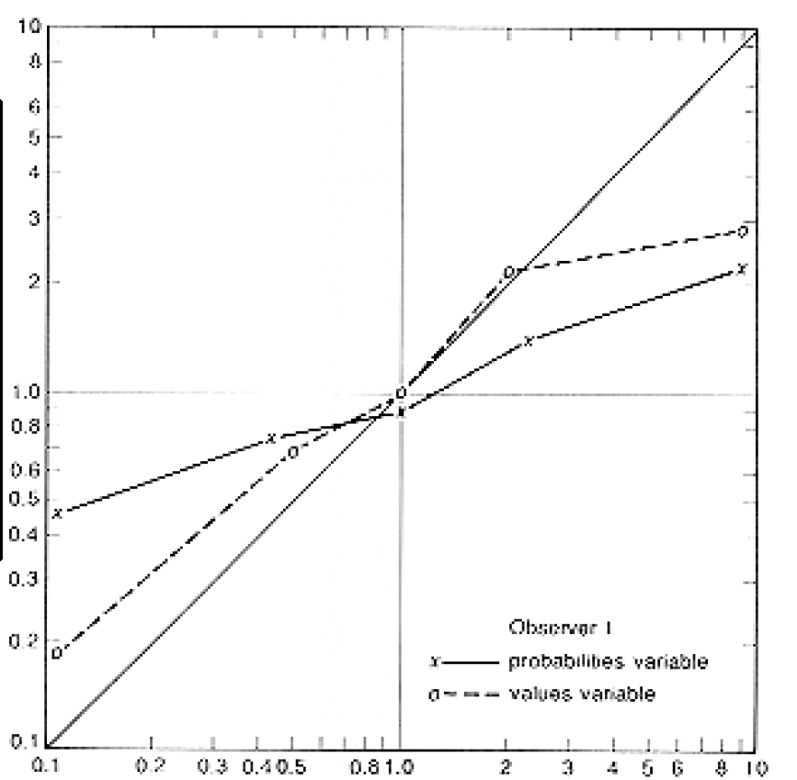
Sluggish Beta
when optimum b is low, less risky than ideal
when optimum b is high, less conservative than ideal
“sluggishness” is more pronounced when b is manipulated by probabilities than by payoffs
Why?
Misestimation of P(S) and/or P(N)
operator bored by repetitive response
Observed beta
Optimal beta

Slide 13
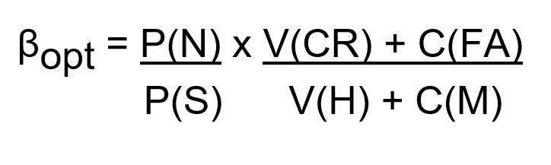
Payoffs
Focus on maximizing financial gain instead of minimizing errors

Slide 14
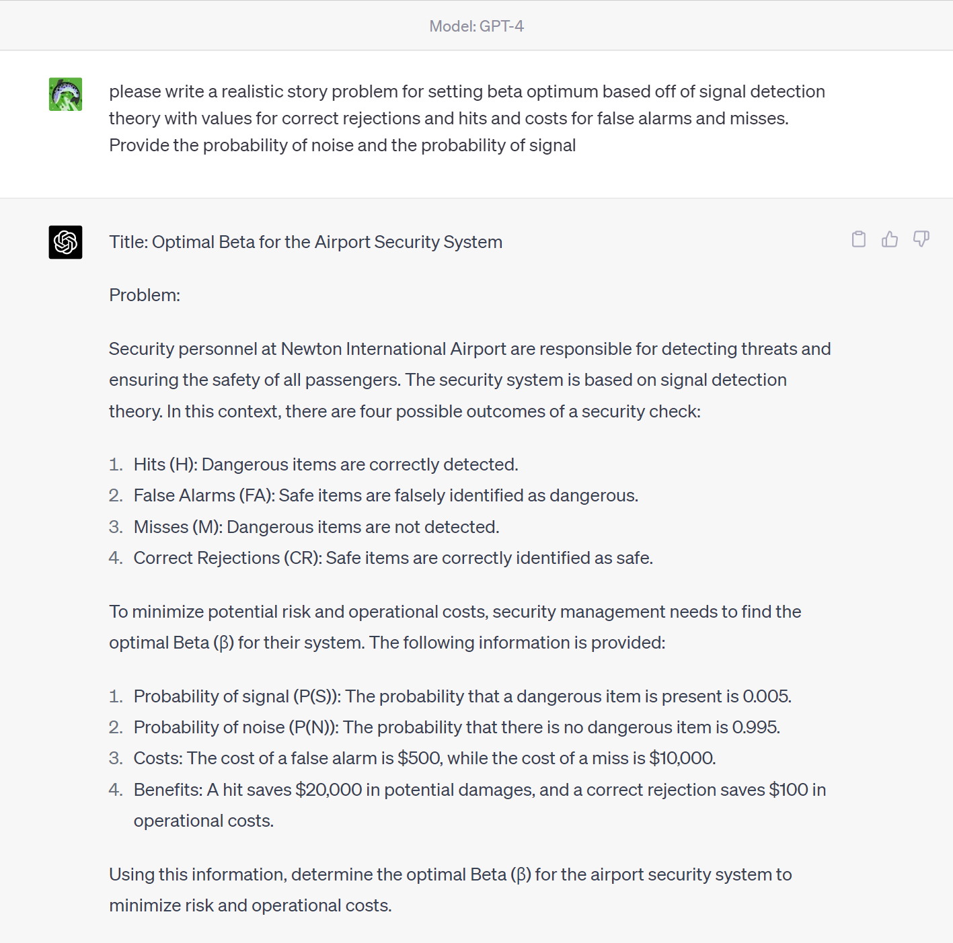
0.995/0.005 * (10 + 5000)/(100000 + 100000)

Slide 15
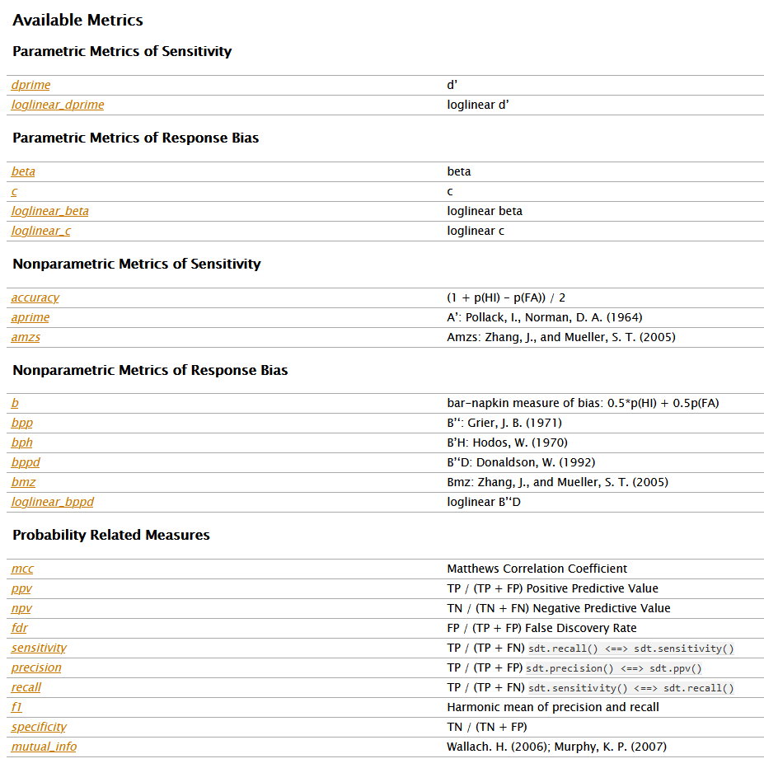
Empirical Data
Curves we’ve seen thus far are idealized
SDT assumes gaussian noise that is same between the noise and signal stimuli
Non-parametric measures
TLDR
Use amzs for sensitivity
Use loglinear_bppd for bias

Slide 16
Vigilance
Components of the typical vigilance task
operator required to detect signals over an extended duration (the watch or vigil)
detection of signals requires sustained attention, which demands mental resources
signals are intermittent, unpredictable, and infrequent
vigilance level: steady state performance

Slide 17
Two Classes of Vigilance
free-response paradigm (e.g., process control)
target event may occur at any time
nonevents are undefined
event frequency: # of targets per unit time
inspection paradigm (e.g., quality control)
events occur at regular intervals
some events are targets
most events are non-targets
event frequency
# of targets per unit time
ratio of targets to total events [P(target)]

Slide 18
Typical Vigilance Performance
The vigilance decrement: decline in detection performance [P(H)] during first 1/2 hour of vigil
Decrease in target saliency (reduced signal intensity or increased similarity to noise)
level of vigilance decreases
size of vigilance decrement increases
Increase in temporal or spatial uncertainty
level of vigilance decreases
size of vigilance decrement increases
Increase in background (non-target) event rate
level of vigilance decreases
size of vigilance decrement increases

Slide 19
Explaining the Vigilance Decrement
Sensitivity Loss: Fatigue and Memory Load (Broadbent, 1971; Parasuraman, 1979)
sustained attention causes fatigue, attention lapses
sustained working memory load fatigues resources
S+N distribution shifts
E.g. Criterion stays the same but signal distribution shifts
Target expectancy changes over time
Perceived expectancy changes
“Vicious circle” hypothesis (Broadbent, 1971)
Ps(S) decreases due to misses
when you miss a target it lowers your
perceived probability of a target
lower Ps(S) causes conservative shift in beta

Slide 20
Combating Vigilance
Increasing Sensitivity
Memory aids - “standard” representation of a target (picture of defect rather than normal)
Training
high amounts of practice with a particular target reduces memory load
develops automatic processing (pop-out)
Reduce number of potential targets
each inspector looks for a particular target
reduces memory load
Lower the event rate

Slide 21
Combating Vigilance
Signal Enhancement
Take advantage of naturally attention-grabbing stimuli, e.g., perception of motion
“blinking”: rapid exchange of visual image of known good prototype and item to be inspected
defect “blinks” on and off
Compress motion of long term events
segregates signal (coherent) from noise (random)
radar display: Scanlan (1975)
weather satellite images
Use redundant coding (multiple sensory modalities, e.g, both visual and auditory)

